Slide 1
Wheels
不同的车轮
选自《多维阅读第1级》

Slide 2
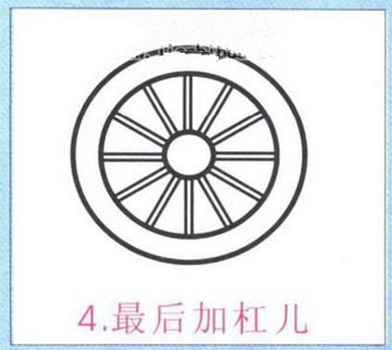
Warm-up 热身: look, guess and say
Look at the picture.
What's this?
Notes:
通过板书画简笔画呈现

Slide 3
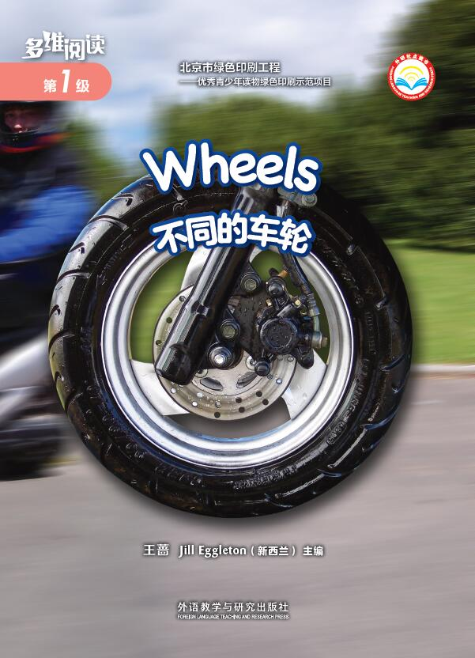
Prediction 预测
What can you see on the front cover?
What's the title?

Slide 4
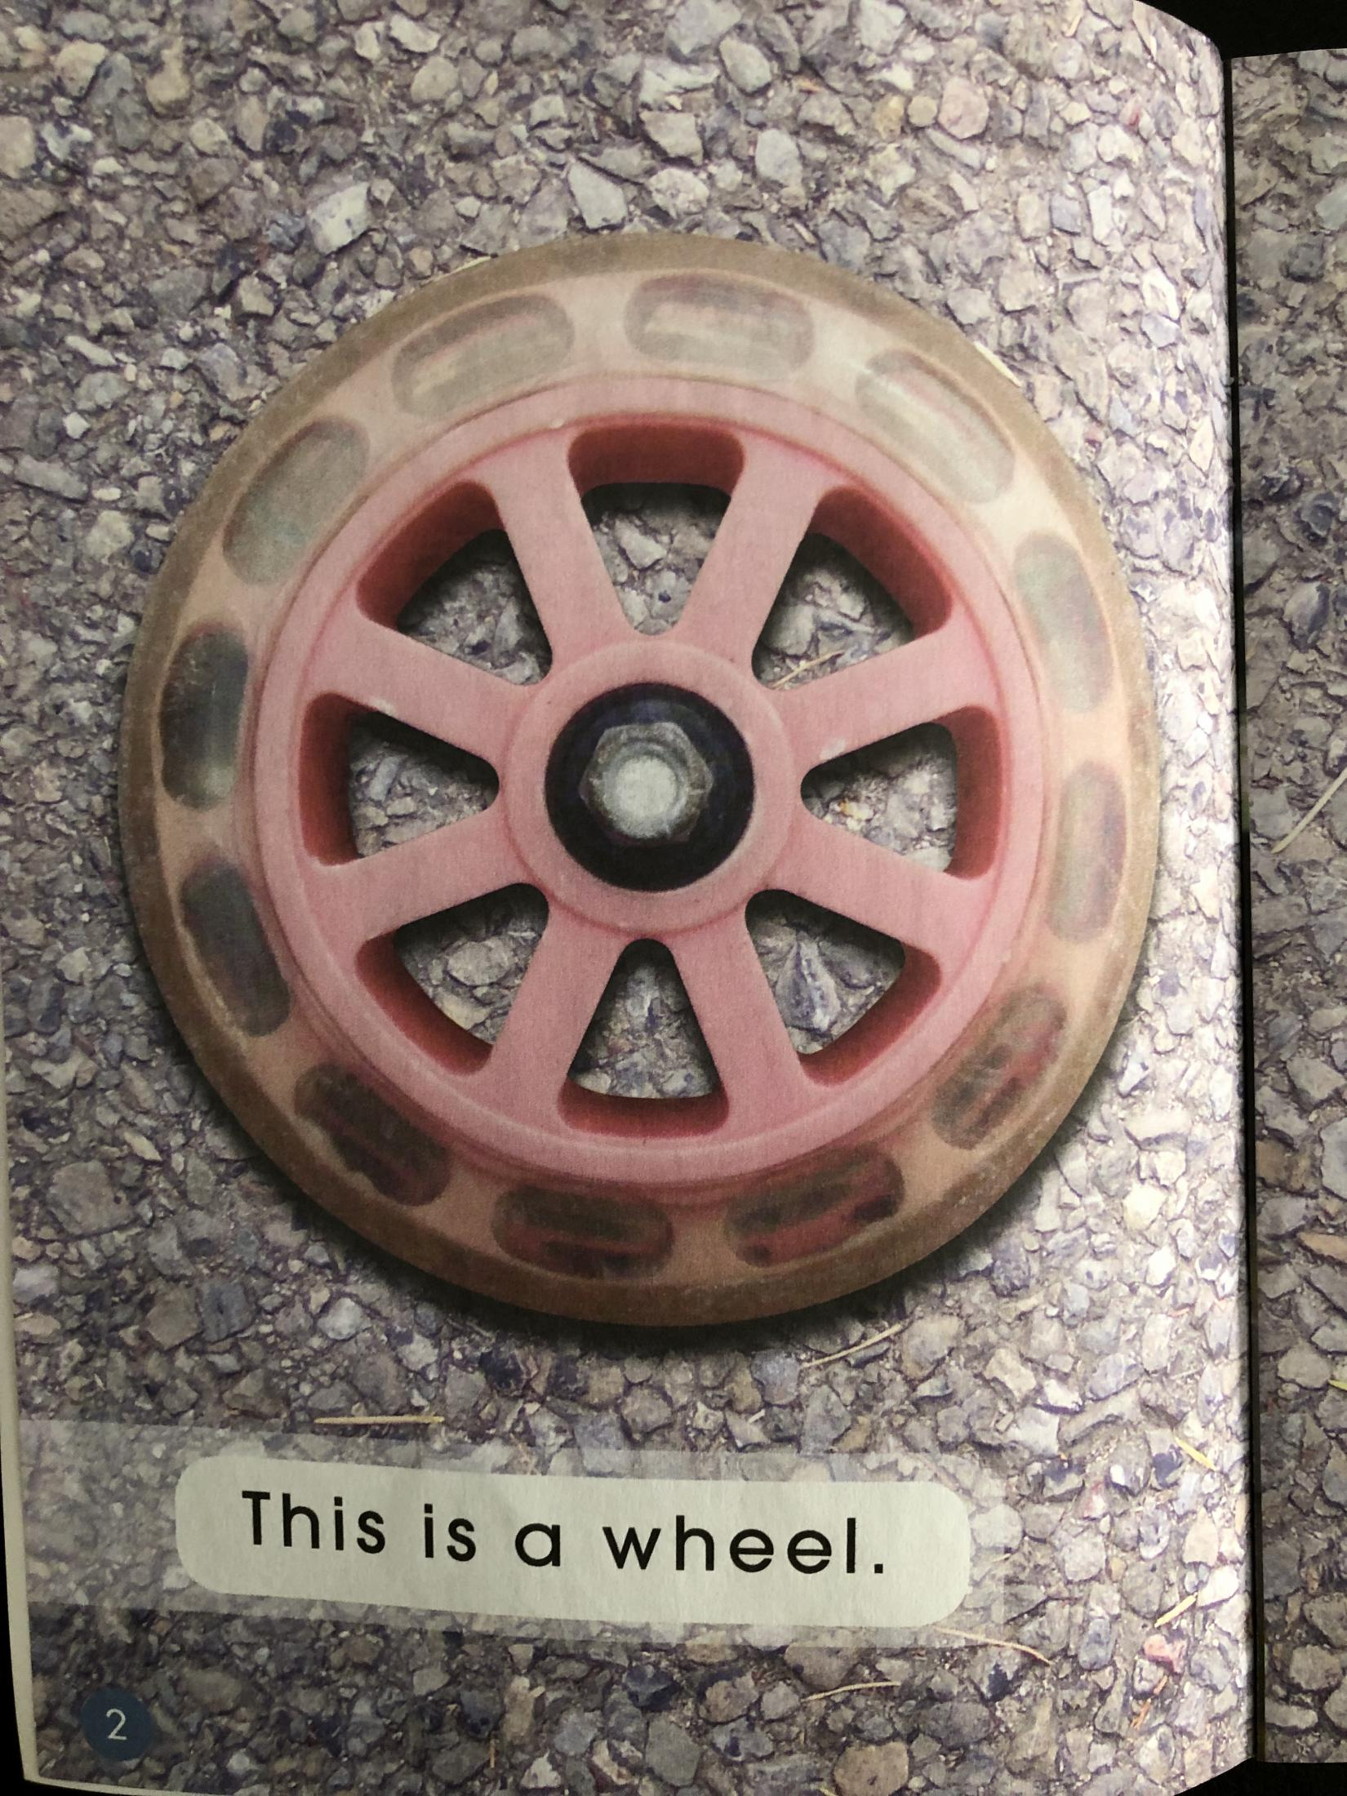
First reading: view & answer 看图回答（PP2-13）
What's this?
Where do you find the wheel?

Slide 5
Do you know anyone who has a scooter like this?
Tell us about it.

Slide 6
Look at the wheel.
What do you think this wheel
might be off?
How can you tell?

Slide 7
What's the wheel like?
Why do you think a bus needs big wheels?

Slide 8
What does this wheel belong to?
Is it the same as other wheels?
What's different?

Slide 9
How many wheels does this bike have?

Slide 10
How many wheels do you find on a scooter/bus/motorcycle?
What's the wheel like?

Slide 11
Predict, read and check 预测与验证
What do you think would happen if a bike had only one wheel?
Have you ever seen a bike like these?
When/Where?

Slide 12
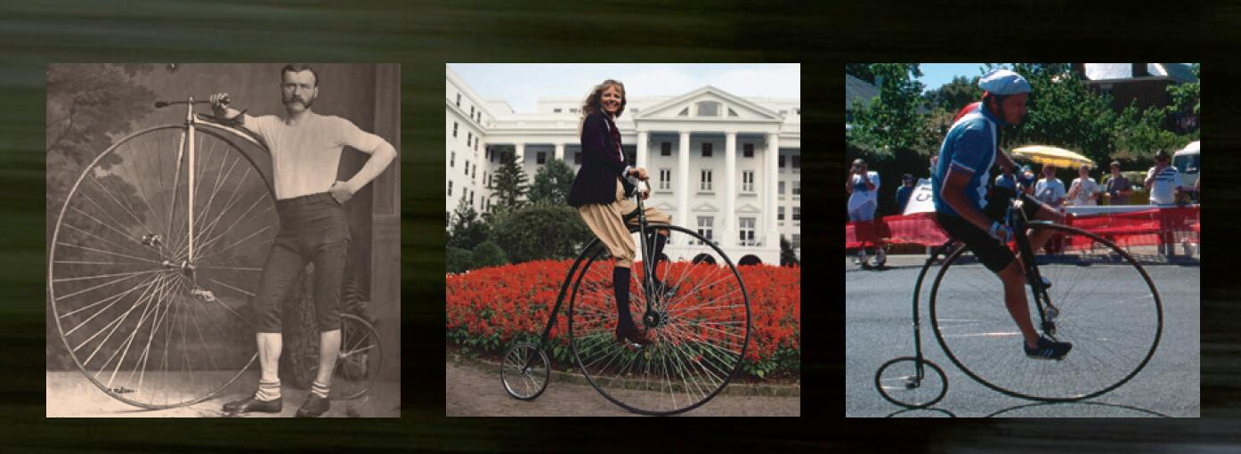
Look, compare and say
What do you notice about these wheels?
penny farthing 前轮大后轮小的自行车
Notes:
建议penny farthing只出现英语，不出现中文

Slide 13
Second reading
Which word in the sentence says wheel? How do you know?
Do you know any other words? Which ones?
Read the sentence.
Notes:
教师过渡语：Let's review the book together.

Slide 14
Make a circle around the word that says on.
Make a circle around the word that says this.

Slide 15
Which words do you know?

Slide 16
Can you find the word that says bus?
What sound does bus start with?
Show me the letter b.

Slide 17
Can you show me the word that says wheel?
How do you know?
Do you know any other words? Which ones?

Slide 18
Where is the wheel?
Which word says on?

Slide 19
All the sentences in this book start with the same word.
What does it say?

Slide 20
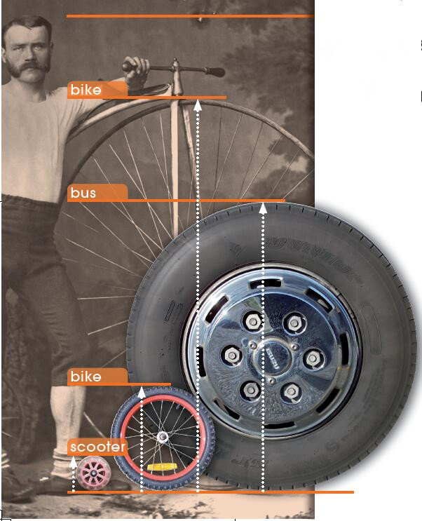
Look, read and retell the book
What does this chart tell us?
Notes:
1. What does this chart tell us?(教学生看图片、单词及对应的页码）2. What does this wheel belong to?

Slide 21
Look, think and say
Are all the wheels the same?
Why do you think all these wheels are different? Why or why not?
Notes:
学生在车轮同不不同的分歧中，得出车轮材质等虽各不相同，但有一个共同点，都是圆的。教师引导学生了解车轮使用的原理：圆的特点是圆心到圆周的距离相等，这样保证了车运动的时候比较平稳。

Slide 22
Do you know?
观看视频《轮子的历史》
Notes:
点击图片，观看视频。

Slide 23
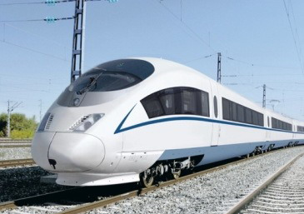
Think and say
Do you know any other vehicles that have wheels? What are they?
What do the wheels look like?
CRH
Notes:
飞机与高铁的图片，仅为教师和学生提供范例

Slide 24
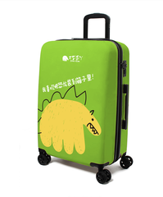
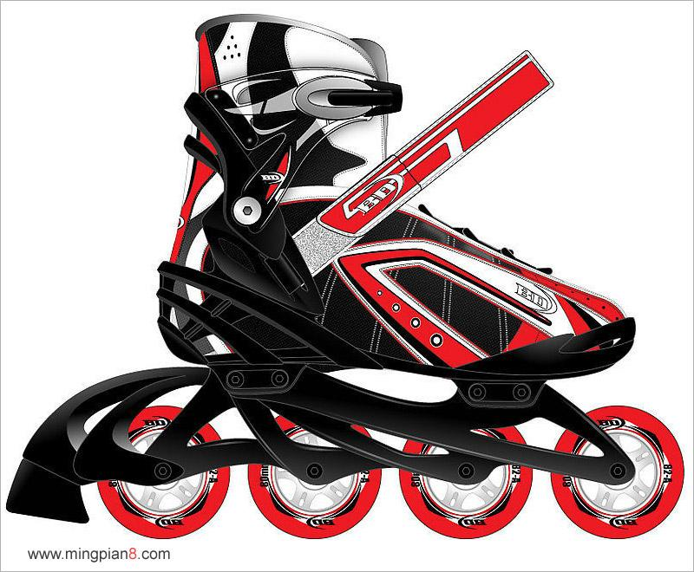
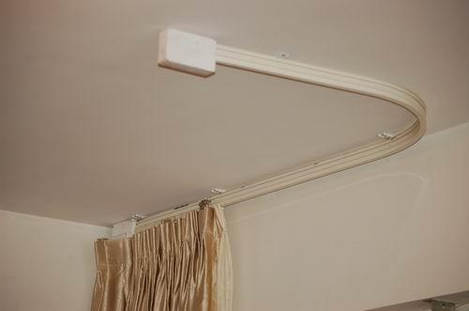
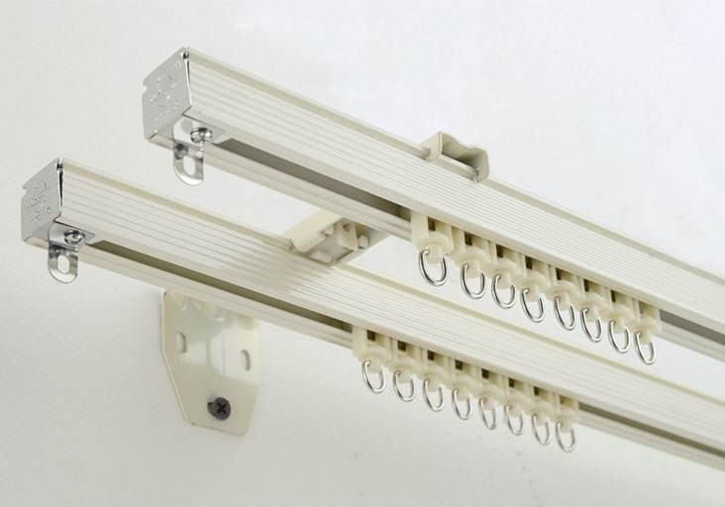
Think and share, then finish the graphic organizer.
Could you name more things that have wheels?
things with wheels
schoolbag

Slide 25
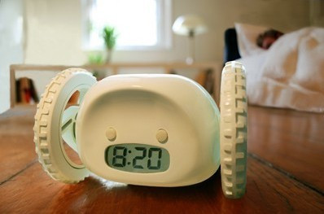
Imagine, think and try to say
What can be installed with wheels that can help us live more easily?
这是一款带轮子会跑的创意闹钟Clocky。早晨喜欢赖床的人通常会在闹钟响后，一次次地按下闹钟按钮，然后继续呼呼睡觉。而这种办法在Clocky身上行不通。当你按下Clocky的按钮时，这个装有一组轮子的新型闹钟就会从桌子上跑到地上，并且滚到屋子的其他地方去，而且Clocky每天都会找一个新的藏身之地。当闹钟铃声再次响起的时候，即使是再想睡觉的人也不得不从床上爬起来，懒人用品必备。
Notes:
轮子闹钟仅为教师提供示例

Slide 26
作业布置，请从两项作业中任选一项并完成。
1. Draw something you travel in with wheels.
2. Draw something that can be installed with wheels.
作业1范例

