Slide 1
《新启航英语》
Unit 5 My week
Period 1 Let’s chant!
册 次：二年级下册 学 科：英语（外研社版）
主讲人：闵燕玲 学 校：成都市石笋街小学校
一品天下分校

Slide 2
通过本课时学习，学生能够：
理解韵文内容，掌握一周七天的英文单词Monday、Tuesday、Wednesday、 Thursday、Friday、Saturday、Sunday。
熟练朗读韵文，并与同伴合作表演韵文。

Slide 3



Look and say.
2026
31

Slide 4
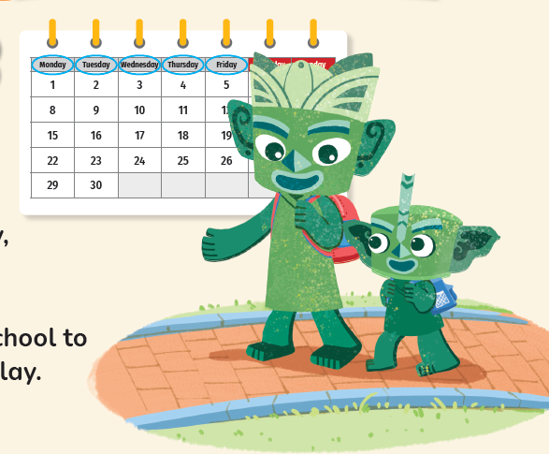
Look and say.
Who are they?
Where do they go?
When do they go to there?

Slide 5

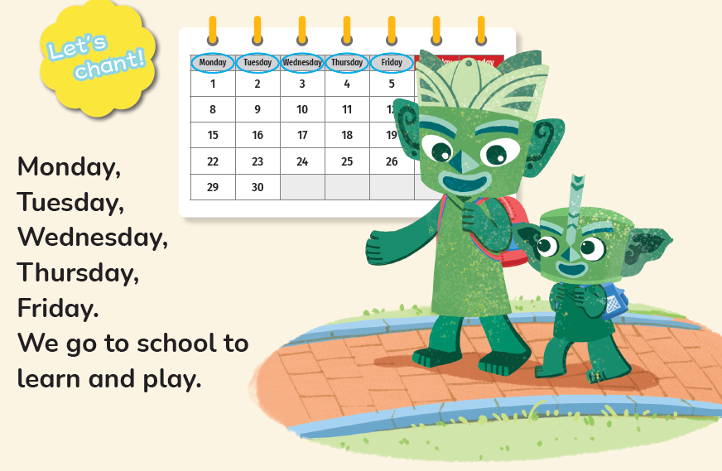
Listen and check. Then look and say.
Monday
Friday
Wednesday
Thursday
Tuesday

Slide 6




Look and say.
school
We go to school to ____________.
learn and play
What do they do at school?
What do they say?
learn
play

Slide 7
Listen and repeat.

Slide 8
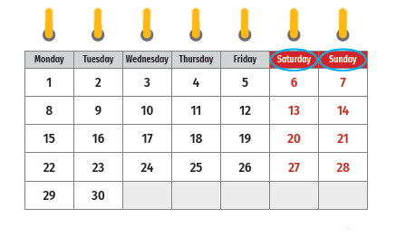
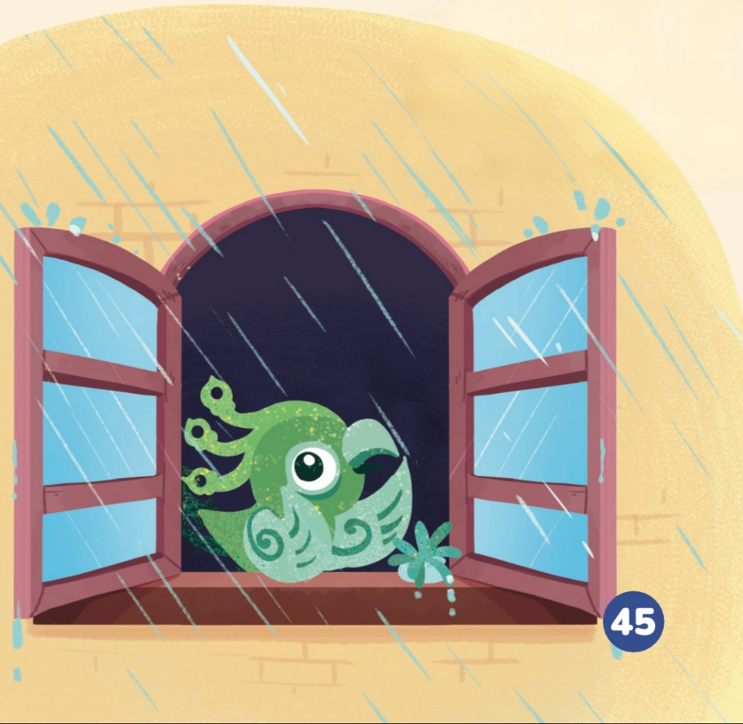
Look and say.
Who is this?
Where is Feifei?
What’s the weather like?
What days are they?
What does Feifei want to do on these days?

Slide 9
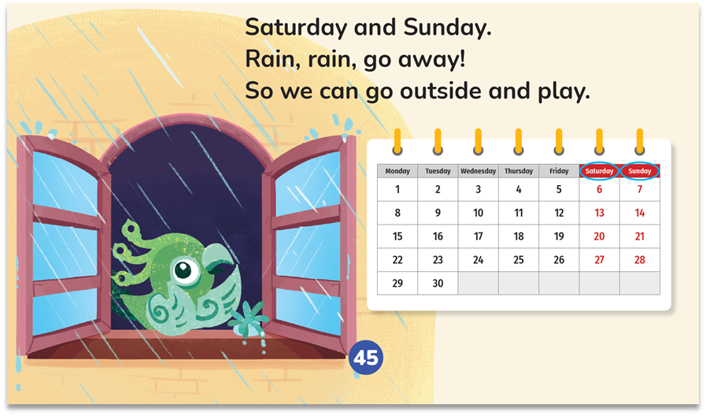
Listen and check. Then look and say.
Saturday
Sunday

Slide 10


Look and say.
Rain, rain, go away!
Does Feifei like the rain?
So we can go outside
and play.
What does Feifei say?

Slide 11
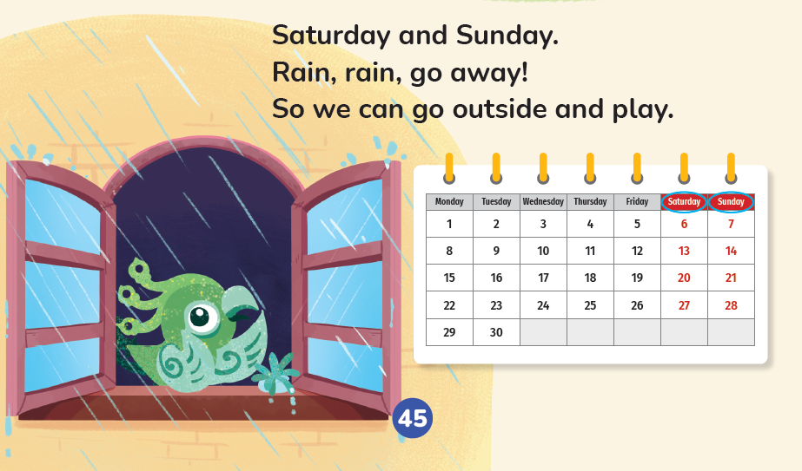
Listen and repeat.

Slide 12
Watch the video and chant.
此处教师可插入教材第45页韵文的视频。

Slide 13

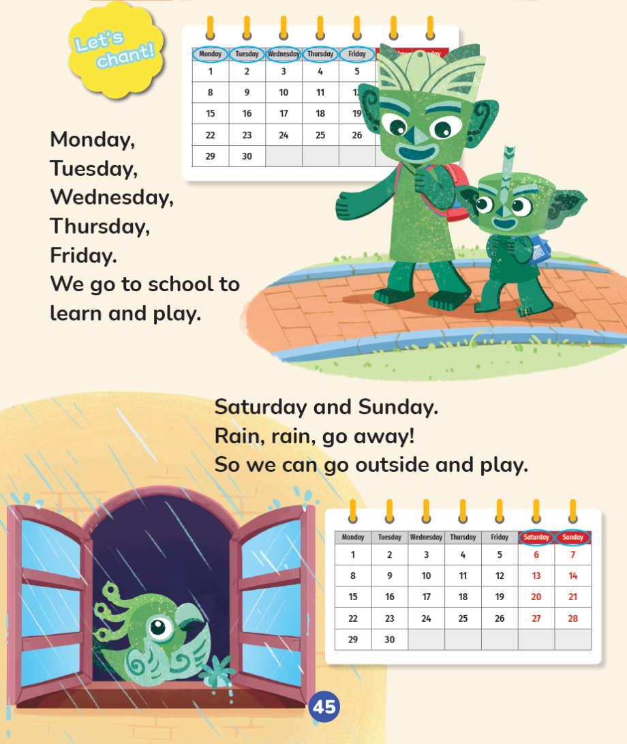

Listen, point and chant.
Read it aloud. ☆
Read it fluently. ☆
Read it with the beat. ☆

Slide 14
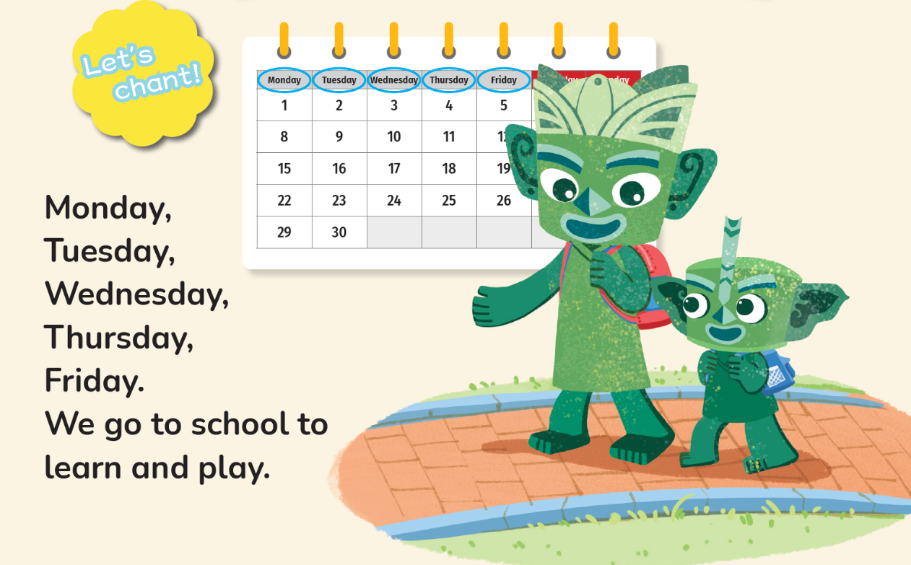
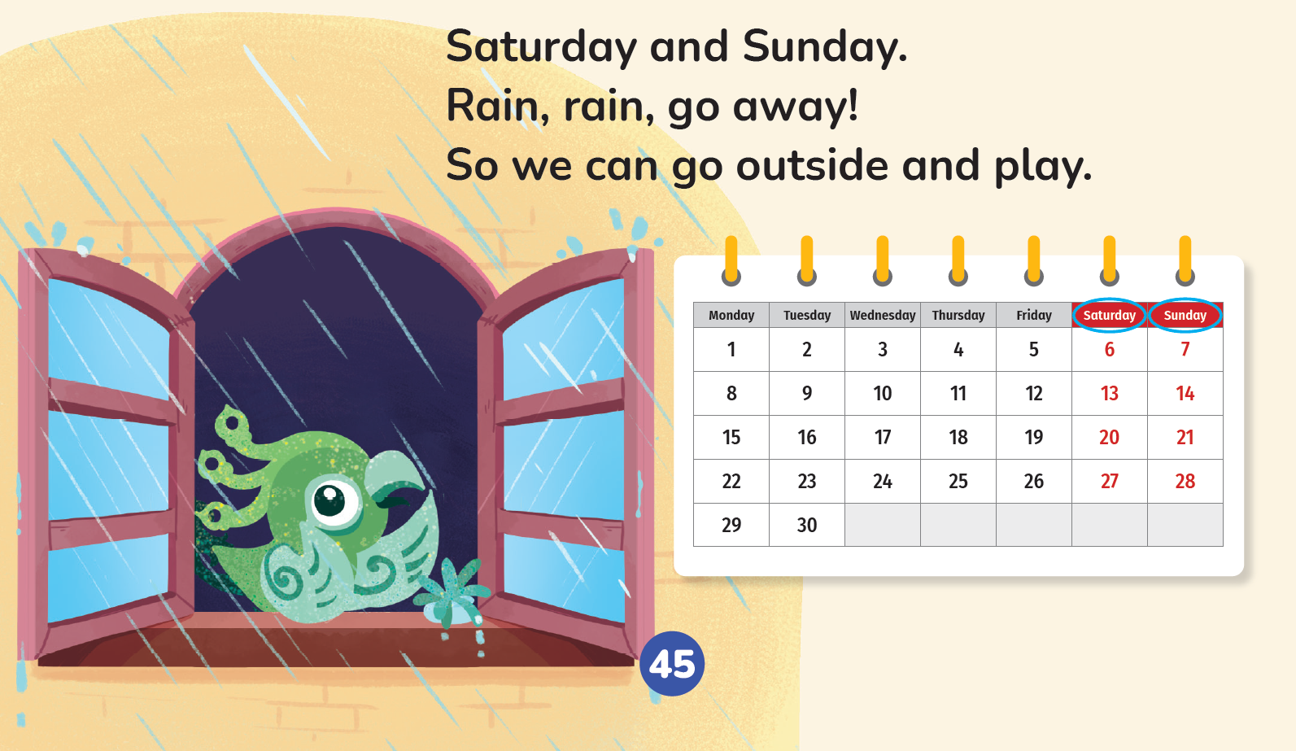
Work in groups. Chant and act out.

Slide 15
Homework
带感情地表演韵文。
思考你在星期一至星期五期间常做的事，以及在星期六和星期日常做的事，然后试着创编一首韵文，在下一节课向同学展示。

Slide 16

《新启航英语》（预备级）
Unit 5 My week
Period 1 Let’s chant!
制作单位：外语教学与研究出版社

