Slide 1


《新交际英语》（预备级）
《新启航英语》
Unit 5 My week
Period 2 Let’s read!
册 次：二年级下册 学 科：英语（外研社版）
主讲人：蒲娅丽 学 校：成都市锦西外国语小学校

Slide 2


国家中小学课程资源
通过本课时学习，学生能够：
在看、听、读等活动中，理解故事的内容并复述故事。
掌握并灵活运用介绍一周七天的句型“It’s...”以及表示倒数日期的句型“... day(s) to go.”。

Slide 3
国家中小学课程资源
Let’s chant.
此处教师可插入教材第45页韵文的视频。

Slide 4
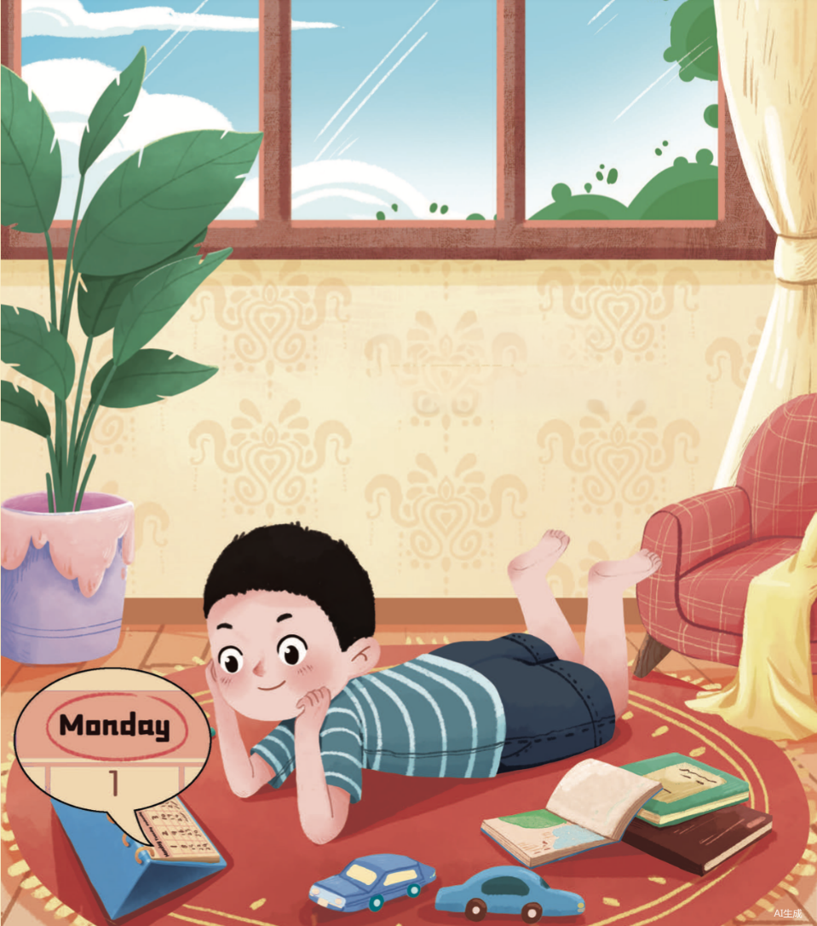

国家中小学课程资源
Look and say.
What can you see?
Where is the boy?
What is he doing?
calendar

Slide 5
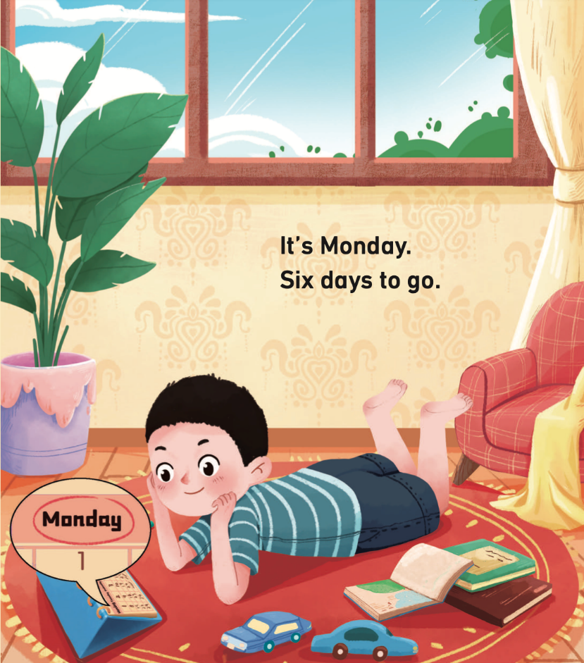

国家中小学课程资源
Look, listen and say.
Monday | Tuesday | Wednesday | Thursday | Friday | Saturday | Sunday
What will happen on Sunday?

Slide 6
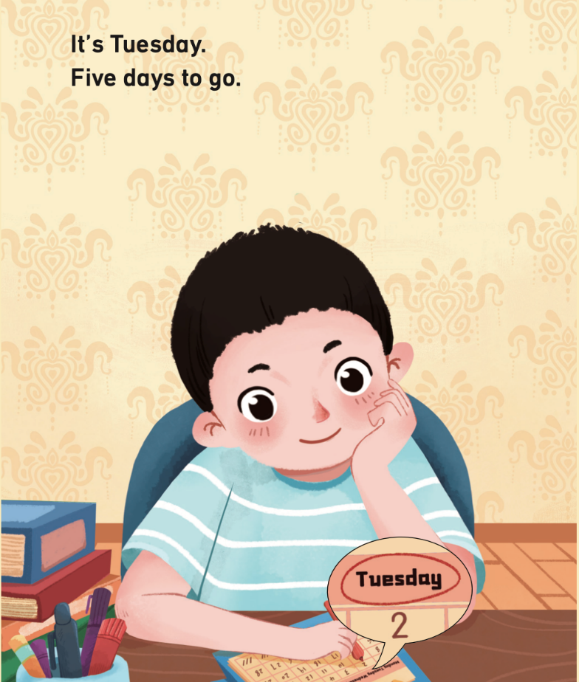


国家中小学课程资源
Look and say. Then listen and check.
Monday | Tuesday | Wednesday | Thursday | Friday | Saturday | Sunday
( and )
Tuesday
It’s _______.
____ days to go.
Five

Slide 7


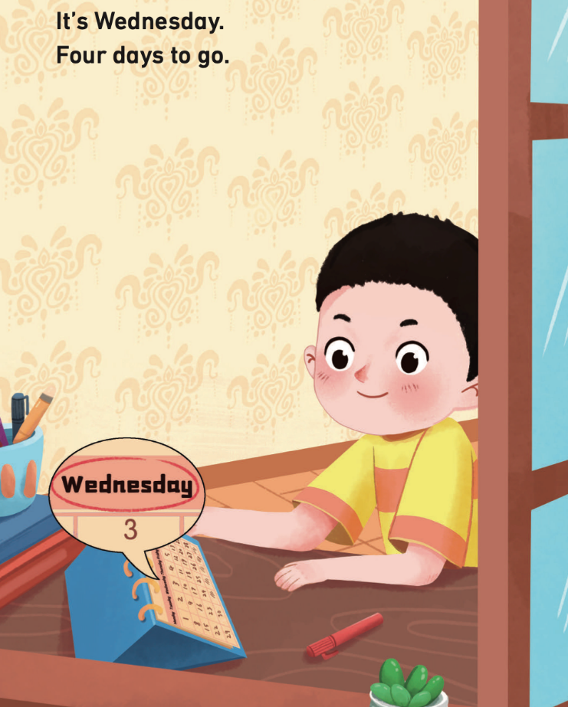
国家中小学课程资源
Look and say. Then listen and check.
Monday | Tuesday | Wednesday | Thursday | Friday | Saturday | Sunday
( and )
Wednesday
It’s __________.
Four
____ days to go.

Slide 8

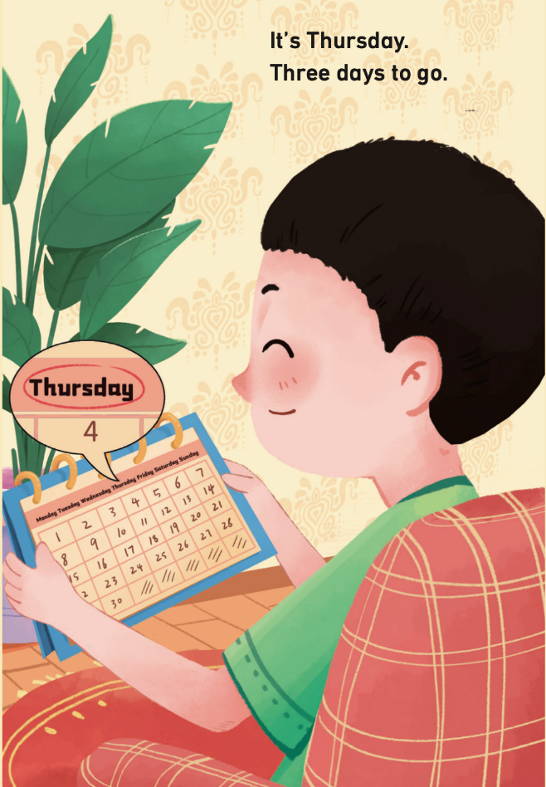
国家中小学课程资源
Look and say. Then listen and check.
Monday | Tuesday | Wednesday | Thursday | Friday | Saturday | Sunday
( and )
Thursday
It’s ________.
_____ days to go.
Three

Slide 9
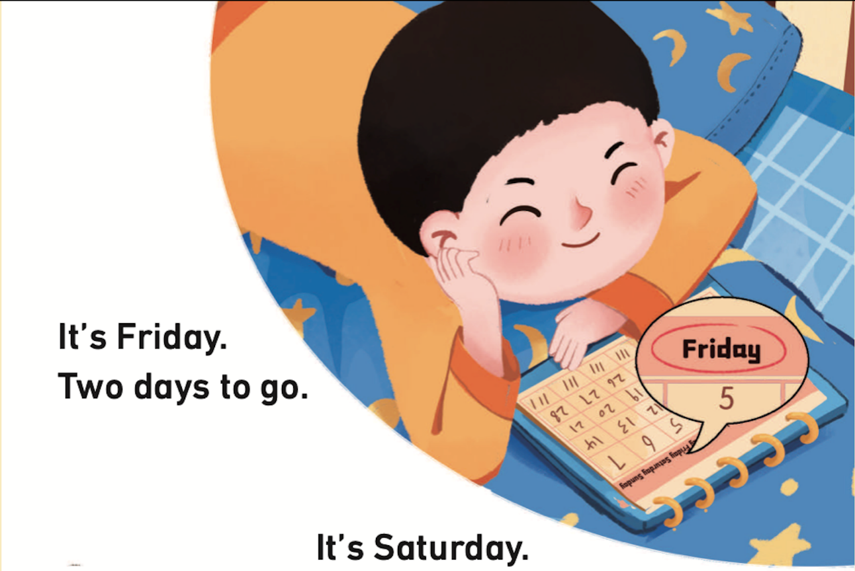
国家中小学课程资源
Look and say. Then listen and check.
Monday | Tuesday | Wednesday | Thursday | Friday | Saturday | Sunday
( and )
Friday
It’s ______.
Two
____ days to go.

Slide 10
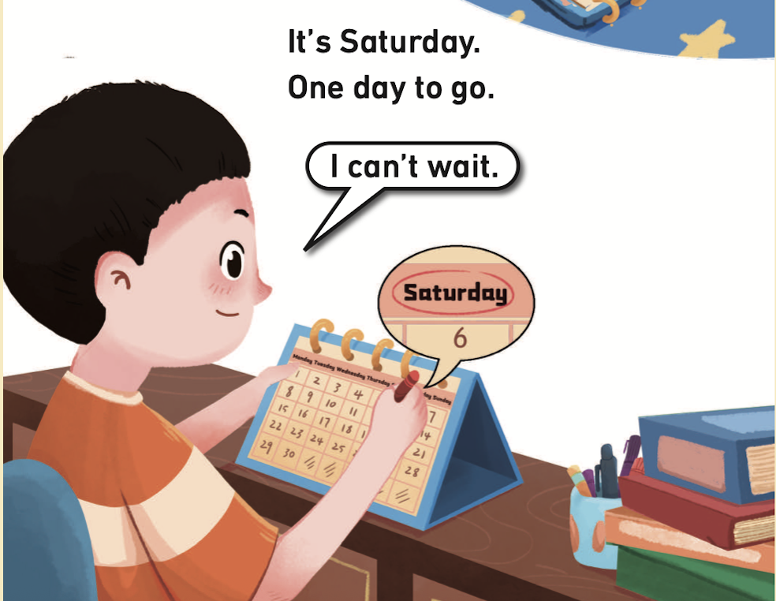
国家中小学课程资源
Look and say.
Monday | Tuesday | Wednesday | Thursday | Friday | Saturday | Sunday
Saturday
( and )
It’s __________.
?
______ day to go.
One
How does the boy feel?
What will he say?

Slide 11
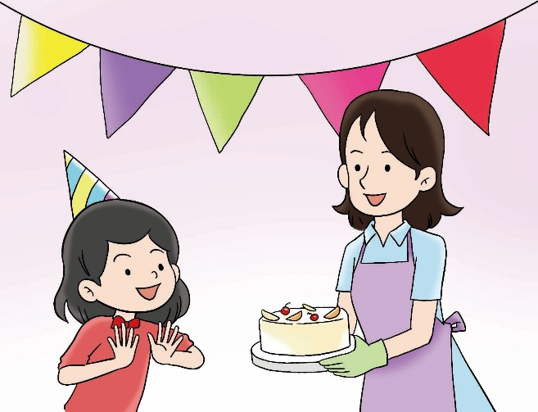
国家中小学课程资源
Listen and check.
I can’t wait.
I can’t wait.

Slide 12
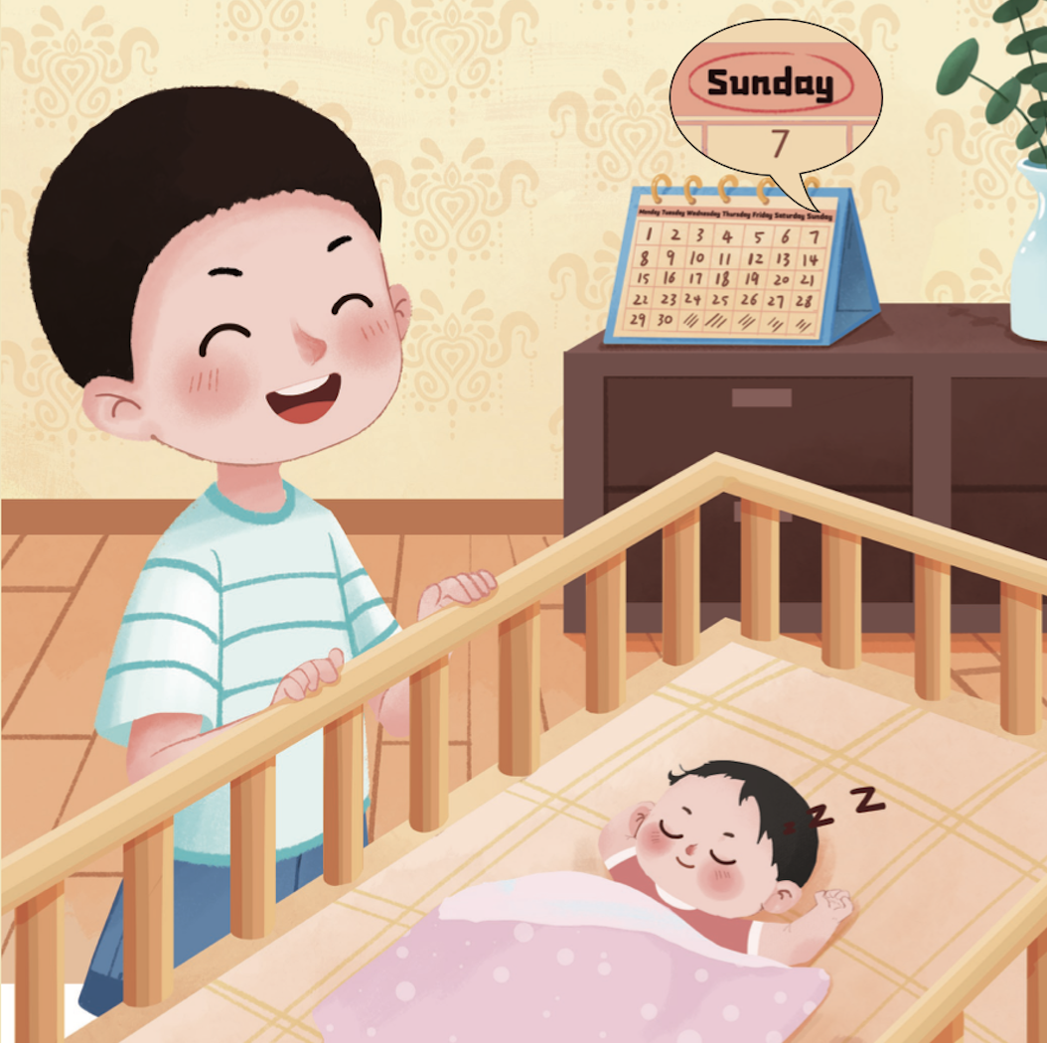
国家中小学课程资源
Look and say.
What day is it today?
Who does the boy see?
How does he feel?
What will he say?

Slide 13
国家中小学课程资源
Listen and check.
It’s Sunday.
Time to meet my little sister.
I’m so happy!

Slide 14
国家中小学课程资源
Watch the video and repeat.
此处教师可插入教材第46—51页故事的视频。

Slide 15
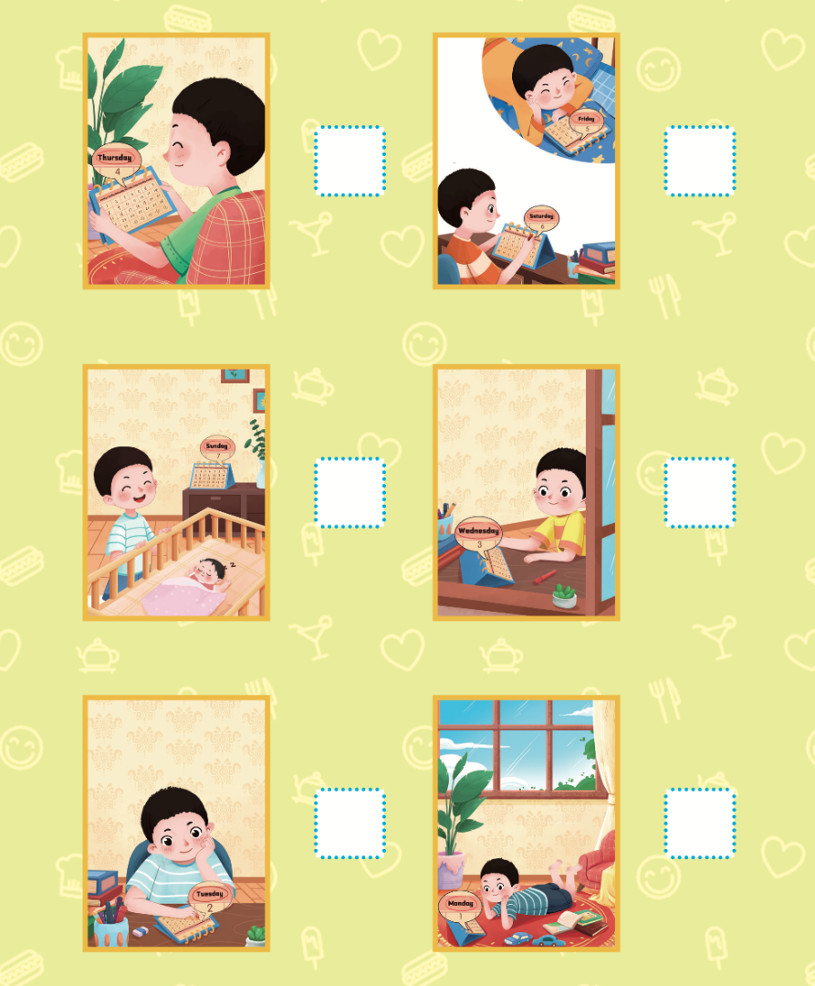
国家中小学课程资源
Read and number.
4
5
6
3
2
1

Slide 16
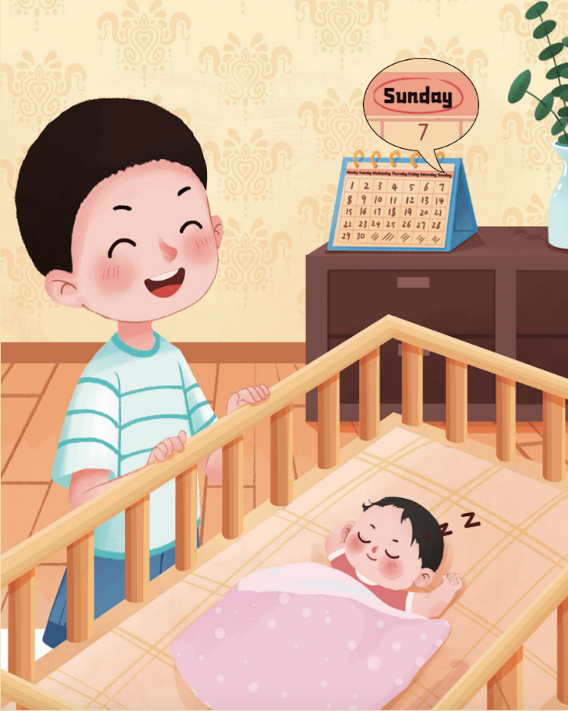
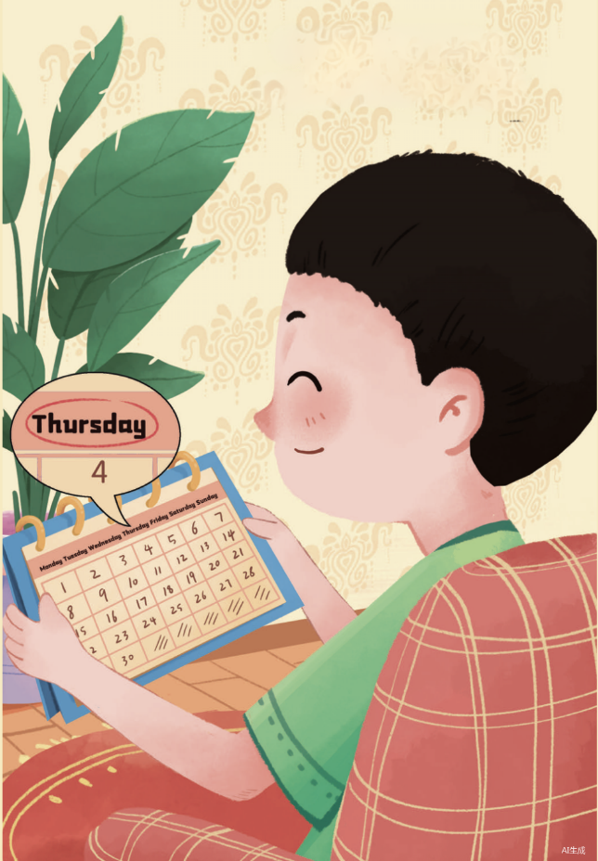

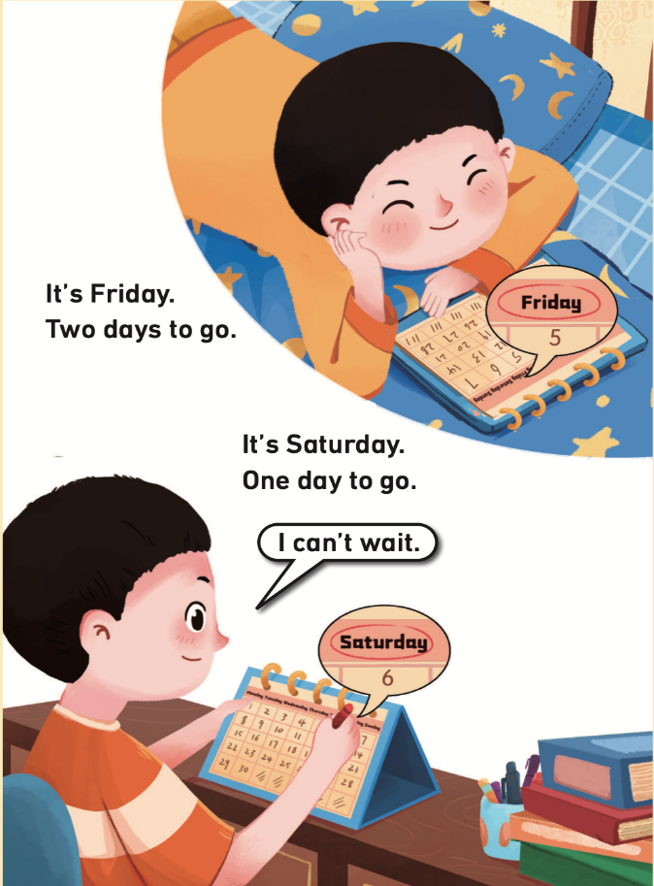
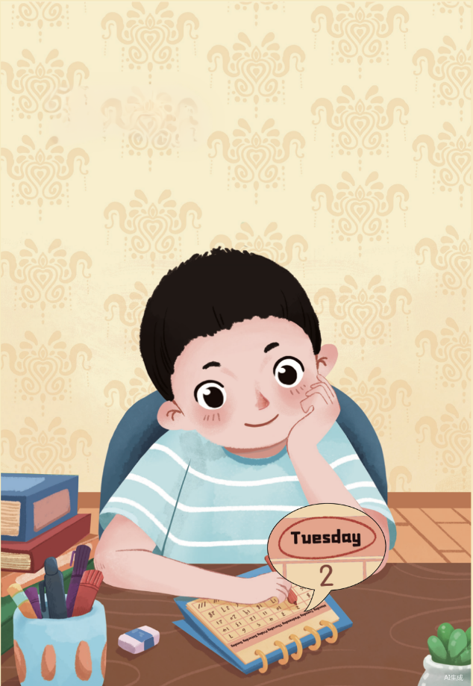
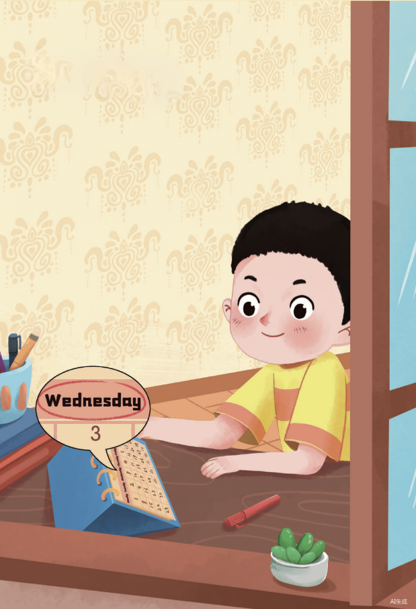
国家中小学课程资源
Look and say.
Friday
Monday
Tuesday
Saturday
Thursday
Wednesday
Sunday
It’s _________.
One
Three
Two
Four
_____ day to go.
_____ days to go.
Five
Time to meet my
________.
Six
little sister
I’m so _____.
happy

Slide 17
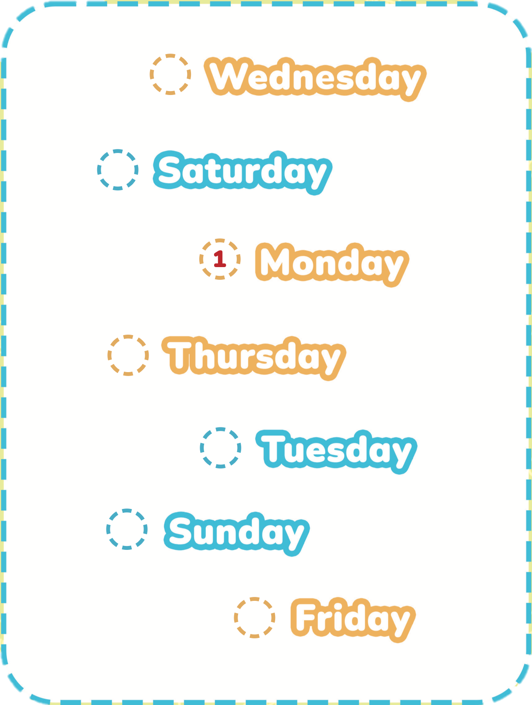
国家中小学课程资源
Listen and order.
3
6
It’s...
4
2
7
5

Slide 18
国家中小学课程资源
Look and say.
Monday | Tuesday | Wednesday | Thursday | Friday | Saturday | Sunday
( and )
It’s _________.
Wednesday
Thursday
Friday
Saturday
_____ days to go.
_____ day to go.
Three
Two
One
Four

Slide 19
国家中小学课程资源
Homework
带感情地朗读故事。
借助以下表格，与同学或朋友玩倒数日期的游戏。
Monday | Tuesday | Wednesday | Thursday | Friday | Saturday | Sunday
It’s __________.
(Circle and count.)
______ day(s) to go.

Slide 20
《新交际英语》（预备级）
《新启航英语》
Unit 5 My week
Period 2 Let’s read!
制作单位：外语教学与研究出版社

