Slide 1


《新交际英语》（预备级）
《新启航英语》
Unit 5 My week
Period 3 Let’s practise. & Look and say. & Let’s have fun.
册 次：二年级下册 学 科：英语（外研社版）
主讲人：邝旭 学 校：成都市茶店子小学校

Slide 2


国家中小学课程资源
通过本课时学习，学生能够：
在具体情境中，运用本单元所学的核心句型“It’s...”介绍一周的七天。
通过观察表格，理解一周七天的安排，并运用核心句型“On..., we...”介绍每天的安排。
设计台历，合理规划自己一周的学习和课余生活，并运用核心语言进行介绍。

Slide 3
国家中小学课程资源
Let’s chant.
此处教师可插入教材第45页韵文的视频。

Slide 4
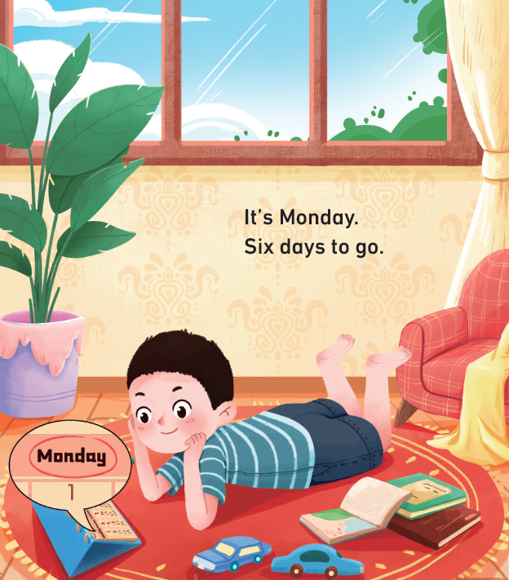
国家中小学课程资源
Look and say.
Monday
It’s _______.
___ days to go.
Six

Slide 5
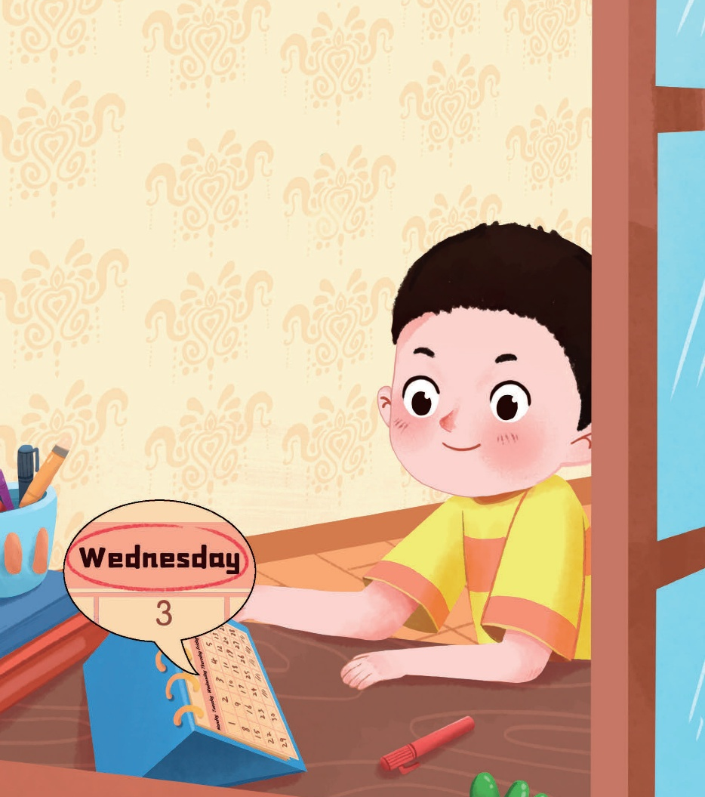

国家中小学课程资源
Look and say.
Tuesday
It’s _______.
____ days to go.
Five
It’s __________.
____ days to go.
Wednesday
Four

Slide 6


国家中小学课程资源
Look and say.
It’s _________.
_____ days to go.
Thursday
Friday
It’s ______.
____ days to go.
Saturday
Three
It’s ________.
___ day to go.
Two
One

Slide 7

国家中小学课程资源
Look and say.
It’s _______.
Time to meet my little sister.
I’m so _____!
Sunday
happy

Slide 8

国家中小学课程资源
Look and say.
What day is it?
？
What will Feifei say?

Slide 9
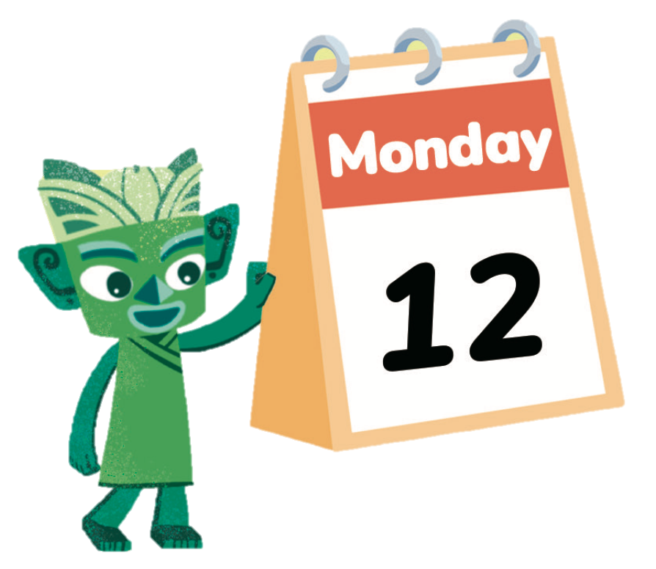
国家中小学课程资源
Look and say.
Tuesday
Wednesday
Thursday
15
13
14
It’s...
Friday
Saturday
Sunday
16
17
18

Slide 10
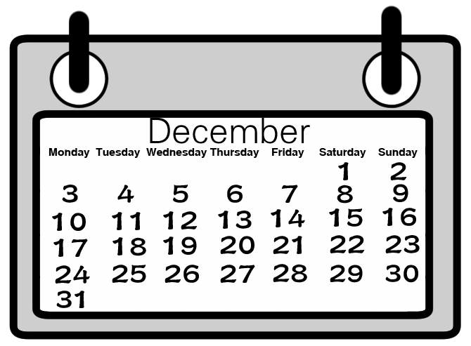

国家中小学课程资源
Let’s practise.
It’s...

Slide 11
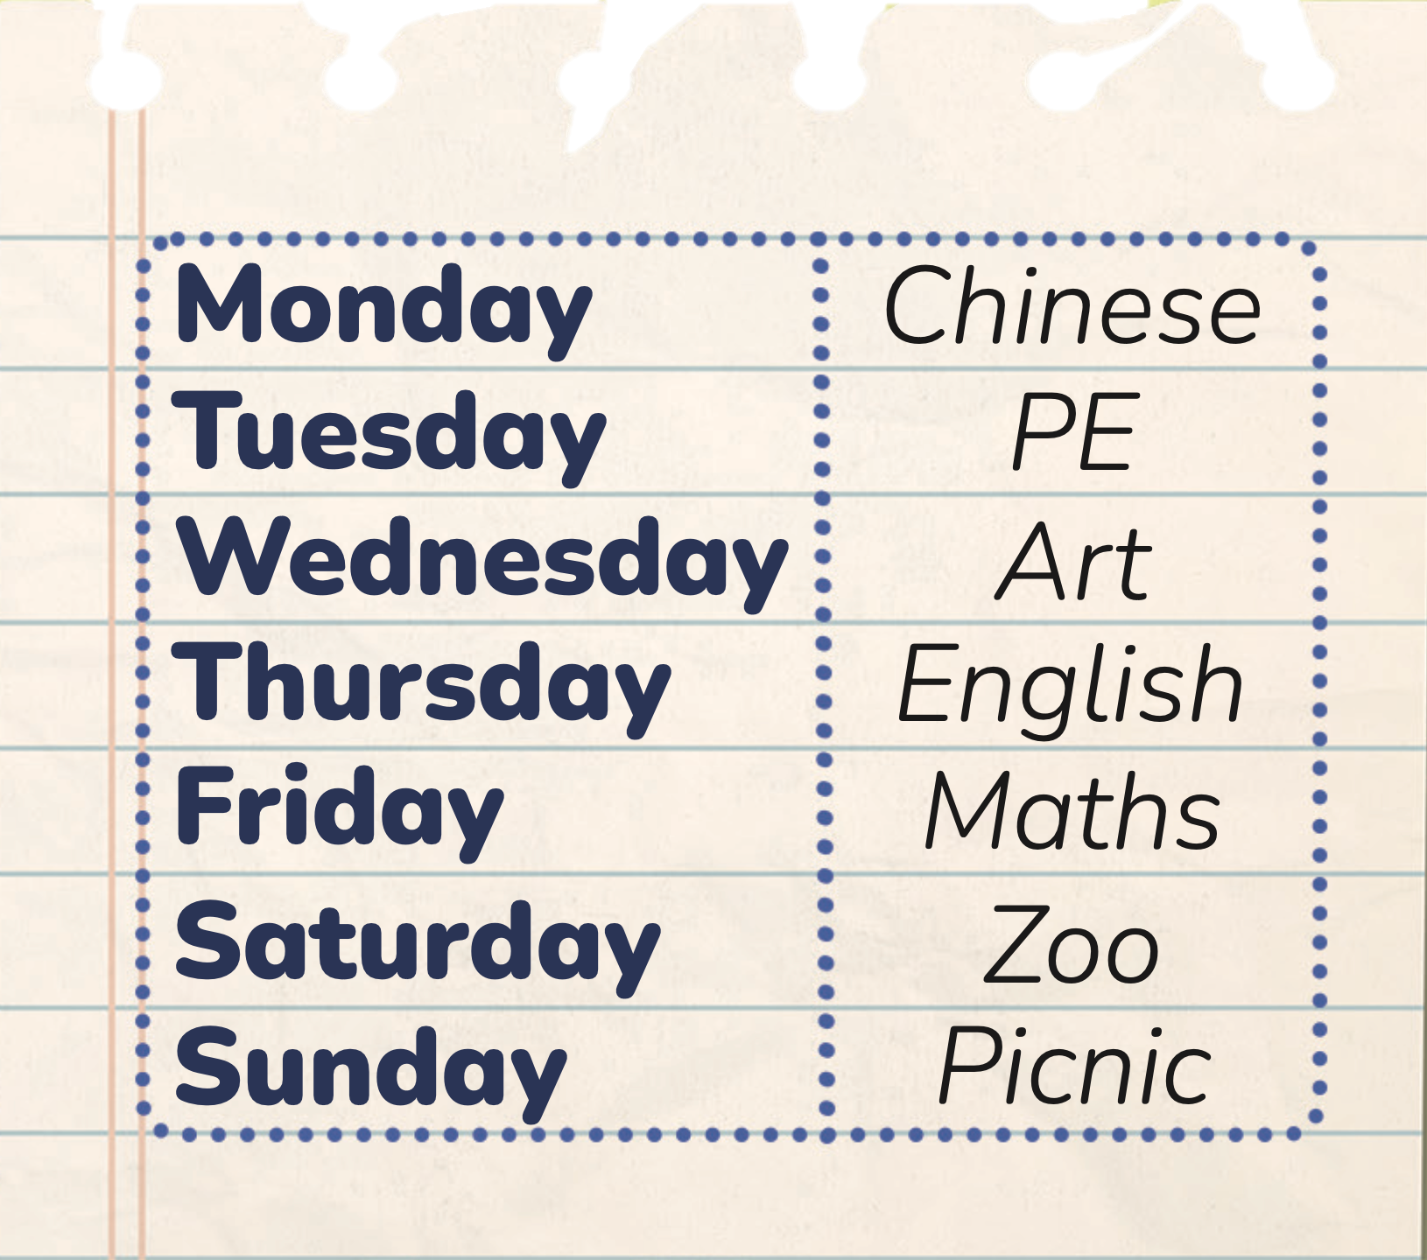
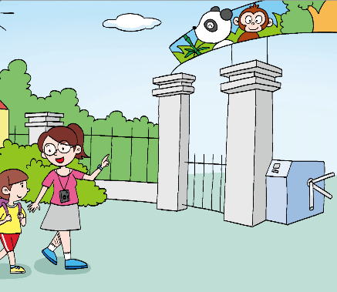

国家中小学课程资源
Look and say.
go to the zoo
have a picnic

Slide 12

国家中小学课程资源
Look and say.

Slide 13

国家中小学课程资源
Work in pairs. Look and say.
___________.
________.
I can speak loudly.
I can speak fluently and correctly.
I can work with my partner well.

Slide 14
国家中小学课程资源
Think and draw.
My calendar
What can you see on the calendar?
What classes do you have from Monday to Friday?
What do you want to do on Saturday and Sunday? Do you want to go outside and play / draw at home / ...?
Monday
Tuesday
Wednesday
Thursday
Friday
Saturday
Sunday
1
2
3
4
5
6
7
PE
Maths
English
Art
Chinese
Picnic
Zoo

Slide 15
国家中小学课程资源
Show your work.
Hi, I’m...
This is my week.
On Monday / Tuesday / Wednesday / ..., I have... / go to...
I can speak loudly.
I can speak fluently and correctly.
I can plan my week well.

Slide 16
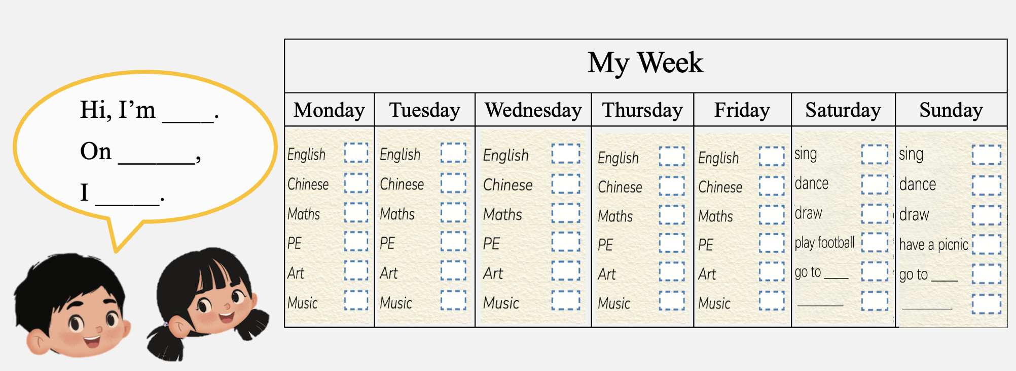
国家中小学课程资源
Homework
结合自身实际情况，参考下面的表格，运用核心句型向同学或朋友介绍自己的一周。
My week

Slide 17
《新交际英语》（预备级）
《新启航英语》
Unit 5 My week
Period 3 Let’s practise. & Look and say. & Let’s have fun.
制作单位：外语教学与研究出版社

