Slide 1
《新启航英语》
Unit 4 Subjects
Period 1 Let’s chant!
册 次：二年级下册 学 科：英语（外研社版）
主讲人：彭雅玺 学 校：成都市电子科技大学实验中学
附属小学

Slide 2
通过本课时学习，学生能够：
理解韵文内容，识别并说出韵文中与学科相关的单词Chinese、English、PE、music、maths、art，理解并灵活运用描述学科难易程度的句型“They are easy for me.”和“They are really hard.”。
熟练朗读韵文，并与同伴合作表演韵文。

Slide 3
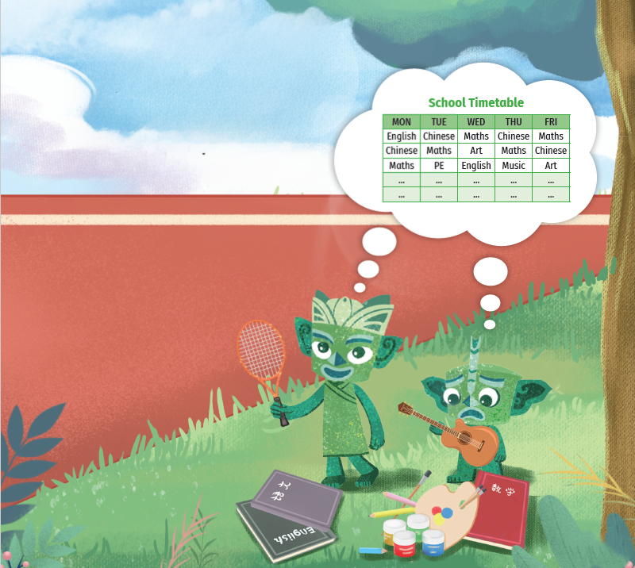
Look and say.
Who are they?
What can you see?
What are they talking about?

Slide 4
Watch the video.
此处教师可以插入教材第34页韵文的视频。

Slide 5
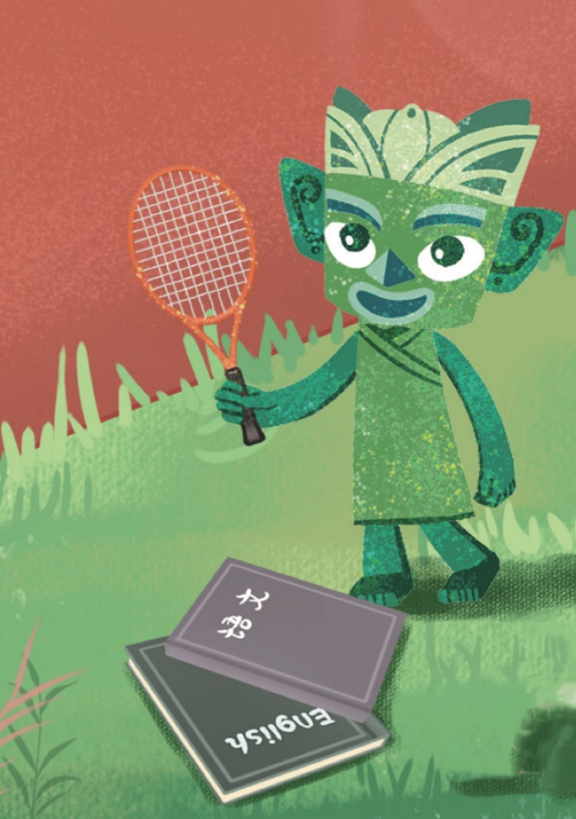

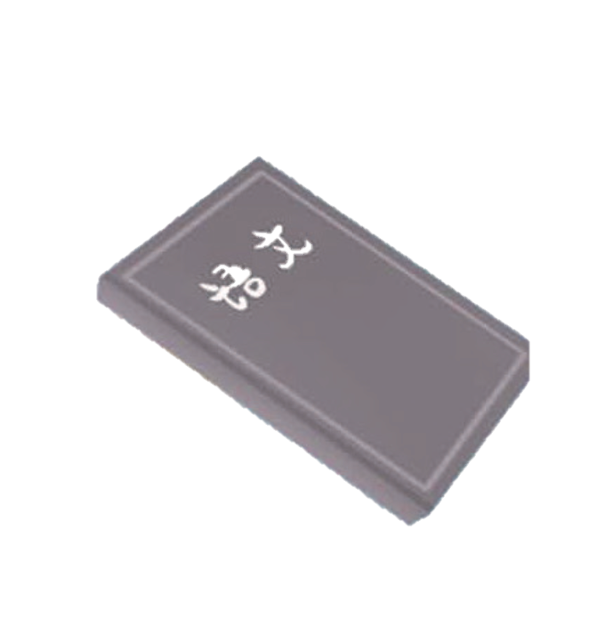


Look , listen and say.
Chinese, English and PE.

Slide 6
Look and say.
How does Tongtong feel?
What will Tongtong say?
Notes:
、

Slide 7
Listen and check.
They are easy for me.

Slide 8
Listen and repeat.
Chinese, English and PE.
They are easy for me.

Slide 9
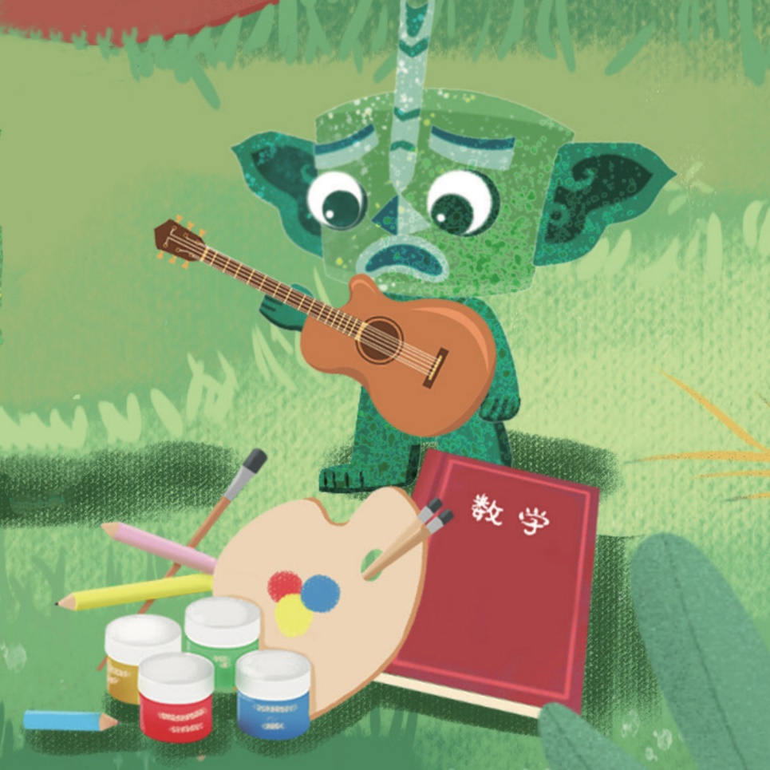
Look and say.
What subjects can you see?

Slide 10


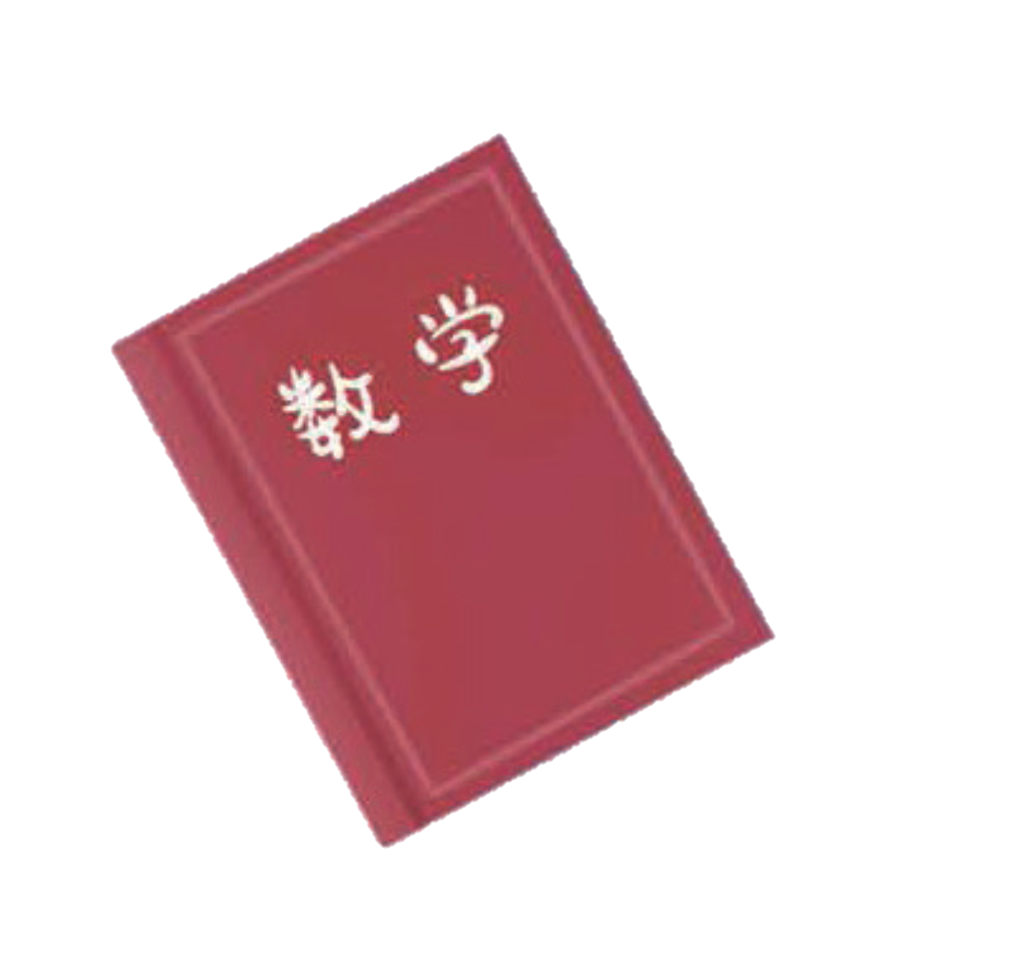

Listen and check.
Music, maths and art.

Slide 11

Look and say.
How does Qingqing feel?
What will Qingqing say?

Slide 12

Listen and check.
They are really hard.

Slide 13
Listen and repeat.
Music, maths and art.
They are really hard.

Slide 14
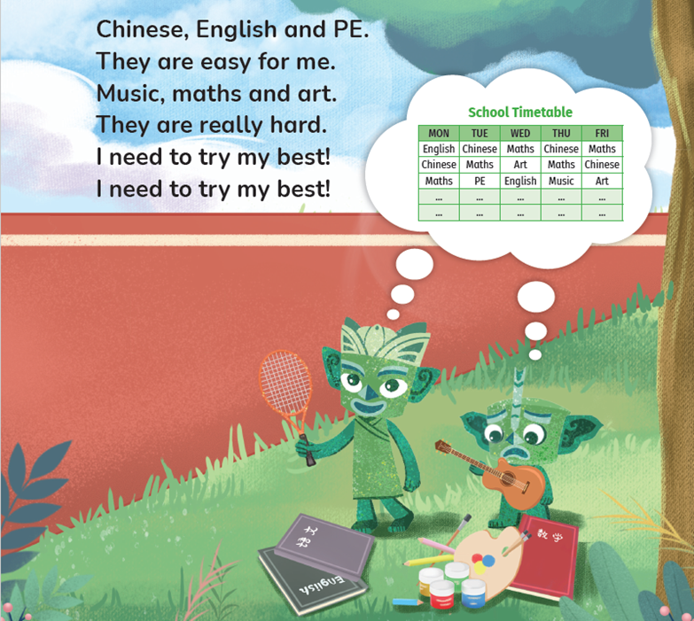
Look and say.
What does Qingqing need to do?

Slide 15

Listen and check.

Slide 16
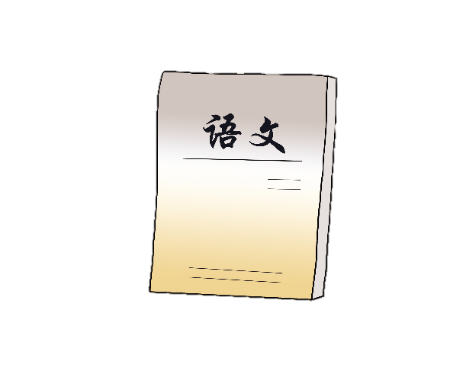
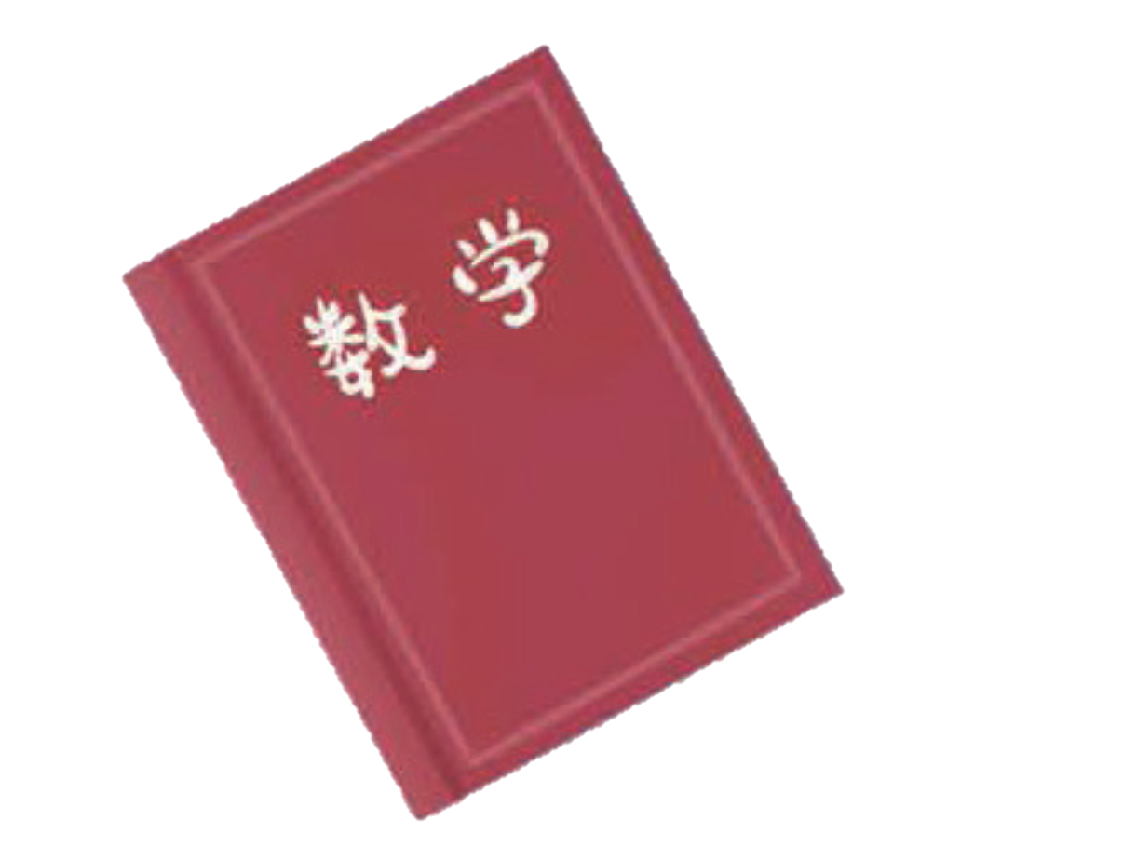


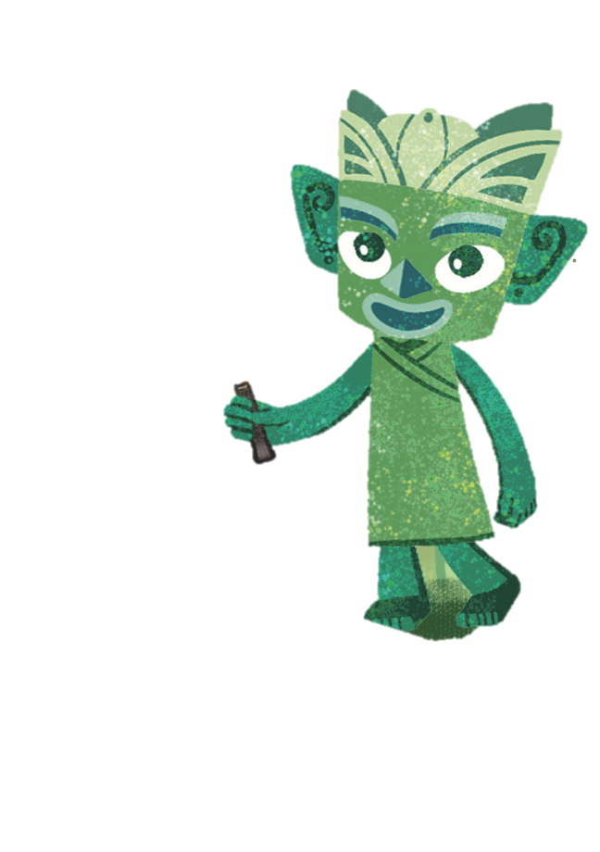

Look, match and say.
________, _______ and ___. They are ____ for me.
Chinese
English
PE
_____, _____ and ____.
They are really _____.
I need to try my best!
I need to try my best!
easy
Music
maths
art
hard

Slide 17
Watch the video and chant.
此处教师可以插入教材第34页韵文的视频。

Slide 18
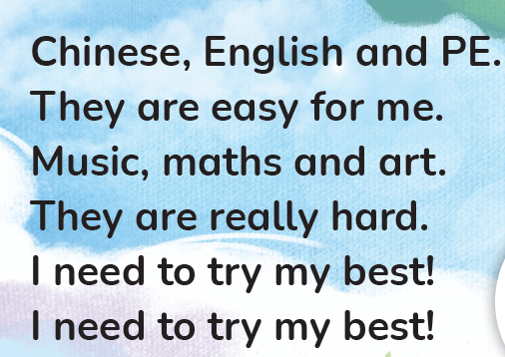
Listen and chant.

Slide 19
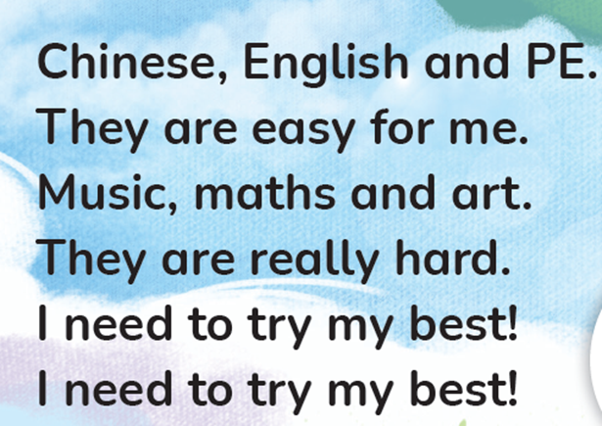
Chant together.

Slide 20
Work in pairs. Chant and act out.

Slide 21
Homework
带感情地表演韵文。
结合自身的实际情况，将自己所学的学科按照难易程度分类，然后创编一首新的韵文，并在下一堂课展示。
Subjects | Easy | Hard
_________________.
They are easy for me.
_________________.
They are really hard.
I need to try my best!
I need to try my best!

Slide 22

《新启航英语》（预备级）
Unit 4 Subjects
Period 1 Let’s chant!
制作单位：外语教学与研究出版社

