Slide 1
《新启航英语》
Unit 4 Subjects
Period 3 Let’s practise. & Do and say. & Let’s have fun.
册 次：二年级下册 学 科：英语（外研社版）
主讲人：邓娟 学 校：成都市锦晖小学金融城分校

Slide 2
通过本课时学习，学生能够：
识别图片中的学科，并运用所学语言介绍自己擅长的学科。
结合自身实际情况，完成科目勾选清单，运用所学语言介绍自己擅长与不擅长的学科。
认真观察图片，完成“找不同”活动。

Slide 3


Let’s chant.

Slide 4
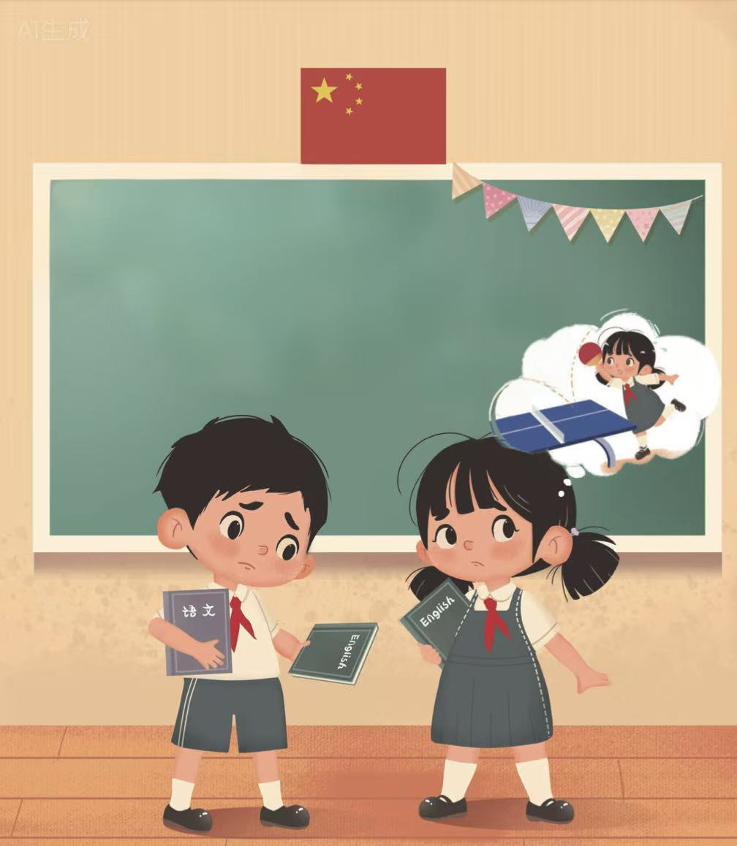

Look and say.
PE
I’m good at ___. But I’m not good at ___.
Chinese
I’m good at _______. But I’m not good at ______.
art
English
art
I’m good at ___. But I’m not good at _____.
I’m good at ______. But I’m not good at ____.
English
music
PE

Slide 5


Look and say.
music
I’m good at _____. But I’m not good at _____.
help
maths
Let’s _____ each other.
I’m good at _____. But I’m not good at _______.
maths
Chinese

Slide 6


Look and say.
Now I’m good at _______, ____ and _____.
Now I’m good at ___, _____ and _______.
English
art
PE
music
maths
Chinese

Slide 7

Look and say.
What subject can you see?
What will Feifei say?

Slide 8
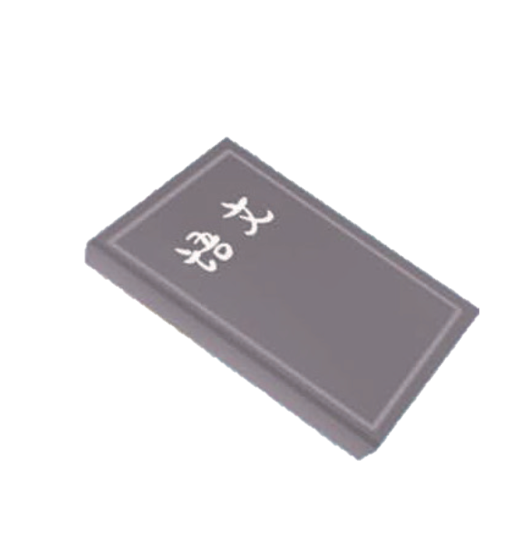



Let’s practise.

Slide 9
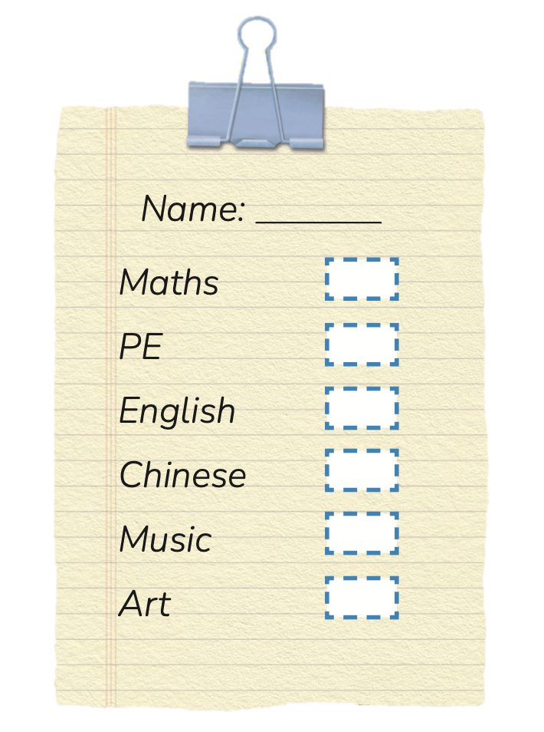
Look, point and say.

Slide 10
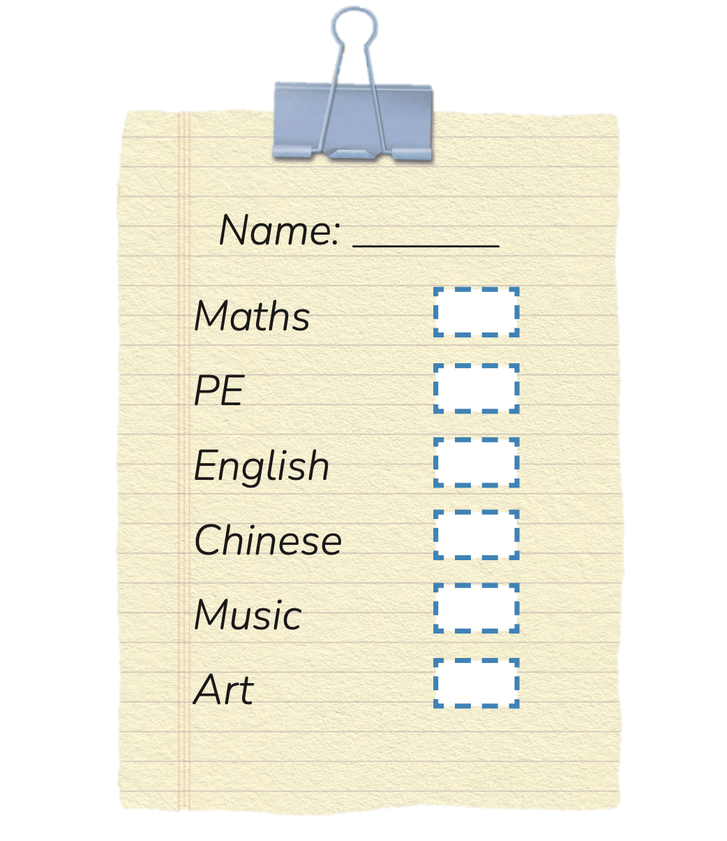
Do and say.
Write your name.
Draw √ or ×.
“√” = You are good at...
“×” = You are not good at...

Slide 11
Do and say.
I’m good at…
I’m not good at...

Slide 12


Look and circle.

Slide 13
Check the answers.

Slide 14
Homework
运用所学语言向家人或朋友介绍自己擅长与不擅长的学科。
借助教材第43页活动6的科目勾选清单，在班级开展调研活动，了解同学们的学科学习情况，并寻找自己的学习伙伴。

Slide 15

《新启航英语》（预备级）
Unit 4 Subjects
Period 3 Let’s practise. & Do and say. & Let’s have fun.
制作单位：外语教学与研究出版社

