Slide 1
《新启航英语》
Unit 3 Clothes
Period 2 Let’s read!
册 次：二年级下册 学 科：英语（外研社版）
主讲人：邱思思 学 校：成都市高新区成外美年学校

Slide 2
通过本课时学习，学生能够：
在看、听、读、演等活动中，理解故事内容。
掌握并灵活运用故事中与服饰相关的词汇以及介绍服饰、表达个人喜好的核心句型。
小组合作表演故事，模仿故事角色的语音、语调、动作和表情，深入体会故事角色的情感，感悟故事传递的道理。

Slide 3
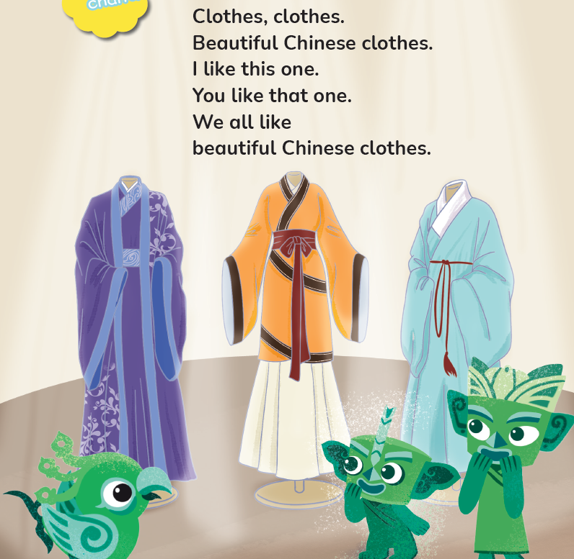
Let’s chant.
此处教师可插入教材第23页韵文的视频。

Slide 4

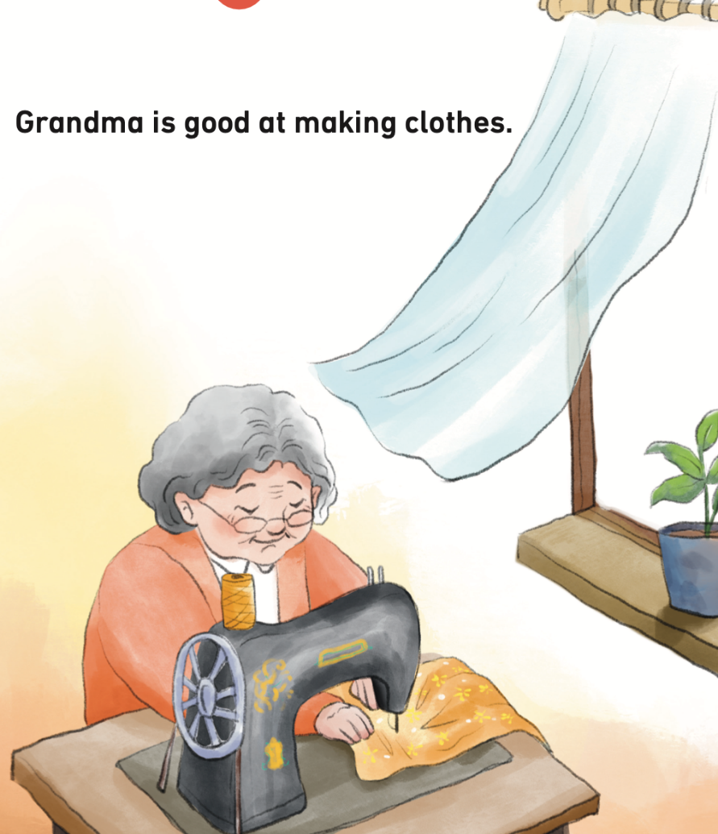
Look, listen and say.
Who is in the picture?
What is she doing?
What will Grandma make?

Slide 5
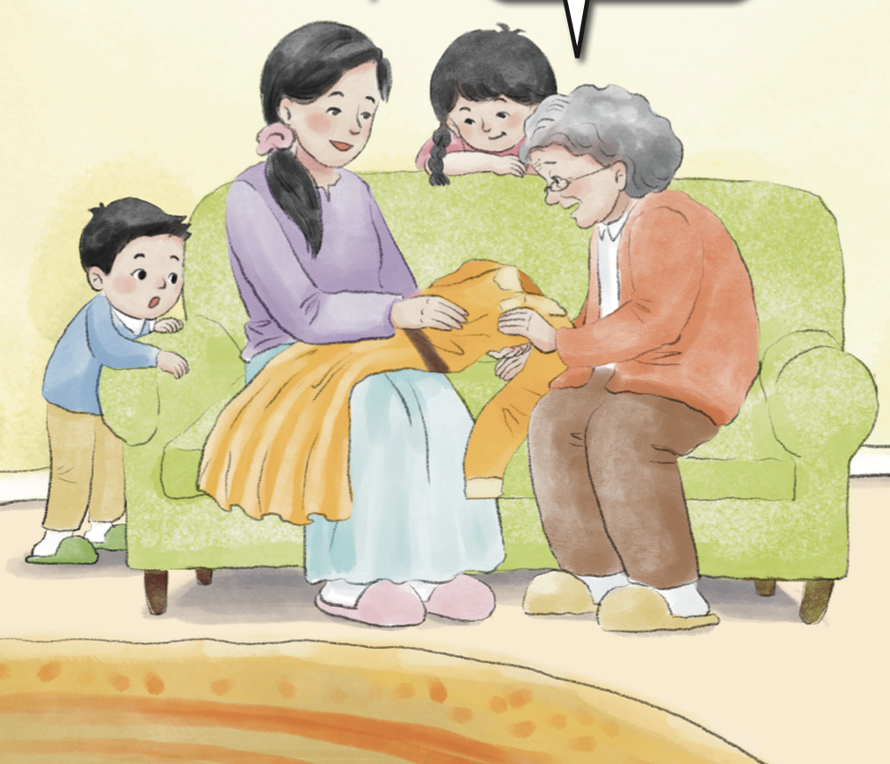
Look and say.
Is it new?
Who are in this picture?
What’s in Mum’s hand?

Slide 6
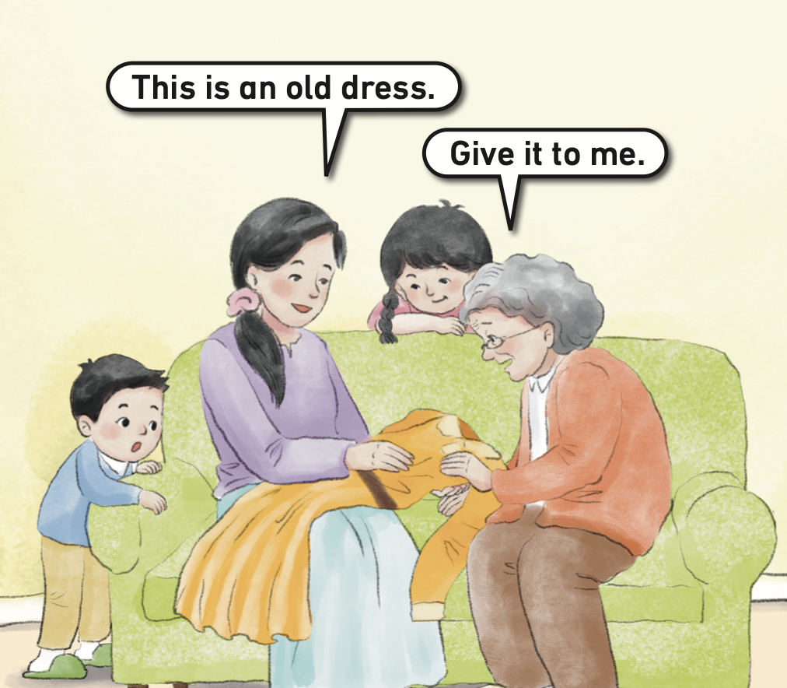
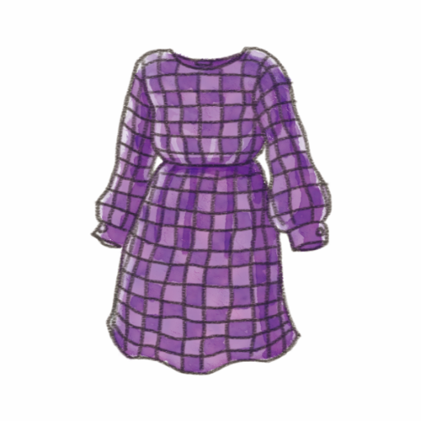
Listen and check.
What will Grandma make the old dress into?
dress

Slide 7
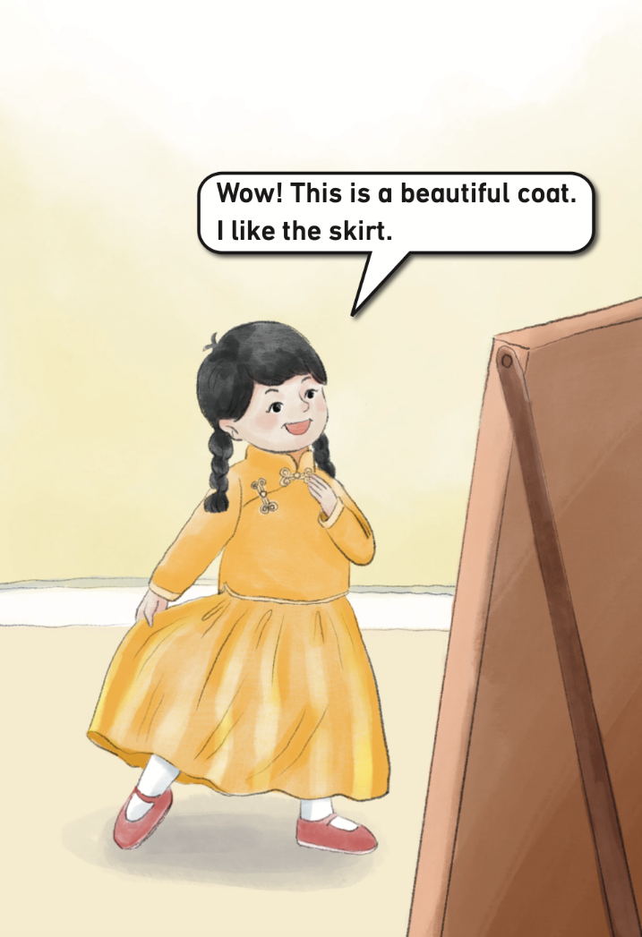
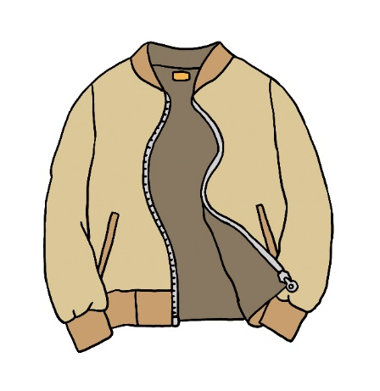
Look and say. Then listen and check.
How does the girl feel?
Does she like the new clothes?
coat
What will she say?
skirt

Slide 8
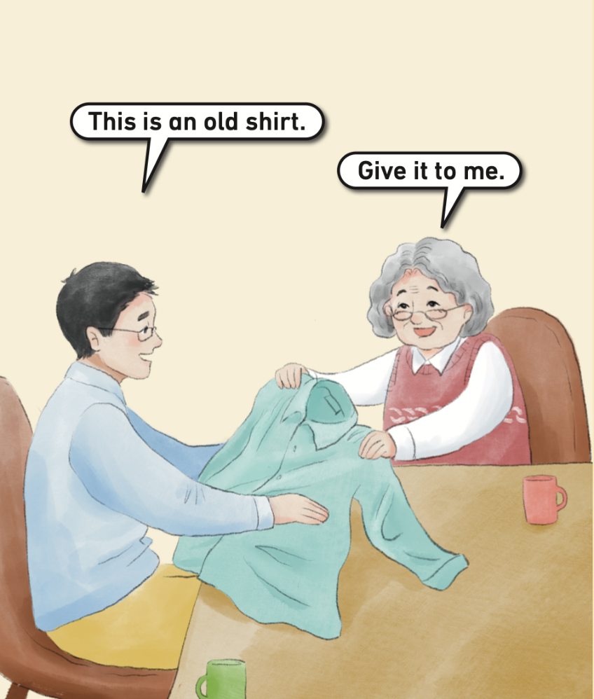
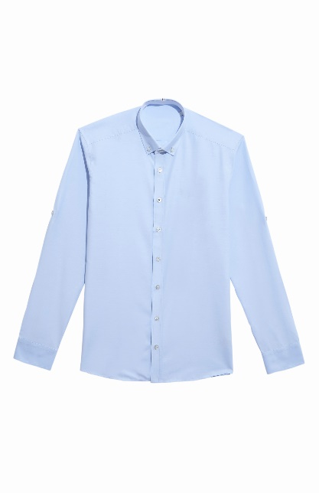
Look and say. Then listen and check.
What’s in Dad’s hand? Is it new?
What will they say?
shirt
What will Grandma make the old shirt into?

Slide 9
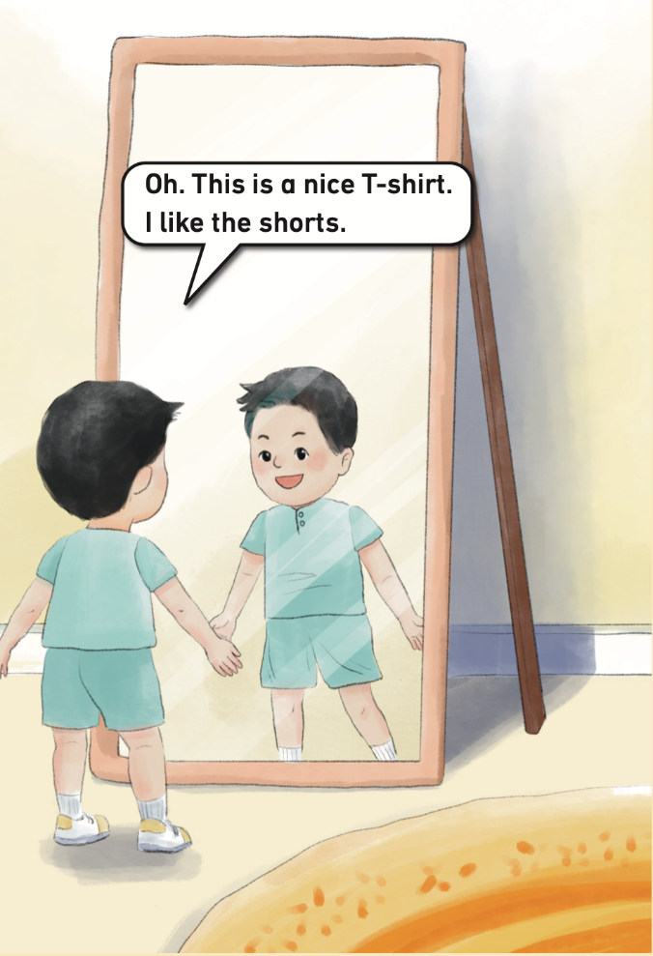

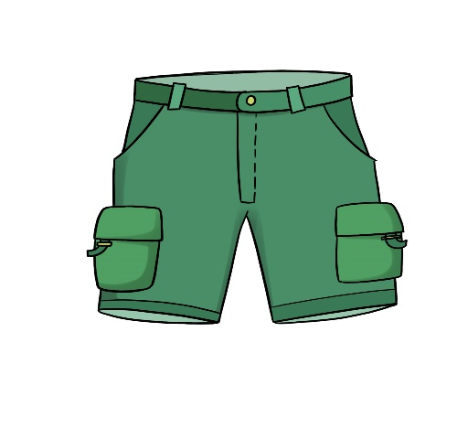
Look and say. Then listen and check.
How does the boy feel?
Does he like the new clothes?
T-shirt
What will he say?
shorts

Slide 10
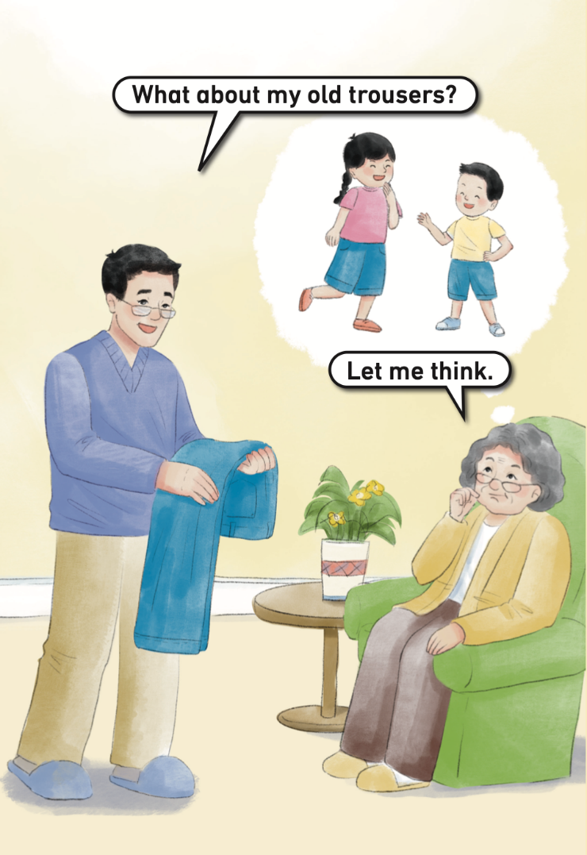
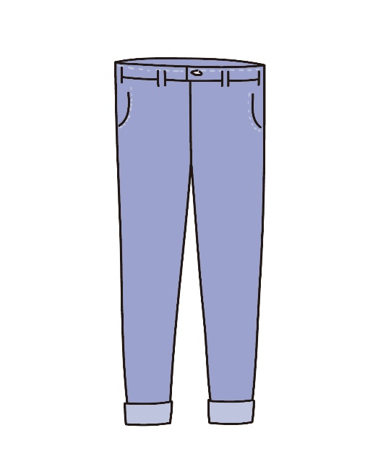
Look, listen and say.
trousers
What will Grandma make the old trousers into?

Slide 11

Look and say.
shorts
trousers

Slide 12
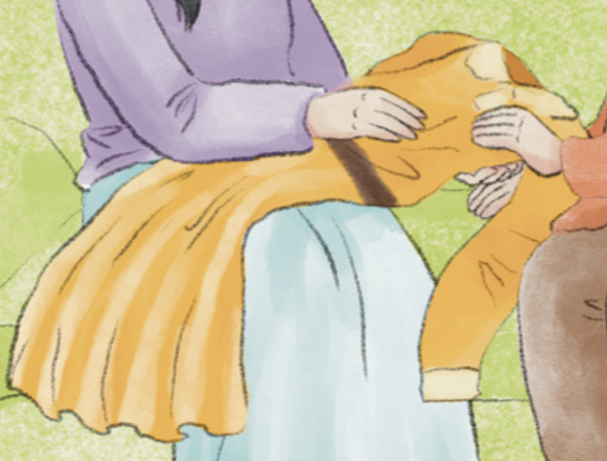
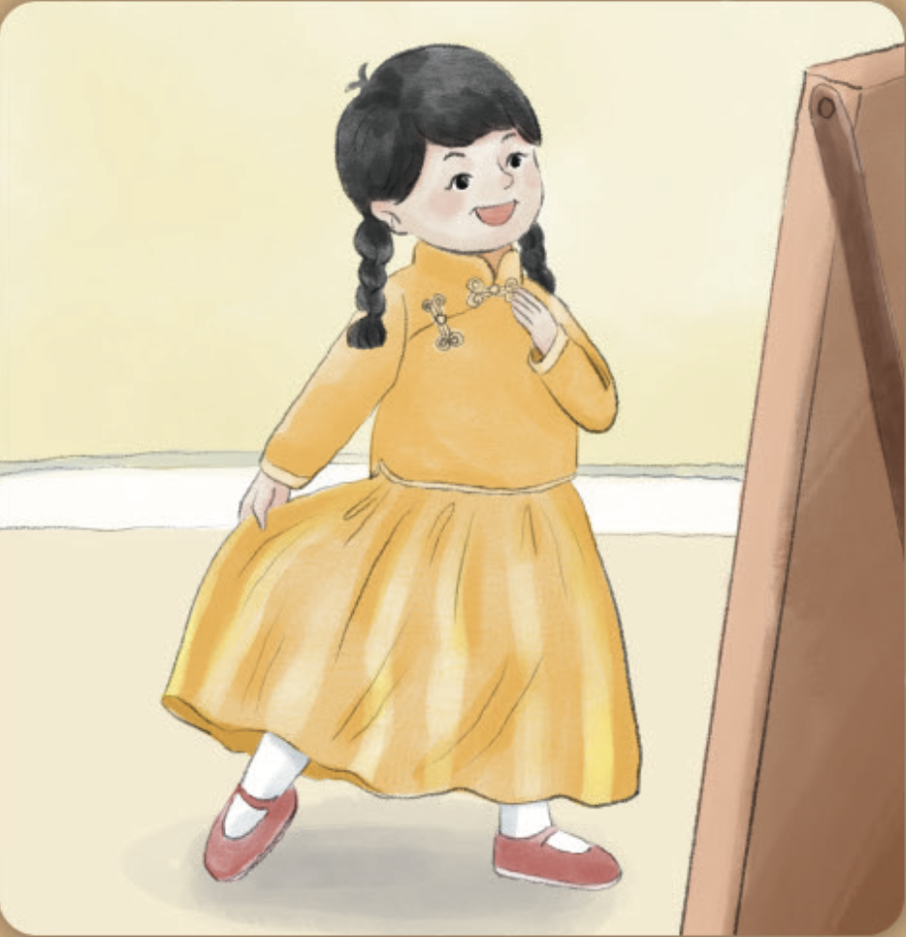
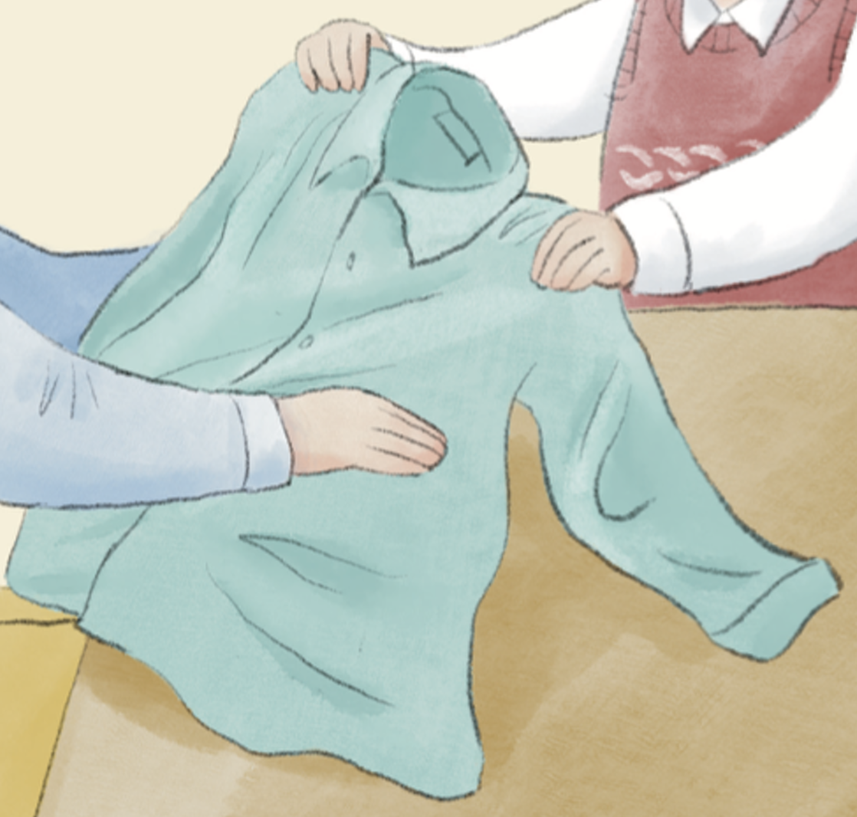
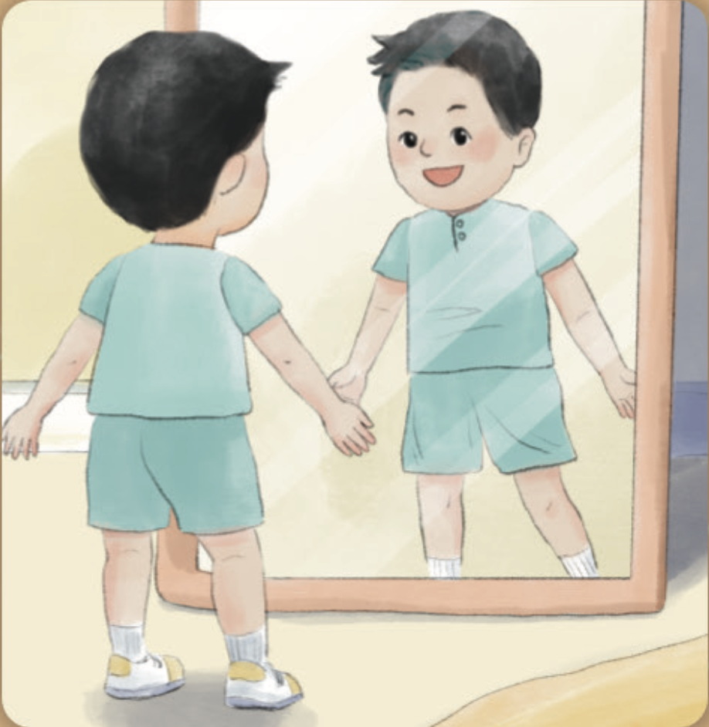
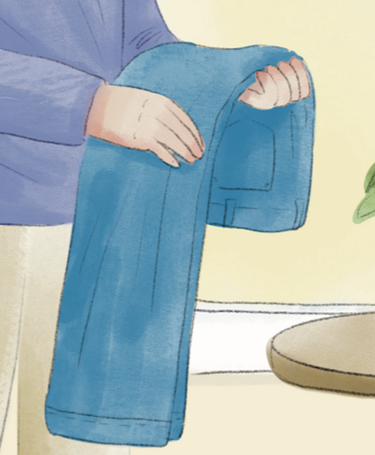
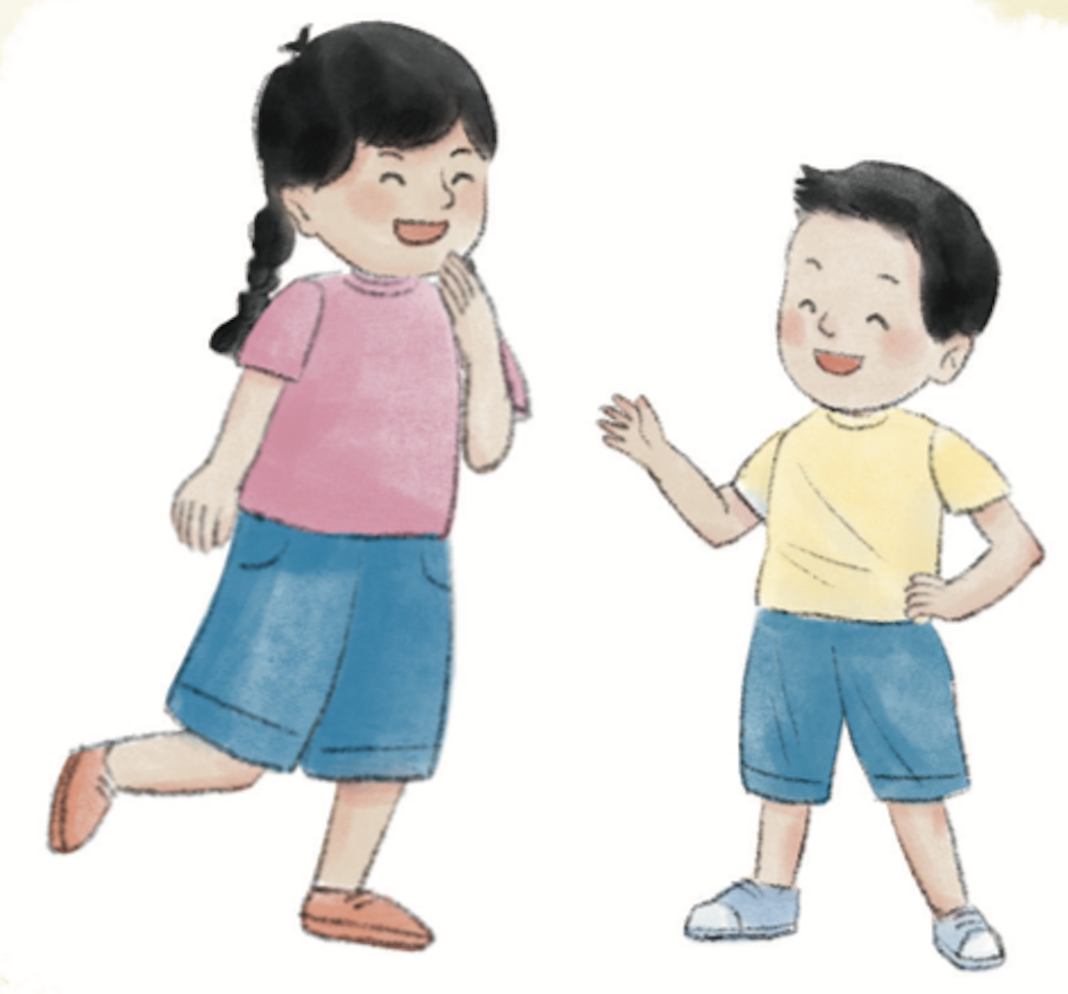
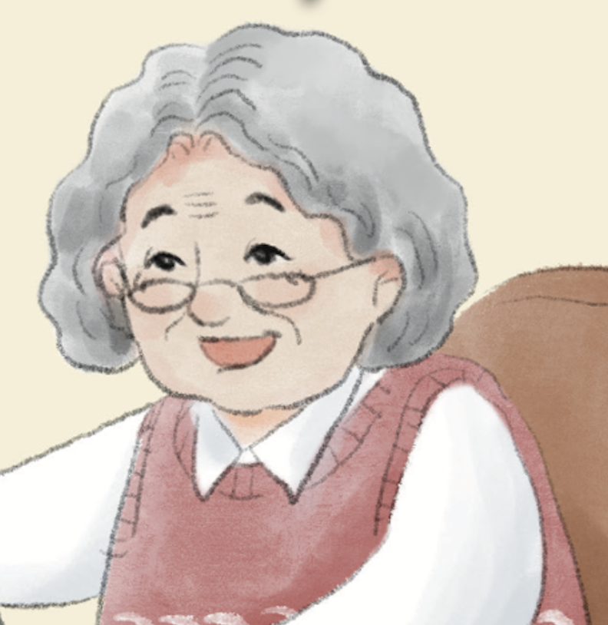
Think and say.
What do you think of Grandma?

Slide 13
Watch the video and repeat.
此处教师可以插入教材第24—29页故事的视频。

Slide 14
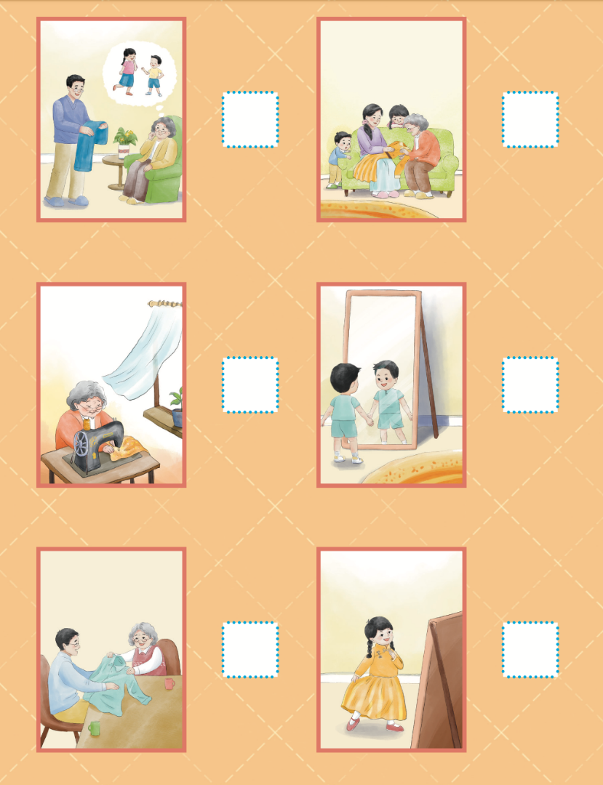
Read and number.
6
2
1
5
4
3

Slide 15
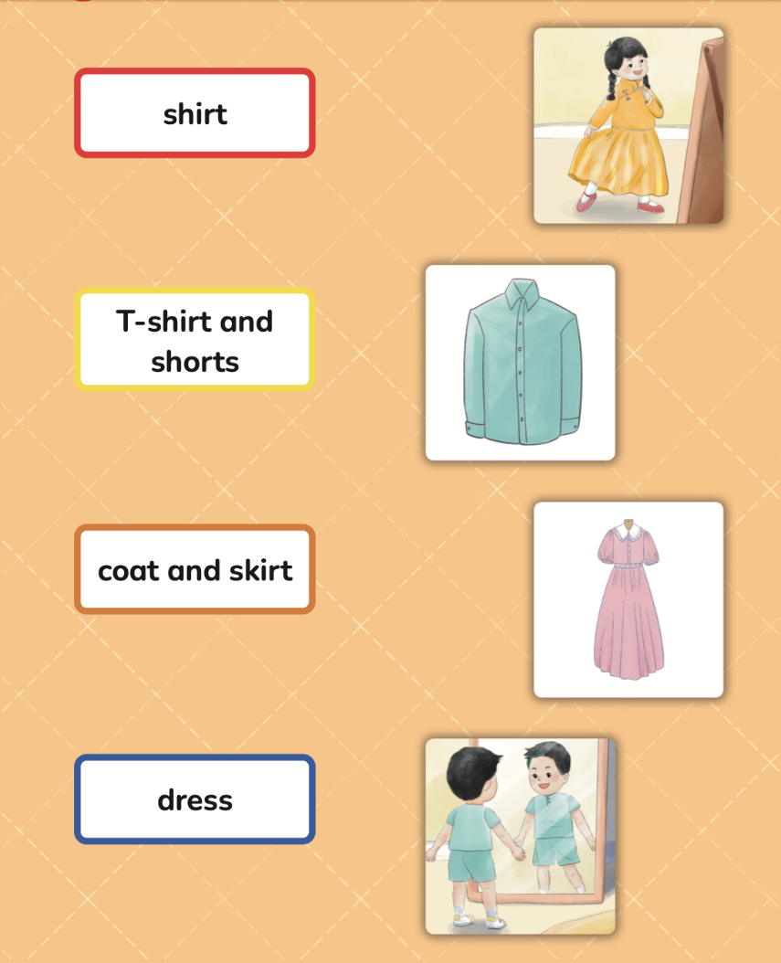

Listen, read and match.

Slide 16
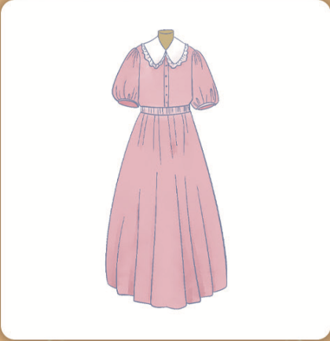
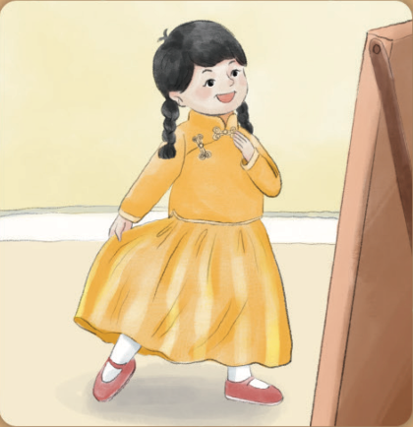
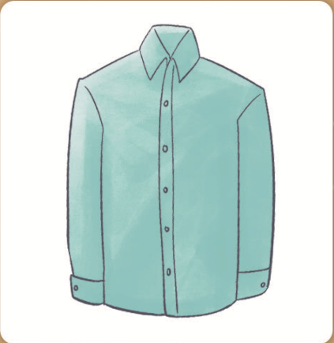

Look and say.
This is a beautiful _____.
This is a _____.
coat
dress
I like the ____.
skirt
This is a nice ______.
T-shirt
This is a _____.
shirt
I like the _____.
shorts

Slide 17
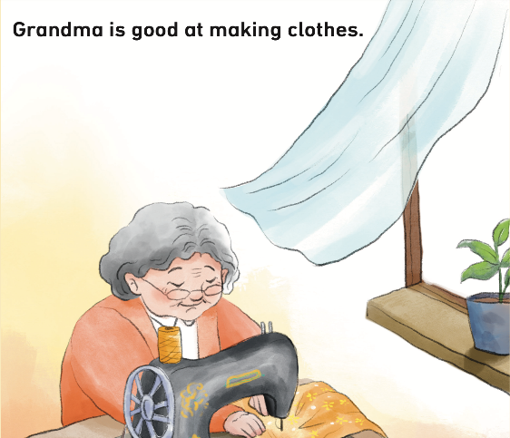
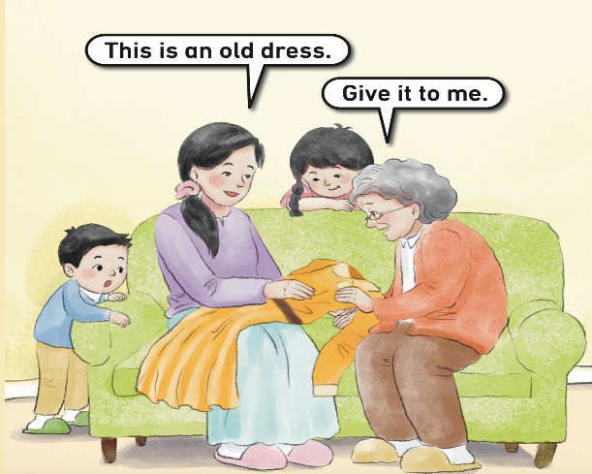
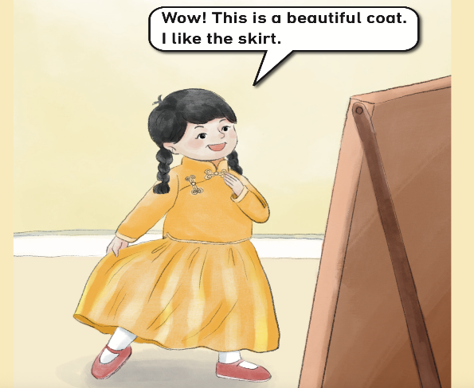
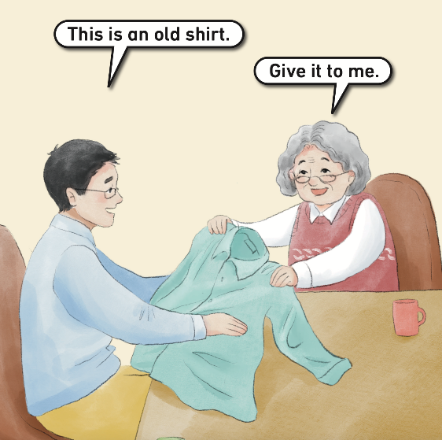
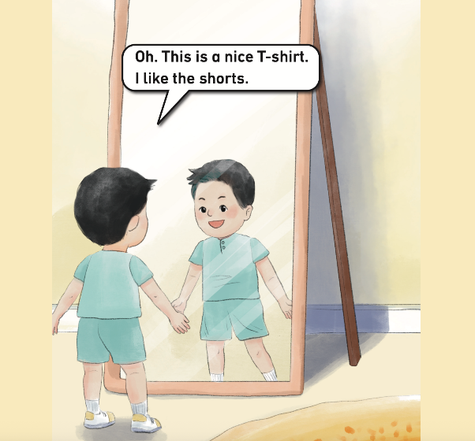
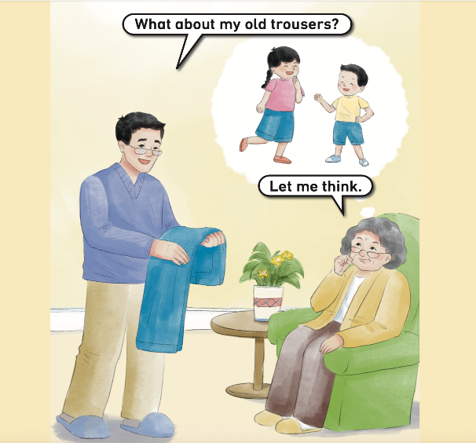
Read the story aloud.

Slide 18

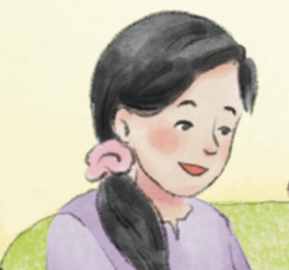

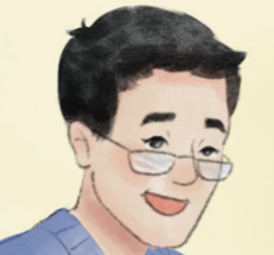
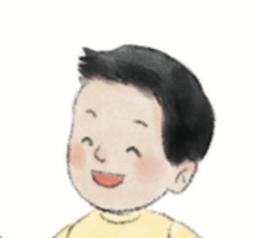
Work in groups. Act out the story.
I can speak fluently. ☆
I can act with emotions. ☆
I can work well with my classmates. ☆

Slide 19
Homework
带感情地朗读故事。
用英语与同学分享自己最喜欢的衣物（实物或照片均可）。

Slide 20

《新启航英语》（预备级）
Unit 3 Clothes
Period 2 Let’s read!
制作单位：外语教学与研究出版社

