Slide 1
《新启航英语》
Unit 3 Clothes
Period 3 Let’s practise. & Look, guess and say. & Let’s have fun.
册 次：二年级下册 学 科：英语（外研社版）
主讲人：代宝宝 学 校：成都市高新区成外美年学校

Slide 2
通过本课时学习，学生能够：
识别常见的衣物，并运用“This is...”句型进行介绍。
推理、判断图片排列的规则，找出问号处缺失的服饰，并说出相应的单词。
设计自己喜爱的服饰，并用本单元的核心语言进行介绍。

Slide 3
Let’s chant.
此处教师可以插入教材第23页韵文的视频。

Slide 4
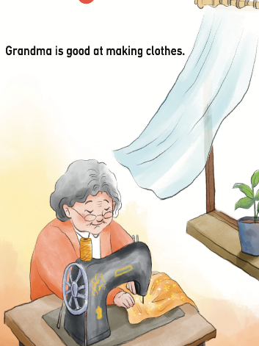
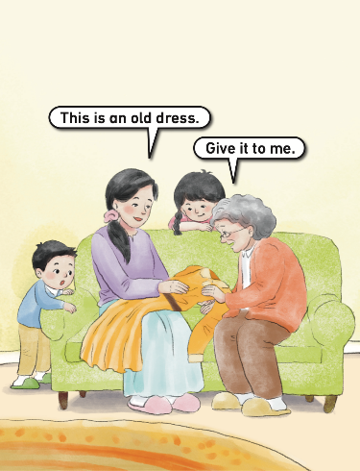
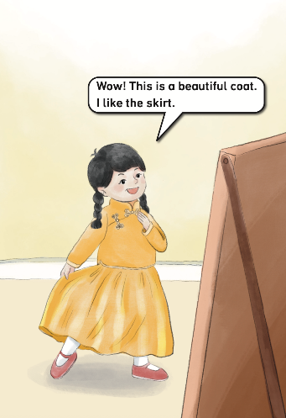

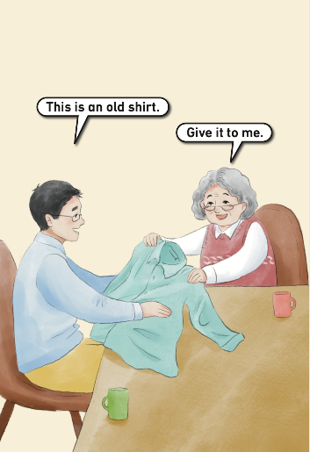
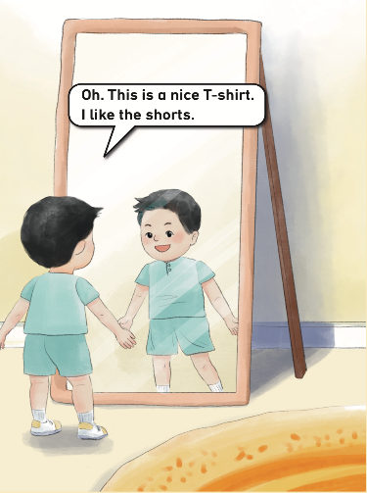
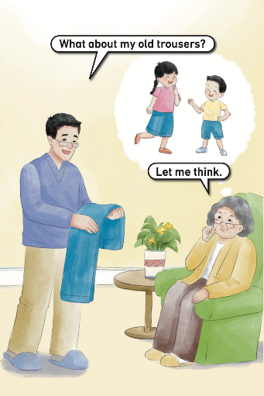
Listen and repeat.

Slide 5

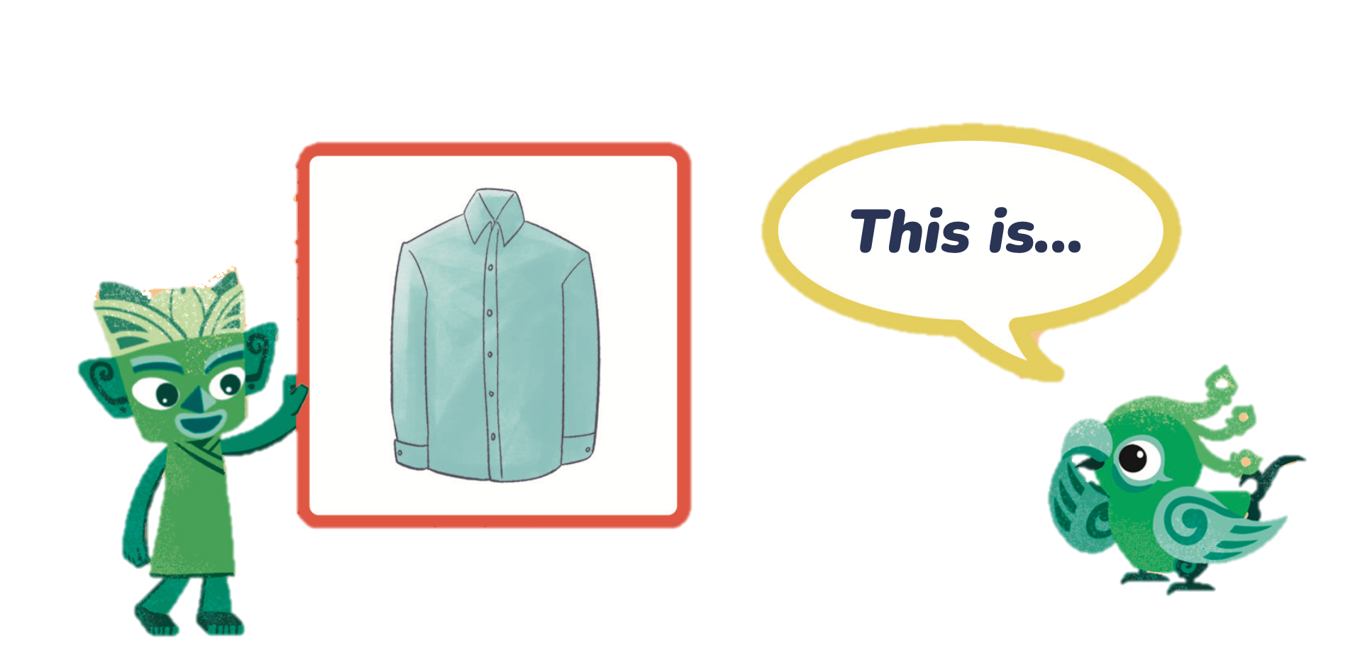
Look and say.
What is this?
This is a shirt.

Slide 6

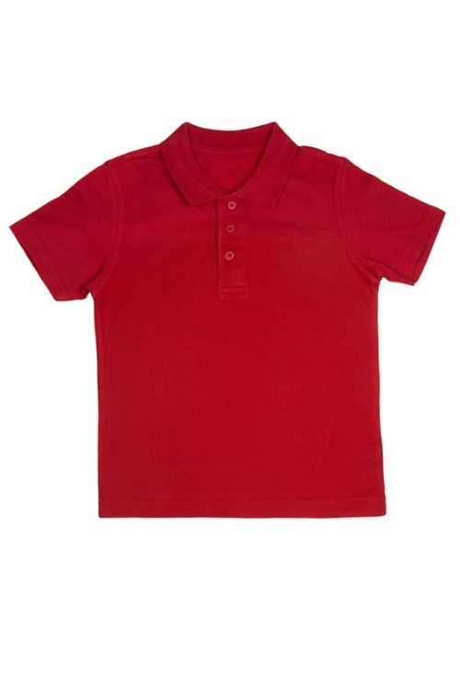
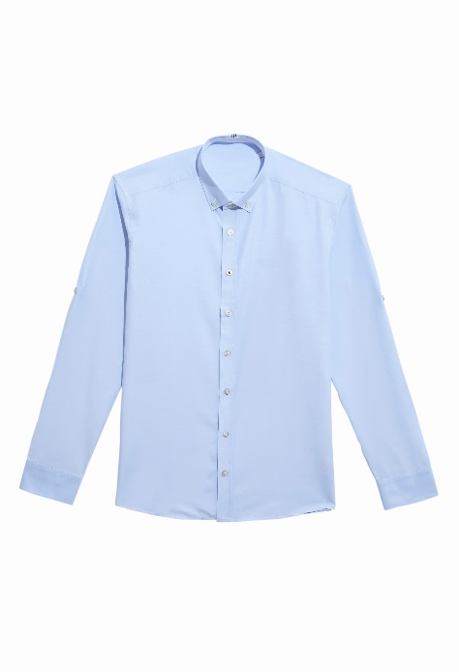
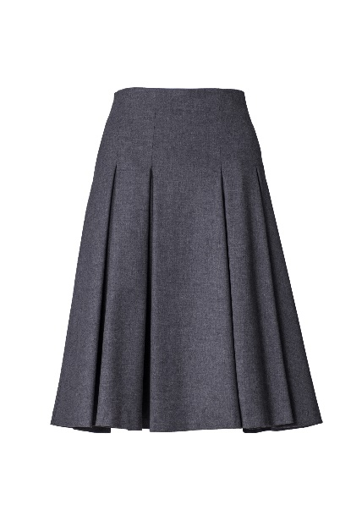

Let’s practise.

Slide 7
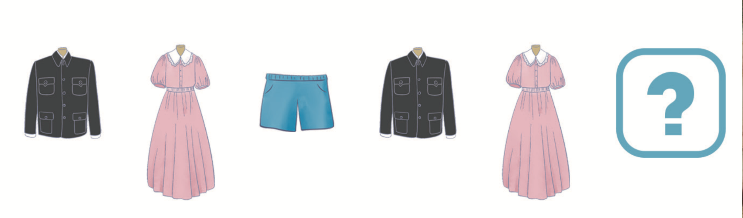
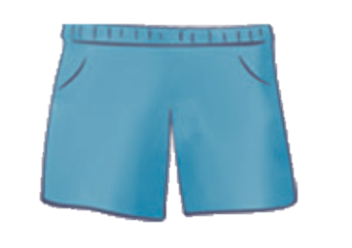
Look, guess and say.
shirt
dress
shorts
shirt
dress
shorts

Slide 8
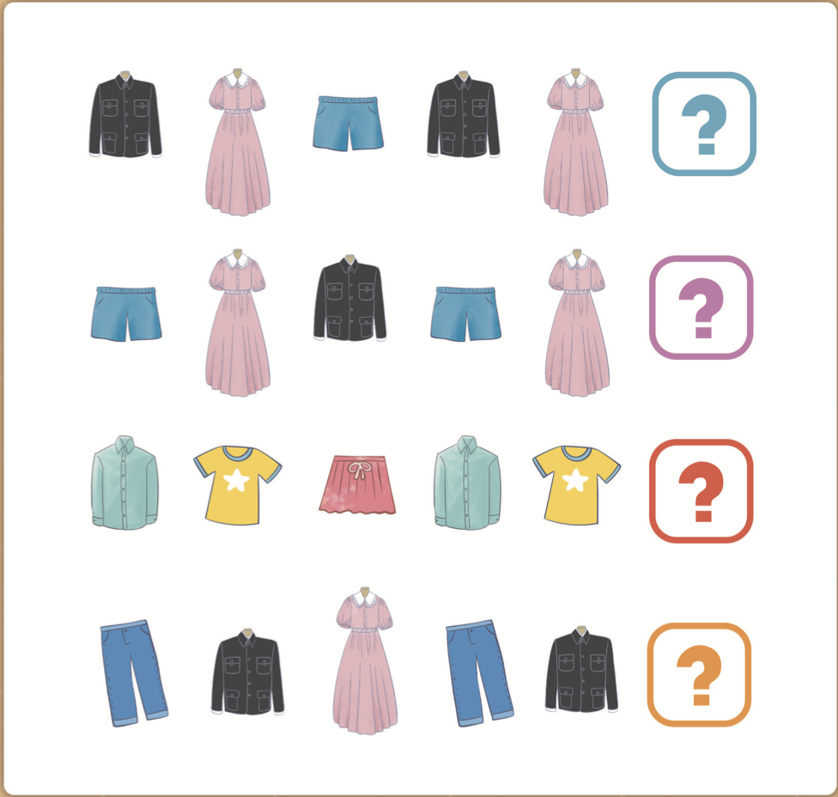
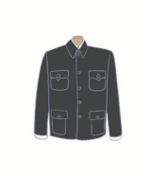
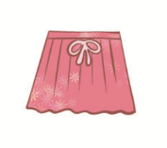
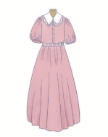
Look, guess and say.
Work in pairs.
Look at the pictures and say the words.
Find the missing clothes.
Say the answers aloud.

Slide 9

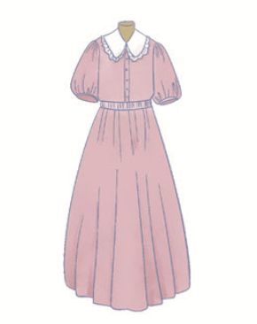
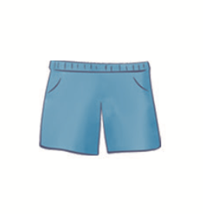
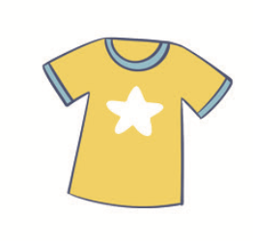

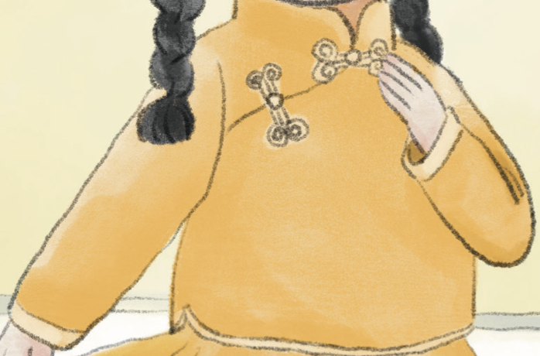
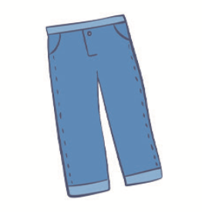
Look and say.
shirt
dress
shorts
T-shirt
skirt
coat
trousers

Slide 10
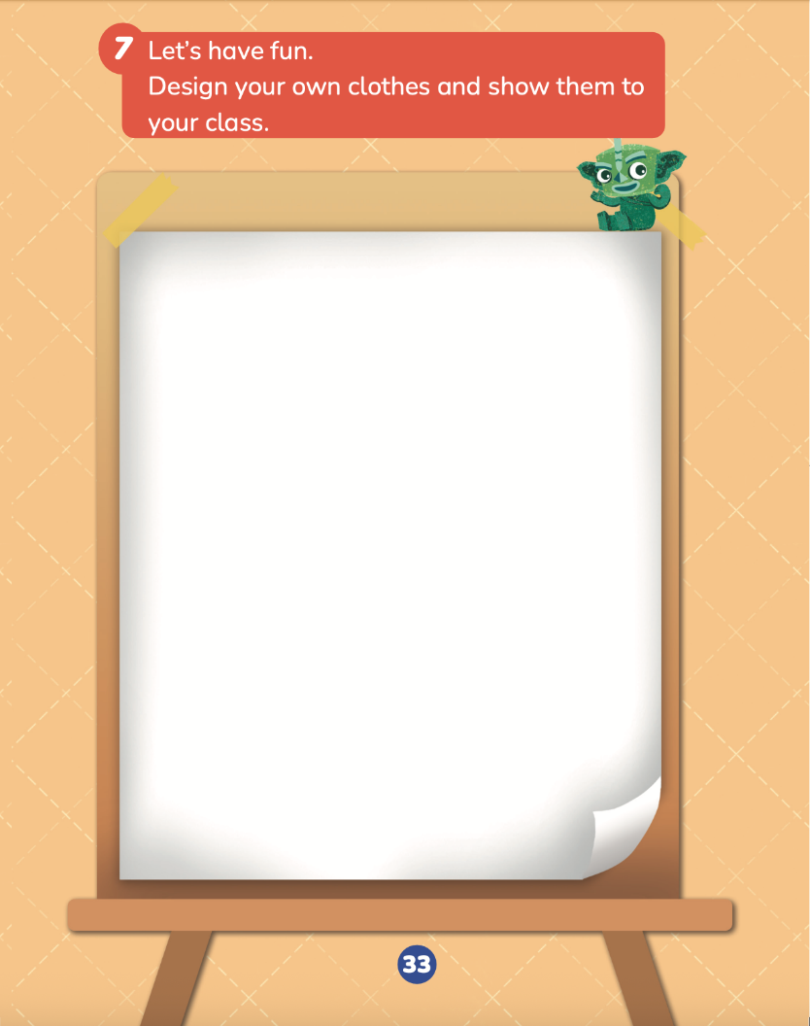
Think and draw.
Design your own clothes.
What kind of clothes do you want to design?
What colour are your clothes?
What is your design for? (e.g., spring, a party, school))

Slide 11

Show your work.
This is my T-shirt / shirt / skirt / dress / coat. They are my trousers / shorts.
It’s / They’re red / green / yellow / ...
It’s / They’re for spring / summer / autumn / winter / school / ...
It’s / They’re beautiful / cool / ...
I like my...
Let’s vote!
☆ The design is nice.
☆ The designer shows the
work well.
☆ I like his / her work.

Slide 12
Homework
仿照教材第32页活动6，设计1—2组按照不同规则排列的服饰图片，请同学或朋友解密。
完善自己设计的服饰，并用英文向朋友介绍。

Slide 13

《新启航英语》（预备级）
Unit 3 Clothes
Period 3 Let’s practise. & Look, guess and say. & Let’s have fun.
制作单位：外语教学与研究出版社

