Slide 1
《新启航英语》
Unit 2 Seasons
Period 1 Let’s chant!
册 次：二年级下册 学 科：英语（外研社版）
主讲人：周密 学 校：成都市成华小学校

Slide 2
通过本课时学习，学生能够：
理解韵文内容，掌握韵文中有关四季的英文单词spring、summer、autumn、winter，以及描述体感的核心句型“It’s warm / hot / cool / cold.”。
熟练朗读韵文，并与同伴合作表演韵文。

Slide 3
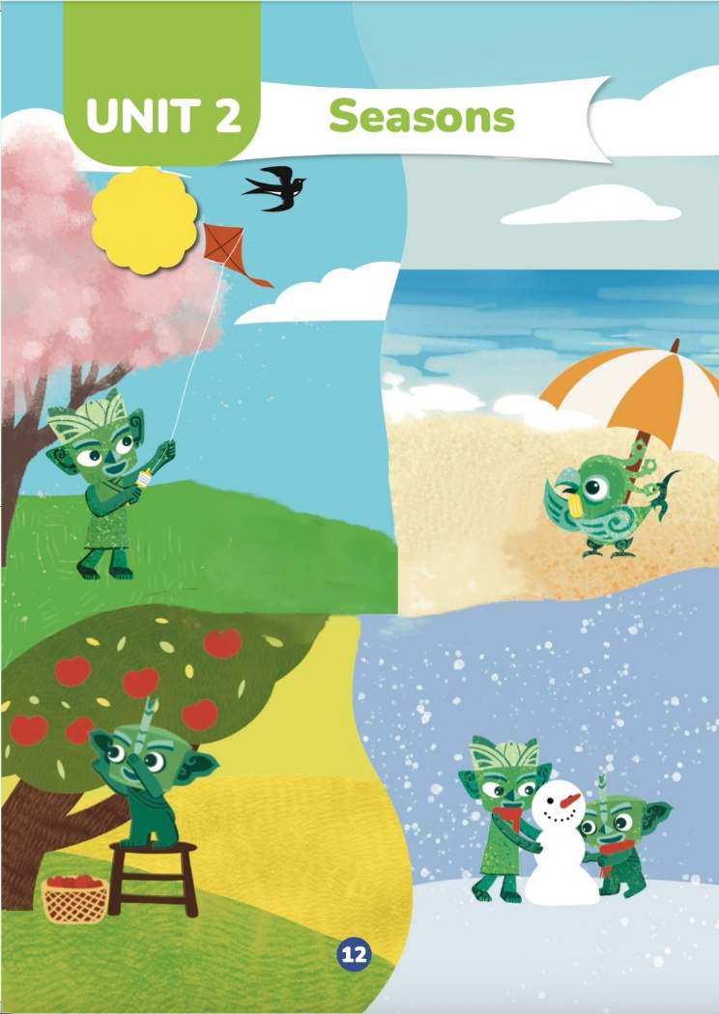

Look and say.
How many seasons are there in a year?
Can you name the seasons?
What do you know about these seasons?

Slide 4

Look and say.
What season is it?
How do you know that?
What is this season like?

Slide 5

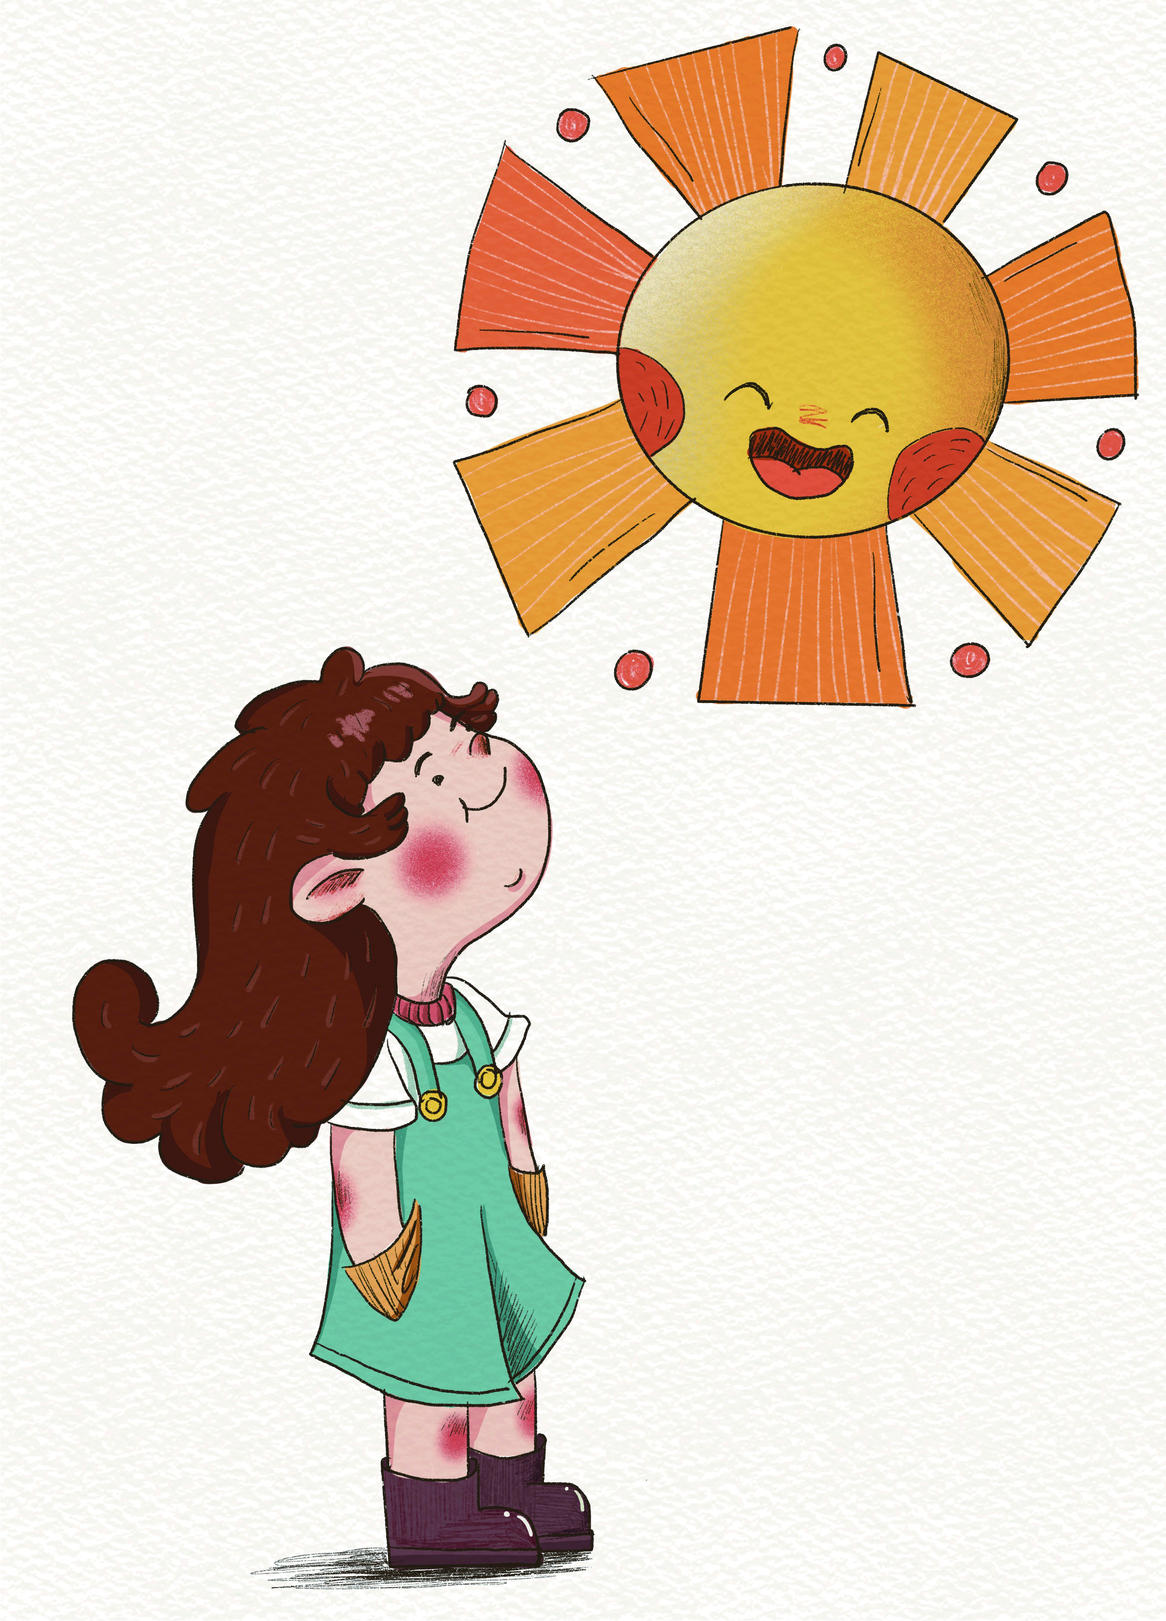
Listen, check and repeat.
Spring, spring, it’s warm.

Slide 6


Look, listen and repeat.
Summer, summer, it’s hot.

Slide 7
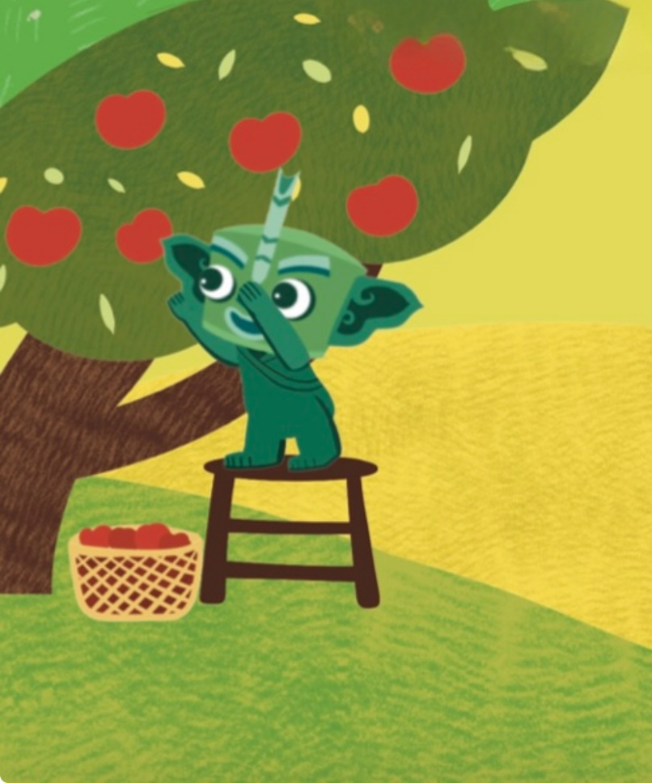
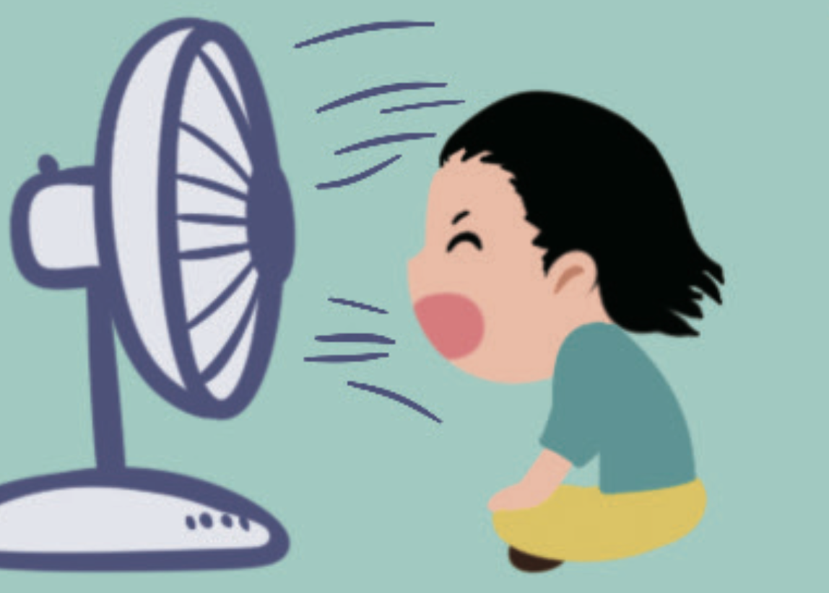
Look, listen and repeat.
Autumn, autumn, it’s cool.

Slide 8
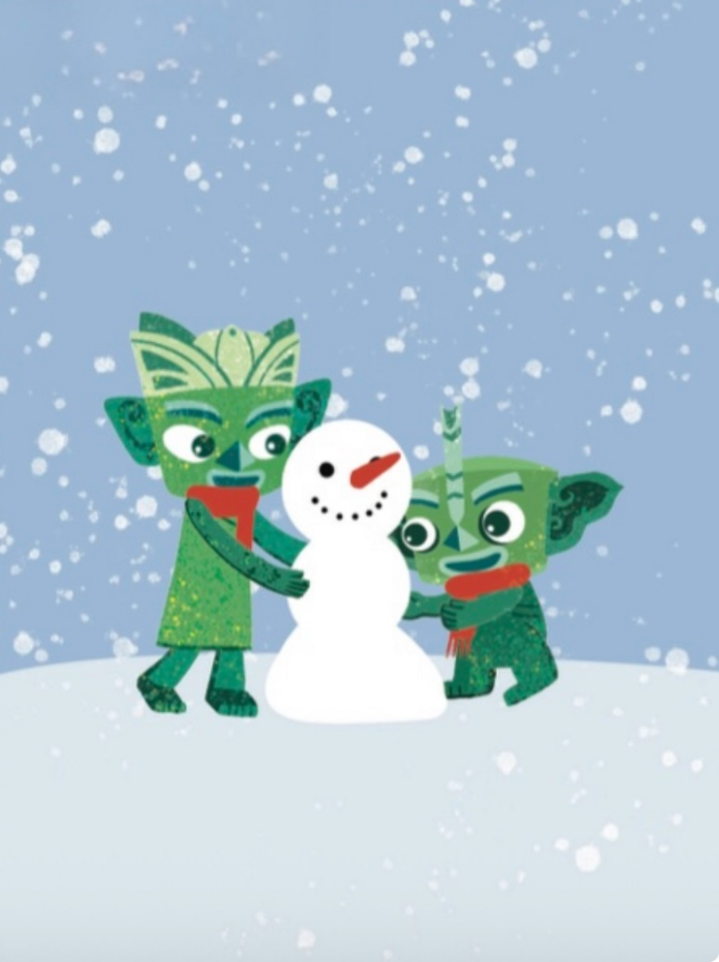

Look, listen and repeat.
Winter, winter, it’s cold.

Slide 9



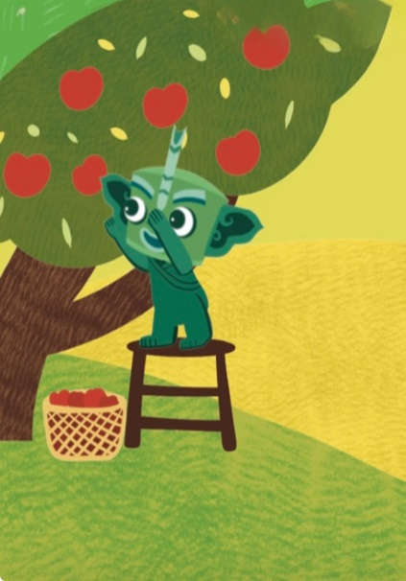
Listen and point.

Slide 10
Watch the video and chant.
此处教师可插入教材第12页韵文的视频。

Slide 11
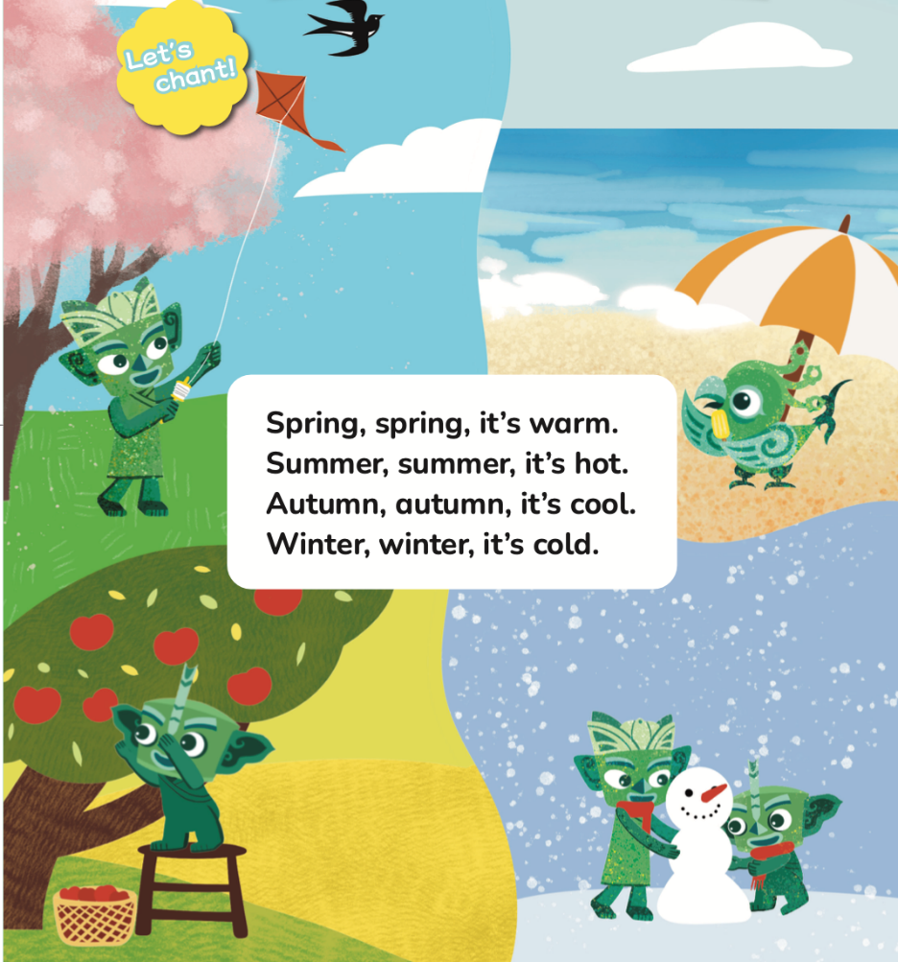
Listen and chant.
Spring, spring, it’s warm.
Summer, summer, it’s hot.
Autumn, autumn, it’s cool.
Winter, winter, it’s cold.

Slide 12

Chant in groups.
S1: Spring, spring, it’s warm.
S2: Summer, summer, it’s hot.
S3: Autumn, autumn, it’s cool.
S4: Winter, winter, it’s cold.

Slide 13

Work in groups. Chant and act out.

Slide 14
Homework
带感情地表演韵文。
准备一些代表春、夏、秋、冬四个季节的图画或风景照，在下一节课与同学分享，请对方用英语猜一猜图中展示的季节。

Slide 15

《新启航英语》（预备级）
Unit 2 Seasons
Period 1 Let’s chant!
制作单位：外语教学与研究出版社

