Slide 1
《新启航英语》
Unit 5 Festival
Period 1 Let’s chant!
册 次：二年级上册 学 科：英语（外研社版）
主讲人：曾超凤 学 校：北京第二外国语学院
成都附属小学

Slide 2
通过本课时学习，学生能够：
理解韵文内容，了解春节的英文名称Spring Festival，掌握春节祝福语“Happy Spring Festival!”“Best wishes to you!”。
熟练朗读韵文，并与同伴合作表演韵文。

Slide 3
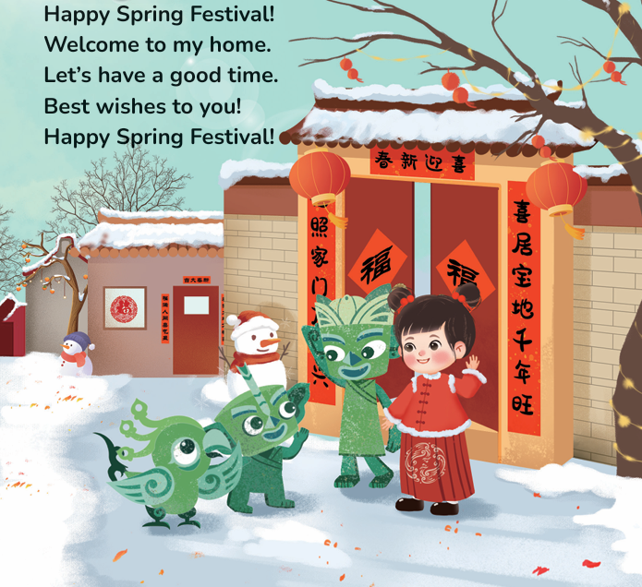
Look and say.
Who are they?
What can you see in the picture?
What are they doing?
Lanlan
Feifei
Tongtong
Qingqing

Slide 4
Look and guess.
What festival is it?
Lanlan
Feifei
Tongtong
Qingqing

Slide 5

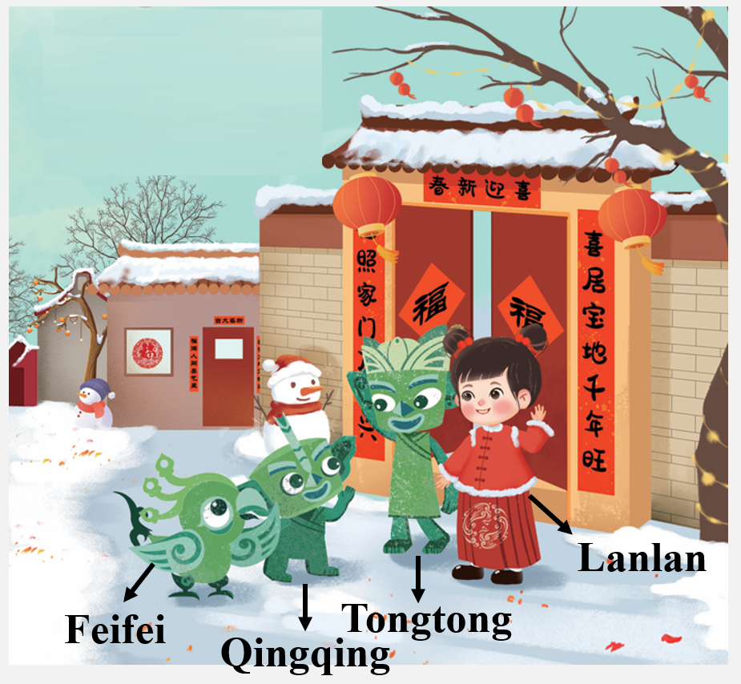
Listen and check.
Happy Spring Festival!

Slide 6
Look and guess.
What does Lanlan say to Feifei, Tongtong and Qingqing?

Slide 7
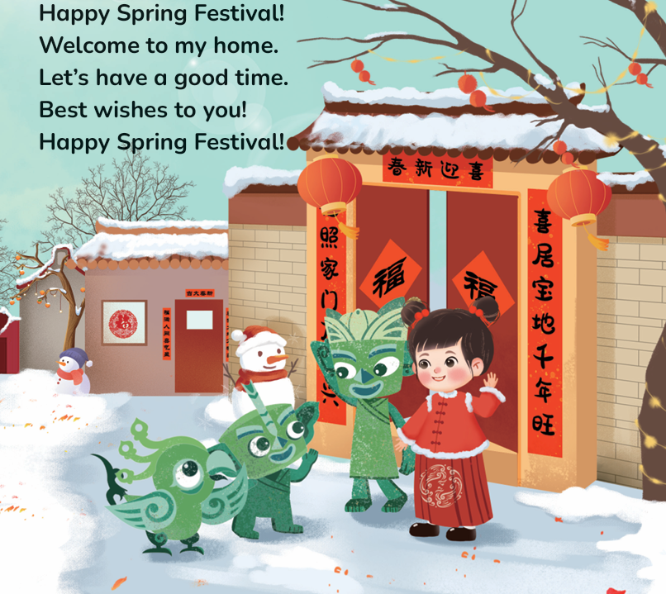
Listen and check.
Lanlan
Feifei
Tongtong
Qingqing

Slide 8
Listen and repeat.
Lanlan
Feifei
Tongtong
Qingqing

Slide 9
Look and guess.
What do Feifei, Tongtong and Qingqing say to Lanlan?
Lanlan
Feifei
Tongtong
Qingqing

Slide 10
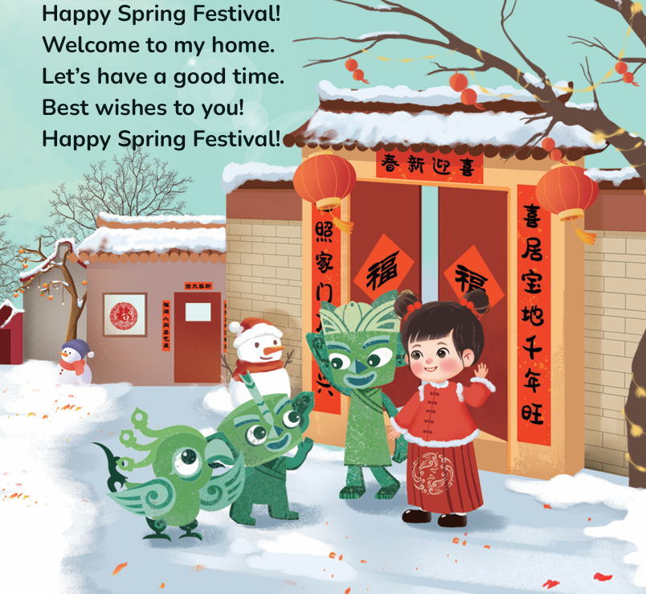
Listen and check.
Lanlan
Feifei
Tongtong
Qingqing

Slide 11
Listen and repeat.
Lanlan
Feifei
Tongtong
Qingqing

Slide 12
Watch the video and chant.
此处教师可插入教材第45页韵文的视频。

Slide 13
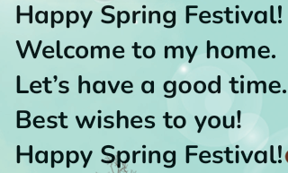
Listen and chant.

Slide 14
Chant together.

Slide 15
Work in groups. Chant and act.

Slide 16
Homework
带感情地朗读韵文。
了解更多春节祝福语，并在下节课与同学分享。

Slide 17

Unit 5 Festival
Period 1 Let’s chant!
制作单位：外语教学与研究出版社

