Slide 1
Unit 5 Festival
Period 2 Let’s read!
册 次：二年级上册 学 科：英语（外研社版）
主讲人：唐雁翎 学 校：成都市龙江路小学
中粮祥云分校

Slide 2
通过本课时学习，学生能够：
在看、听、读、演等活动中，理解故事内容。
掌握并灵活运用介绍节日习俗的表达。
小组合作表演故事，模仿故事角色的语音、语调、表情和动作，深入体会故事角色的情感，感受语言交流的真实性、互动性和趣味性，进一步了解和体验春节习俗，感受中国传统节日的魅力。

Slide 3
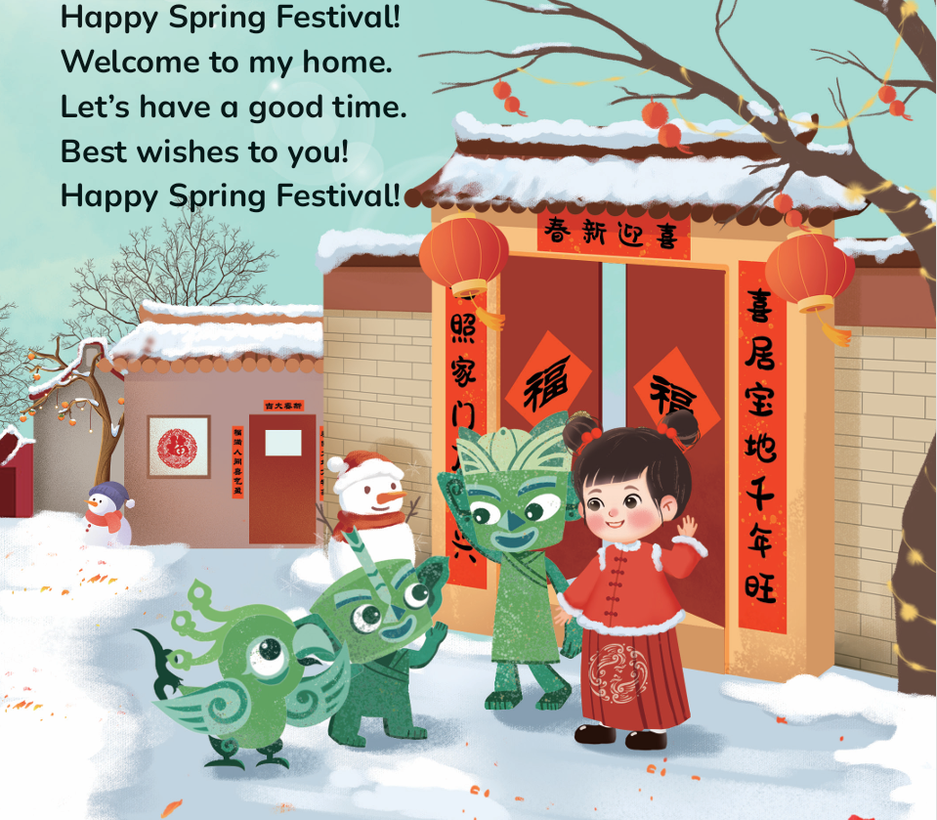
Let’s chant.
此处教师可插入教材第45页韵文的视频。

Slide 4
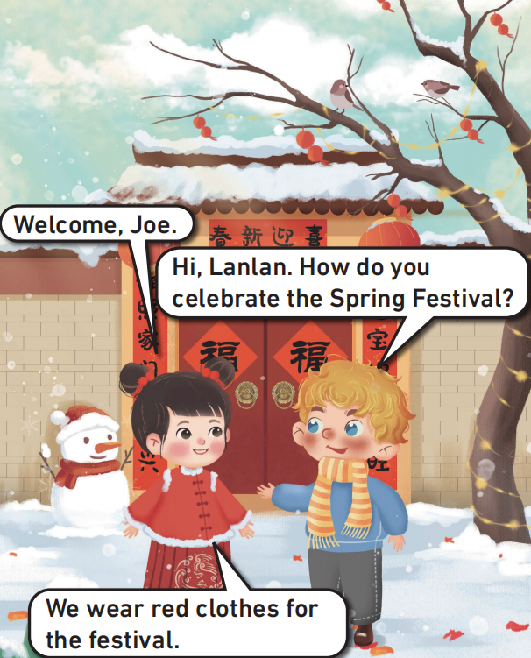
Look and guess.
What can you see in the picture ?
Who are they?
Where are they?
What festival is it?

Slide 5


Listen and check.

Slide 6
Look, read and say.
What does Joe want to know?
What does he say to Lanlan?
What does Lanlan wear? Why?
What will Lanlan say?

Slide 7
Listen, check and repeat.

Slide 8
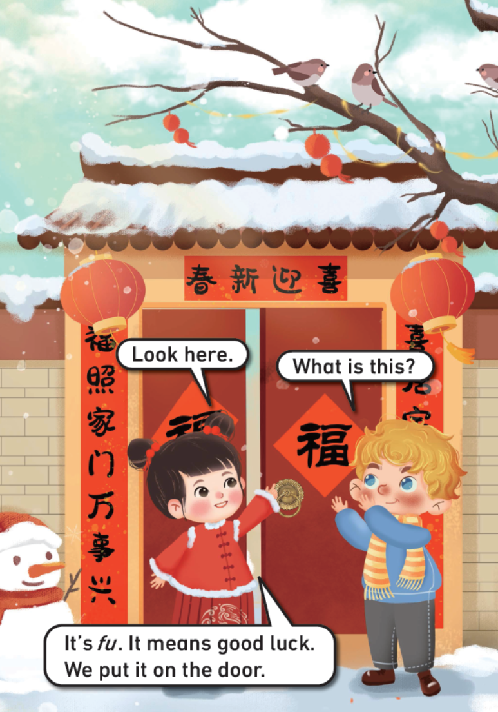
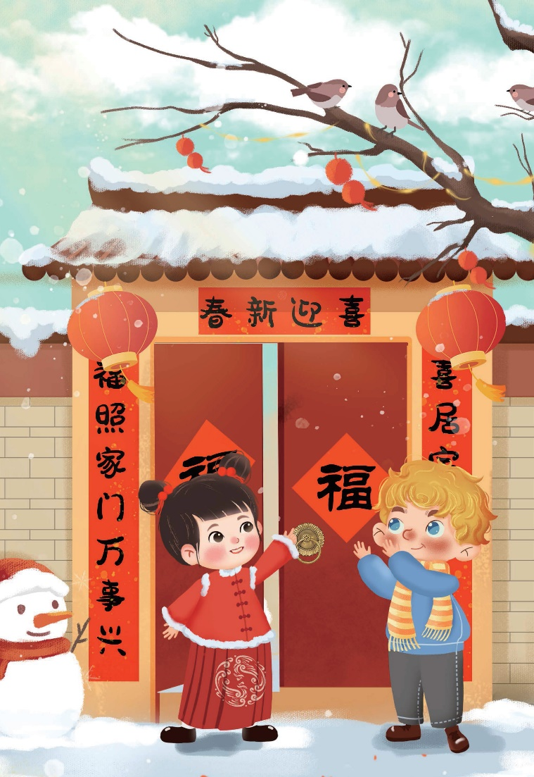
Look, listen and say.
fu
It’s __________.
on the door
It’s __________.
What does it mean?
It means good luck.
What will Lanlan and Joe say?

Slide 9
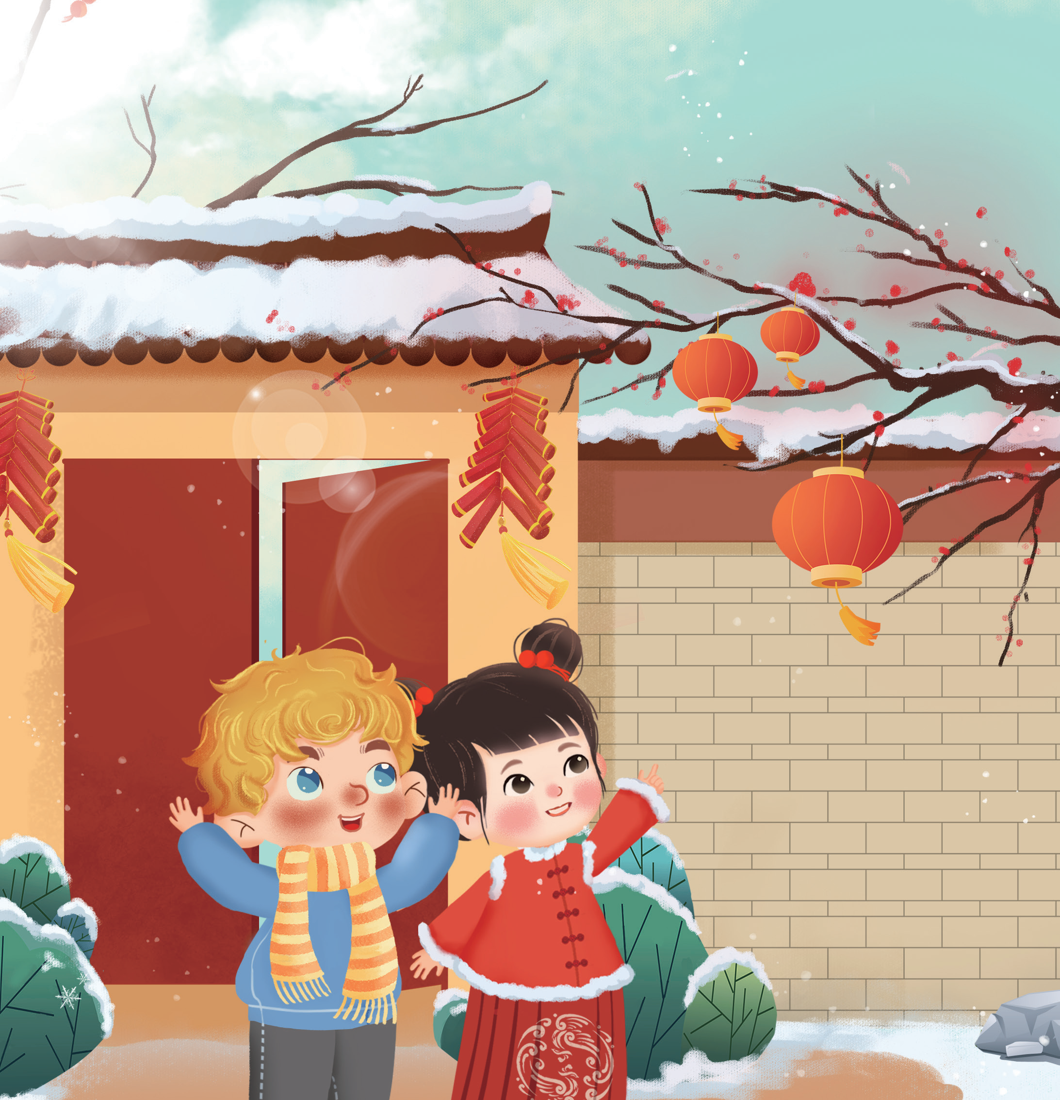
Look and say.
What are they looking at?
How does Joe feel?
What will he say?

Slide 10
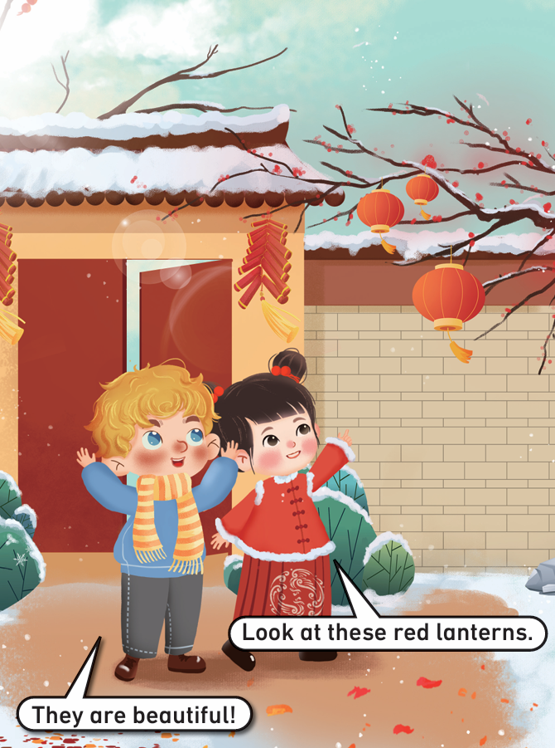
Listen, check and repeat.

Slide 11
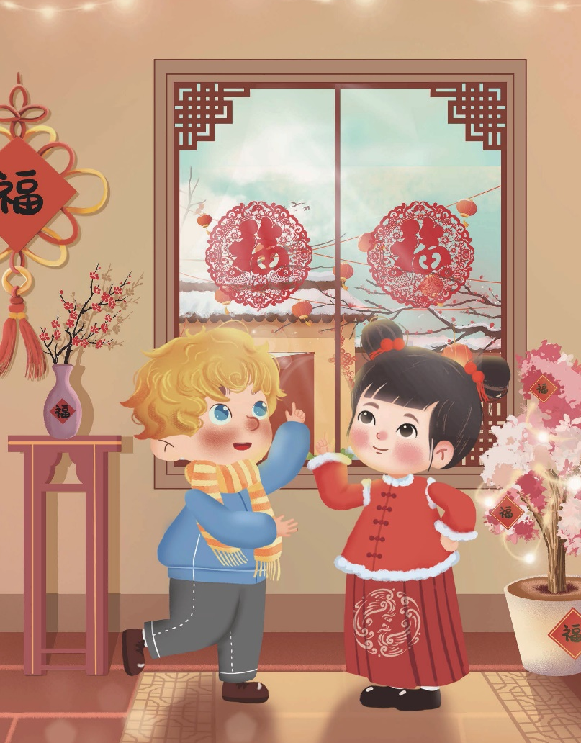
Look, listen and say.
What are they looking at?
How does Joe feel?
What will he say?

Slide 12
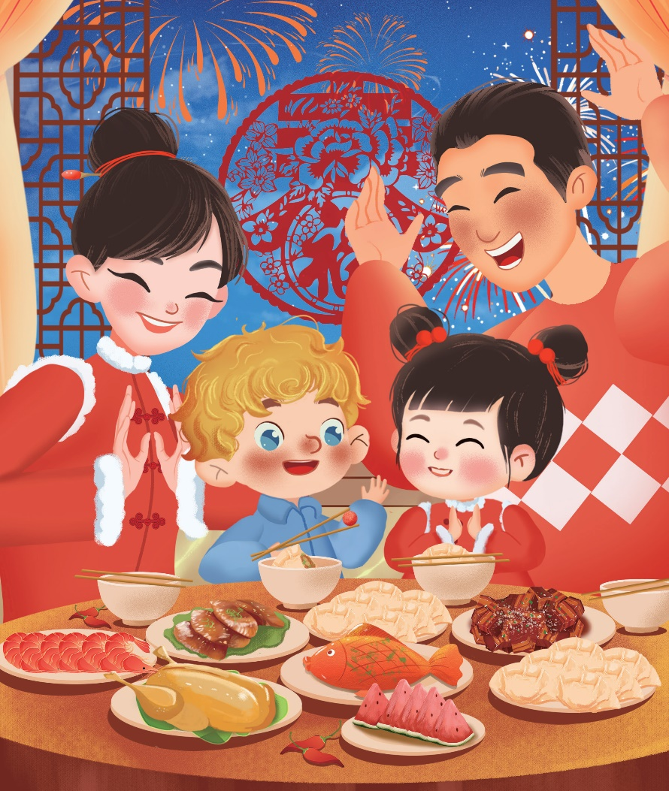
Look and say.
Who are Lanlan and Joe with?
What are they doing?
What is this?
What does it mean?

Slide 13
Listen, check and repeat.
Joe, come and have some jiaozi.
Oh. What is this? A red candy.
It’s ___________.
good luck
lucky jiaozi
It means _________ for the new year!

Slide 14
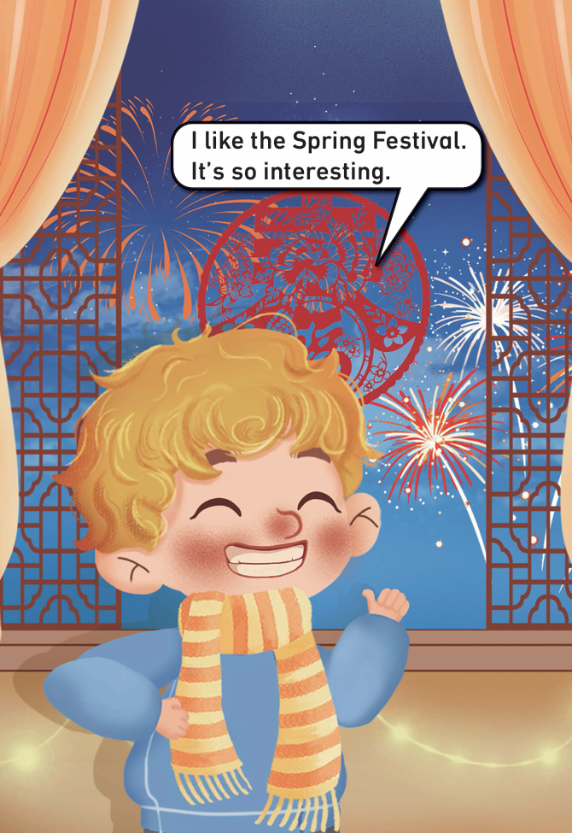
Look and say.
We
How does Joe feel?
Does he have a good time?
What will he say?

Slide 15
Listen, check and repeat.

Slide 16
Watch the video and repeat.
此处教师可插入教材第46—51页故事的视频。

Slide 17
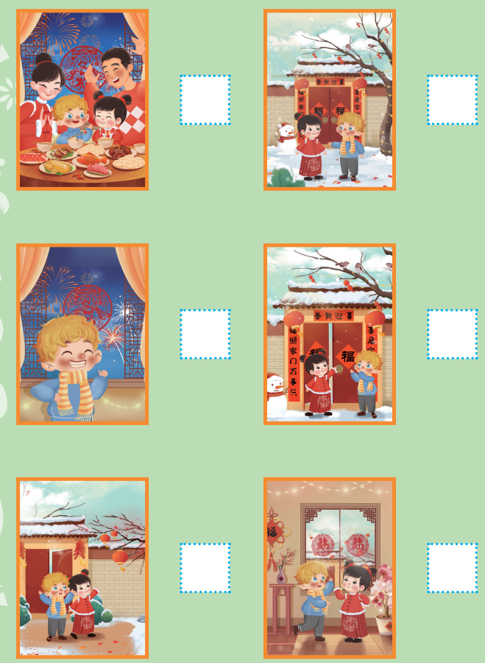
Read and number.
5
1
6
2
3
4

Slide 18
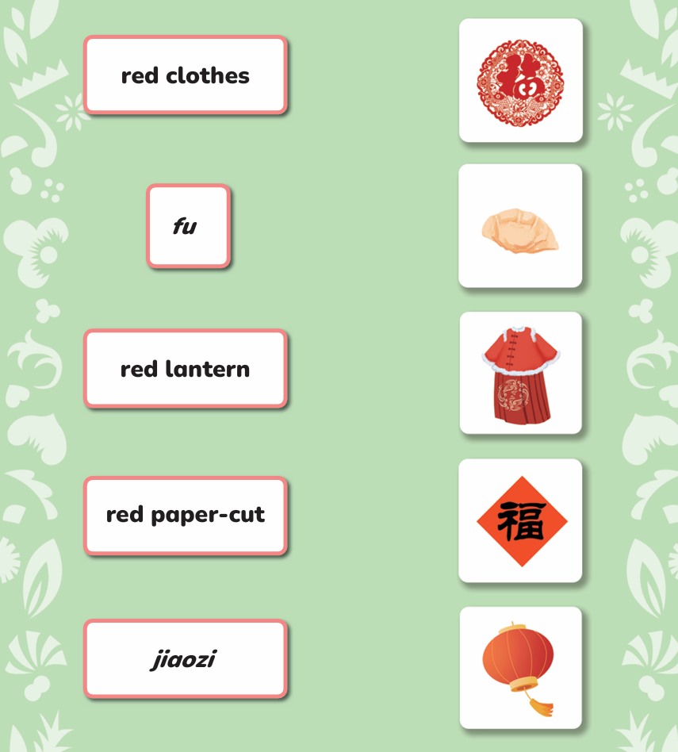
Listen, read and match.

Slide 19

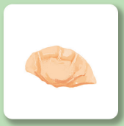
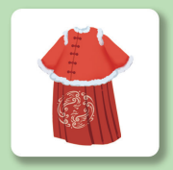


Look and say.
It’s… / They are…
We wear red clothes.
We eat jiaozi.
…

Slide 20

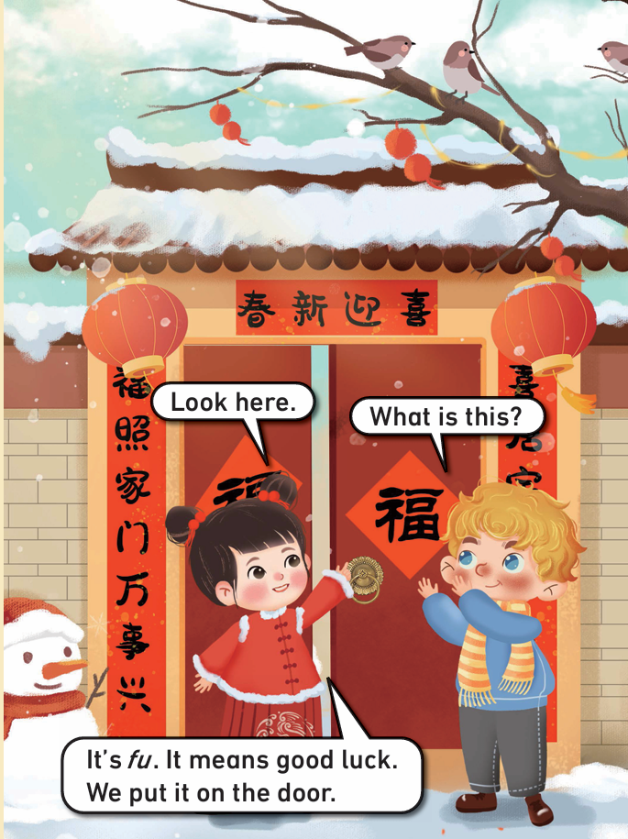
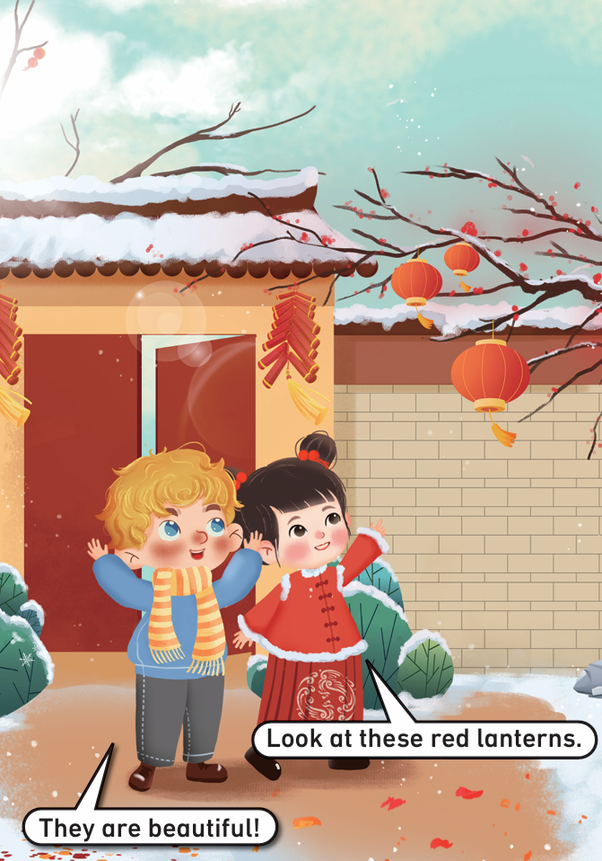
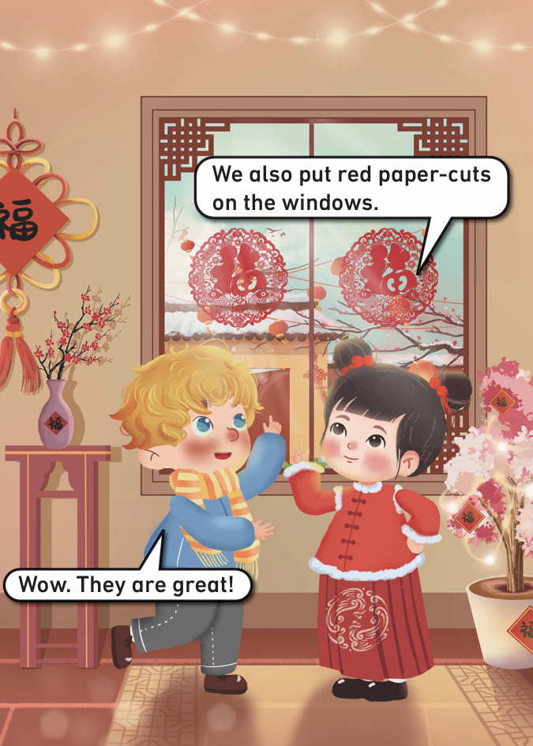
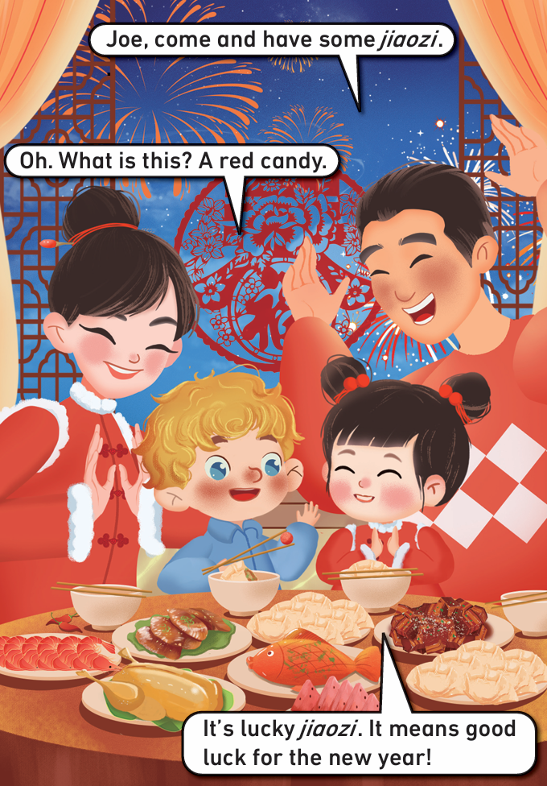

Read the story aloud.

Slide 21
Work in groups. Act out the story.
I can speak correctly. | 
I can act with emotions. | 
I like my acting. | 
I like acting with my friends. | 

Slide 22
Homework
带感情地朗读故事。
用英语向朋友或家人介绍所学的春节习俗，并尝试介绍自己了解的其他习俗。

Slide 23

Unit 5 Festival
Period 2 Let’s read!
制作单位：外语教学与研究出版社

