Slide 1
Unit 4 Food
Period 1 Let’s chant! & Let’s practise.
册 次：二年级上册 学 科：英语（外研社版）
主讲人：邓上燕 学 校：成都市崇州市辰居小学校

Slide 2
通过本课时学习，学生能够：
理解韵文内容，掌握韵文中与食物相关的单词apple、banana、milk，初步掌握表达个人喜好的核心句型“I like…”。
熟练朗读韵文，并与同伴合作表演韵文。
运用核心句型表达自己的饮食喜好。

Slide 3
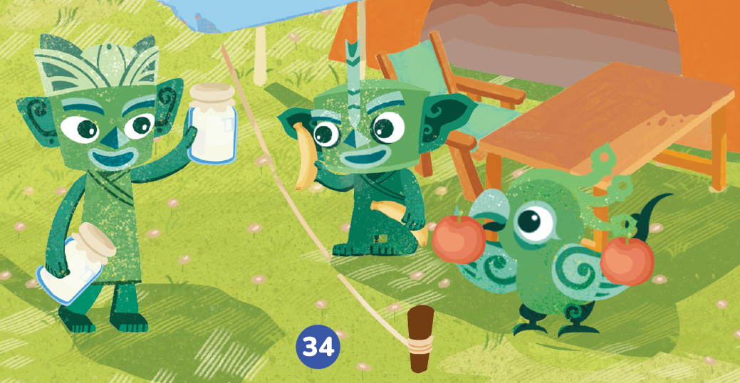
Look and say.
Who are they?
What are they talking about?
Qingqing
Tongtong
Feifei

Slide 4
Watch the video and check.
What food do they like?
此处教师可插入教材第34页韵文的视频。

Slide 5
Look and say.
What are in Feifei’s hands?
Apples.
What does Feifei like?
What will Feifei say?
Feifei

Slide 6

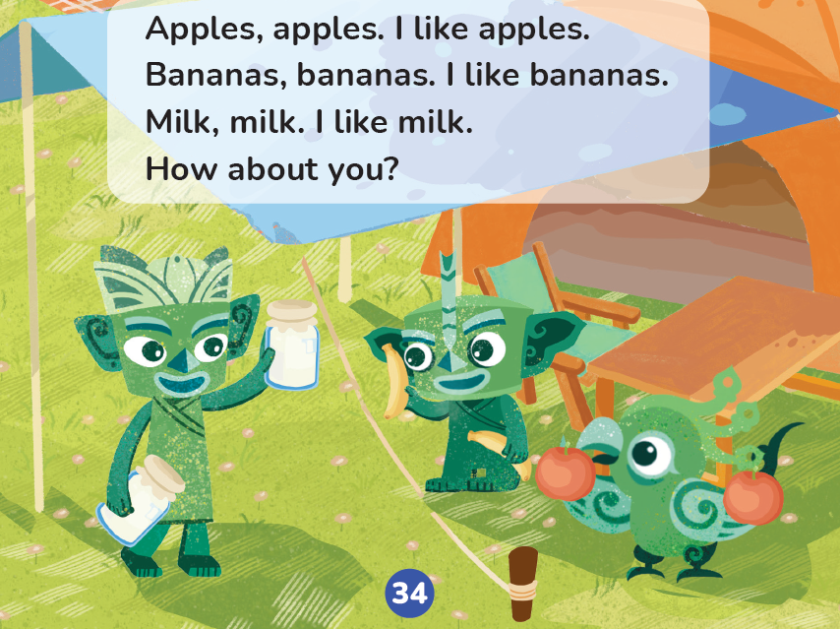


Listen, check and repeat.
Apples, apples. I like apples.
What does Feifei like?
Apples.
apple
What will Feifei say?
apples
Apples, apples. I like apples.
Feifei

Slide 7
Look and say.
What are in Qingqing’s hands?
Bananas.
What does Qingqing like?
Qingqing
What will Qingqing say?

Slide 8

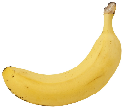
Listen, check and repeat.
Bananas, bananas. I like bananas.
What does Qingqing like?
Bananas.
banana
What will Qingqing say?
bananas
Bananas, bananas. I like bananas.
Qingqing

Slide 9
Look and say.
What is in Tongtong’s hands?
Milk.
What does Tongtong like?
What will Tongtong say?
Tongtong

Slide 10

Listen, check and repeat.
What does Tongtong like?
Milk, milk. I like milk.
Milk.
milk
What will Tongtong say?
milk
Milk, milk. I like milk.
Tongtong

Slide 11
Listen and repeat.
I like
Apples, apples. I like apples.
I like
Bananas, bananas. I like bananas.
Milk, milk. I like milk.
I like
I like…
Qingqing
Tongtong
Feifei

Slide 12
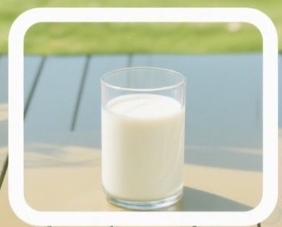
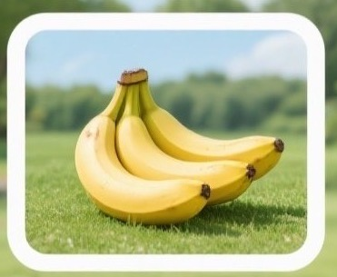
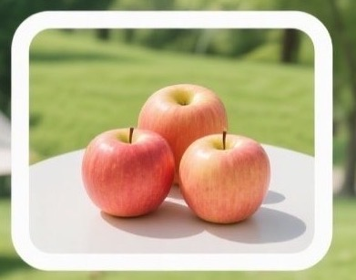
Look, listen and match.
1. Apples, apples. I like apples.
2. Milk, milk. I like milk.
3. Bananas, bananas. I like bananas.

Slide 13
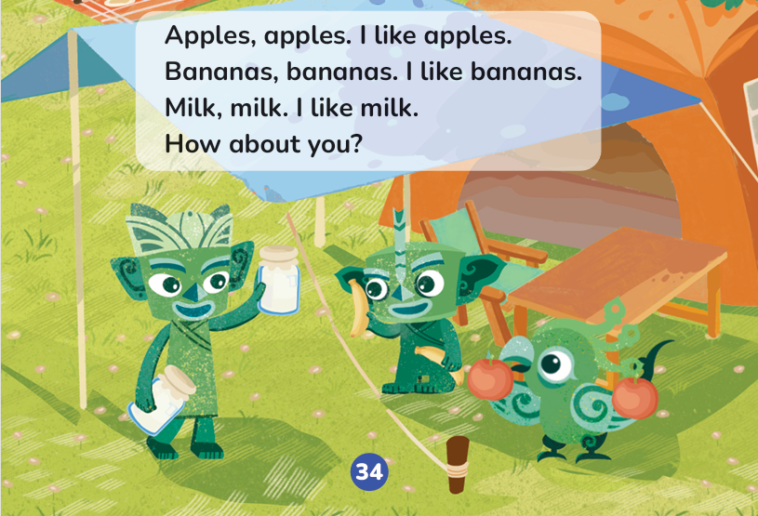

Listen and repeat.
How about you?

Slide 14
Watch the video and chant.
此处教师可插入教材第34页韵文的视频。

Slide 15
Listen and chant.

Slide 16
Chant together.

Slide 17
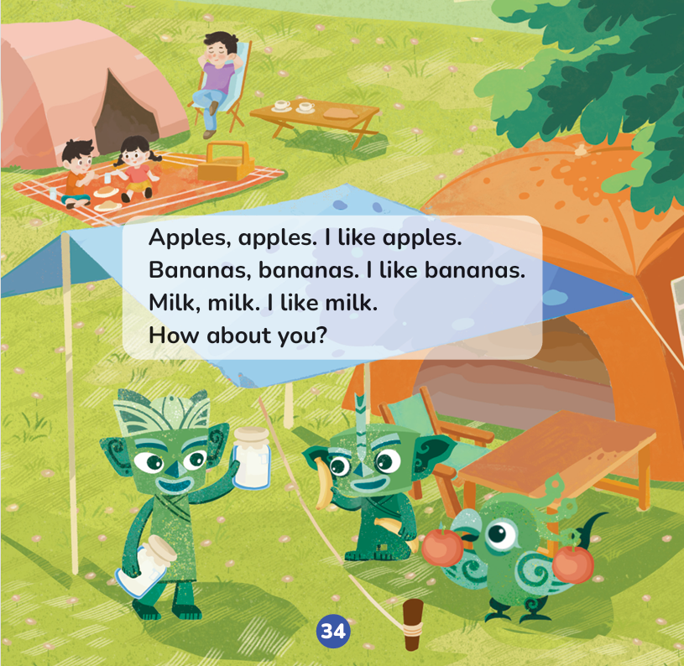
Work in groups. Chant and act.
I can:
□chant correctly.
□chant with emotions and actions.
□chant with my friends.

Slide 18
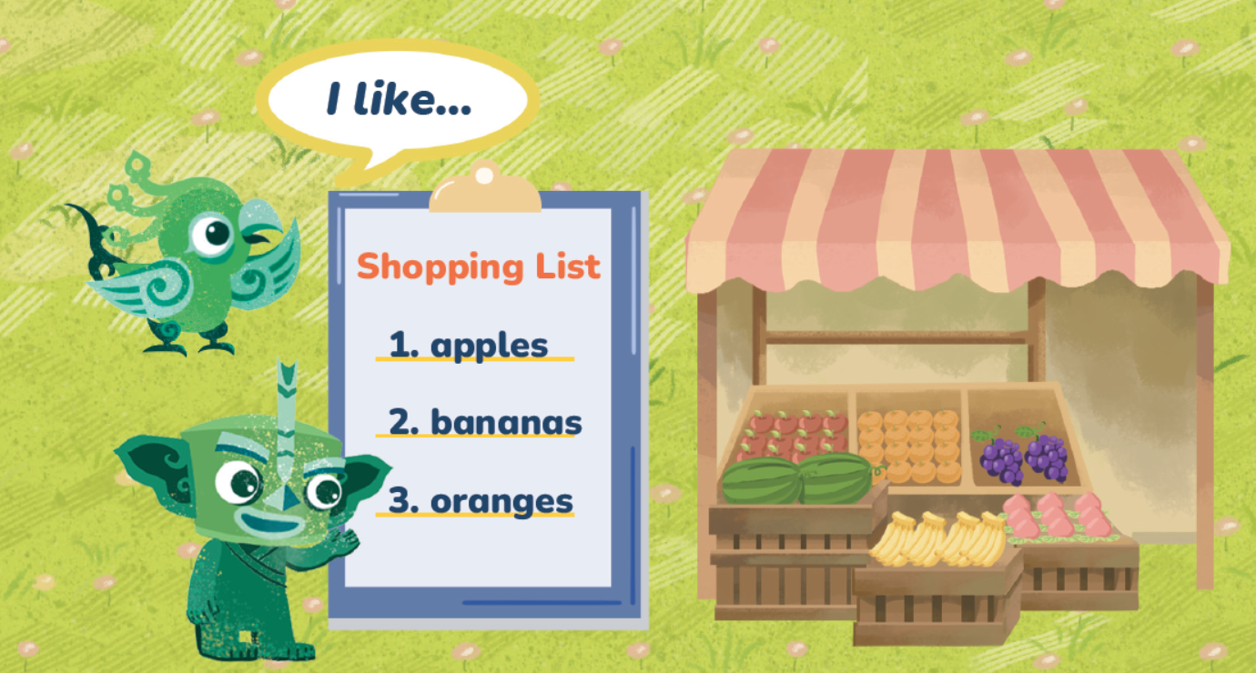
Look and say.
?
购物清单

Slide 19
Look and say.
?
?
购物清单
apples
oranges
grapes
peaches
watermelons
bananas

Slide 20
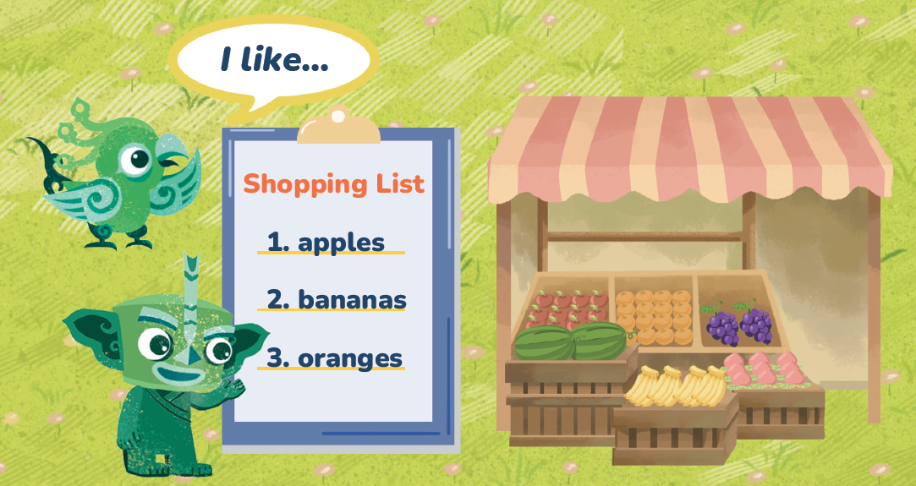
Let’s practise.
?
购物清单
apples
oranges
grapes
peaches
watermelons
bananas

Slide 21
Homework
带感情地朗读韵文。
仿照教材第42页活动5，设计一份购物清单，并运用“I like…”向同学或朋友介绍自己喜欢的食物。

Slide 22

Unit 4 Food
Period 1 Let’s chant! & Let’s practise.
制作单位：外语教学与研究出版社

