Slide 1


Unit 4 Food
Period 2 Let’s read!
册 次：二年级上册 学 科：英语（外研社版）
主讲人：齐芮欣 学 校：成都市崇州市城北学校

Slide 2


国家中小学课程资源
通过本课时学习，学生能够：
在看图片、听录音、朗读课文等活动中，理解故事内容。
掌握并灵活运用与食物相关的词汇和表达个人喜好的核心句型“I like...”。
小组合作表演故事，模仿故事角色的语音、语调、表情和动作，深入体会故事角色的情感，感受分享食物的乐趣。

Slide 3
国家中小学课程资源
Let’s chant.
此处教师可插入教材第34页韵文的视频。

Slide 4


国家中小学课程资源
Look and say. Then listen and check.
What can you see?
Where are they?
What are they doing?
What day is it? Is it a school day?

Slide 5

国家中小学课程资源
Look and say.
What food do they have?

Slide 6
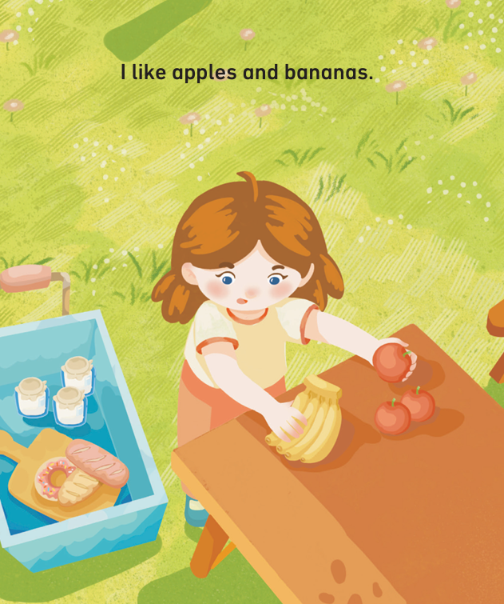
国家中小学课程资源
Look, listen and say.
apples
bananas

Slide 7
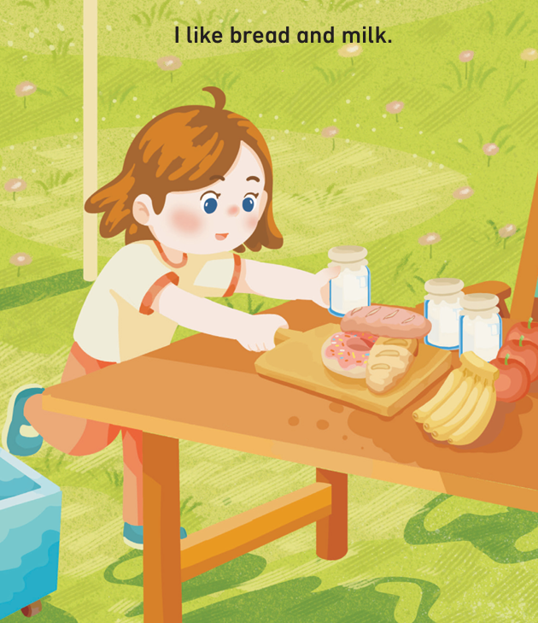
国家中小学课程资源
Look, listen and say.
milk
bread
ea

Slide 8
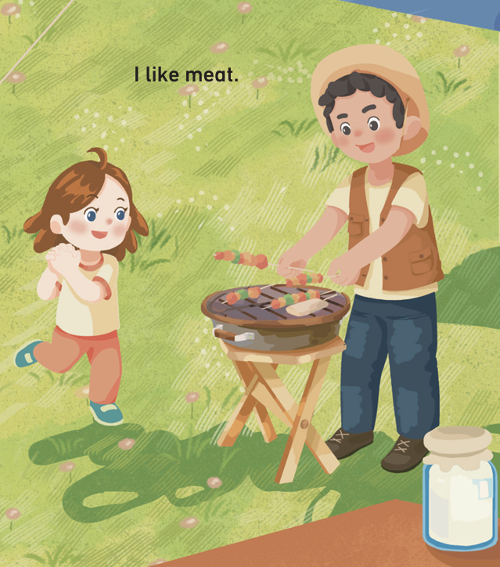
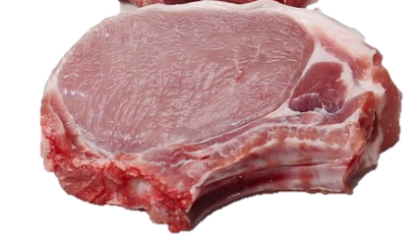
国家中小学课程资源
Look, listen and say.
meat
ea
meat

Slide 9
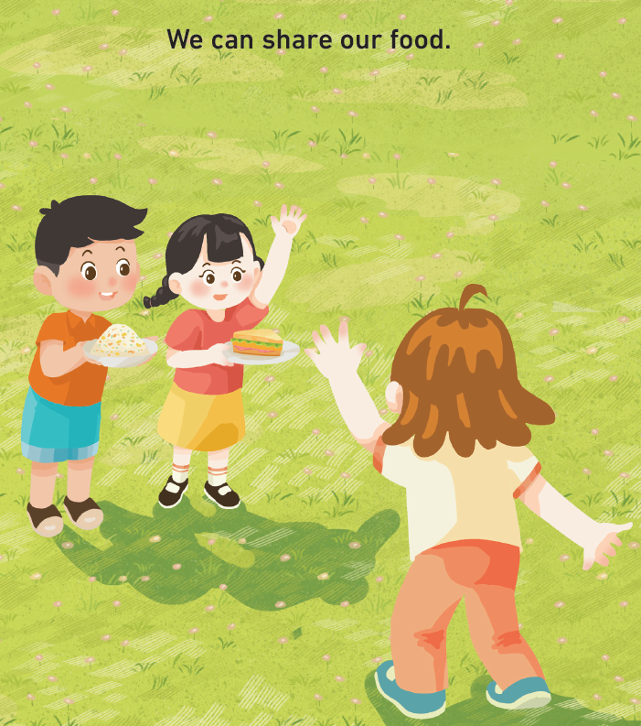
国家中小学课程资源
Look and say.
What do they have in their hands?
What will they do?
rice
sandwich
What will they say?

Slide 10
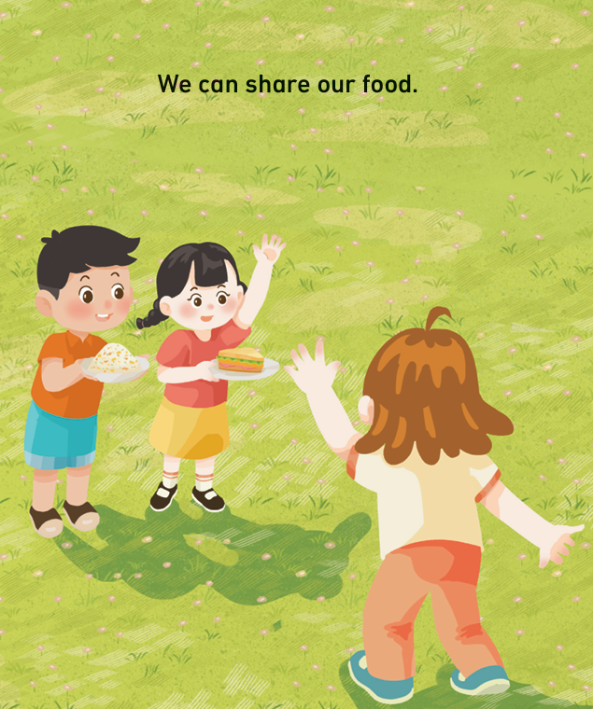


国家中小学课程资源
Listen, check and repeat.

Slide 11
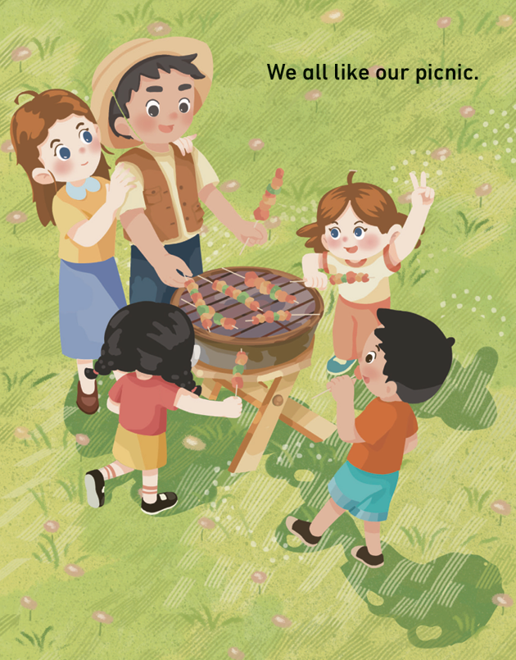
国家中小学课程资源
Look, listen and say.

Slide 12
国家中小学课程资源
Watch the video and repeat.
此处教师可插入教材第35—40页课文的视频。

Slide 13

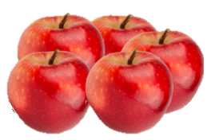


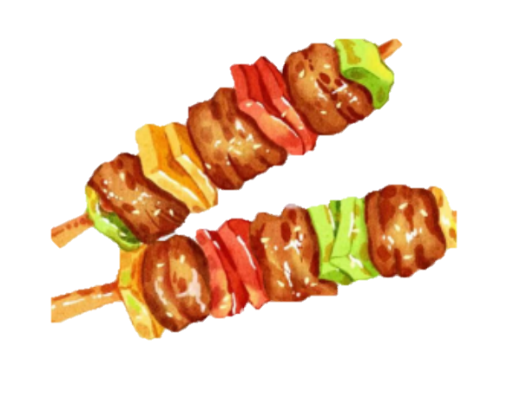
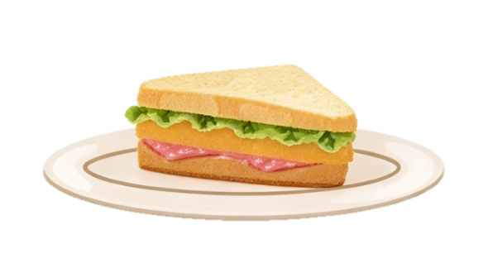
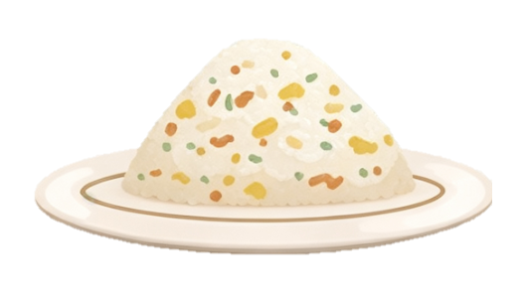
Think and say.
apples
bananas
bread
milk
meat
rice
sandwich

Slide 14
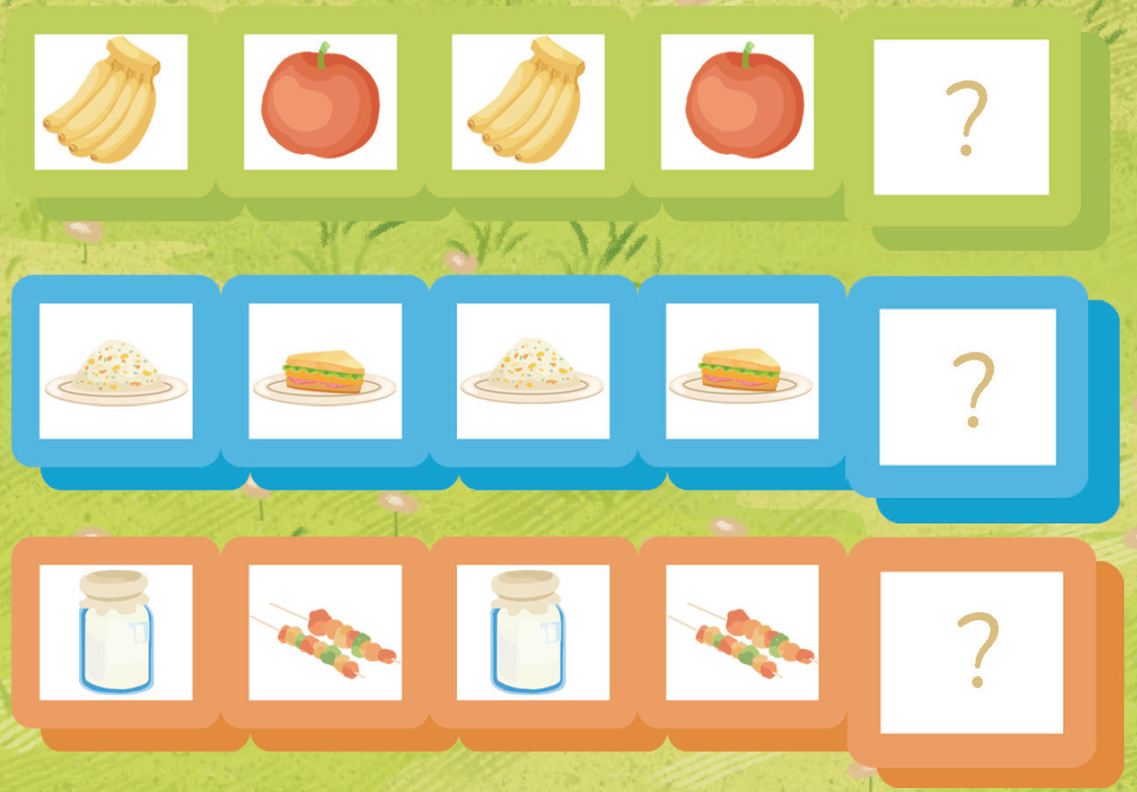



Think, draw and say.
bananas
rice
milk

Slide 15
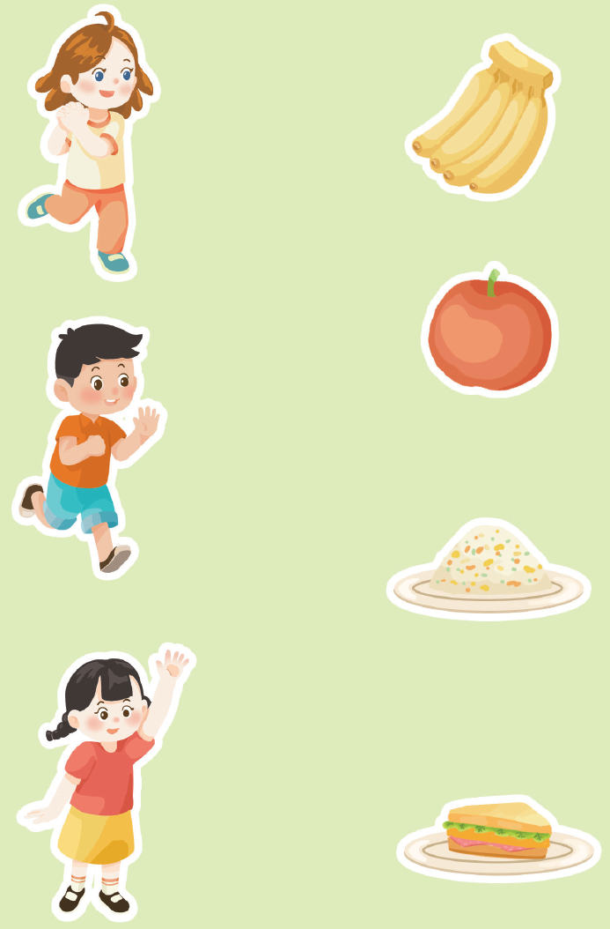

国家中小学课程资源
Match and say.
I like...
We can share our food.

Slide 16

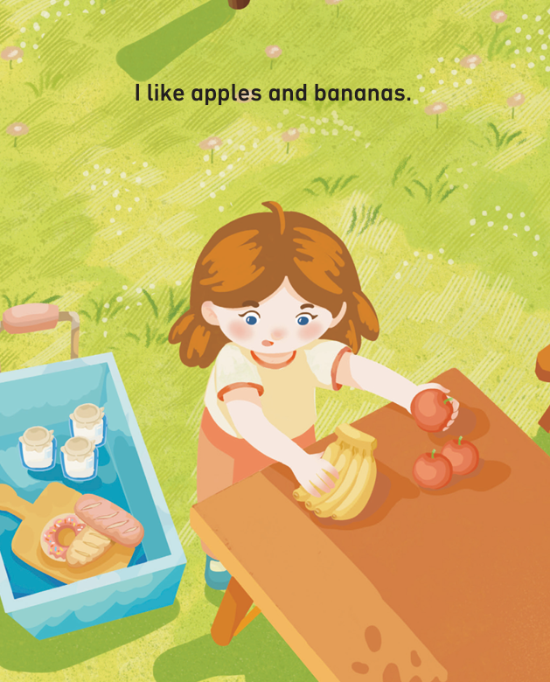
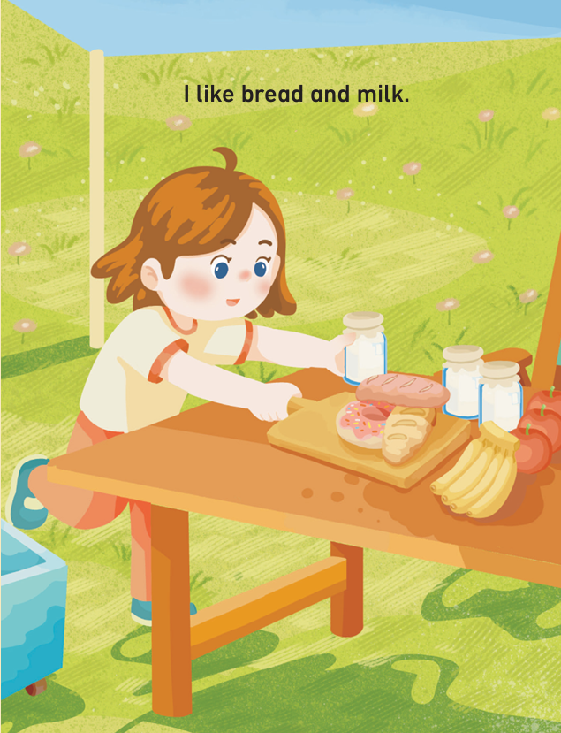
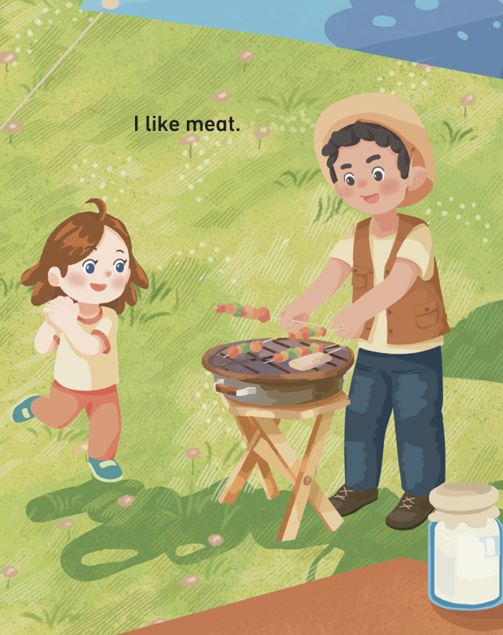
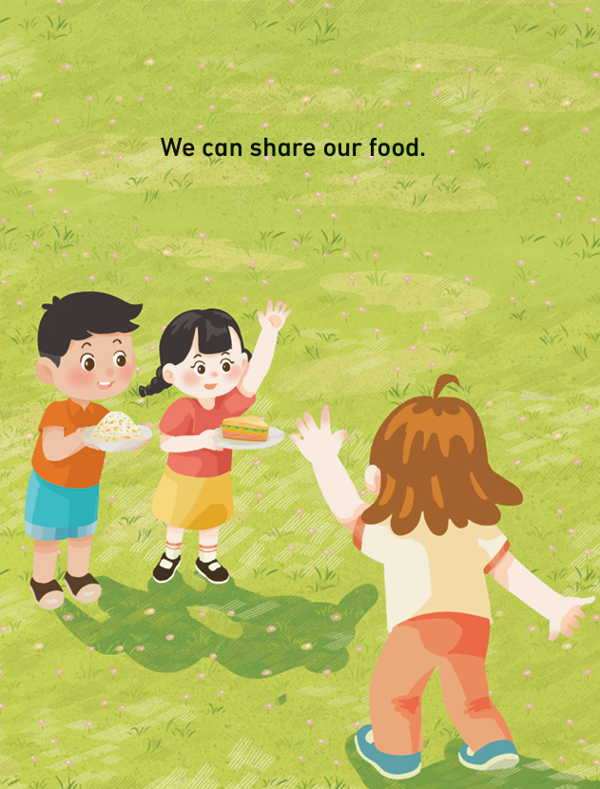
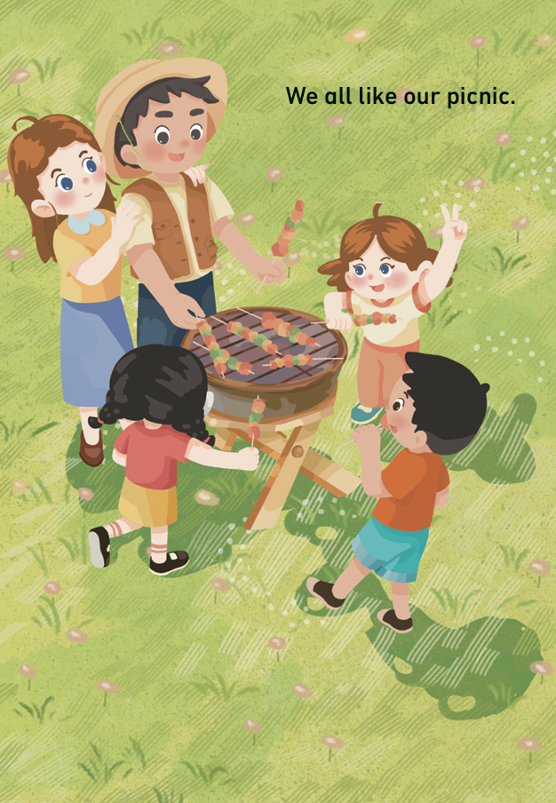
Read the story aloud.
Read correctly. | 
Read loudly. | 
Read with emotions. | 

Slide 17
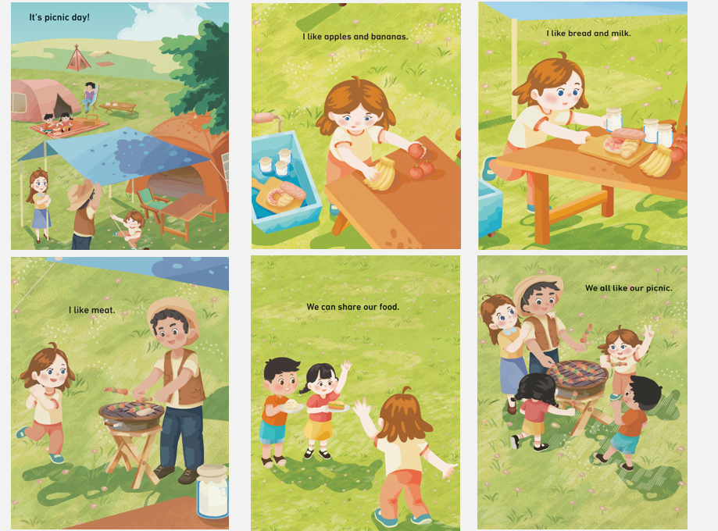
Work in groups. Act out the story.
Speak correctly. | 
Speak loudly. | 
Act with emotions. | 
Act creatively. | 

Slide 18
国家中小学课程资源
Homework
带感情地朗读故事。
根据故事图片，复述故事。

Slide 19
Unit 4 Food
Period 2 Let’s read!
制作单位：外语教学与研究出版社

