Slide 1
Unit 4 Food
Period 3 Listen, think and match. & Let’s have fun.
册 次：二年级上册 学 科：英语（外研社版）
主讲人：刘玲 学 校：成都市崇州市学府小学校

Slide 2
通过本课时学习，学生能够：
在具体情境中，与同伴围绕食物进行交流，巩固本单元核心语言。
绘制自己喜欢的食物，并运用核心语言表达自己的饮食喜好。

Slide 3

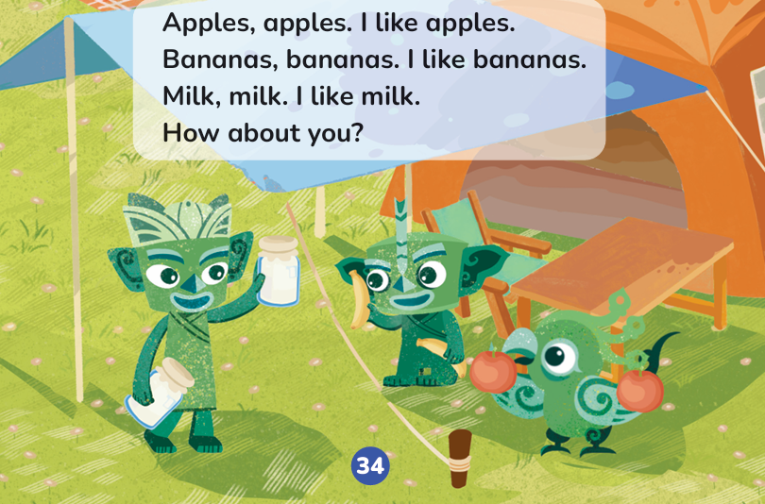
Let’s chant.

Slide 4

Look and say.
picnic
It’s day!

Slide 5
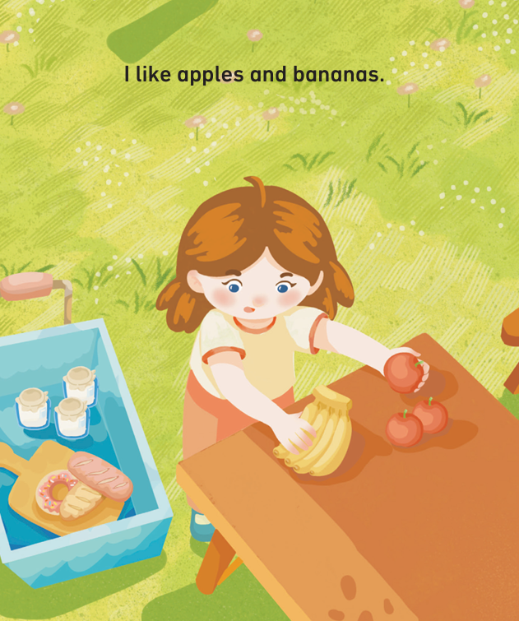


Look and say.
apples
I like ______ and ________.
bananas

Slide 6
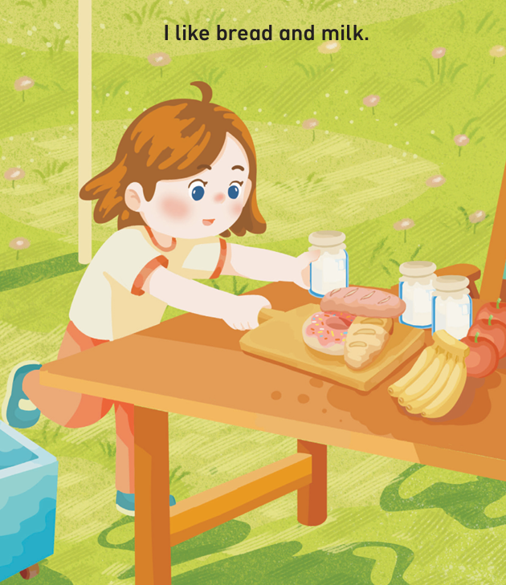


Look and say.
I like ______ and _____.
bread
milk

Slide 7
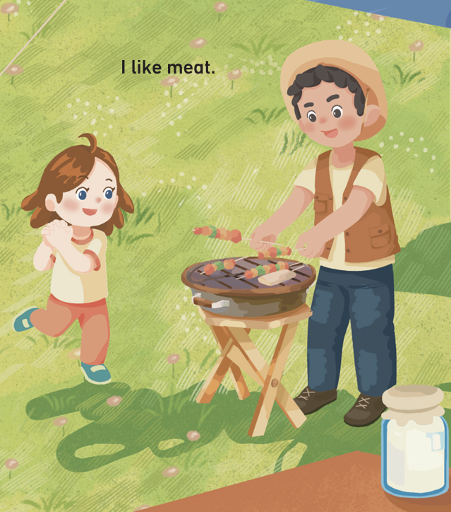
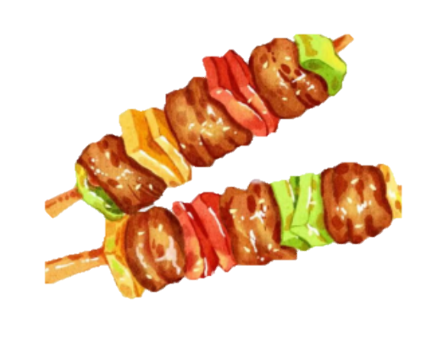
Look and say.
I like _____.
meat

Slide 8
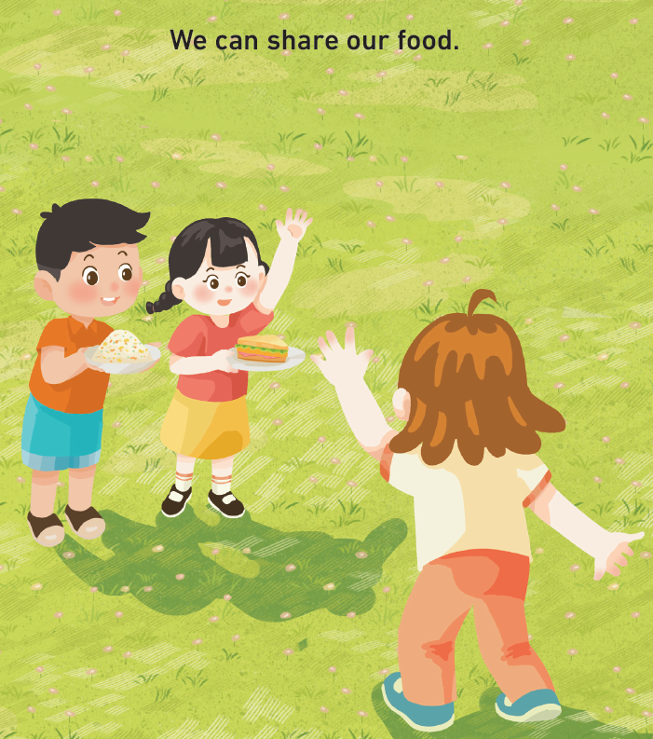
Look and say.
We can _____ our food.
share

Slide 9
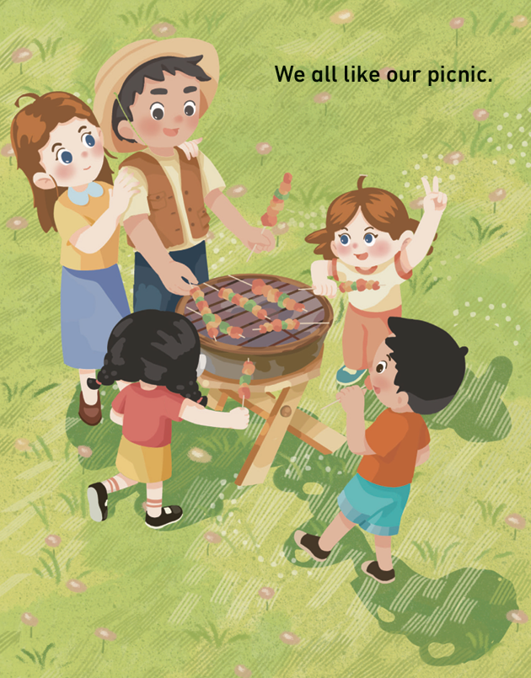
Look and say.
We ____ like our picnic.
all

Slide 10
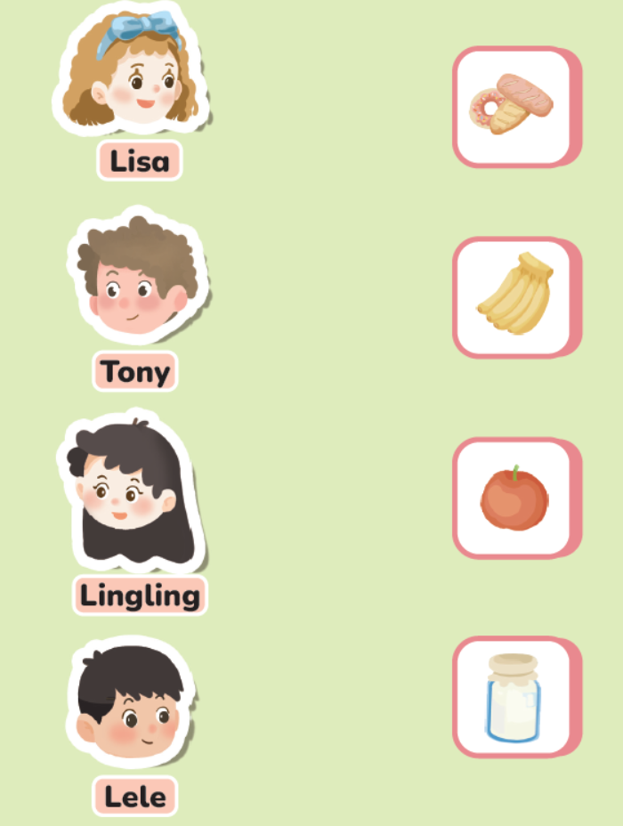

Look and say.

Slide 11
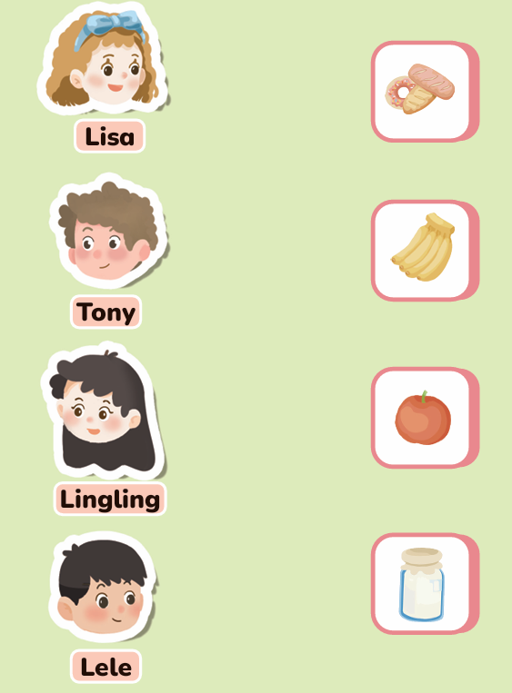
Listen and match.
listen 听一听
match 连一连

Slide 12
Look and say.
Hi! / Hello!
I’m .
I like .

Slide 13


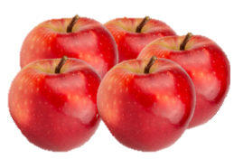
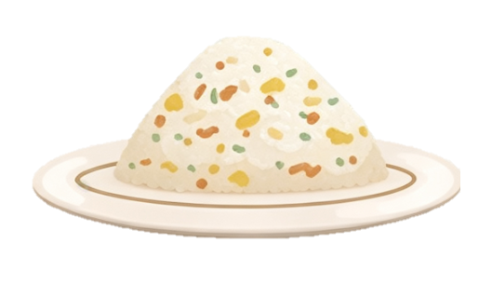
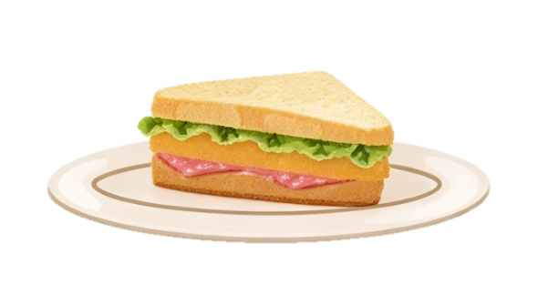


Think and draw.
What food do you like?
What food do you like?

Slide 14
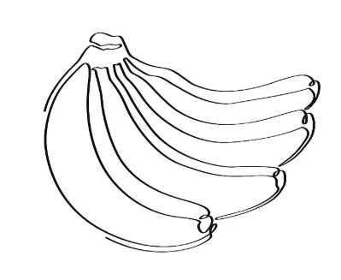
Showtime
What food do you like?
Hi! / Hello!
I’m .
I like .
Li Hao
bananas

Slide 15
Homework
朗读本单元第一课时的韵文和第二课时的课文。
向同学、朋友介绍自己喜欢的食物。

Slide 16

Unit 4 Food
Period 3 Listen, think and match. & Let’s have fun.
制作单位：外语教学与研究出版社

