Slide 1
Unit 3 Animals
Period 1 Let’s chant!
册 次：二年级上册 学 科：英语（外研社版）
主讲人：漆艳萍 学 校：成都七中八一学校

Slide 2
通过本课时学习，学生能够：
理解韵文内容，掌握韵文中与动物相关的词汇以及祈使句“Let’s go to the zoo.”。
熟练朗读韵文，并与同伴合作表演韵文。

Slide 3
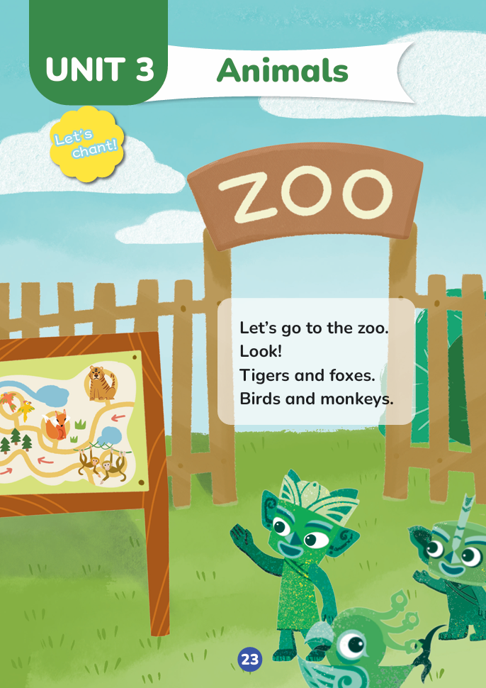
Look, guess and say.
Who are they?
Qingqing, Tongtong and Feifei.
Where are they?

Slide 4
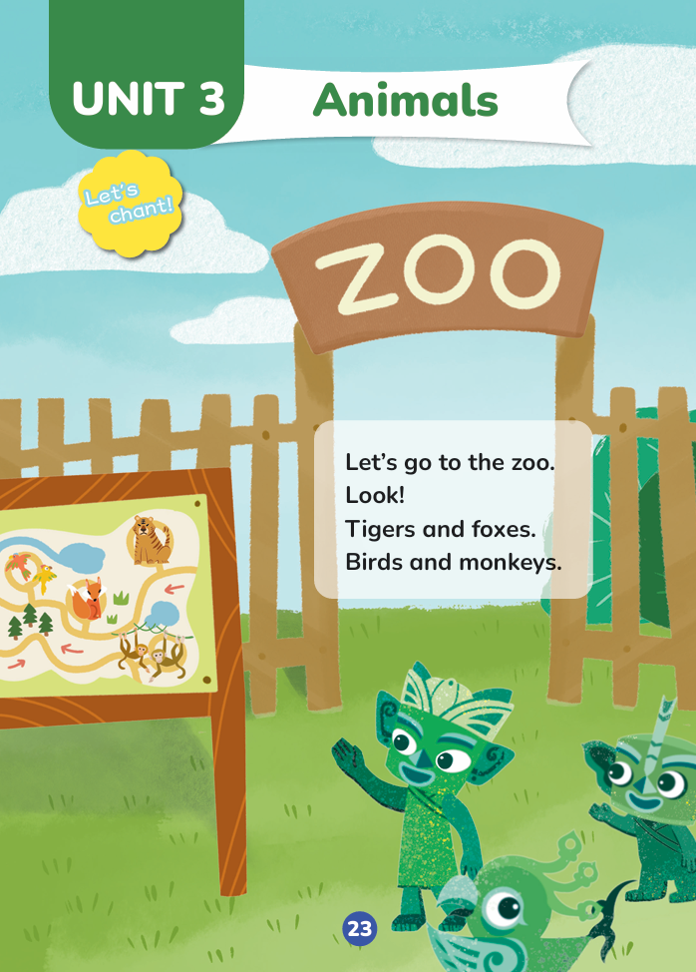

Listen, read and check.
Where are they?
They are at the zoo.

Slide 5
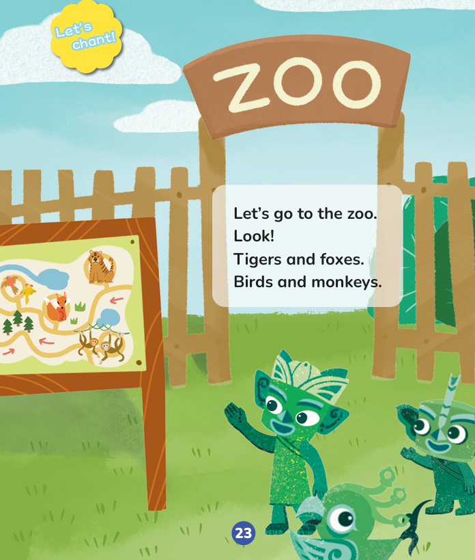
Listen and repeat.

Slide 6
Look and say.
What are they looking at?
map

Slide 7
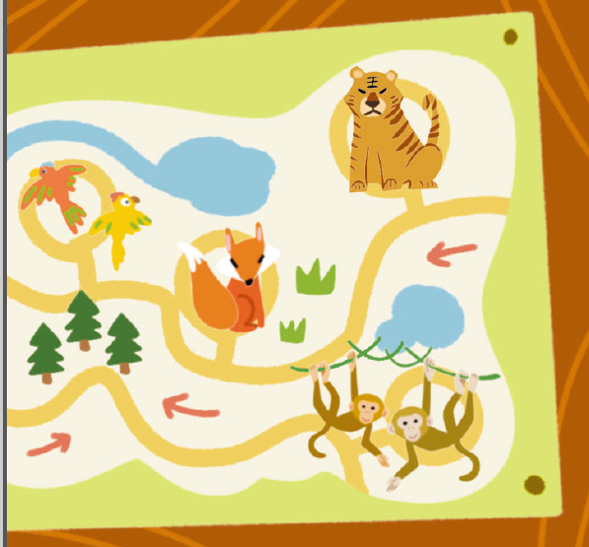
Look and say.
What animals can you see on the map?
A tiger, a fox, two birds and two monkeys.

Slide 8


Look and say.
a tiger
tigers

Slide 9

Look and say.
a fox
a bird
a monkey
foxes
birds
monkeys

Slide 10
Listen and repeat.

Slide 11
Watch the video and chant.
此处教师可插入教材第23页韵文的视频。

Slide 12
Listen and chant.

Slide 13
Chant together.

Slide 14
Work in groups. Chant and act.
I can:
□chant correctly.
□chant with emotions and actions.
□chant with my friends.

Slide 15
Homework
带感情地朗读韵文。
仿照本课时学习的韵文，自主创编一个新的韵文，下节课在全班进行展示。（可选做）

Slide 16

Unit 3 Animals
Period 1 Let’s chant!
制作单位：外语教学与研究出版社

