Slide 1
Unit 3 Animals
Period 2 Let’s read!
册 次：二年级上册 学 科：英语（外研社版）
主讲人：毛珊 学 校：成都市石笋街小学校

Slide 2
通过本课时学习，学生能够：
在看图片、听录音、朗读课文等活动中，梳理、理解故事内容，掌握表示请求的祈使句。
掌握并灵活运用动物词汇。
小组合作表演故事，模仿故事角色的语音、语调、表情和动作，深入体会故事角色的情感，感悟、理解故事传递的道理。

Slide 3
Let’s chant.
此处教师可插入教材第23页韵文的视频。

Slide 4
Look and say.
What are they?
A tiger and a fox.
Where are they?
Maybe in a forest.

Slide 5
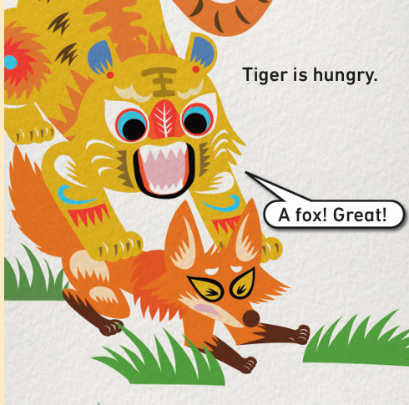

Listen, read and answer.
How does Tiger feel?
Tiger is hungry.
What does Tiger say?
“A fox! Great!”
What does Tiger want to do?
Tiger wants to eat Fox.
What do you think Fox will do? Will Fox run away?

Slide 6
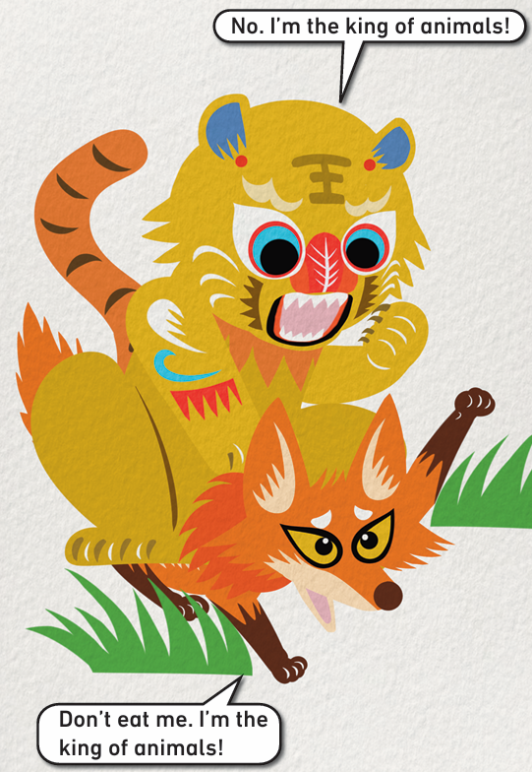
Listen, read and answer.
Does Fox run away?
No.
What does Fox say?
“Don’t eat me. I’m the king of animals!”
What does Tiger say?
“No. I’m the king of animals!”
Does Tiger believe Fox?
No.

Slide 7
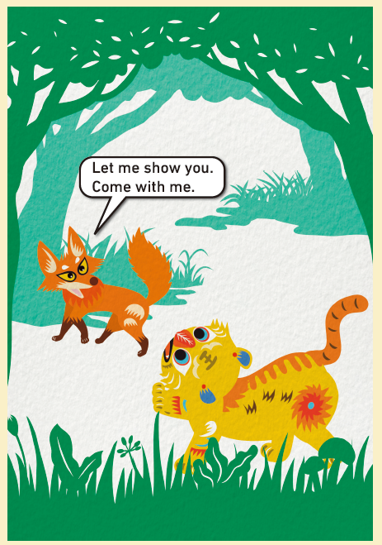
Listen, read and answer.
What does Fox say then?
“Let me show you. Come with me.”

Slide 8
What do you think will happen next?

Slide 9
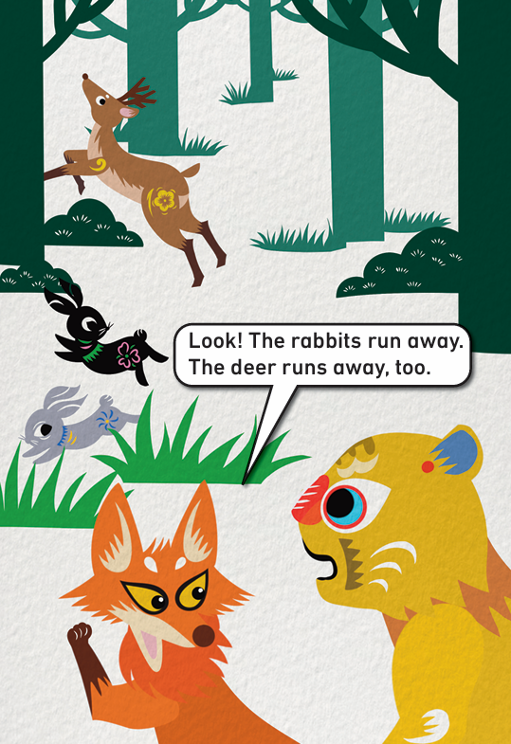
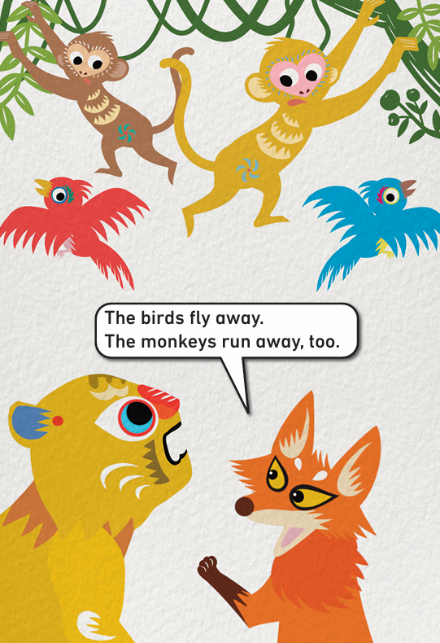
Listen, read and answer.
What animals do they meet?
The rabbits, the deer, the birds and the monkeys.
How do the animals feel?
They are afraid / scared (害怕的) / ...
What do the animals do?
They run away or fly away.

Slide 10
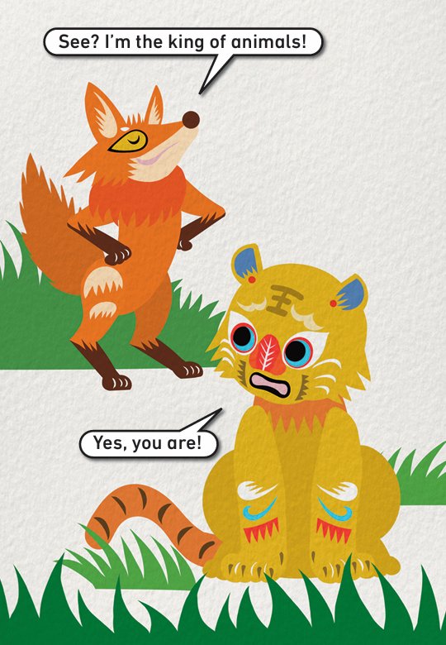
Listen, read and answer.
Does Tiger believe Fox now?
Yes.
How does Fox feel?
Fox is happy / proud (得意的) / ...
How does Tiger feel?
Tiger is unhappy / confused (困惑的) / ...

Slide 11
Watch the video and repeat.
此处教师可插入教材第24—29页课文的视频。

Slide 12
Think and answer.
Why do the animals run away or fly away?
They are afraid.
Who are the animals truly afraid of?
Tiger.
Who is the real king of animals?
Tiger.
What can you learn from the story?

Slide 13
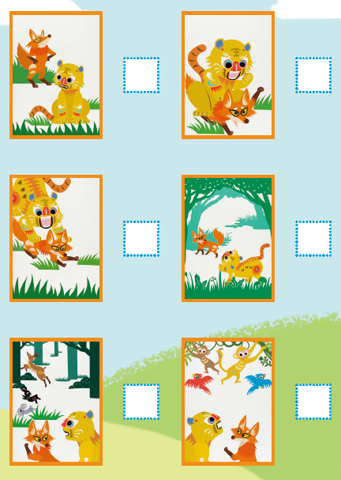
Read and number.
6
2
1
3
4
5

Slide 14
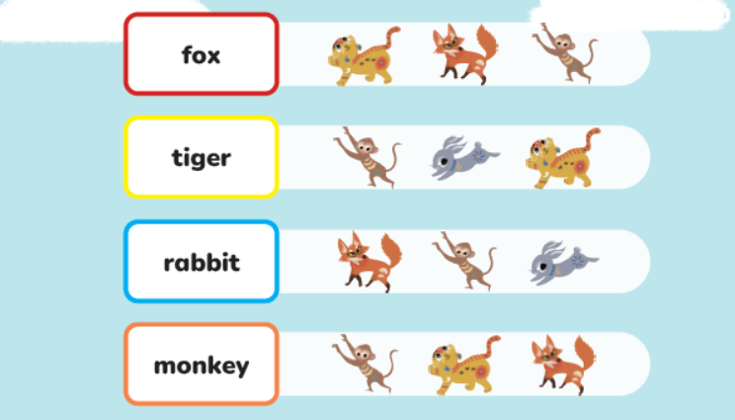
Listen, read and circle.

Slide 15
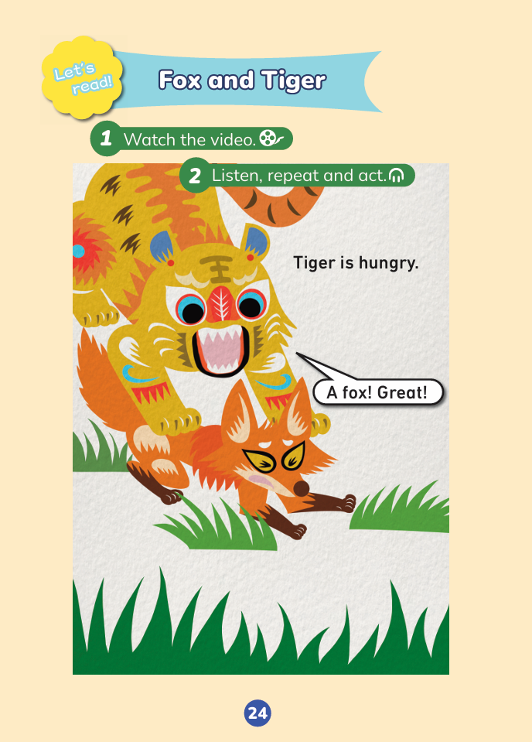
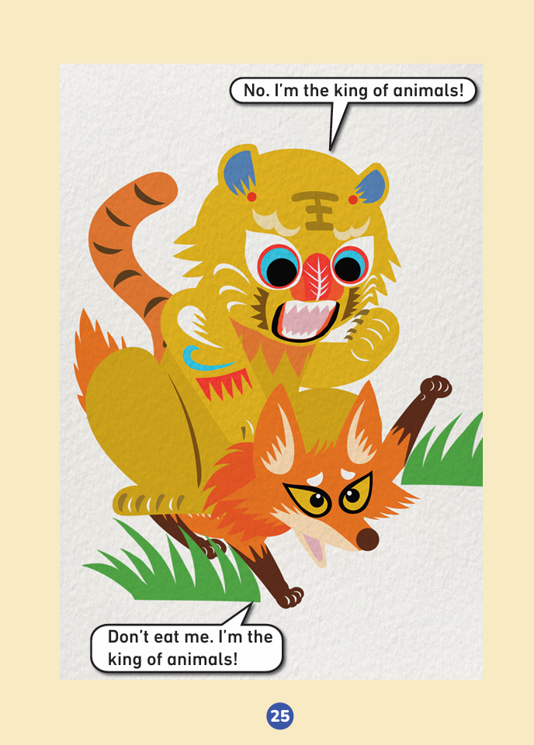
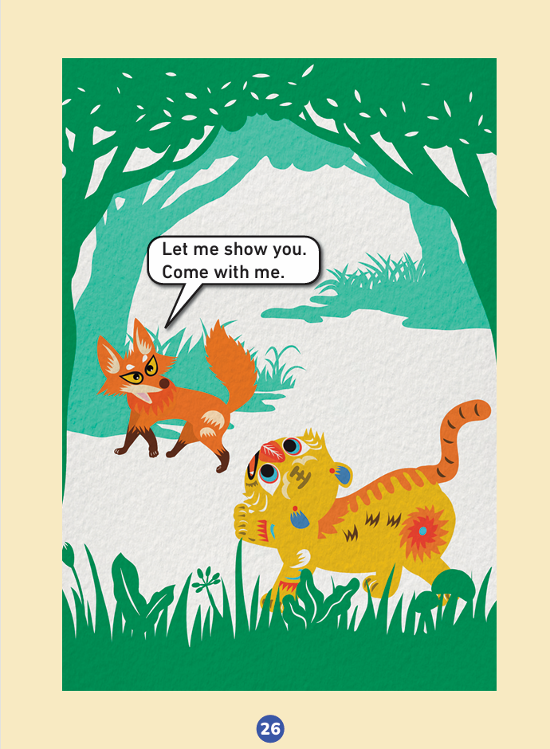
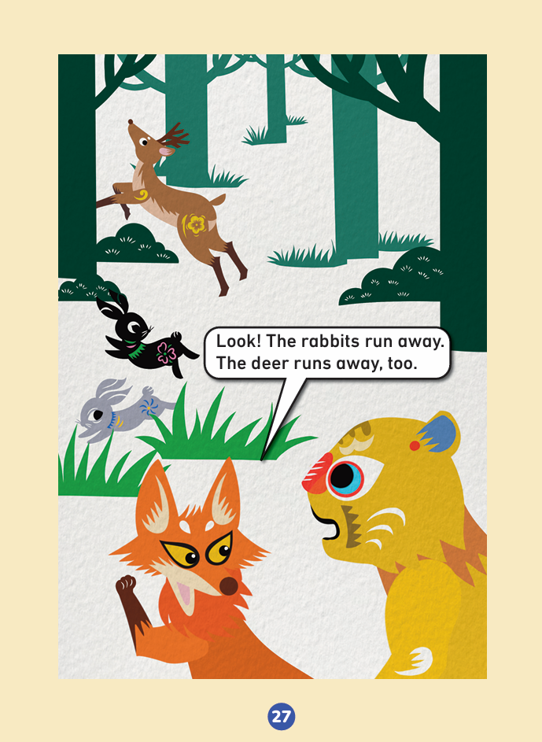
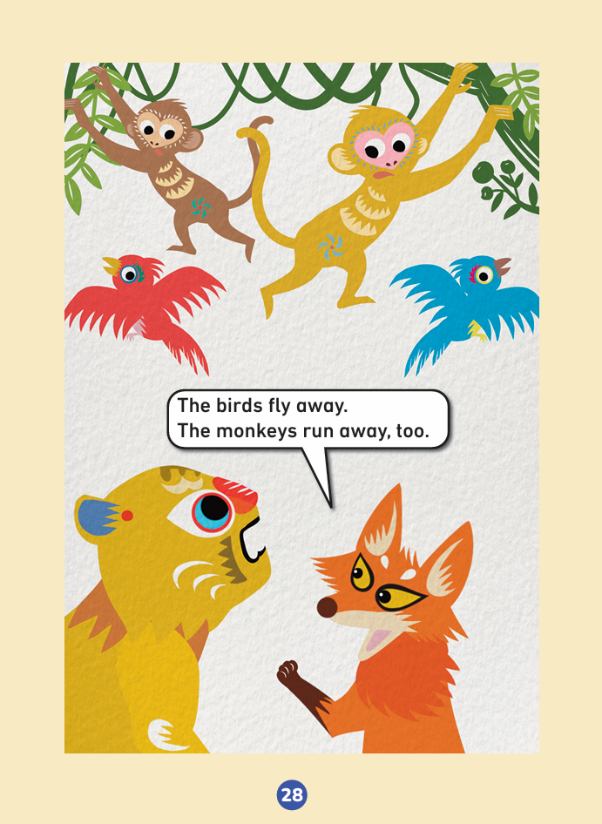
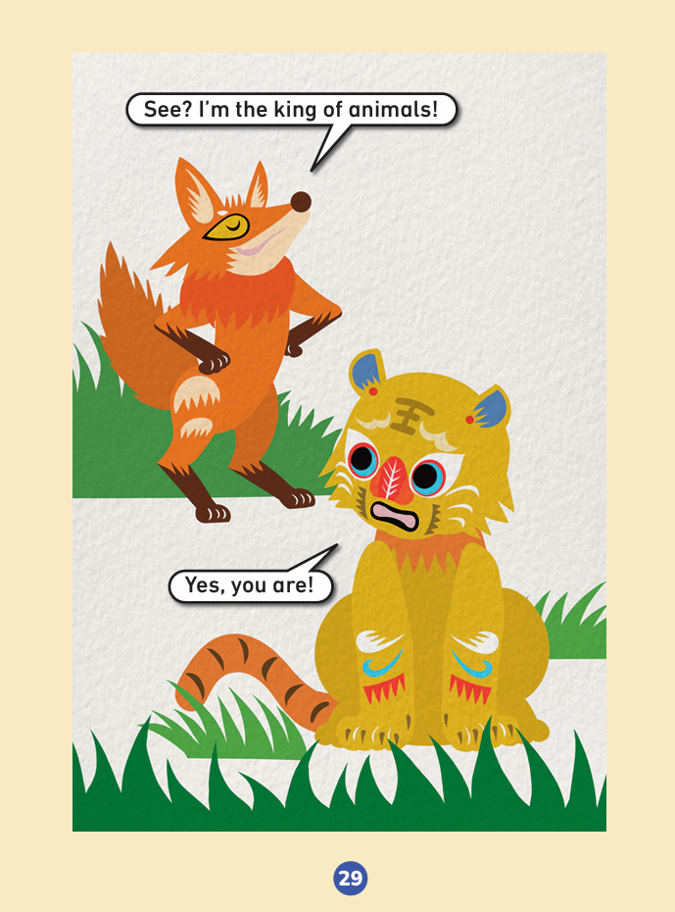
Read the story aloud.

Slide 16
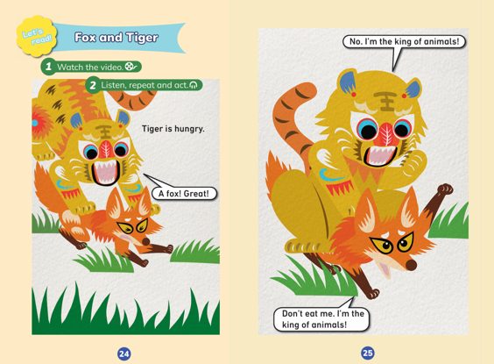
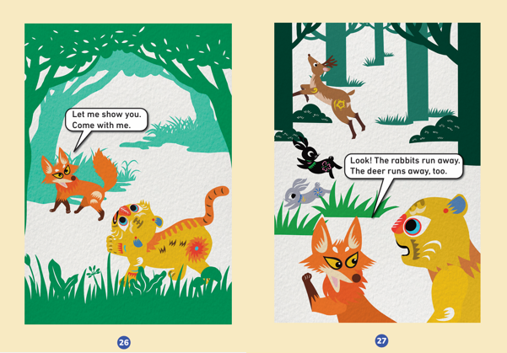
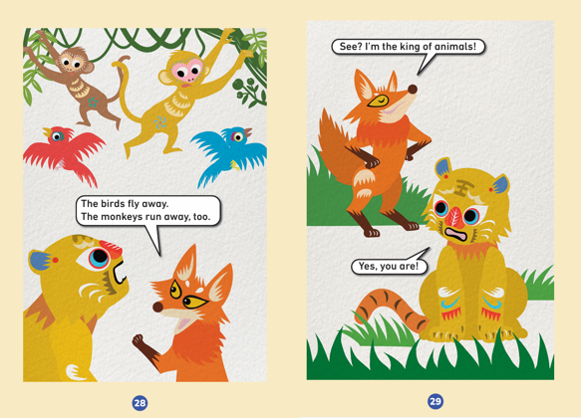
Work in groups. Act out the story.
Speak correctly. | 
Speak loudly. | 
Act with emotions. | 
Act creatively. | 

Slide 17
Homework
带感情地朗读故事。
根据故事图片，向家人或朋友讲述所学故事。

Slide 18

Unit 3 Animals
Period 2 Let’s read!
制作单位：外语教学与研究出版社

