Slide 1


Unit 3 Animals
Period 3 Let’s practise. & Draw and say. & Let’s have fun.
册 次：二年级上册 学 科：英语（外研社版）
主讲人：刘思梦 学 校：成都市人民北路小学校
天北校区

Slide 2
通过本课时学习，学生能够：
根据动物剪影识别出相应的动物，并运用所学语言进行简单的交流。
根据步骤提示绘制动物，并运用所学语言介绍动物。
完成涂色活动并圈出真正的百兽之王，加深对故事寓意的理解。

Slide 3
Let’s review.
Watch and chant.
此处教师可插入教材第23页韵文的视频。

Slide 4
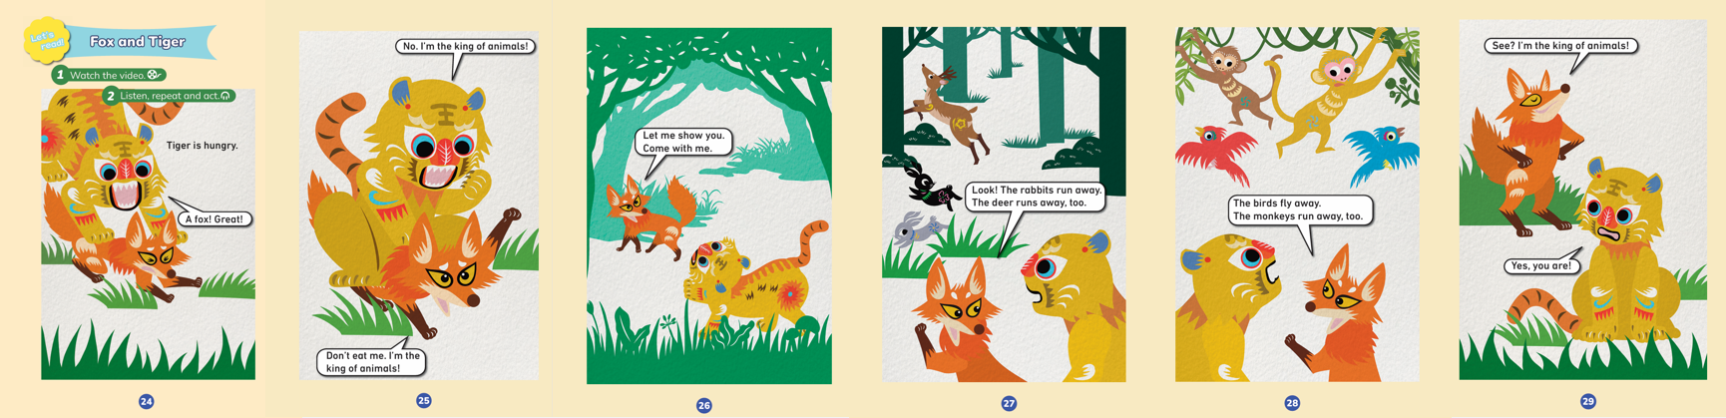
Let’s review.
Read in roles.

Slide 5


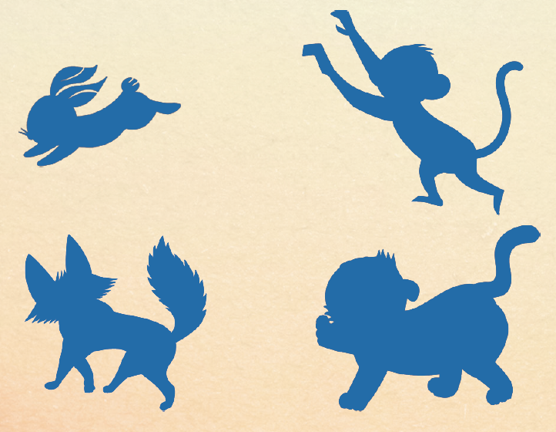
Let’s practise.
What is this?
rabbit
It’s a rabbit.

Slide 6

Let’s practise.
What is this?
monkey
It’s a monkey.

Slide 7
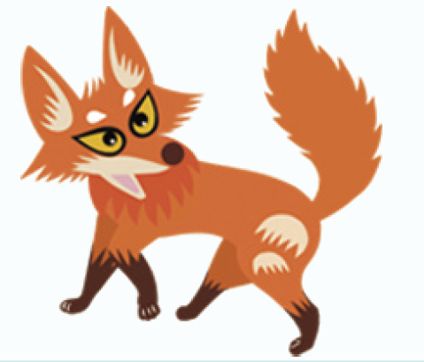
Let’s practise.
What is this?
fox
It’s a fox.

Slide 8
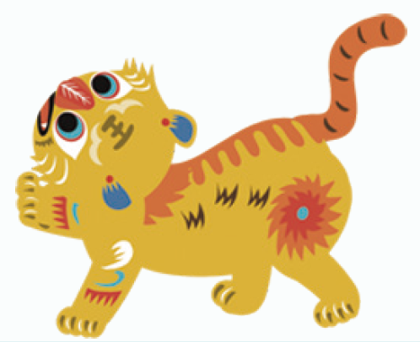
Let’s practise.
What is this?
tiger
It’s a tiger.

Slide 9
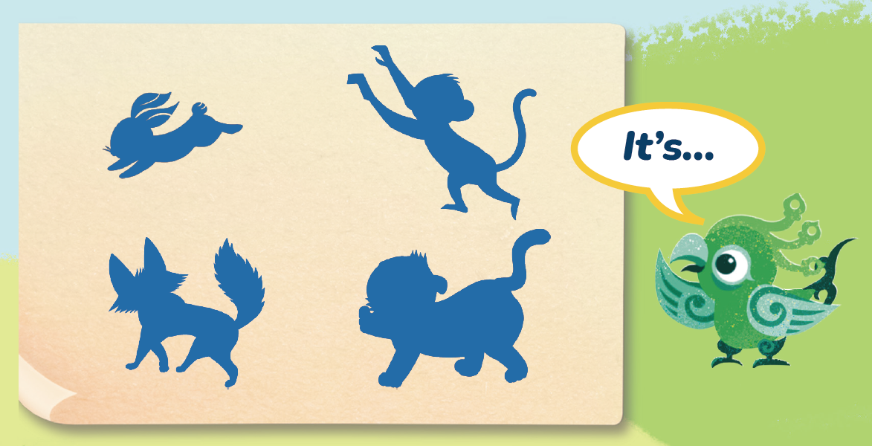
Let’s practise.
Work in pairs and take turns to be Feifei.
(两人一组，轮流扮演Feifei。)

Slide 10
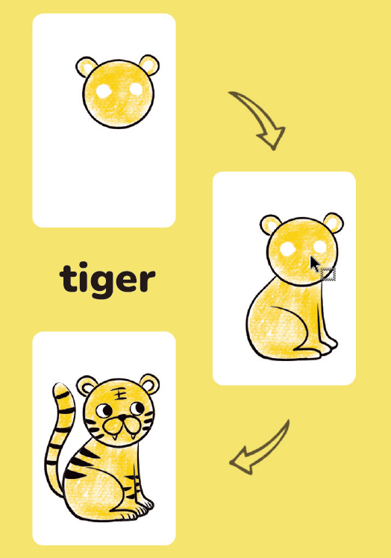
Look and say.
What is this?
It’s a tiger.
What body parts can you see?
A head, a body and a tail. (Two ears, two eyes...)
What colour is the tiger?
Yellow, black and white.

Slide 11

Draw and say.
How can you draw the tiger?
Step 1: Draw a head.
Step 2: Draw a body.
Step 3: Draw a tail and add details (细节).

Slide 12
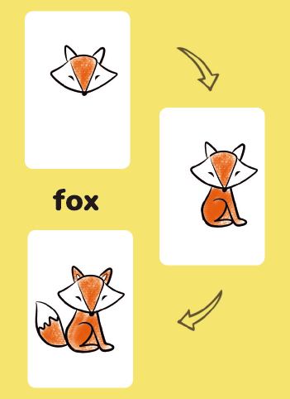
Look and say.
What is this?
It’s a fox.
What body parts can you see?
A head, a body and a tail. (Two ears, two eyes...)
What colour is the fox?
Orange, white and black.

Slide 13

Draw and say.
How can you draw the fox?
Step 1: Draw a head.
Step 2: Draw a body.
Step 3: Draw a tail and add details (细节).

Slide 14
Let’s introduce.
It’s... (动物)
It’s... (颜色)
It’s... (动物)
It’s... (颜色)

Slide 15
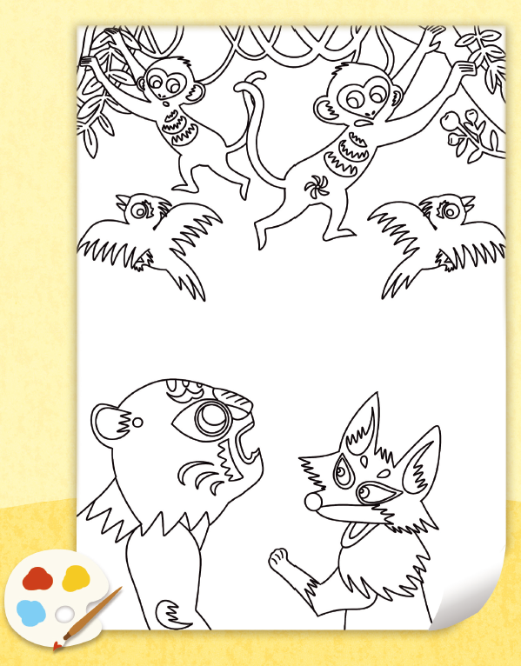

Look and say.
What does Fox say in the picture?

Slide 16
Colour and circle.
Colour the picture and circle the real king of animals.

Slide 17
Discuss and share.
Who do you think is the king of animals? Why?

Slide 18
Homework
朗读本单元第一课时的韵文和第二课时的课文。
画出你最喜欢的动物，并运用所学语言向同学或者朋友进行介绍。

Slide 19
Unit 3 Animals
Period 3 Let’s practise. & Draw and say. & Let’s have fun.
制作单位：外语教学与研究出版社

