Slide 1
Unit 2 Body parts
Period 1 Let’s chant!
册 次：二年级上册 学 科：英语（外研社版）
主讲人：向宇秋 学 校：四川省教育科学研究院
附属实验小学

Slide 2
通过本课时学习，学生能够：
理解韵文内容，认识韵文中与身体部位相关的单词head、neck、hand、arm、body、leg，掌握表达组装身体部位的核心句型“Put the... on the...”。
熟练朗读韵文，并与同伴合作表演韵文。

Slide 3





Look and say. Then play a game.
eye
eyes
Touch your...
nose
mouth

Slide 4
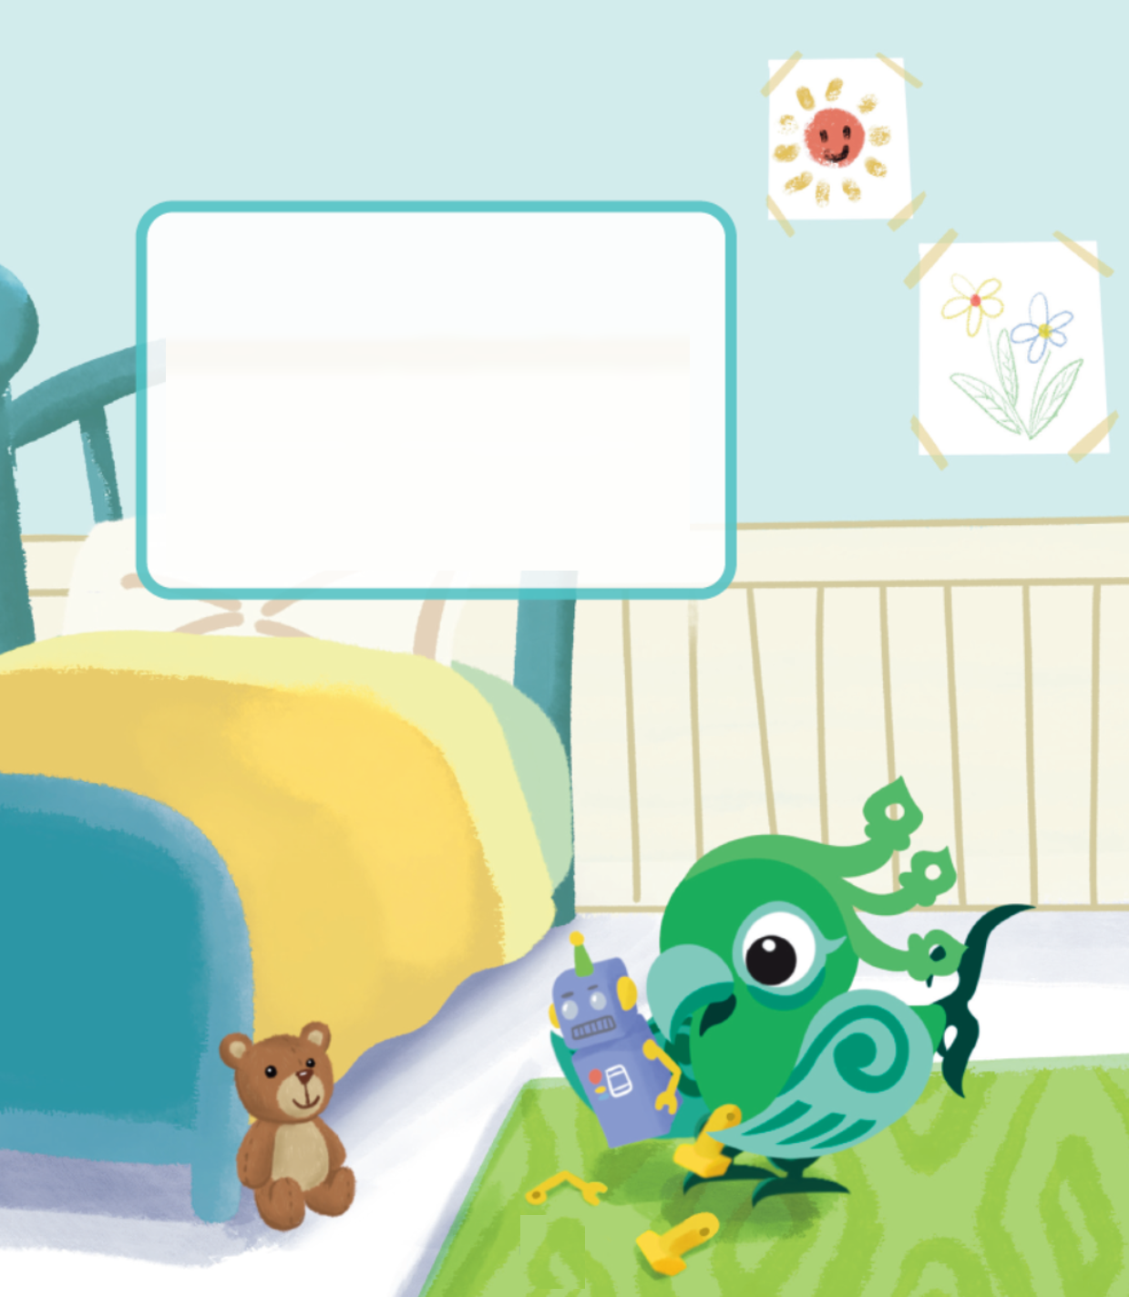
Look and say.
Who is in the picture?
What is Feifei doing?
Feifei

Slide 5
Watch the video and check.
What can you hear?
此处教师可插入教材第12页韵文的视频。

Slide 6









Listen and say.
neck
Put the on the .
head
neck
body
legs
Put the on the .
Put the on the .
body
arms
Put the on the .
hands
arms
body
This is my friend Andy.
Put the on the .

Slide 7
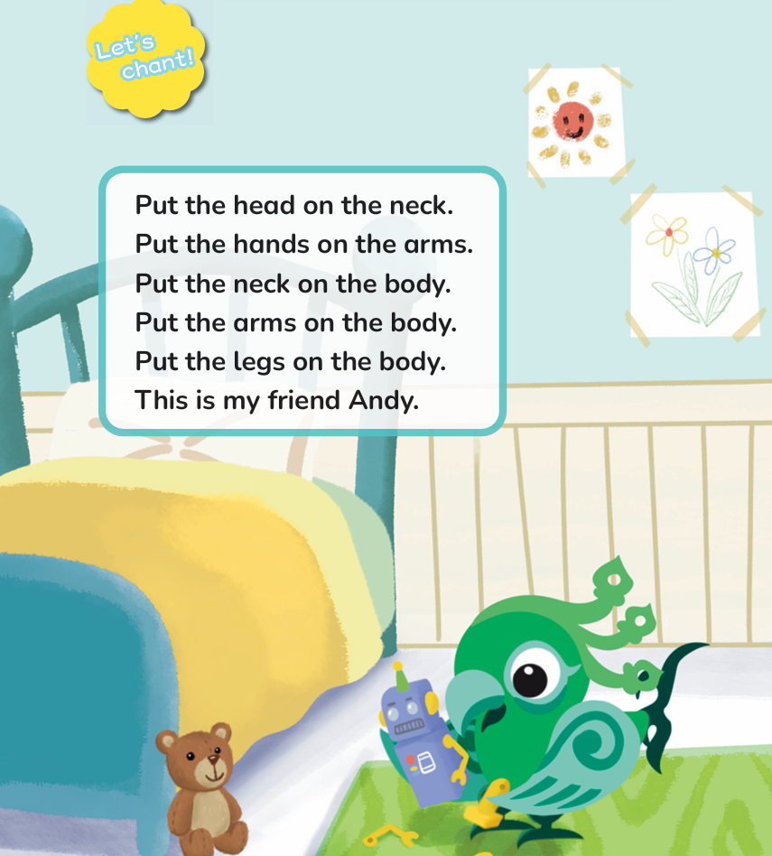
Listen and repeat.

Slide 8
Look, match and say.
Put the head on the neck.
Put the hands on the arms.
Put the neck on the body.
Put the arms on the body.
Put the legs on the body.

Slide 9
Look, match and say.
Put the head on the neck.
Put the hands on the arms.
Put the neck on the body.
Put the arms on the body.
Put the legs on the body.

Slide 10
Look, match and say.
Put the head on the neck.
Put the hands on the arms.
Put the neck on the body.
Put the arms on the body.
Put the legs on the body.
This is my friend Andy.

Slide 11
Watch the video and chant.
此处教师可插入教材第12页韵文的视频。

Slide 12
Look, listen and chant.
Put the on the .
Put the on the .
Put the on the .
Put the on the .
Put the on the .
This is my friend Andy.

Slide 13
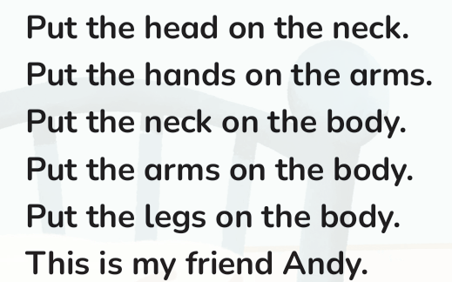
Work in pairs. Chant and act.
I can chant correctly. ☆
I can chant fluently. ☆
I can chant with actions. ☆

Slide 14
Homework
带感情地朗读韵文。
与同学或朋友合作组装机器人或画出一个机器人，一人用句型“Put the... on the...”发布指令，另一人组装或画出相应的身体部位，可以加入第一单元学习的面部器官词汇。

Slide 15

Unit 2 Body parts
Period 1 Let’s chant!
制作单位：外语教学与研究出版社

