Slide 1
Unit 2 Body parts
Period 3 Let’s practise. & Look and say. & Let’s have fun.
册 次：二年级上册 学 科：英语（外研社版）
主讲人：尚恩多 学 校：四川省教育科学研究院
附属实验小学崇和分校

Slide 2
通过本课时学习，学生能够：
在具体情境中，运用所学语言与同伴围绕各自的身体部位进行交流。
通过观察图片，识别机器人的不同身体部位及对应的数量，并用“I have...”准确描述身体部位。
设计玩偶，并运用本单元所学的核心语言介绍玩偶的身体部位。

Slide 3
Let’s chant.
此处教师可插入教材第12页韵文的视频。

Slide 4
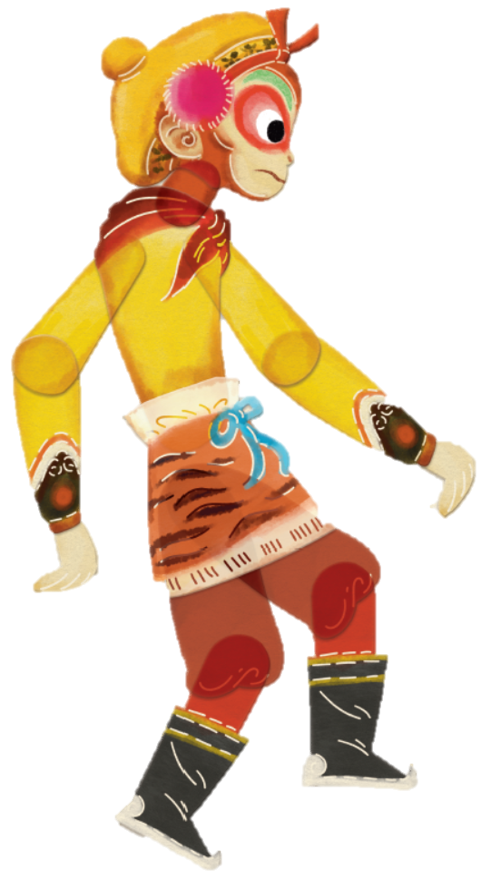
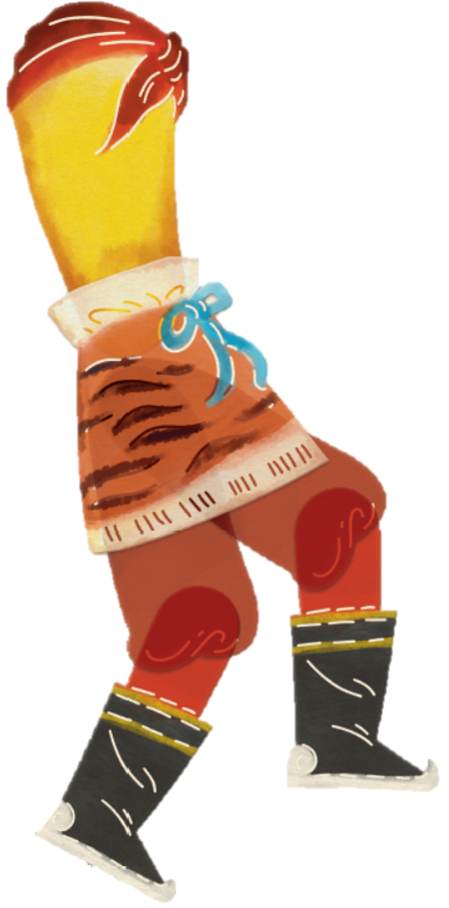
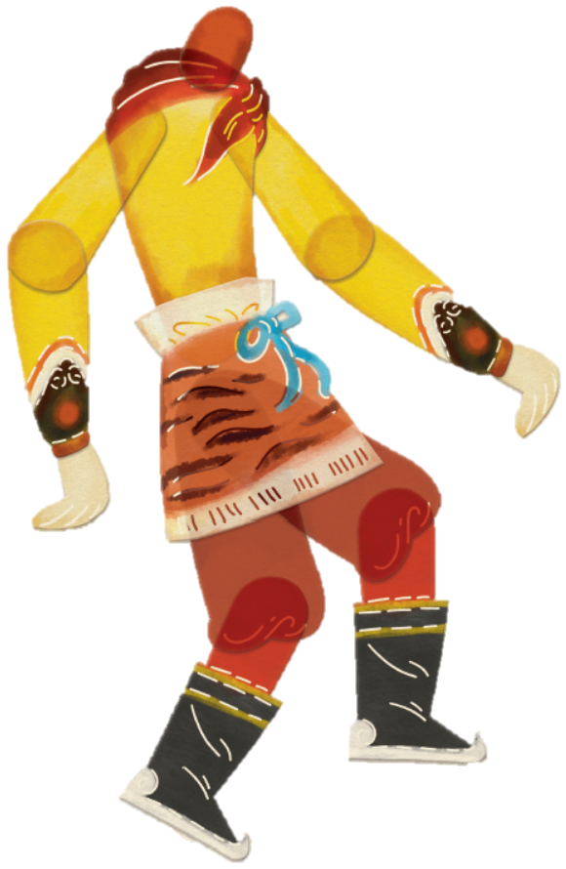
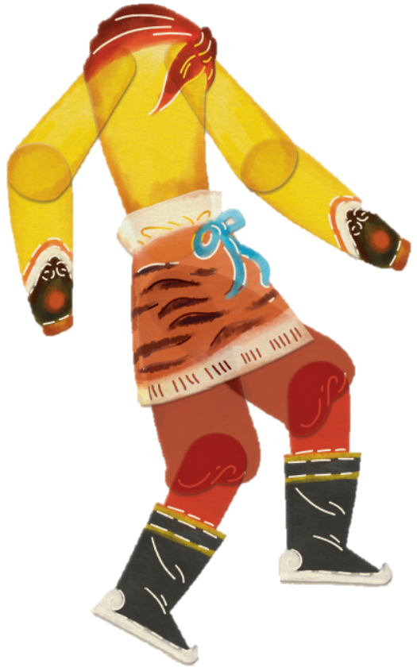

Look and say.
I have...

Slide 5
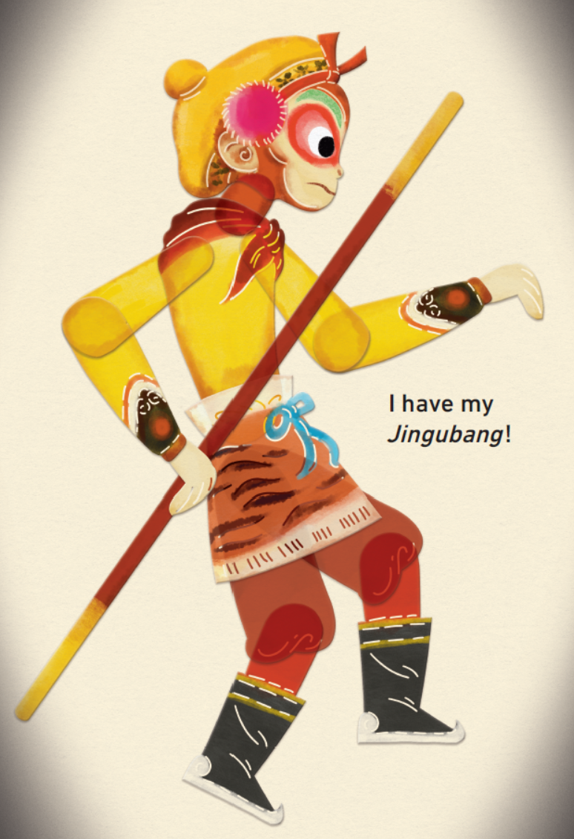

Look and say.
I have...

Slide 6
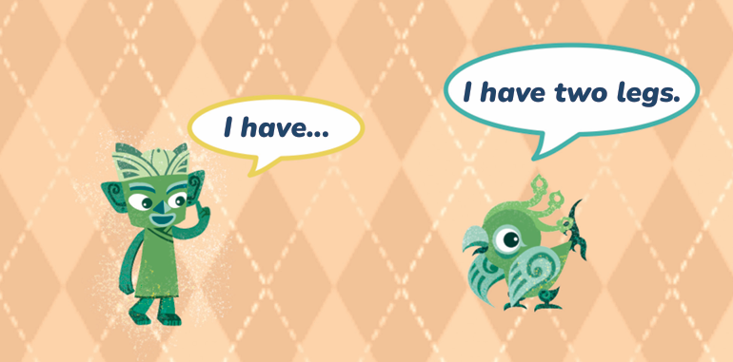
Look and say.

Slide 7
Look and say.
What is Tongtong pointing at?
I have two big ears.
?
His ear.
What will Tongtong say?

Slide 8



Let’s practise.
I have a big / small / long / short...
I have two big / small / long / short...
I can:
talk about my body parts correctly.
listen to my partner carefully.
use different words to talk about my body parts.

Slide 9
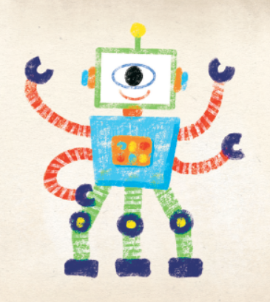
Look and say.
What body parts can you see?
How many?

Slide 10


Work in pairs. Look and say.
Hello, this is my robot Bobo.
I have...
I love my robot.
I can:
speak loudly.
speak fluently and correctly.
work with my partner well.
Speak like a robot!

Slide 11


Look and say.
What body parts can you see?
How many?

Slide 12
Think and draw.
Design your puppet.
Draw the puppet’s body parts clearly.

Slide 13
Show your work.
Hello, my name is...
I’m a puppet.
Look! I have...

Slide 14
Homework
继续完善自己设计的木偶，并运用核心语言向朋友或家人展示、介绍。
与同学开展“你说我画”的游戏：一人构思一个小动物或小“怪兽”，用第一人称描述其身体部位，另一人根据描述进行绘画。完成后，负责描述的学生评判同伴的画作与自己构思的形象是否相符。

Slide 15
Unit 2 Body parts
Period 3 Let’s practise. & Look and say. & Let’s have fun.
制作单位：外语教学与研究出版社

