Slide 1
Unit 5 My classroom
Period 1 Let’s chant!
册 次：一年级上册 学 科：英语（外研社版）
主 讲 人：郭梦笛 学 校：四川省成都市双流区实验小学
外国语学校

Slide 2
通过本课时学习，学生能够：
准确理解韵文，掌握简单的问候语“Good morning, …”，认识教室及教室内的基本设施相关的单词：classroom、blackboard、desk、chair，并能运用句型“This is…”进行简单的介绍。
熟练朗读韵文，并能与同伴合作表演韵文。

Slide 3

Look and say.
Tongtong
Feifei
Qingqing

Slide 4
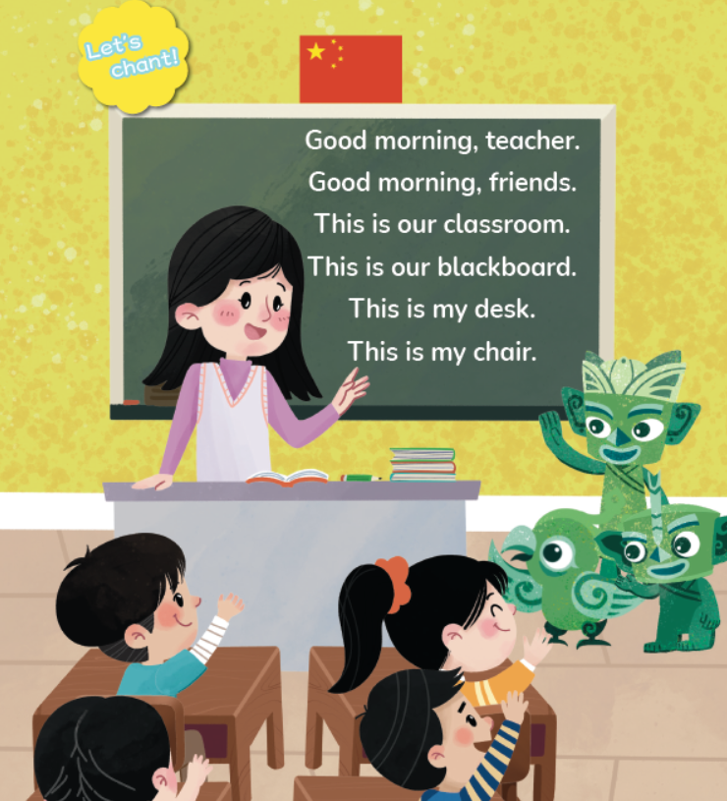
Look and say.
Where are they?
They are in a classroom.
What can you see in the picture?
What are they talking about?

Slide 5
Watch the video and check.
此处教师可插入教材第45页韵文的视频。

Slide 6
Look and say.
?

Slide 7

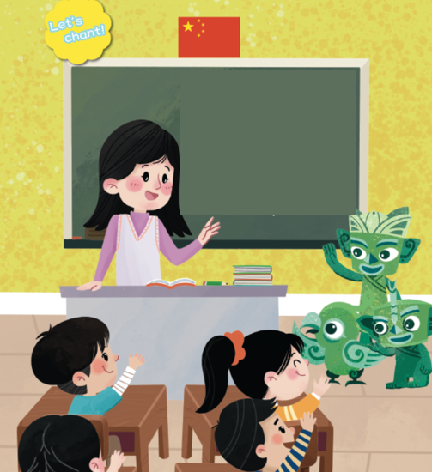
Listen, check and repeat.
?
Good morning, teacher.
Good morning, friends.
teacher
Good morning.

Slide 8
Look and say.
?

Slide 9

Listen, check and repeat.
This is our __________.
This is our __________.
classroom
blackboard
blackboard

Slide 10
Look and say.
?

Slide 11
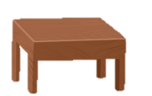

Listen, check and repeat.
This is my ______.
This is my ______.
desk
chair
desk
chair

Slide 12
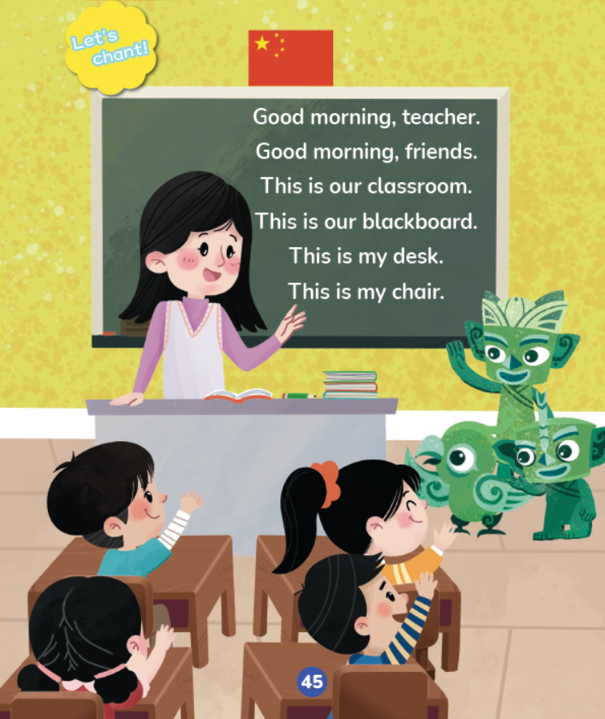
Play a game.
I say, you point. 我说你指。
I point, you say. 我指你说。

Slide 13
Watch the video and chant.
此处教师可插入教材第45页韵文的视频。

Slide 14

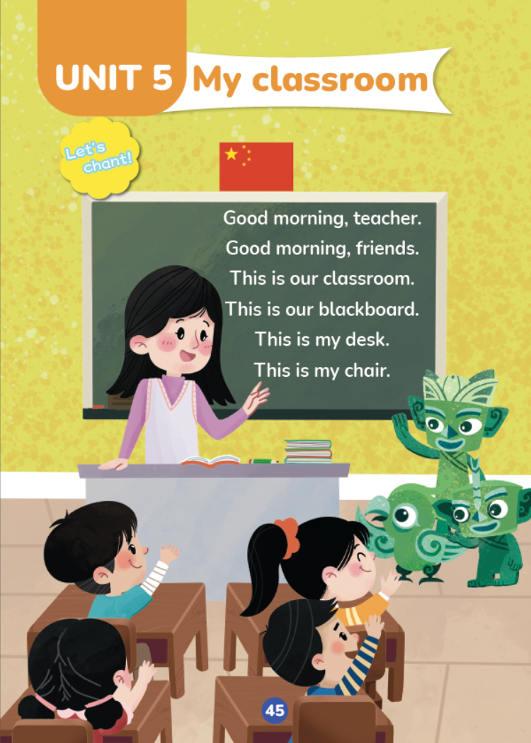
Listen and chant.
Let’s chant together!
Tips:
1. Chant correctly. (发音正确)
2. Chant fluently. (朗读流畅)
3. Chant with rhythm. (有节奏感)
⭐️
⭐️
⭐️

Slide 15
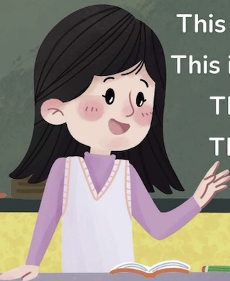
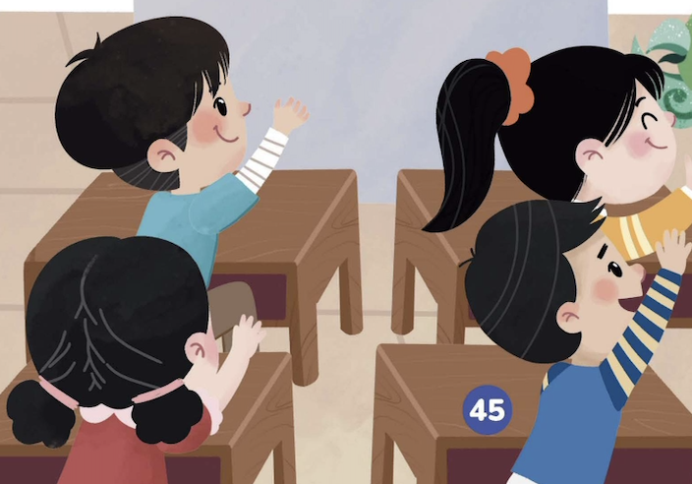
Work in groups. Chant and act it out.
Good morning, teacher.
This is our classroom.
Good morning, friends.
This is our blackboard.
This is my desk.
Tips:
1. Chant correctly. (发音正确)
2. Chant with rhythm. (有节奏感)
3. Chant with actions. (有动作)
⭐️
This is my chair.
⭐️
⭐️

Slide 16
Homework
看视频，跟读韵文。
带感情地朗读韵文，并向朋友或家人展示。

Slide 17
Unit 5 My classroom
Period 1 Let’s chant!
制作单位：外语教学与研究出版社

