Slide 1
Unit 5 My classroom
Period 3 Let’s practise. & Circle the five differences in the two pictures. & Let’s have fun.
册 次：一年级上册 学 科：英语（外研社版）
主讲人：陈雅茹 学 校：四川省成都市双流区
协和实验小学

Slide 2
在具体情境中，运用所学语言表达打扫教室的提议，并给予恰当的回应。
观察并找出两幅图片的不同之处，尝试用英语进行描述。
画出自己的教室以及教室内的设施，运用核心语言在全班进行展示、介绍，并在此过程中，学会欣赏教室的美，自觉维护教室的环境。
通过本课时学习，学生能够：

Slide 3
Let’s chant.
此处教师可插入教材第45页韵文的视频。

Slide 4
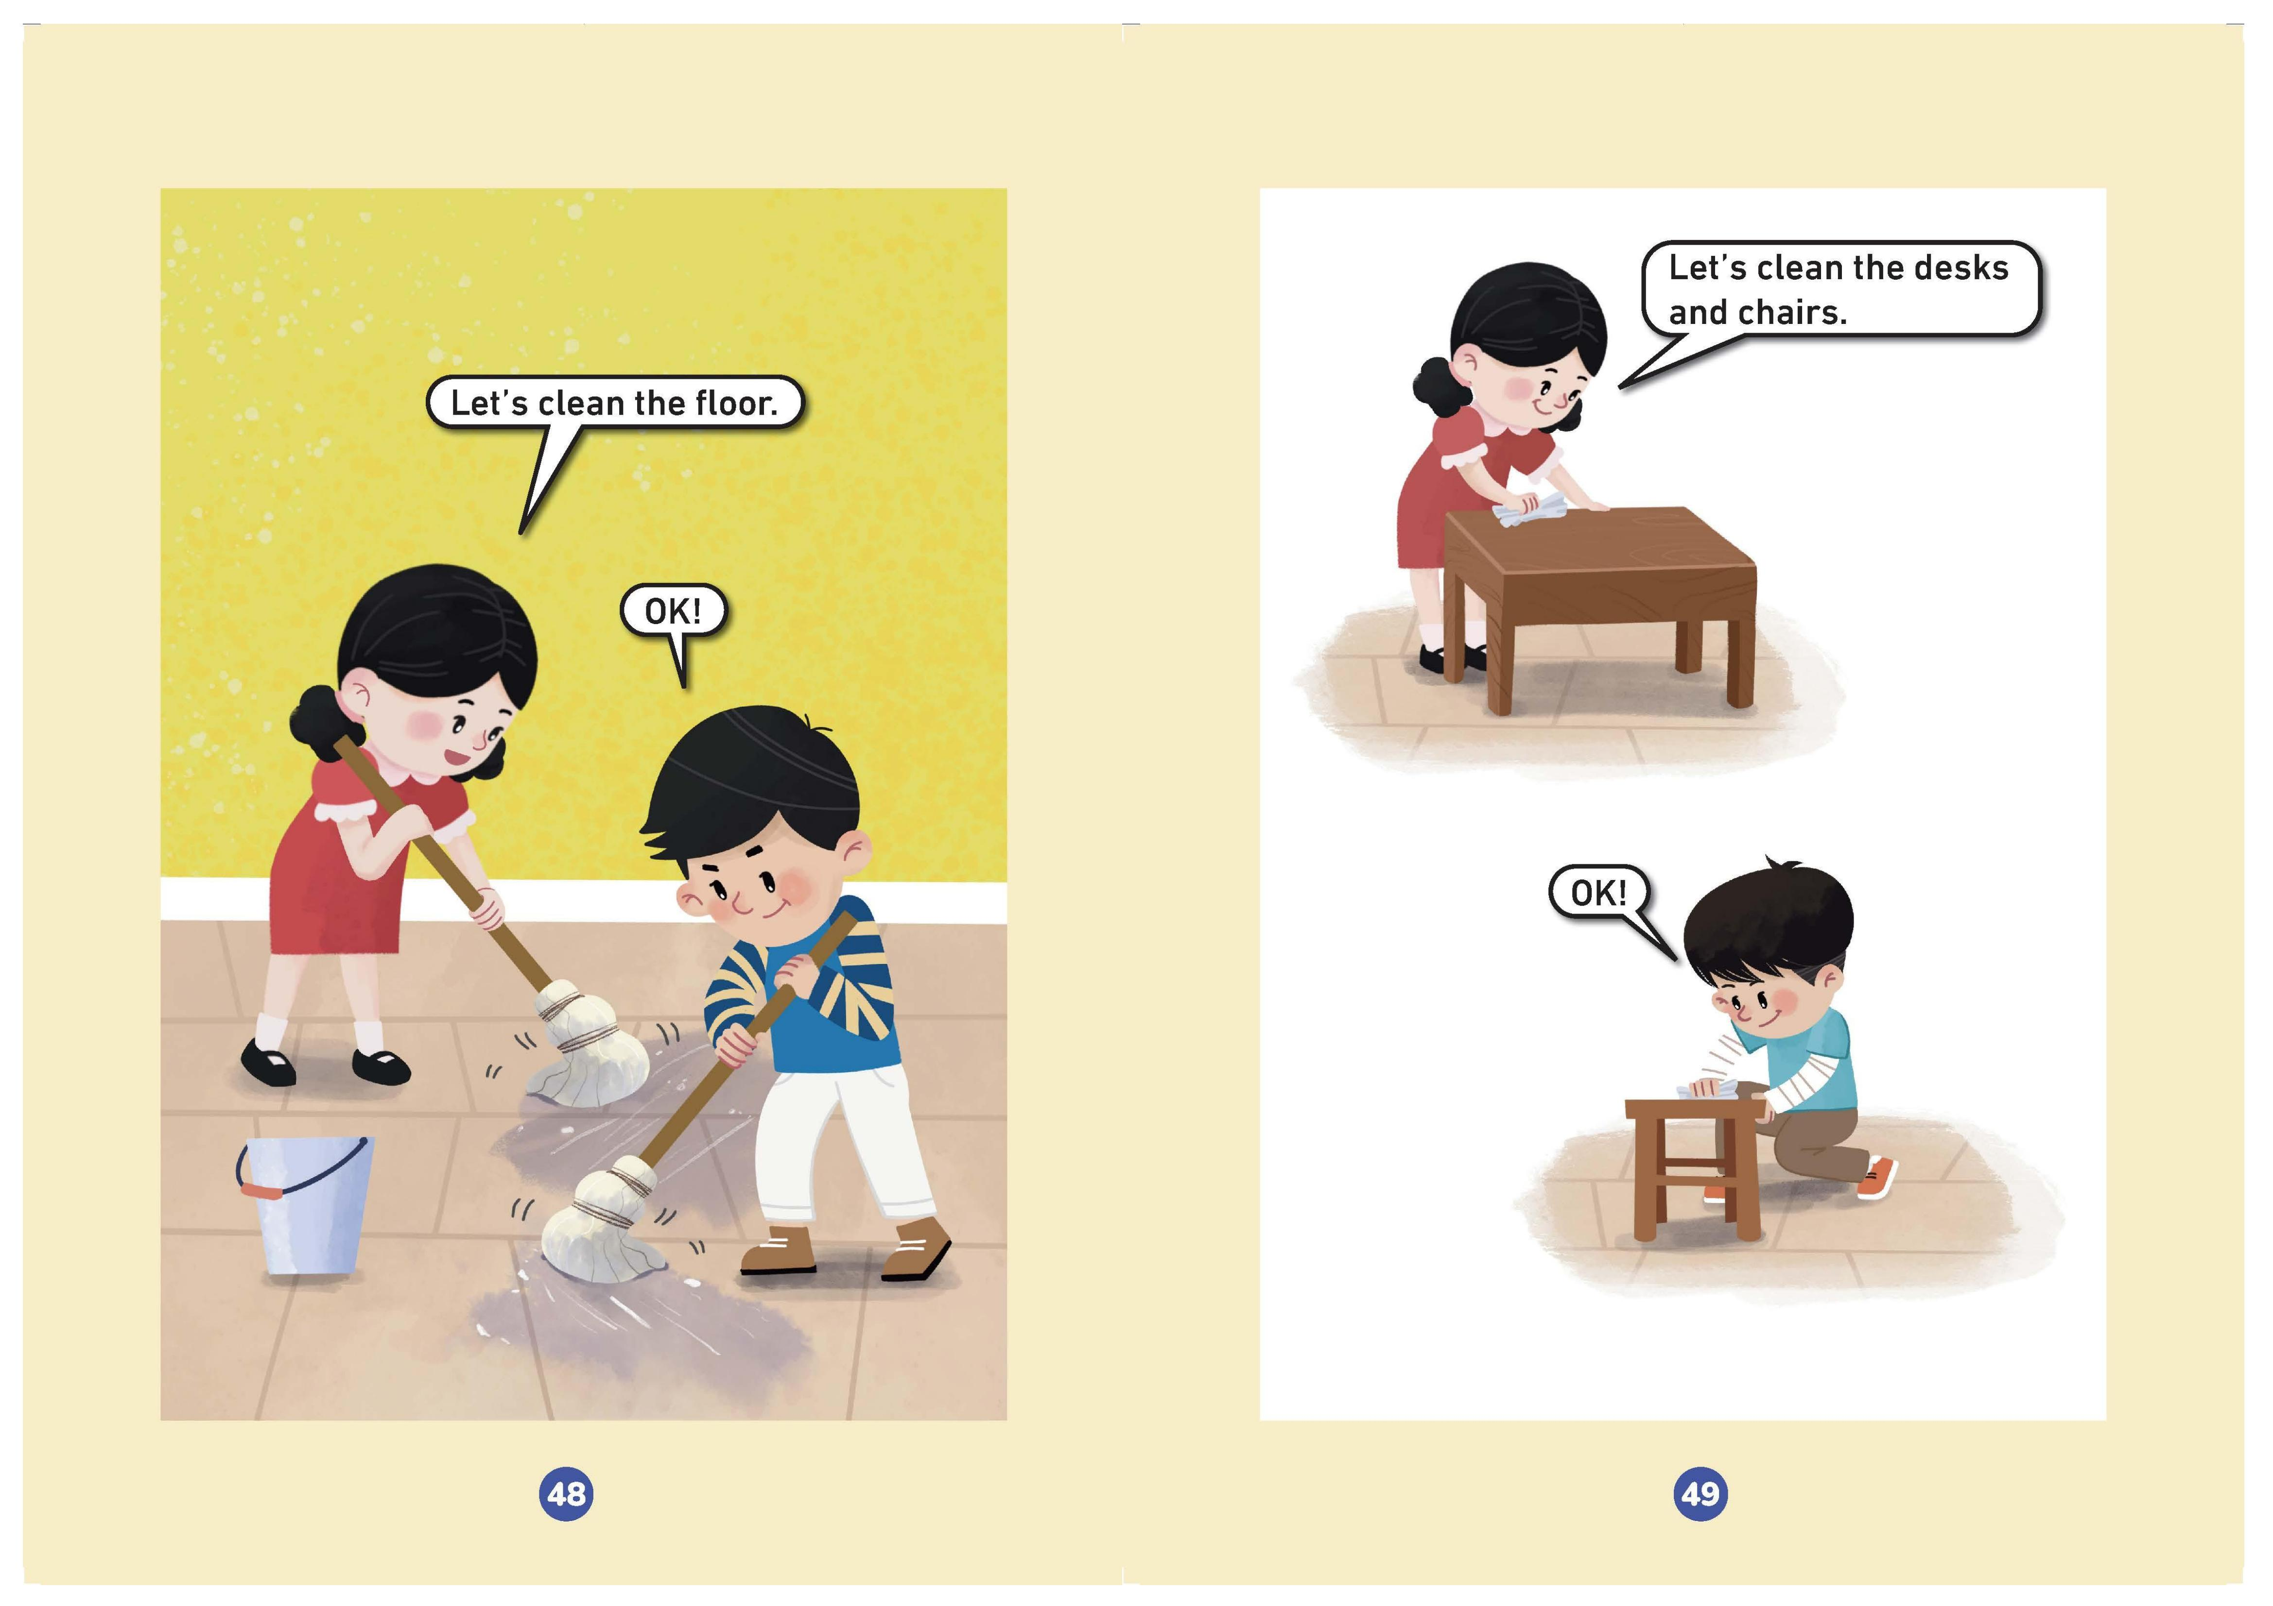
Look and say.
Let’s clean the ______.
floor
School is over.
Let’s clean our _________.
OK!
classroom
blackboard
Let’s clean our _________.
OK!

Slide 5
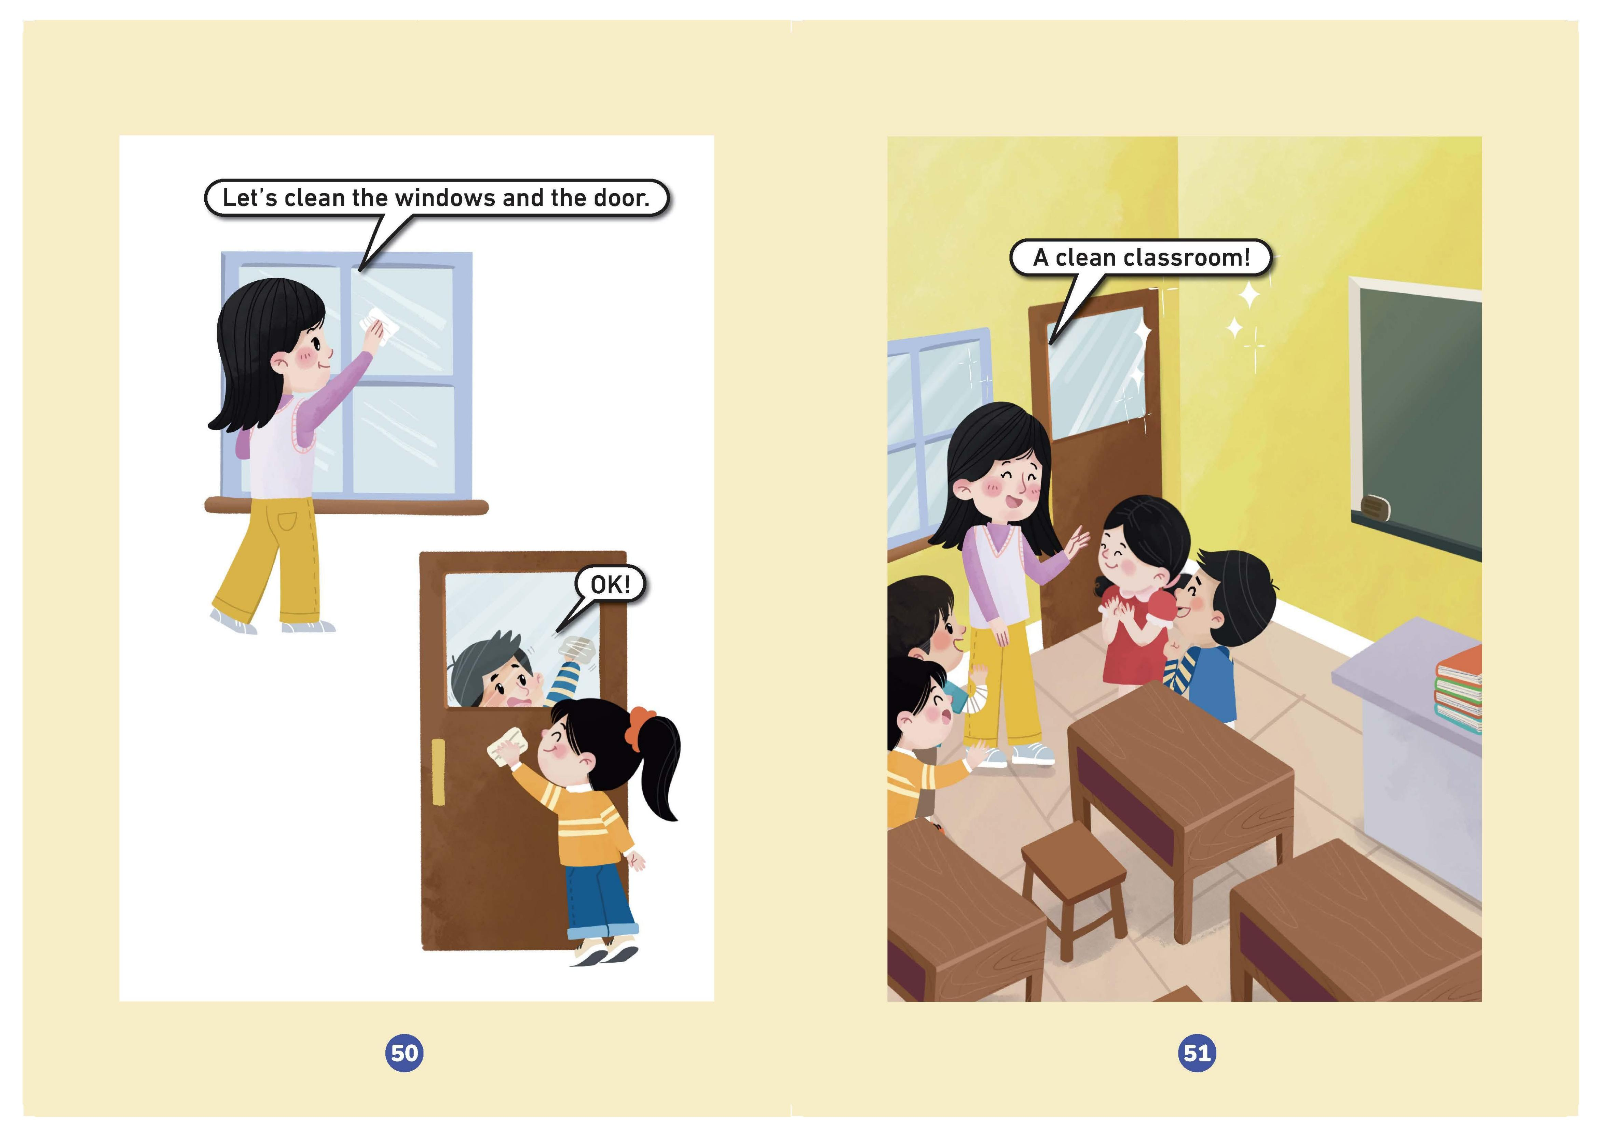
Look and say.
Let’s clean the _____ and _____.
windows
desks
Let’s clean the ________ and the _______.
chairs
door
A ______________!
clean classroom
OK!
OK!

Slide 6
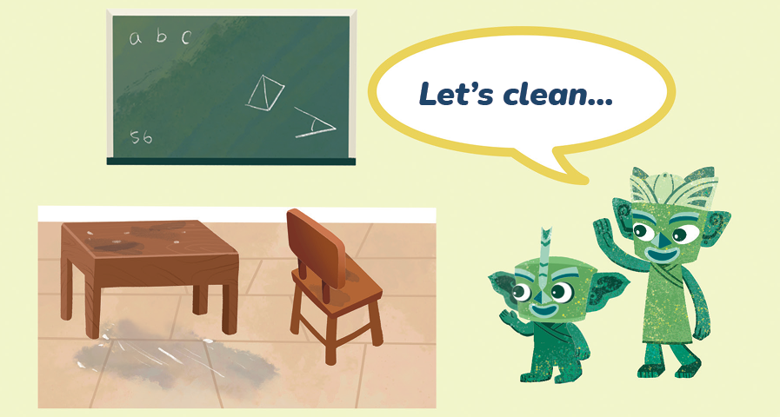
Look and say.
What can you see?
I can see a blackboard, a desk, a chair and the floor.
Are they clean?
No.
What will Tongtong say to Qingqing?

Slide 7
Let’s practise.
Tips:
1. Work in pairs. (两人一组进行对话)
2. 评价内容
I can:
(1) speak correctly (准确).
(2) speak fluently (通顺).
(3) speak with body gestures (有动作).

Slide 8
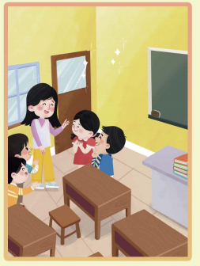
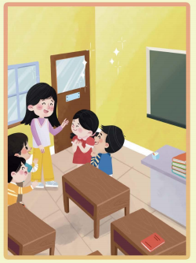
Look and circle.
A
B

Slide 9
Check the answers.
A
B

Slide 10



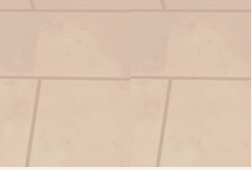


Think and say.
What can you see in our classroom?

Slide 11
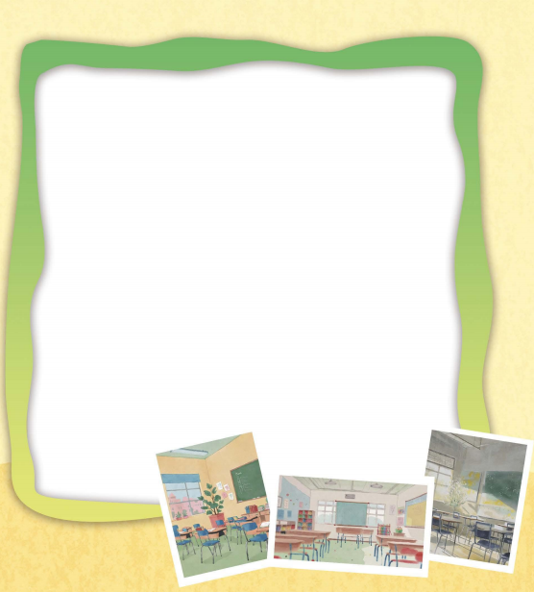
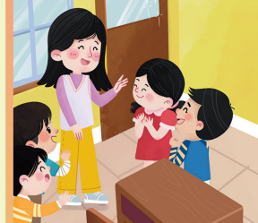
Draw a picture of the classroom.
Need to draw (必画): windows, door, blackboard, floor, desks, chairs
Circle your desk and chair.
Choose to draw (选画): your teacher and friends

Slide 12
Share your work.
Good morning, __________.
This is our __________.
This is my / the __________.
Look! A clean classroom!

Slide 13
Homework
有感情地朗读第一课时的韵文和第二课时的课文。
完善自己的画作，用英语向朋友或家人展示。

Slide 14
Unit 5 My classroom
Period 3 Let’s practise. & Circle the five differences in the two pictures. & Let’s have fun.
制作单位：外语教学与研究出版社

