Slide 1
Unit 4 School things
Period 1 Let’s chant!
册 次：一年级上册 学 科：英语（外研社版）
主讲人：樊玲 学 校：四川省成都市成都棠湖
外国语学校附属小学

Slide 2
通过本课时学习，学生能够：
理解韵文内容，掌握与学习用品相关的词汇pencil、ruler、schoolbag、eraser、book。
准确朗读韵文，并与同伴合作表演韵文。

Slide 3





Look and say.
...
pencil
ruler
eraser
book
school things
学习用品

Slide 4
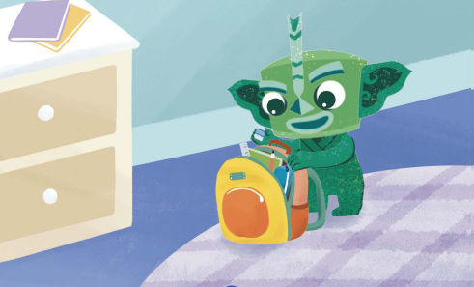


Look and say.
What school things are in Qingqing’s schoolbag?
Qingqing
schoolbag

Slide 5



Listen, check and say.

Slide 6
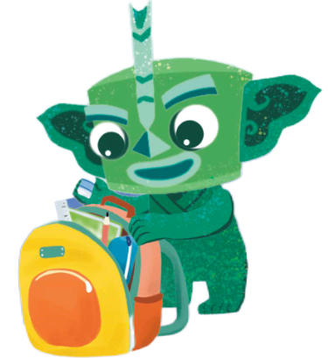

Listen, point and say.
pencil

Slide 7

Listen, point and say.
ruler

Slide 8

Listen and repeat.
All in my schoolbag.

Slide 9
Play a game.
All in my schoolbag.
Round 1: I say, you do. (我说你做)
Round 2: I do, you say. (我做你说)

Slide 10

Listen, point and say.
eraser

Slide 11
Listen, point and say.
book

Slide 12
Listen and repeat.
All in my schoolbag.

Slide 13
Watch the video and chant.
此处教师可插入教材第34页韵文的视频。

Slide 14



Match and chant.
?
?
?
?
?
?

Slide 15



Match and chant.
?
?
?
?
?
?

Slide 16
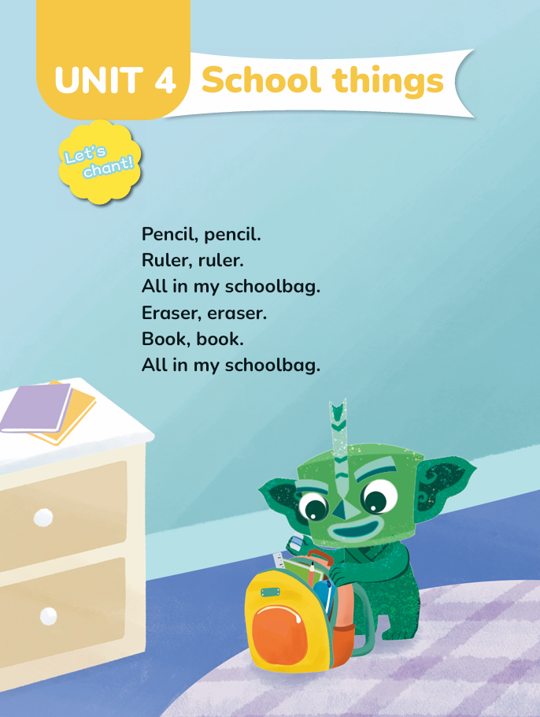
Listen and chant.
I can:
1. Chant accurately and fluently. 准确流利。
2. Chant with rhythm. 有节奏感。

Slide 17
Chant in groups.

Slide 18

Chant and act it out.
Task:
1. Work in groups of 4.
(四人一组。)
2. Act it out.
(创编动作，表演韵文。)

Slide 19
Summary
What school things do you learn?
Pencil, ruler, eraser…
Where should we put the school things?
In the schoolbag.
Put the school things in the schoolbag.
讲学习用品放进书包里。

Slide 20
Homework
带感情地朗读韵文。
整理自己的学习用品，并尝试用自己的学习用品创编一首新的韵文，下节课在班级分享。（可选做）
________, ________.
________, ________.
All in my schoolbag.
________, ________.
________, ________.
All in my schoolbag.

Slide 21

Unit 4 School things
Period 1 Let’s chant!
制作单位：外语教学与研究出版社

