Slide 1
Unit 4 School things
Period 2 Let’s read!
册 次：一年级上册 学 科：英语（外研社版）
主讲人：陈煦冬 学 校：四川省成都市成都棠湖
外国语学校附属小学

Slide 2
通过本课时学习，学生能够：
在看图片、听录音、朗读课文等活动中，梳理、理解故事内容。
掌握表示学习用品的核心词汇和分享学习用品的表达“Here’s...”，学会用得体的语言表达安慰、分享和感谢。
小组合作表演故事，模仿人物的语言和表情，深入体会故事角色的情感变化，感悟妥善保管学习用品的重要性，以及同学之间相互帮助、乐于分享的美好品质。

Slide 3










Look and say.
ruler
book
pencil
eraser
schoolbag

Slide 4
Let’s chant.
此处教师可插入教材第34页韵文的视频。

Slide 5


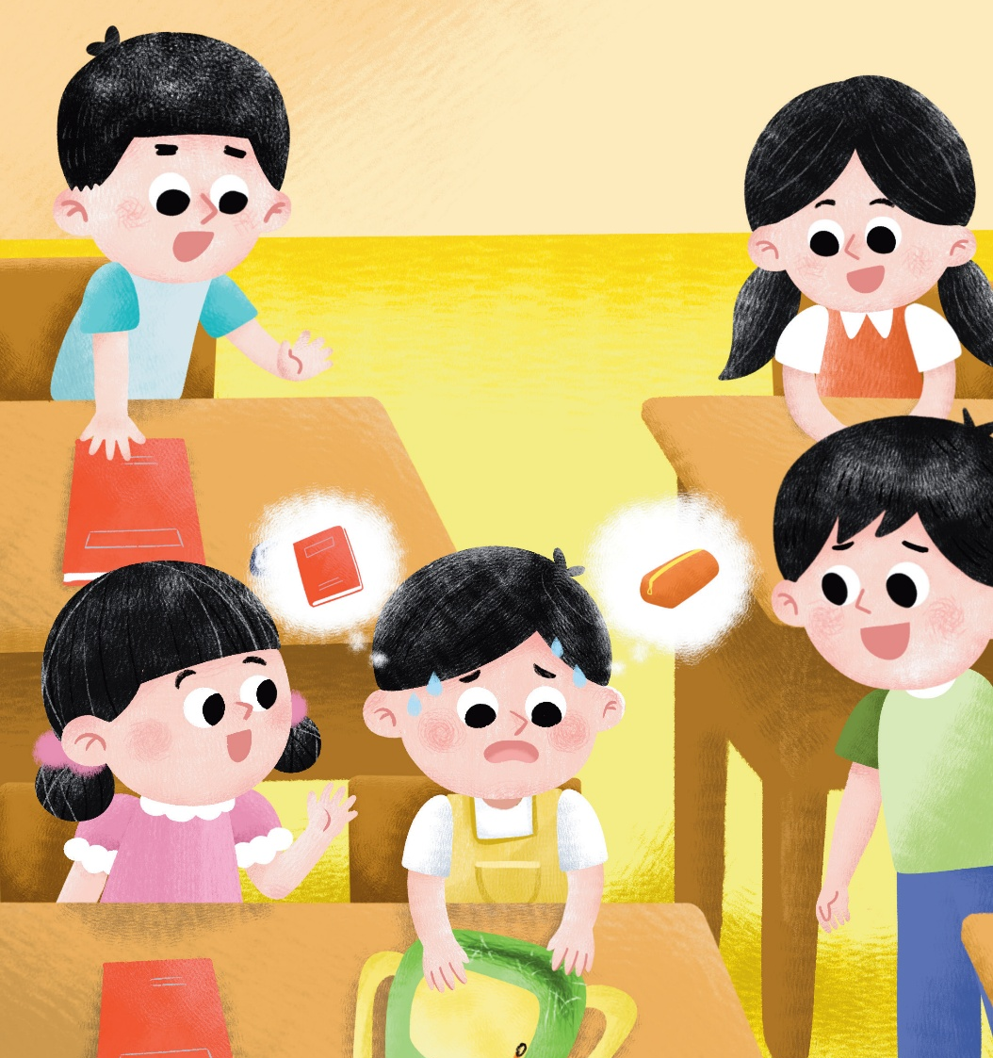


Look and say.
Xiaotian

Slide 6

Listen and check. Then look and say.
Oh, my schoolbag.
Who may help Xiaotian?
My pencil case!
And my English book!

Slide 7

Listen, check and repeat.
Who helps Xiaotian?
Don’t worry, Xiaotian.
What will they share with him?
share
Let’s !

Slide 8


Look and say.
？
a pencil

Slide 9
Listen, check and repeat.
Here’s a pencil.
a pencil

Slide 10


Look and say. Then listen, check and repeat.
an eraser
Here’s .
an eraser

Slide 11


Look and say. Then listen, check and repeat.
Here’s
a ruler.
a ruler

Slide 12


Look and say.
? the book.
a book

Slide 13
Listen, check and repeat.
Let’s share
the book.
a book

Slide 14

Look and say.
How does Xiaotian feel now?
He is happy.
?
What will he say?

Slide 15
Listen, check and repeat.
Thank you!

Slide 16
Look, think and say.
Are Xiaotian’s classmates happy?
Yes.
Why?
Because they help Xiaotian.
Thank you!
Helping and sharing
make everyone happy!
助人为乐、相互分享使人快乐!

Slide 17
Watch the video and repeat.
此处教师可插入教材第35—40页故事的视频。

Slide 18
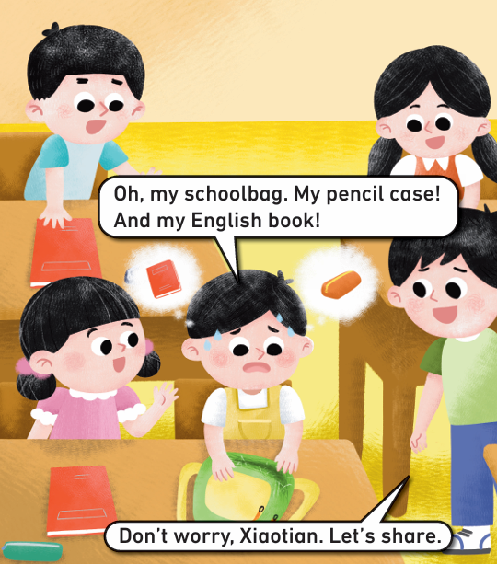
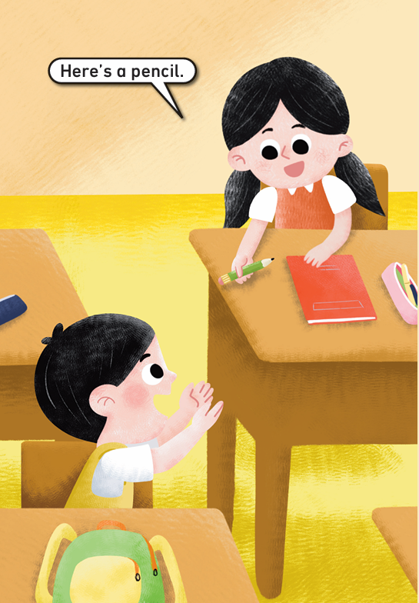
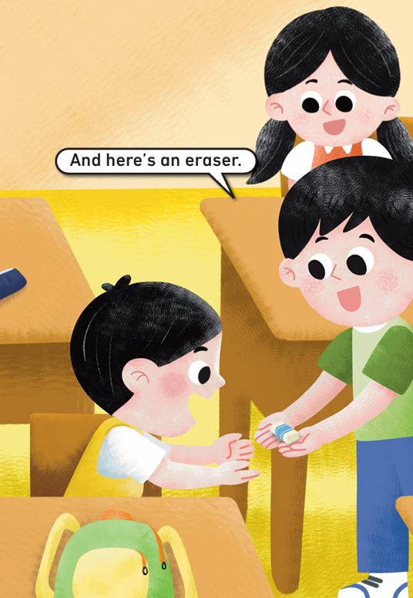
Listen, point and repeat.
36
37
35

Slide 19
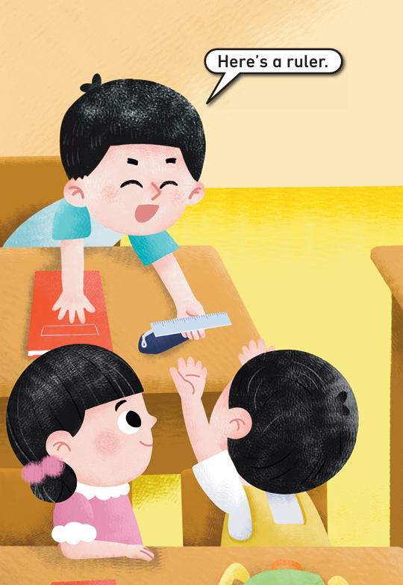
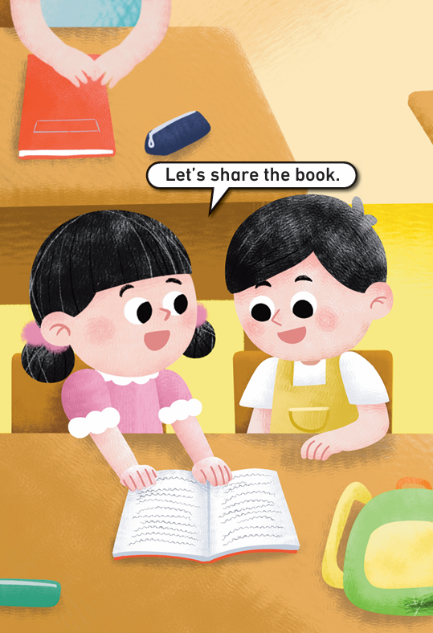

Listen, point and repeat.
38
39
40

Slide 20
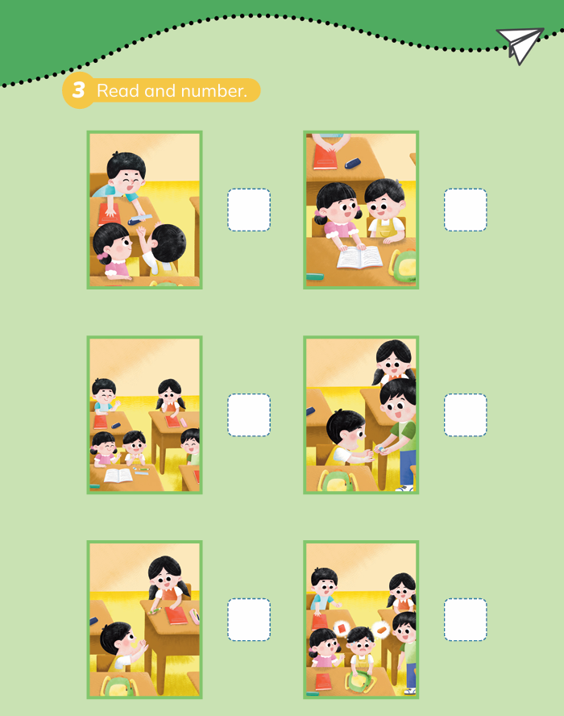
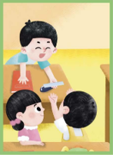


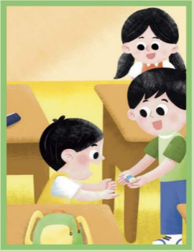
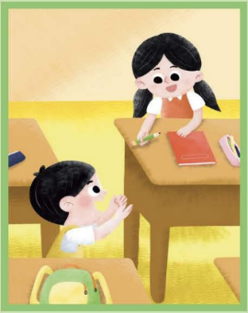
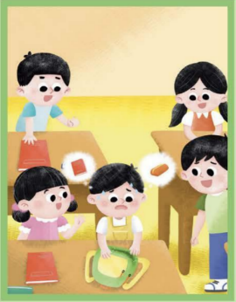
Read and number. Then check.
给图片排序
4
5
3
6
2
1
41

Slide 21

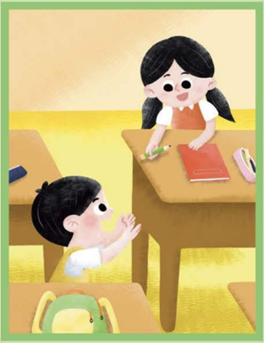

Look and say.
Oh, my…
Don’t worry.
Let’s share.
Here’s a / an…
Let’s share…
…

Slide 22








Look and match. Then check and say.
Here’s a / an…
Thank you.
Let’s share…

Slide 23
Read the story aloud.

Slide 24


Work in groups. Act out the story.
Oh, my…
Don’t worry.
Tips:
‣ correctly 正确
‣ fluently 流畅
‣ vividly 生动
Let’s share.
‣ Work in groups of 5.
(五人合作，表演对话。)
Here’s a / an…
Let’s share…
…

Slide 25
Homework
带感情地朗读课文。
寻找一件可以与同学或朋友一起分享的学习用品，用本课时学习的句子“Here’s… / Let’s share…”与对方分享。

Slide 26

Unit 4 School things
Period 2 Let’s read!
制作单位：外语教学与研究出版社

