Slide 1
Unit 4 School things
Period 3 Let’s practise. ＆ Circle and say. ＆ Let’s have fun.
册 次：一年级上册 学 科：英语（外研社版）
主讲人：刘万友 学 校：四川省成都市成都双流区
立格实验学校附属小学

Slide 2
通过本课时学习，学生能够：
在具体情境中，与同伴围绕学习用品进行简单的交流。
联系自身，运用所学语言介绍自己的物品。
观察并找出两幅图片的不同之处，尝试用英语进行描述。

Slide 3
Let’s chant!
此处教师可插入教材第34页韵文的视频。

Slide 4






Look and say.
What’s this?

Slide 5
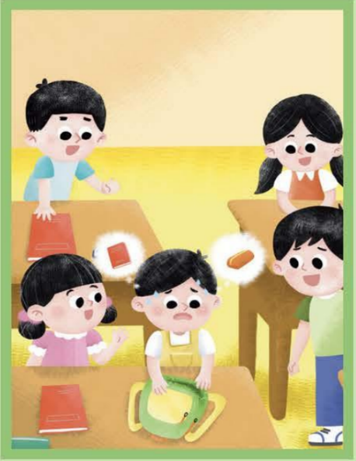
Look and say.
Who is he?
He is Xiaotian.
What does he say?
Oh, my schoolbag. My pencil case!
And my English book!

Slide 6
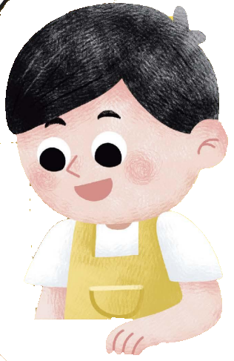

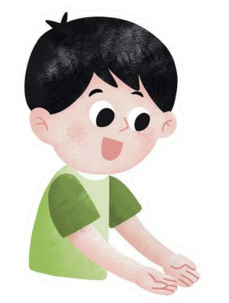
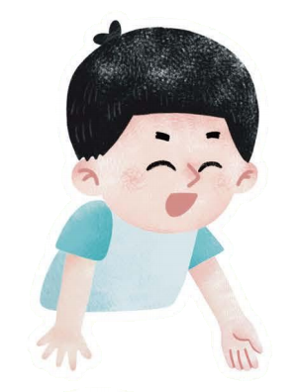
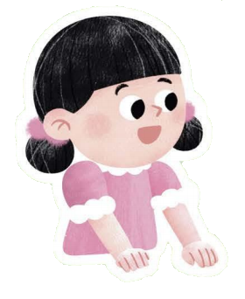
Look and say.
What do they share with Xiaotian?
Xiaotian
What do they say?

Slide 7
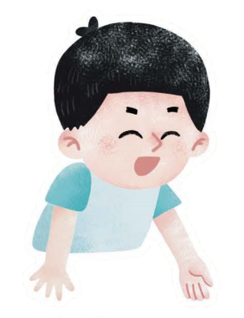
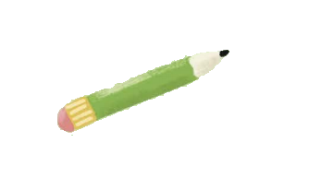

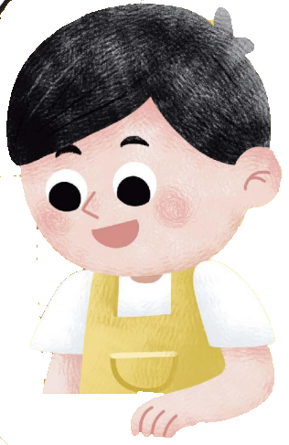


Look and say.
What do they share with Xiaotian?
What do they say?
Here’s a / an…
Let’s share…

Slide 8

Look and say.
What will Qingqing say?
Here’s a pencil.

Slide 9

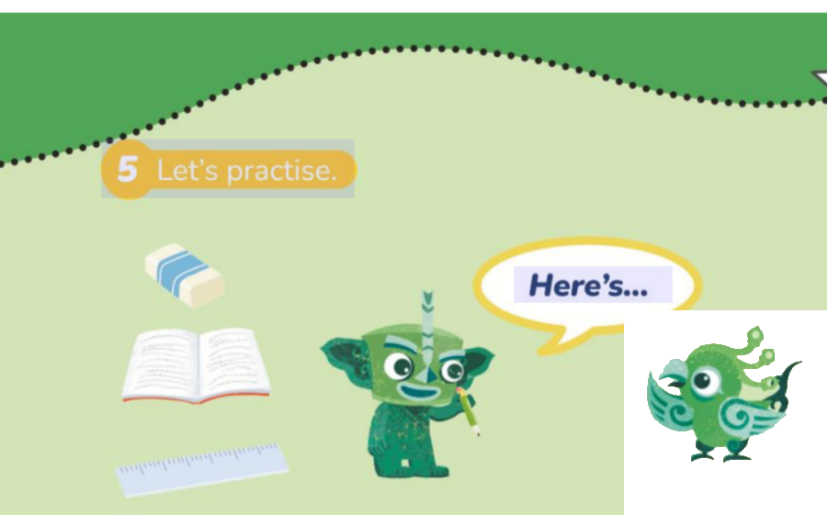
Let’s practise.
Talk about the school things.
Here’s...
Good job! / No, here’s…

Slide 10


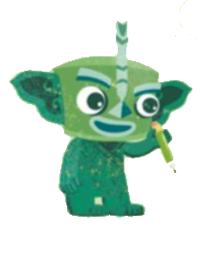
Role-play.
Feifei: Oh, my pencil!
Qingqing: Don’t worry.
Here’s a pencil.
Feifei: Thank you!

Slide 11

Look and say.
water bottle
toy car

Slide 12
Think and circle.
What’s in your schoolbag?

Slide 13
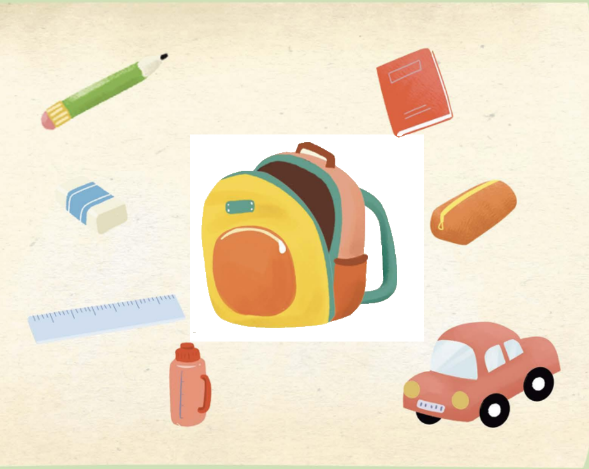

Work in pairs. Guess and say.
S1: A / An... is in your schoolbag.
S2: No.
S1: A / An... is in your schoolbag.
S2: Yes.

Slide 14
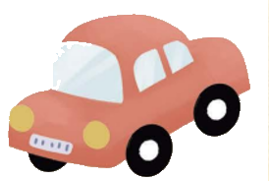
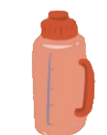
Play the game.
A /An... is in your schoolbag.

Slide 15
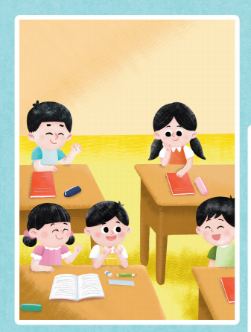
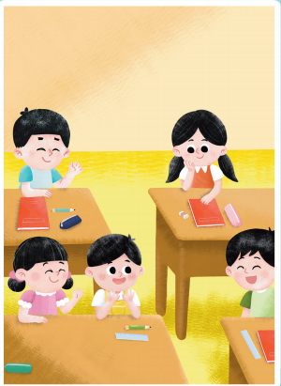
Look and circle.
Please circle the five differences in the two pictures.
Picture 1
Picture 2

Slide 16
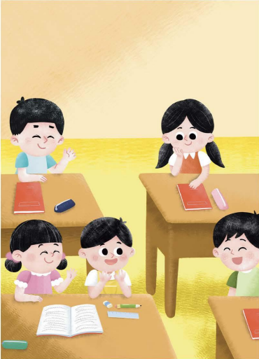
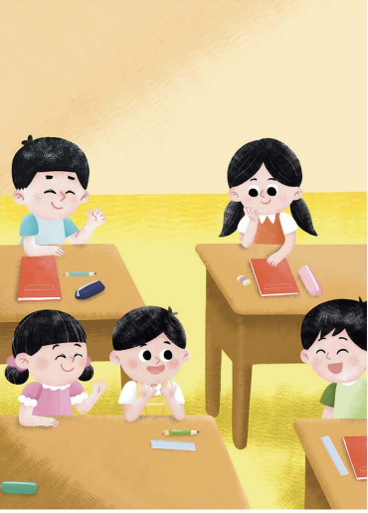
Check the answers.
Picture 1
Picture 2

Slide 17
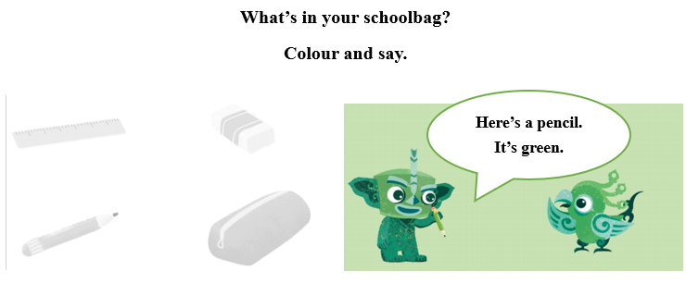
Homework
运用所学语言向朋友介绍自己书包里的学习用品等物品。
给图中的学习用品涂上自己喜欢的颜色，并向同学介绍。（可选做）

Slide 18

Unit 4 School things
Period 3 Let’s practise! ＆ Circle and say. ＆ Let’s have fun.
制作单位：外语教学与研究出版社

