Slide 1
《新启航英语》
Unit 1 Face
Period 1 Let’s chant! & Look, say and draw.
册 次：二年级上册 学 科：英语（外研社版）
主讲人：黄敏 学 校：四川大学附属实验小学
南区学校

Slide 2
通过本课时学习，学生能够：
理解韵文内容，掌握韵文中的面部器官词汇eye、face、 mouth 、nose以及介绍面部器官的核心句型“... on the face.” 。
熟练朗读韵文，并与同伴合作表演韵文。
观察图片，发现人物缺失的面部器官或头发，并进行绘制。

Slide 3

Look and guess.
What can you see in the picture?
How is the weather?
What are they doing?

Slide 4

Listen and check.
snowman

Slide 5
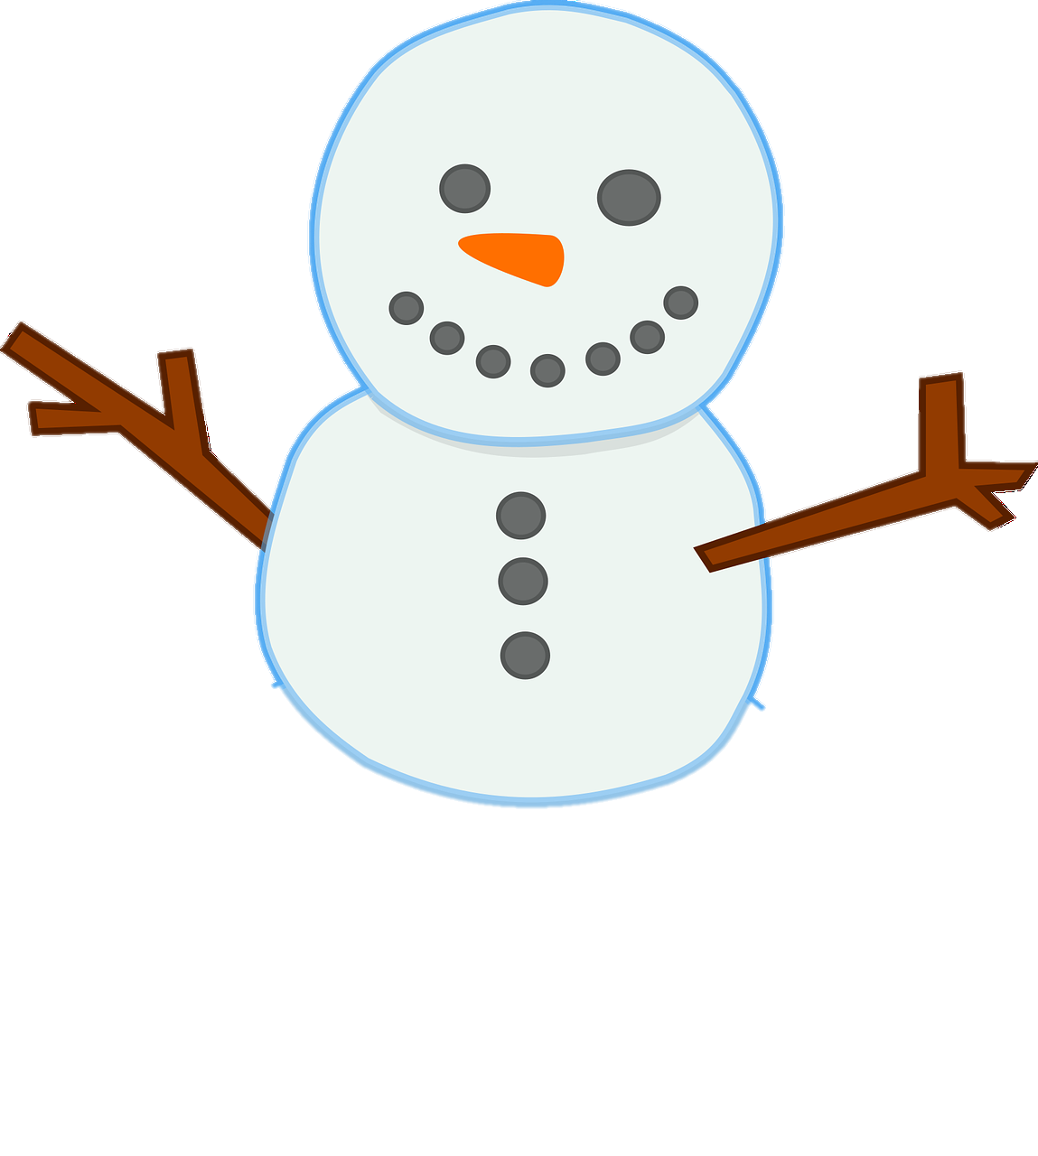

Look and say.
What parts are on the face?
face

Slide 6


Listen, point and say.
Eyes on the face.

Slide 7

Listen, point and say.
A mouth on the face.

Slide 8

Listen, point and say.
A nose on the face.

Slide 9
Listen, match and say.

Slide 10
Look and say.
Are they happy?
Yes, they are happy.
Do they love the snowman?
Yes, they love the snowman.

Slide 11

Listen and say.
What do they say?
This is a snowman.
We love the snowman.

Slide 12
Watch the video and chant.
此处教师可插入教材第1页韵文的视频。

Slide 13
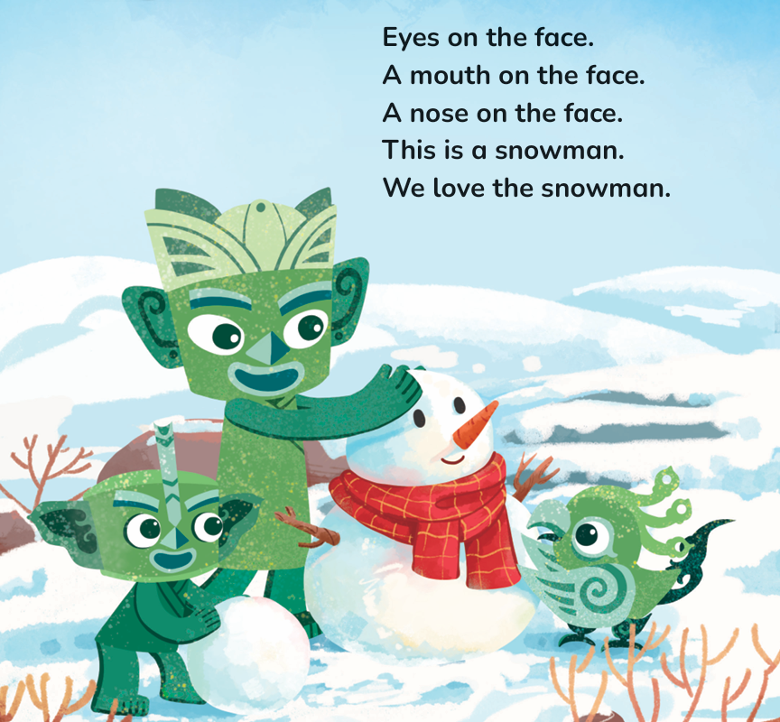
Listen and chant.

Slide 14
Chant together.

Slide 15
Work in groups. Chant and act.
I can:
□chant correctly.
□chant with emotions and actions.
□chant with my friends.

Slide 16

Look and say.
hair

Slide 17


Play a game.
I say. You touch.
Nose.

Slide 18

Look and say.
Which part is missing?

Slide 19

Work in pairs. Find, say and draw.

Slide 20
Homework
带感情地朗读韵文。
仿照教材第10页活动6的游戏，画出人物形象，然后请同学或朋友说出并补全缺失的部分。
仿照本课时学习的韵文，自主创编一个新的韵文，下节课在全班进行展示。（可选做）

Slide 21

Unit 1 Face
Period 1 Let’s chant! & Look, say and draw.
制作单位：外语教学与研究出版社

