Slide 1
Unit 3 Colours
Period 1 Let’s chant!
册 次：一年级上册 学 科：英语（外研社版）
主讲人：郝悦 学 校：四川省成都市成都天府国际
生物城万汇小学

Slide 2
通过本课时学习，学生能够：
理解韵文内容，掌握颜色相关词汇red、blue、yellow、green、orange，以及表达个人喜好的句型“I like...”。
熟练朗读韵文，并与同伴合作表演韵文。

Slide 3
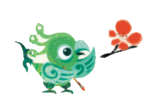
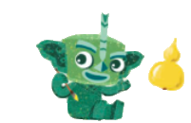
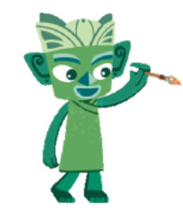
Look and say.
Feifei
Tongtong
Qingqing

Slide 4
Watch the video and answer.
What colours can you hear?
此处教师可插入教材第23页韵文的视频。

Slide 5

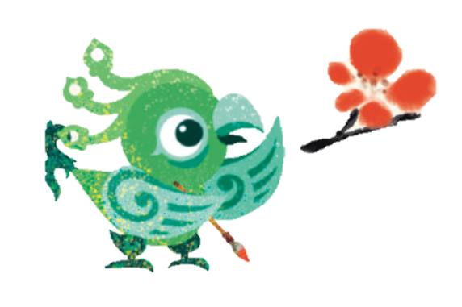
Look, listen and say.
What’s the colour?
Red, red.
I like red.

Slide 6
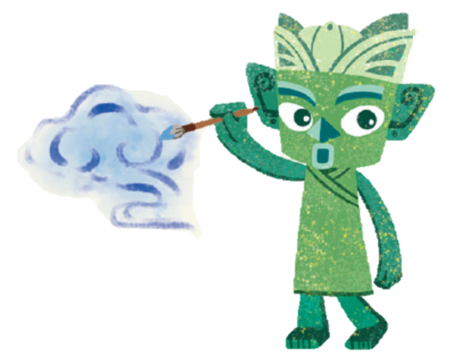
Look, listen and say.
What’s the colour?
Blue, blue.
I like blue.

Slide 7
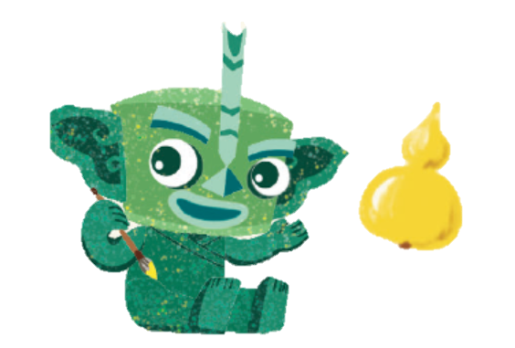
Look, listen and say.
What’s the colour?
Yellow, yellow.
I like yellow.

Slide 8
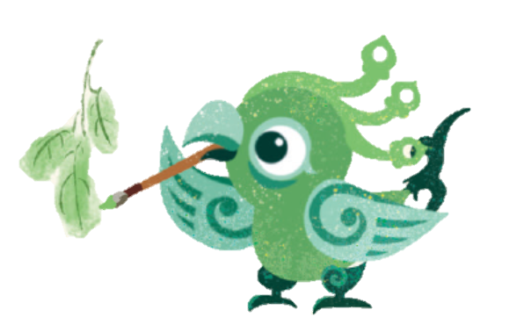
Look, listen and say.
What’s the colour?
Green, green.
I like green.

Slide 9
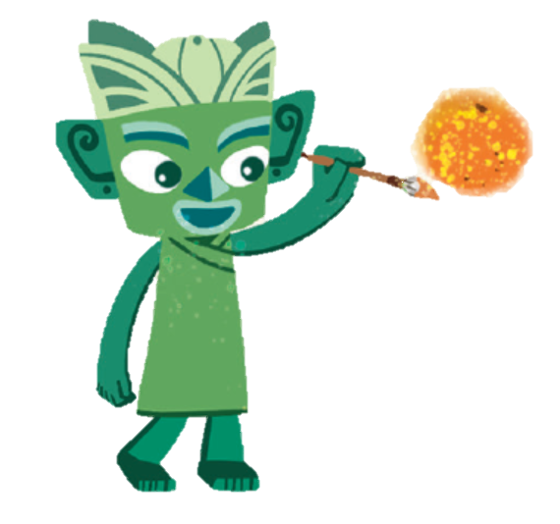
Look, listen and say.
What’s the colour?
Orange, orange.
I like orange.

Slide 10
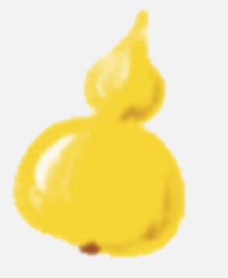
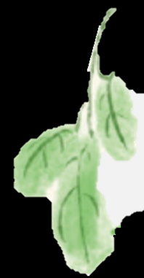

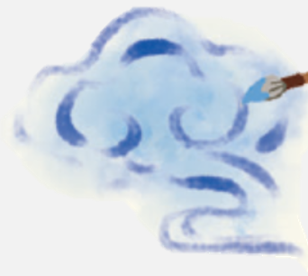

Look and say.
What’s the colour?
red
blue
yellow
green
orange

Slide 11
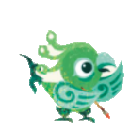
Match and say.
Red red red
_______, _______, I like _______.

Slide 12
Match and say.
Green green green
_______, _______, I like _______.

Slide 13
Match and say.
Yellow yellow yellow
_______, _______, I like _______.

Slide 14
Match and say.
Blue blue blue
_______, _______, I like _______.

Slide 15
Match and say.
Orange orange orange
_______, _______, I like _______.

Slide 16
Watch the video and repeat.
此处教师可插入教材第23页韵文的视频。

Slide 17
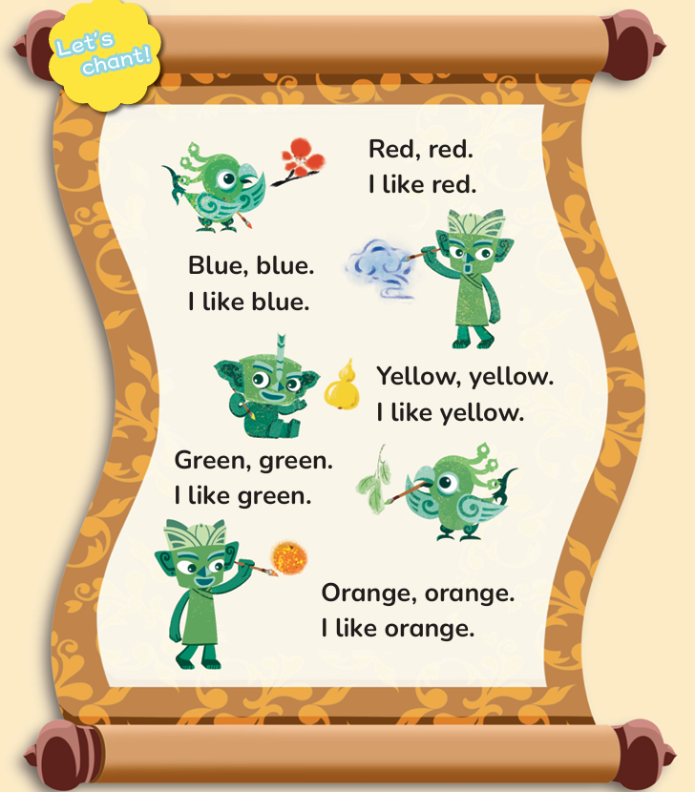
Listen, point and chant.
Red, red.
I like red.
Green, green.
I like green.
Blue, blue.
I like blue.
Orange, orange.
I like orange.
Yellow, yellow.
I like yellow.

Slide 18
Let’s chant.
Red, red.
I like red.
Green, green.
I like green.
Blue, blue.
I like blue.
Orange, orange.
I like orange.
Yellow, yellow.
I like yellow.

Slide 19
Work in groups. Chant and act it out.

Slide 20
Think and say.
What colour do you like?
I
like
red.
blue.
yellow.
green.
orange.

Slide 21

Colour and say.
______, ______.
I like ______.
Tips:
1. Be correct. (准确)
2. Be fluent. (流畅)
3. Be rhythmic. (有节奏)

Slide 22
Homework
带感情地朗读韵文。
向父母表演韵文。

Slide 23

Unit 3 Colours
Period 1 Let’s chant!
制作单位：外语教学与研究出版社

