Slide 1

Unit 1 Hello!
Period 1 Let’s chant!
册 次：一年级上册 学 科：英语（外研社版）
主讲人：高雪 学 校：四川省成都市双流区迎春小学

Slide 2
通过本课时学习，学生能够：
理解韵文内容，掌握表示打招呼的礼貌用语“Hello.”“ Hi.”“Nice to meet you!”，初步感知与理解发出邀约时使用的表达“ Let’s play!”，以及表示信息确认和回应的表达“OK? OK!”。
熟练朗读韵文，并与同伴合作表演韵文。

Slide 3

Look and say.
Feifei

Slide 4


Look and say.
Hello..
Hello. Feifei..
Feifei

Slide 5

Look and say.
Qingqing

Slide 6
Look and say.
Hi..
Hi. Qingqing..
Qingqing

Slide 7

Look and say.
Tongtong

Slide 8
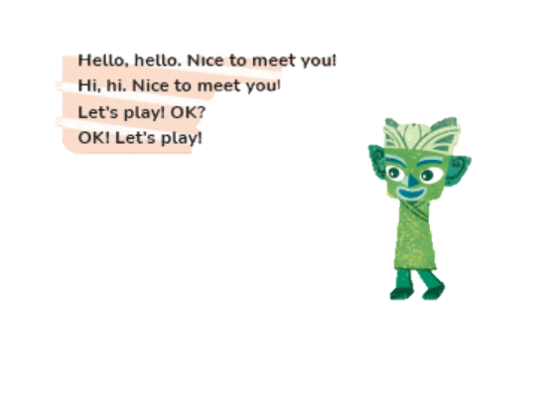
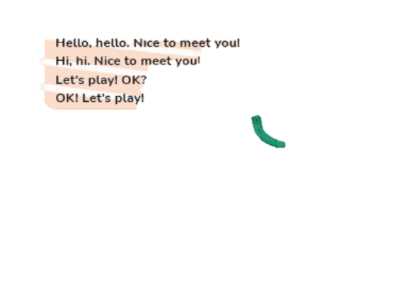

Look and say.
Hello..
Hi..
_____. Tongtong..
Tongtong

Slide 9

Look and say.
______. Qingqing..
Qingqing

Slide 10

Look and say.
Feifei
______. Feifei..

Slide 11
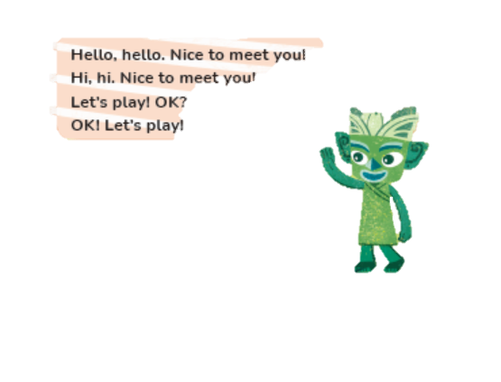
Look and say.
_____. Tongtong..
Tongtong

Slide 12




Look and say.
?
?
Qingqing
Feifei

Slide 13
Listen, check and repeat.
Nice to meet you!
Nice to meet you!
?
?
Qingqing
Feifei

Slide 14
Look, listen and say.
Nice to meet you!
Nice to meet you!
Qingqing
Tongtong

Slide 15
Look, listen and say.
Nice to meet you!
Nice to meet you! .
Tongtong
Feifei

Slide 16



Look and say.
?
Let’s play! OK?
OK! Let’s play!
?
OK! Let’s play!
Feifei
?
Qingqing
Tongtong

Slide 17

Look and say.
?
Let’s play! OK?
OK! Let’s play!
?
OK! Let’s play!
?
Qingqing
Tongtong
Feifei

Slide 18

Look and say.
Let’s play! OK?
OK! Let’s play!
?
OK! Let’s play!
?
Let’s play! OK?
Feifei
Tongtong
Qingqing

Slide 19
Watch the video and chant.
此处教师可插入教材第1页韵文的视频。

Slide 20
Chant in groups.
Hello, hello. Nice to meet you!
Hi, hi. Nice to meet you!
Let’s play! OK?
OK! Let’s play!

Slide 21
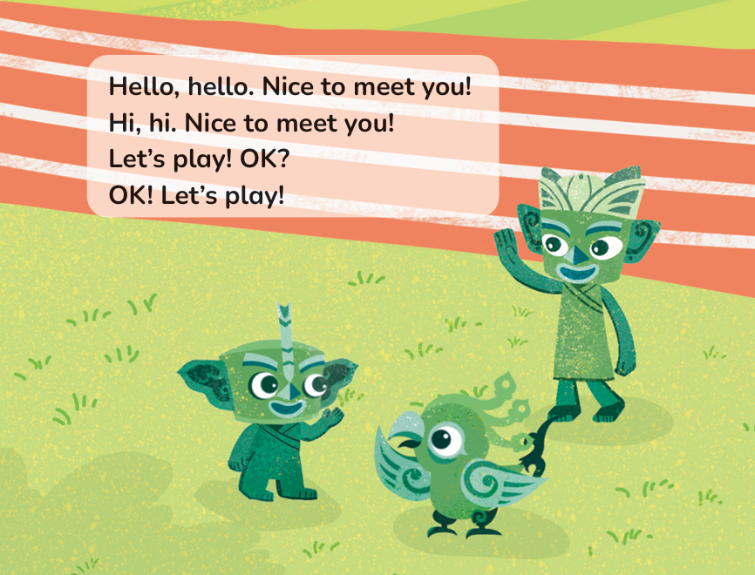
Chant with actions.

Slide 22
Summary
Hello.
Hi.
Nice to meet you!

Slide 23

Summary
Let’s play! OK?
OK! Let’s play!

Slide 24
Homework
带感情地朗读韵文。
用本课时所学语言与教师和班级同学打招呼。

Slide 25
Unit 1 Hello!
Period 1 Let’s chant!
制作单位：外语教学与研究出版社

