Slide 1


《新启航英语》（预备级）
Unit 5 My room
Period 1 Let’s chant!
册 次：一年级下册 学 科：英语（外研社版）
主讲人：钟乐艳 学 校：成都市实验小学

Slide 2
通过本课时学习，学生能够：
理解韵文内容，掌握描述房间和房间设施的词汇、表示方位的介词以及询问物品位置的疑问句。
准确朗读韵文，并与同伴合作表演韵文。

Slide 3
Watch the video and chant.
此处教师可插入一年级上册Unit 5韵文的视频。

Slide 4
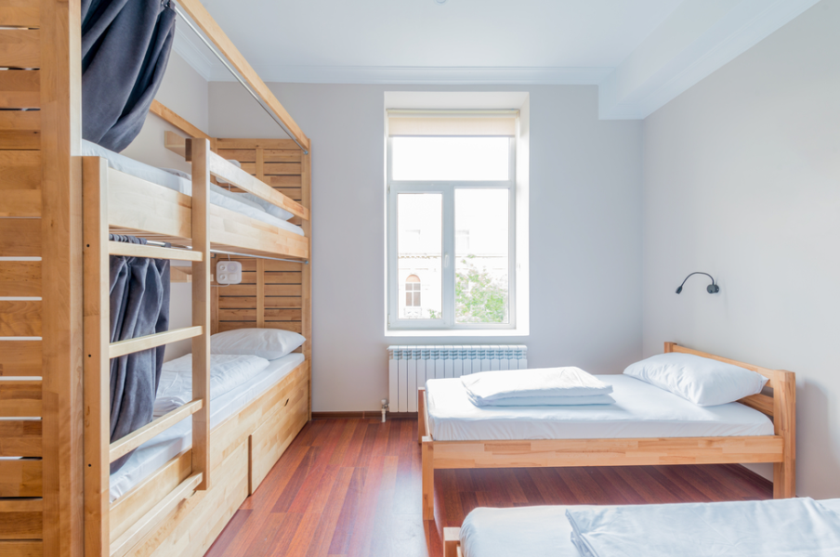


Look and say.

Slide 5
Watch the video and say.
此处教师可插入教材第45页韵文的视频。

Slide 6

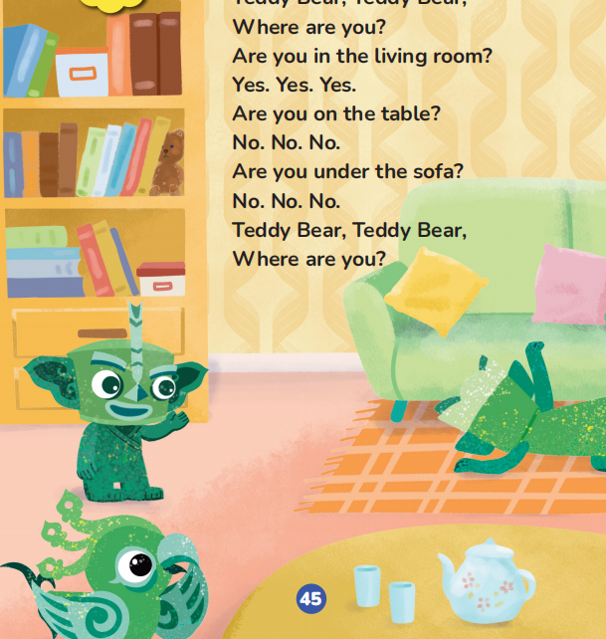



Watch the video and say.
classroom
living room

Slide 7
Listen and say.
What can you find in the living room?

Slide 8
Listen and say.
table

Slide 9
Listen and say.
sofa

Slide 10
Let’s say.
Table. Table. In the living room.
Sofa. Sofa. In the living room.

Slide 11
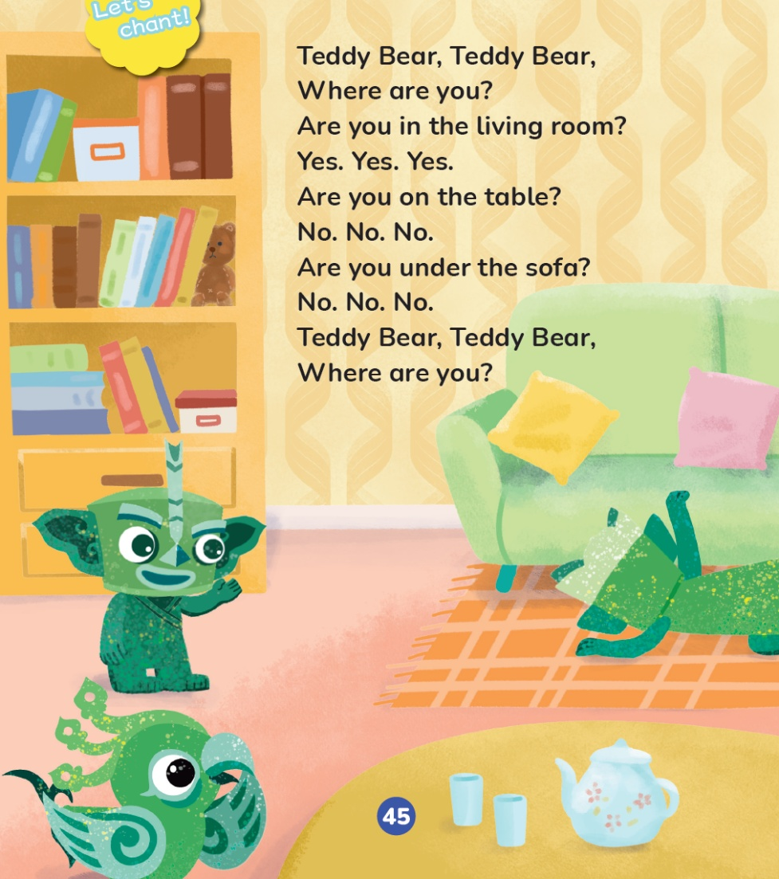
Look and say.
Who’s in the living room?

Slide 12
Look and say.
What are they looking for?
teddy bear

Slide 13
Look and say.
What do they say?

Slide 14
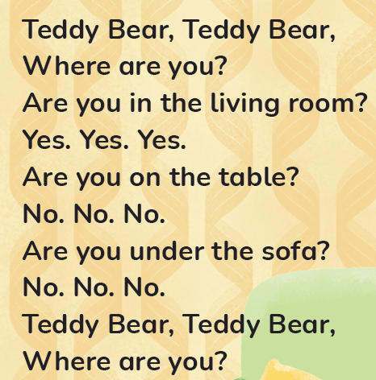
Listen and repeat.

Slide 15
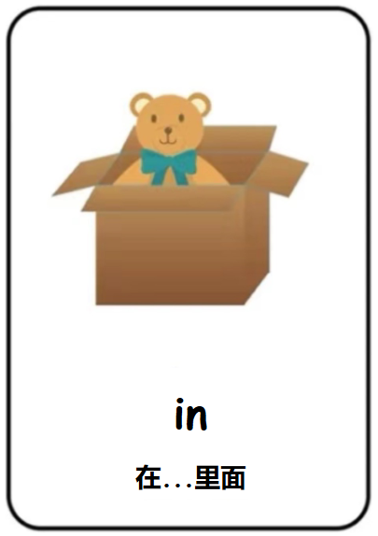




Listen and repeat.
in the living room
in
在……里面

Slide 16
Listen and repeat.
Are you in the living room?
Yes. Yes. Yes.

Slide 17
Listen and repeat.

Slide 18
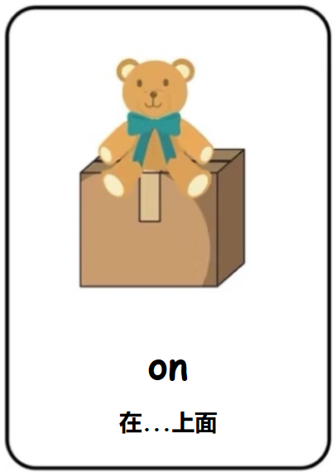

Listen and repeat.
on
the table
on
在……上面

Slide 19
Listen and repeat.
Are you on the table?
No. No. No.

Slide 20
Listen and repeat.

Slide 21




Listen and repeat.
under
the sofa
under
在……下面

Slide 22
Listen and repeat.
Are you under the sofa?
No. No. No.

Slide 23
Listen and chant.

Slide 24
Watch the video and chant.
此处教师可插入教材第45页韵文的视频。

Slide 25

Work in groups. Chant and act out.

Slide 26
Homework
带感情地朗读韵文。
与同学合作表演韵文。

Slide 27

《新启航英语》（预备级）
Unit 5 My room
Period 1 Let’s chant!
制作单位：外语教学与研究出版社

