Slide 1

《新启航英语》（预备级）
Unit 5 My room
Period 3 Match and say. & Let’s practise. & Let’s have fun.
册 次：一年级下册 学 科：英语（外研社版）
主讲人：缪沐珍 学 校：成都市泡桐树小学桐欣校区

Slide 2
通过本课时学习，学生能够：
完成拼图和图文匹配活动，掌握本单元所学的物品词汇。
在具体情境中，运用本单元所学语言询问和描述物品的位置。
设计并绘制自己梦想中的房间，运用所学语言进行介绍。

Slide 3
Let’s chant.
此处教师可插入教材第45页韵文的视频。

Slide 4
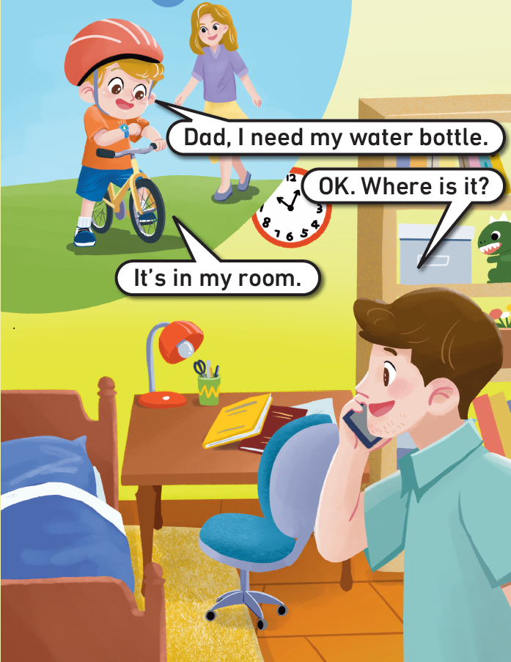
Look and say.

Slide 5
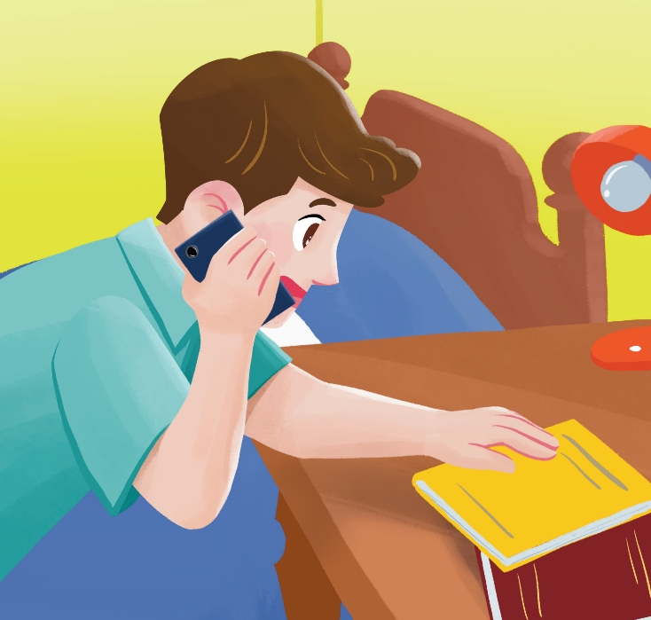
Look and say.
Is the water bottle on the desk?
?
×

Slide 6
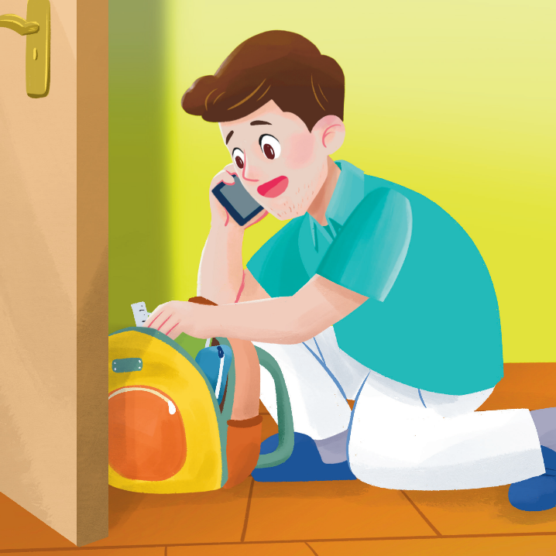
Look and say.
Is the water bottle in the schoolbag?
?
×

Slide 7
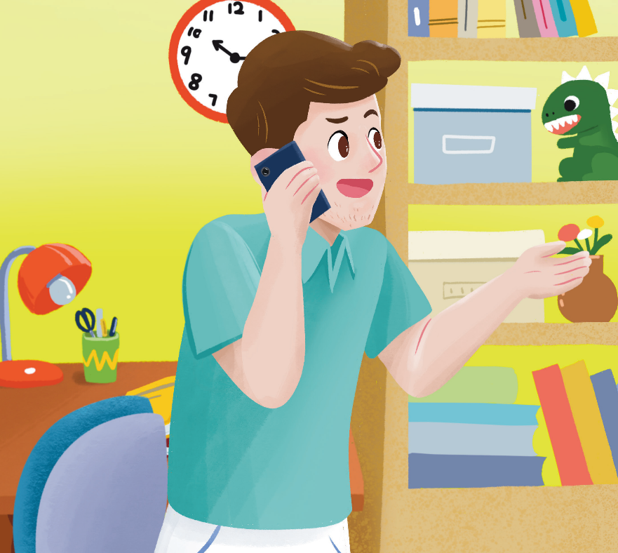

Look and say.
Is the water bottle on the bed?
?
×

Slide 8



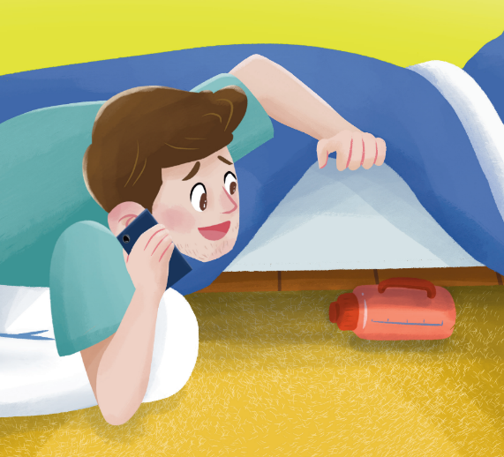
Look and say.
×
×
×
The water bottle is not…
√
under the bed
The water bottle is ____________.

Slide 9




Work in pairs. Match and say.
What’s this?
water bottle

Slide 10




Work in pairs. Match and say.
bed
schoolbag
water bottle

Slide 11



Look and answer.
schoolbag
book
water bottle
What’s this?

Slide 12

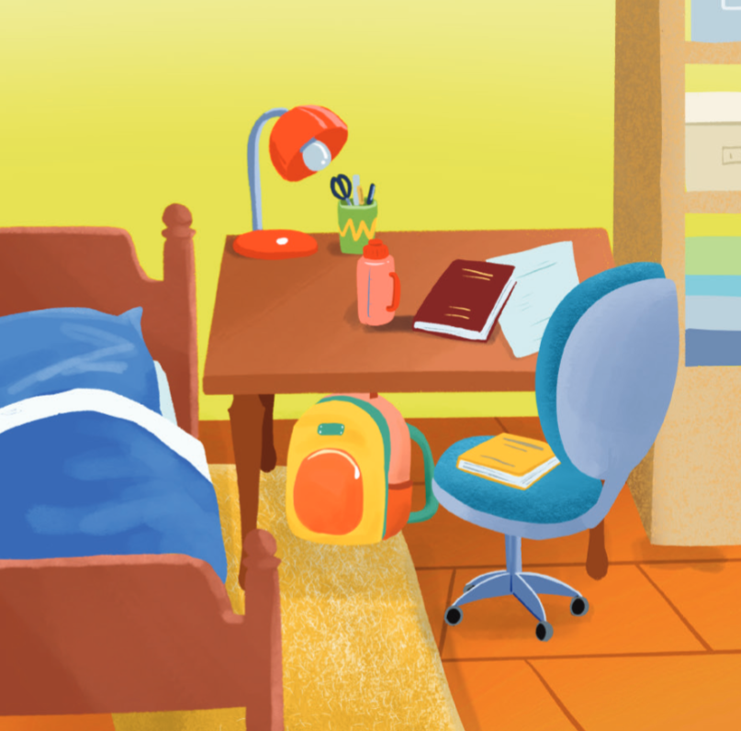

Look and say.
Where is the _______?
It’s under the desk.

Slide 13

Let’s practise.
Where is the _______?
on the chair
It’s ___________.

Slide 14

Let’s practise.
Where is the _______?
on the desk
It’s ____________.

Slide 15
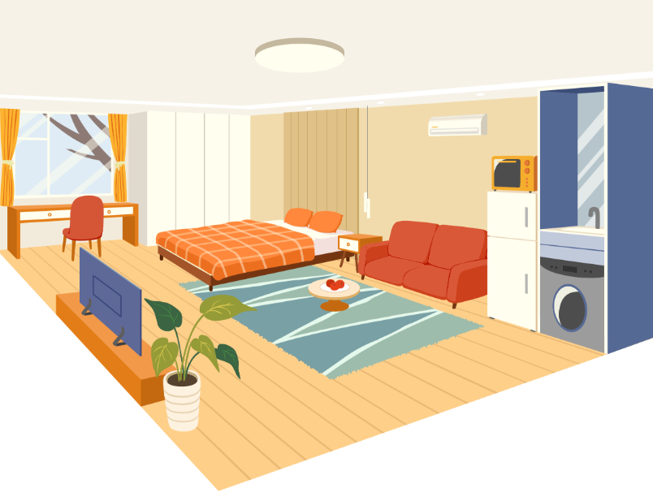
Look and say.

Slide 16

Think and draw.
Is your dream room big / small?
What things are there in the room?
Where are the things?

Slide 17
Work in groups.
This is my dream room.
Share the picture of your dream room with your group members.
Introduce it to your class.
It’s big / small.
Look! I have… in my room.
It’s on / in / under…

Slide 18
Homework
仿照教材第53页Let’s practise.的活动，与同学交流不同物品在教室里的位置。
完善自己梦想中的房间的画作，并运用核心语言向家人或朋友介绍。

Slide 19

《新启航英语》（预备级）
Unit 5 My room
Period 3 Match and say. & Let’s practise. & Let’s have fun.
制作单位：外语教学与研究出版社

