Slide 1
《新启航英语》（预备级）
Unit 4 At the farm
Period 1 Let’s chant! & Let’s practise.
册 次：一年级下册 学 科：英语（外研社版）
主讲人：杨柳 学 校：成都市实验小学青华分校

Slide 2
通过本课时学习，学生能够：
理解韵文内容，掌握数字1—12的英文表达。
熟练朗读韵文，并与同伴合作表演韵文。
运用所学语言，与同伴交流物品的数量。

Slide 3
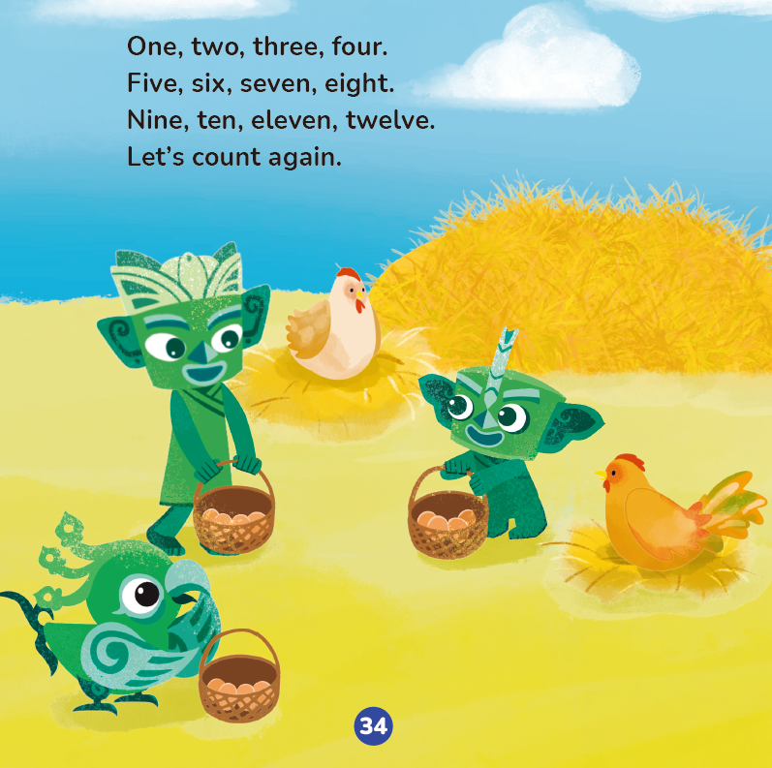
Look and say.
Tongtong
Who are they?
Qingqing
Qingqing, Tongtong and Feifei.
Where are they?
At the farm.
Feifei

Slide 4
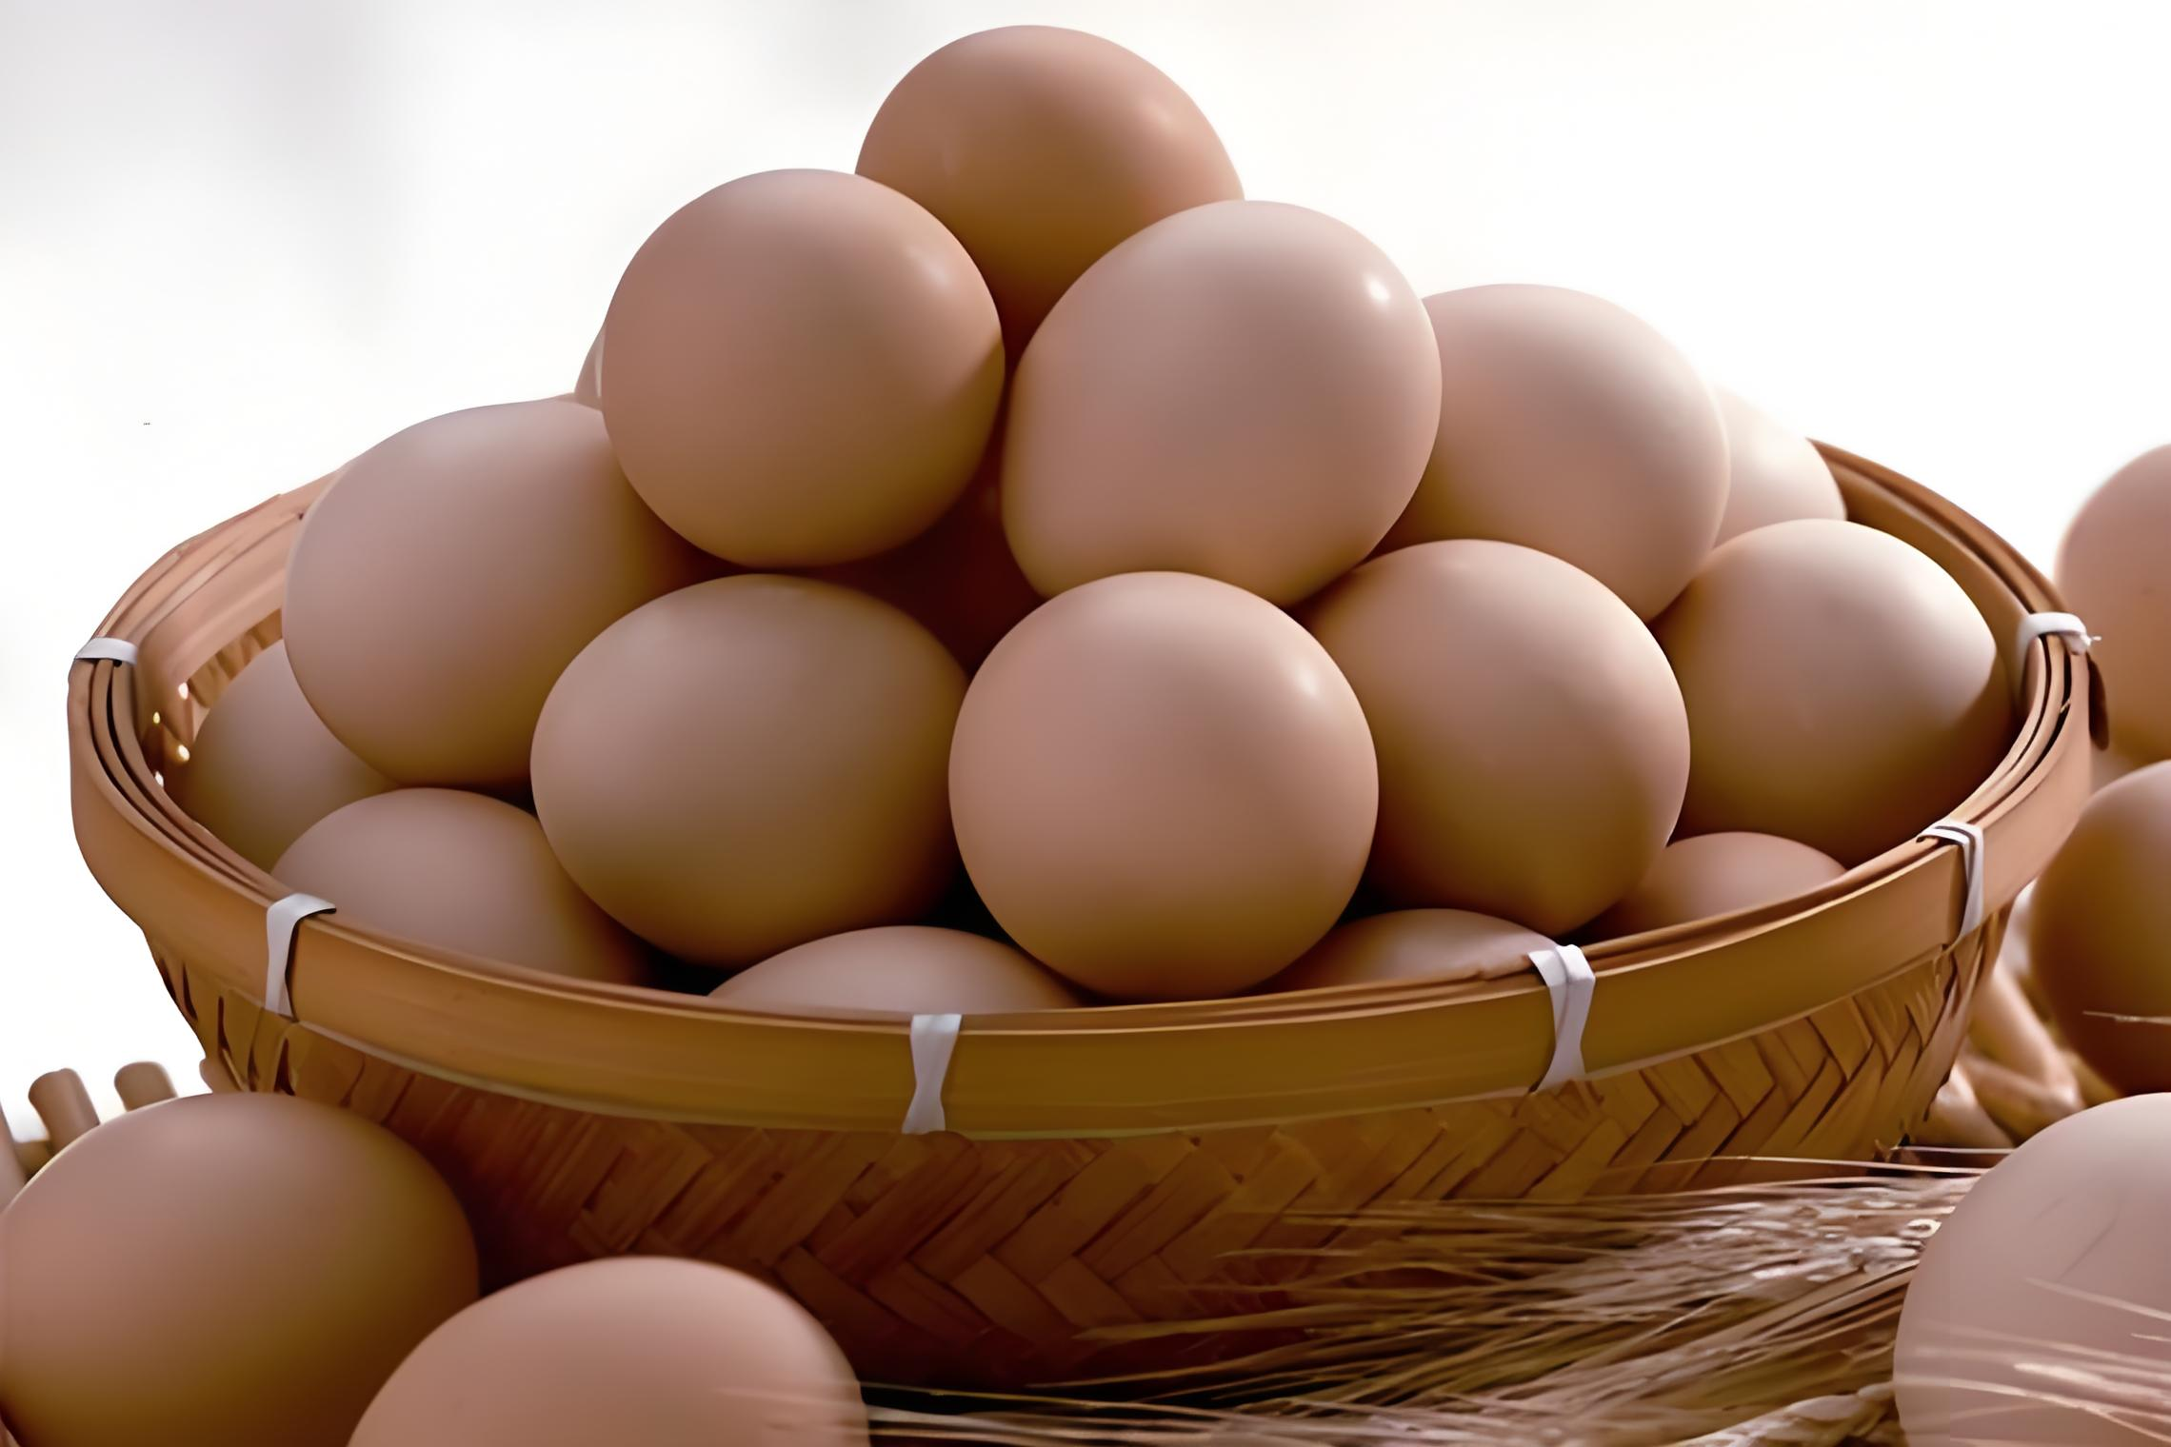

Look and say.
What do they have?
Eggs.
eggs
egg
How do they feel?
Happy.

Slide 5
Look and say.
How many eggs do they have? Can you count?
2
4
1
3
1
2
3
4
2
4
1
3

Slide 6
Watch the video.
此处教师可插入教材第34页韵文的视频。

Slide 7

Listen and repeat.
5
8
6
7
1
2
3
4
9
12
10
11
One, two, three, four.
Five, six, seven, eight.
Nine, ten, eleven, twelve.
Let’s count again.

Slide 8

Work in pairs. Count and say.
One, two, three... Let’s count again. OK?
OK. One, two, three...

Slide 9
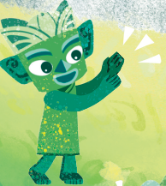
Watch the video and chant.
此处教师可插入教材第34页韵文的视频。
Clap your hands!

Slide 10
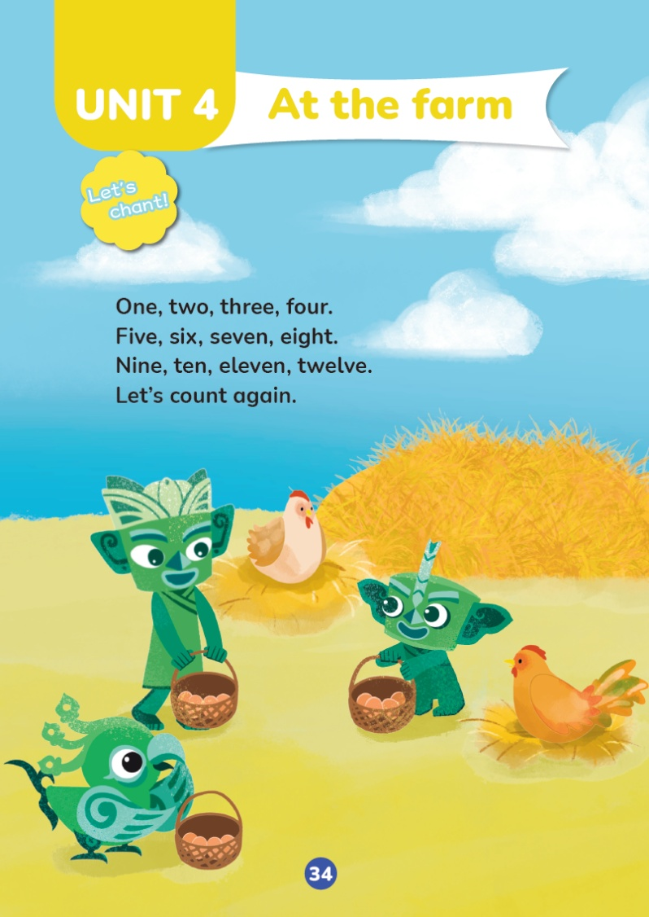
Listen and chant.

Slide 11
Chant together.

Slide 12
Work in groups. Chant and act it out.
Tongtong
Qingqing
Feifei

Slide 13


Let’s practise.
One,
two,
three,
four,
five.
How many?
Six,
seven,
eight,
nine,
ten,
eleven.

Slide 14
Let’s practise.
One,
two,
three,
four,
five,
How many?
Seven,
eight,
nine,
ten,
eleven,
twelve.
six.

Slide 15
Work in pairs. Count and say.
How many?

Slide 16
Homework
看视频，跟读教材第34页的韵文。
仿照教材第43页的活动5，与同学或朋友玩一玩数数的游戏。

Slide 17

《新启航英语》（预备级）
Unit 4 At the farm
Period 1 Let’s chant! & Let’s practise.
制作单位：外语教学与研究出版社

