Slide 1
《新启航英语》（预备级）
Unit 4 At the farm
Period 3 Let’s explore. & Let’s have fun.
册 次：一年级下册 学 科：英语（外研社版）
主讲人：李雨庭 学 校：成都市双眼井小学

Slide 2
通过本课时学习，学生能够：
在具体情境中，运用“How many...?”和表示数字的英文词汇与同伴进行关于数量的交流。
完成连点成画和涂色的活动，识别并说出图中的动物。

Slide 3
Watch and chant.
此处教师可插入教材第34页韵文的视频。

Slide 4
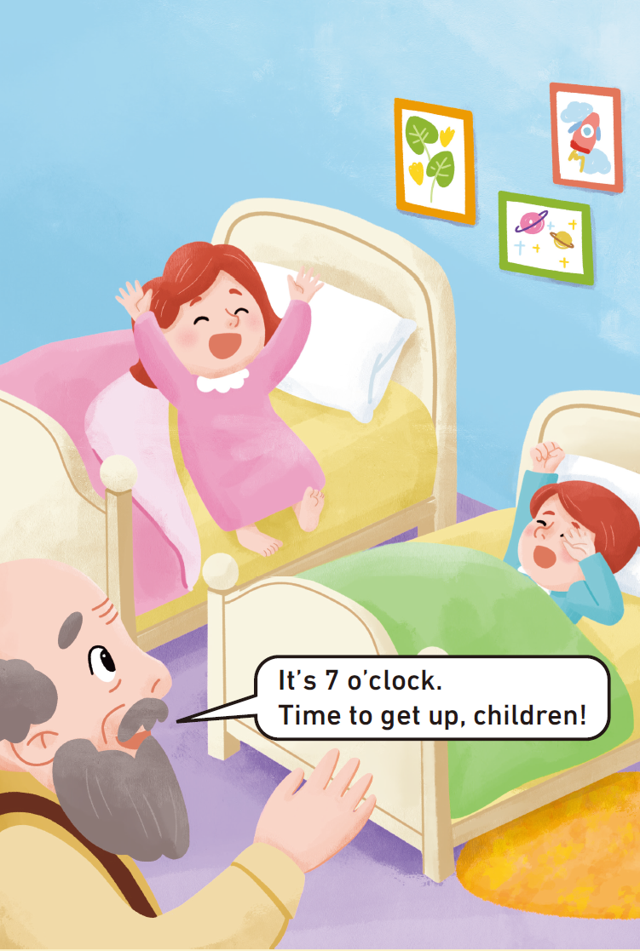

Look and say.
It’s... o’clock. Time to...

Slide 5
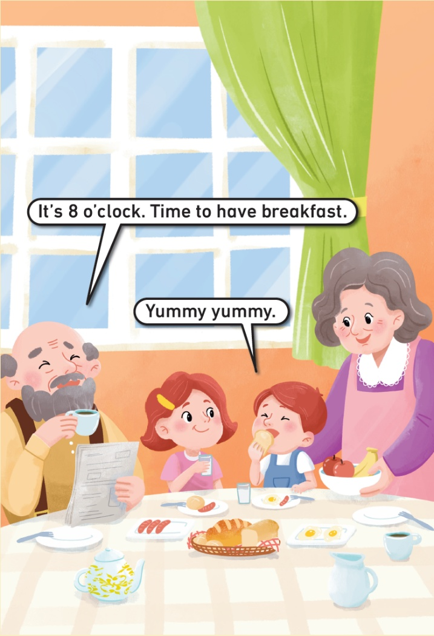

Look and say.
It’s... o’clock. Time to...

Slide 6


Look and say.
It’s... o’clock. Let’s...

Slide 7
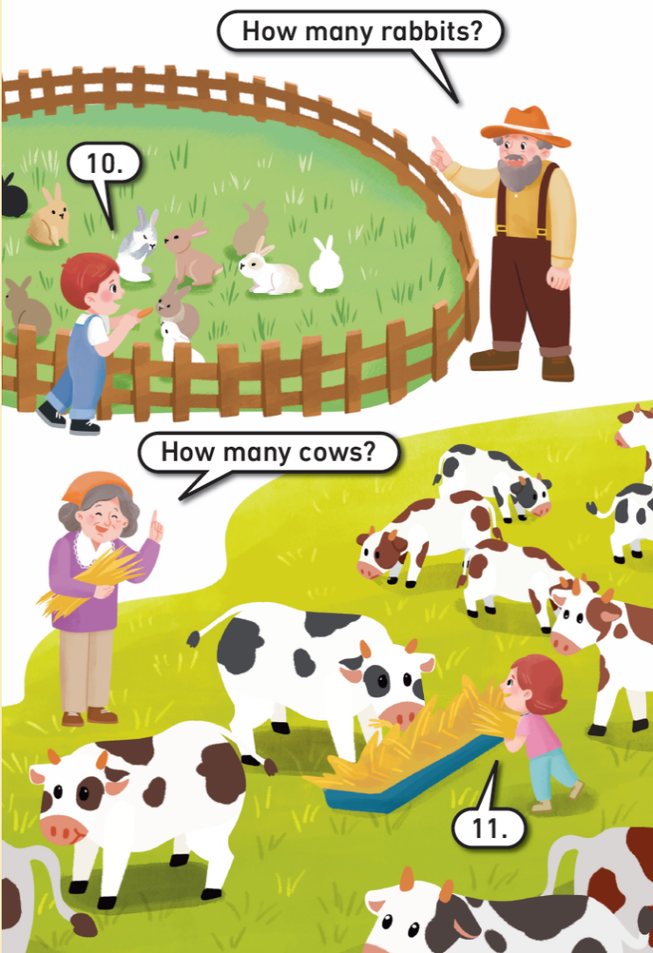
Look and say.
How many...?

Slide 8
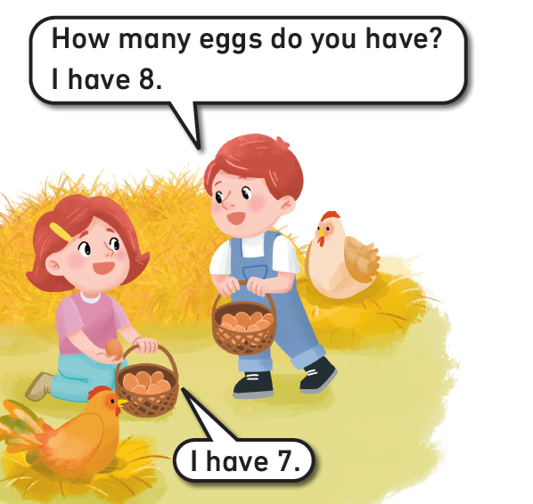
Look and say.
How many... do you have?
I have...

Slide 9
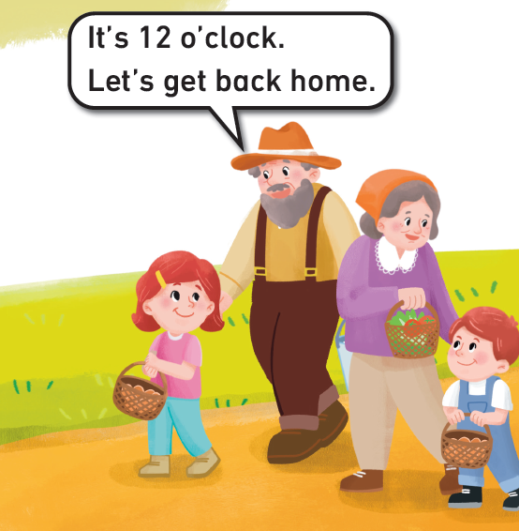

Look and say.
It’s... o’clock. Let’s...

Slide 10
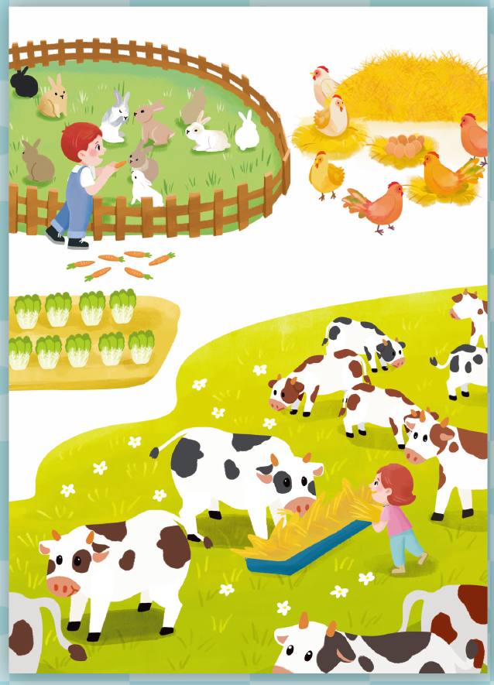




Look and say.
What can you see in the picture?

Slide 11

Look, count and say.
How many ?
Nine.

Slide 12
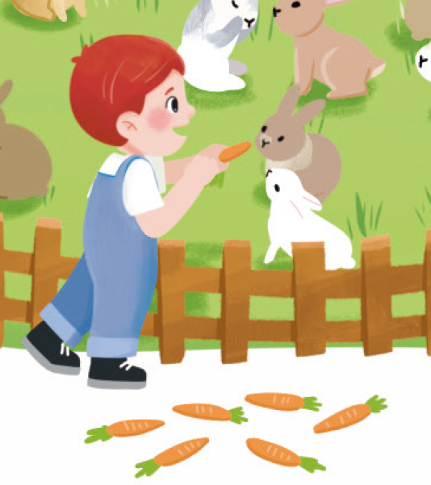

Look, count and say.
How many ?
Seven.

Slide 13









Work in pairs. Count and say.
eggs
chickens
cows
flowers
rabbits
How many _________?

Slide 14
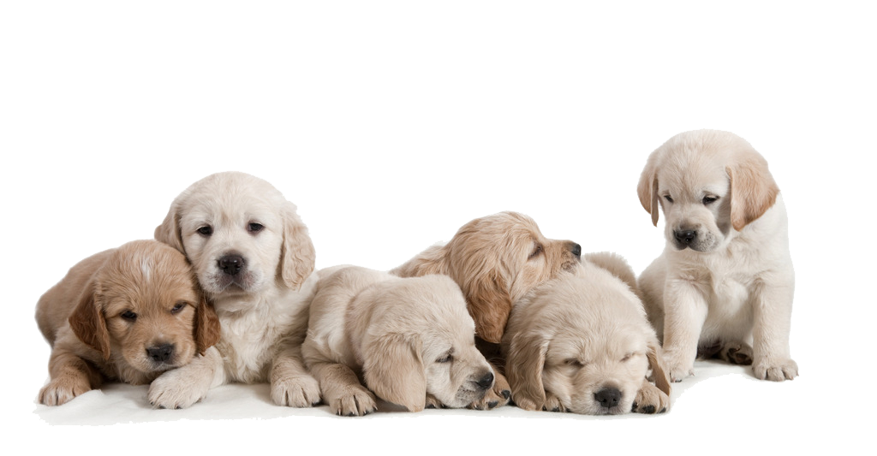


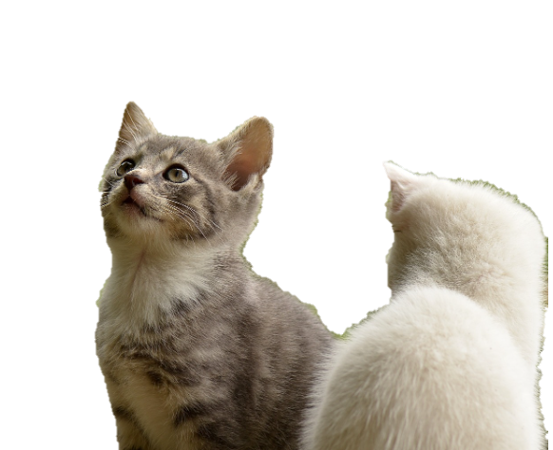
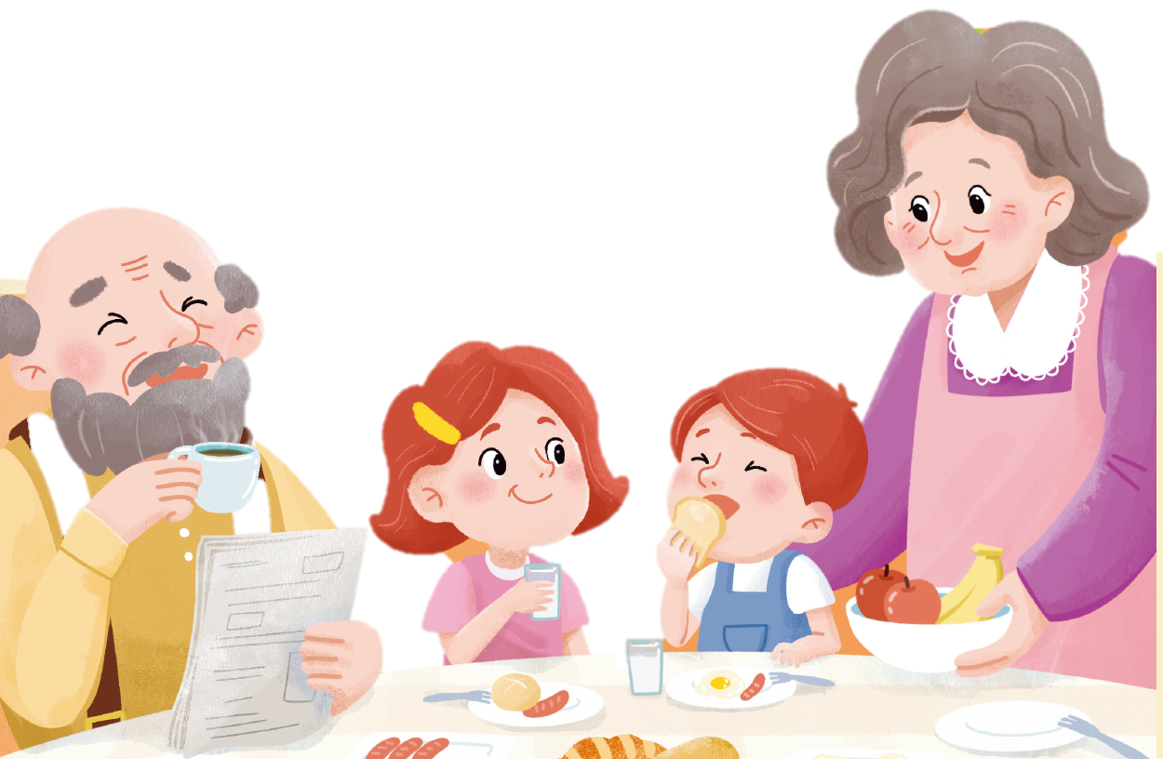
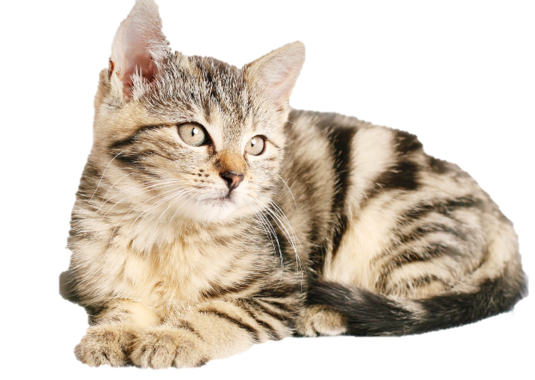
Count, match and say.
How many...?
dogs
birds
11
4
6
5
people
cats

Slide 15
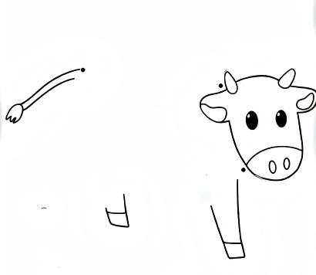
Look and guess.
What is it?

Slide 16
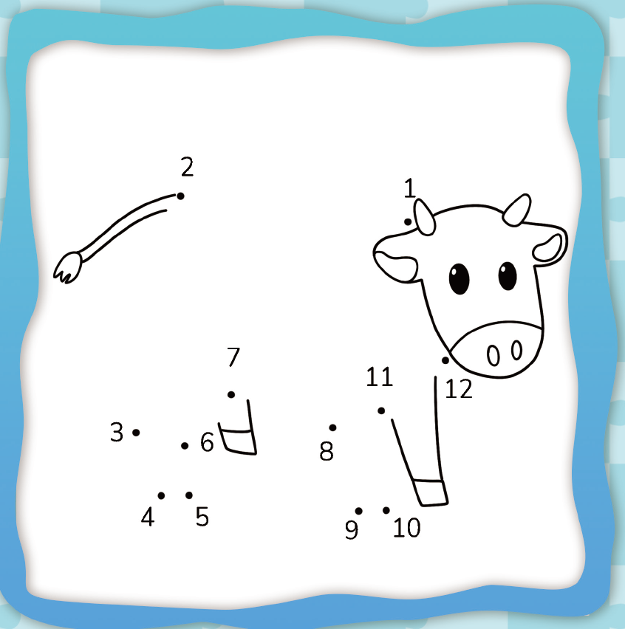
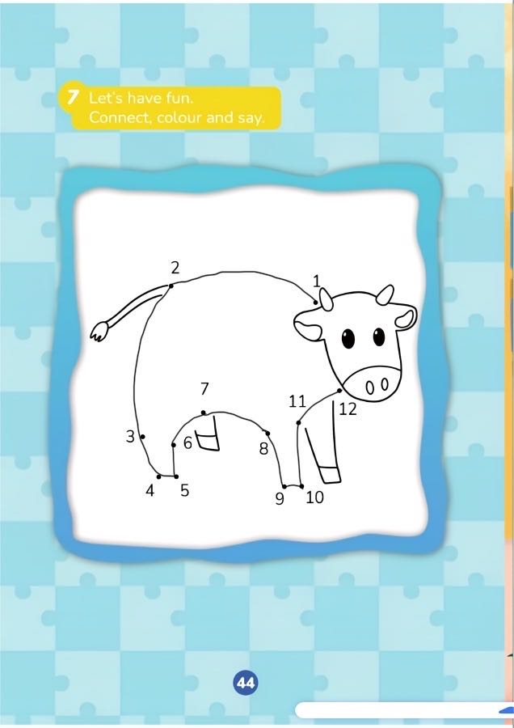
Connect and check.
What is it?
It’s a cow.

Slide 17
Let’s colour.

Slide 18
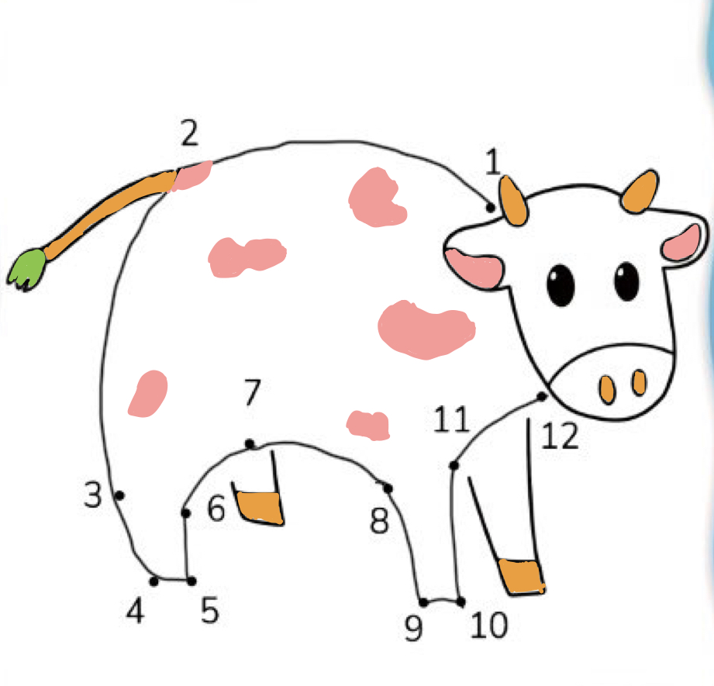
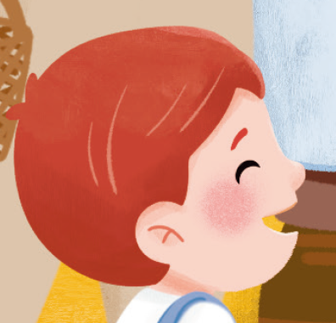

Work in pairs. Share your work.
How many colours do you use?
Three.
What are they?
...

Slide 19
Homework
与同伴运用核心语言就身边不同物品的数量开展问答。
设计一个连点成画并涂色的任务，然后与同学交换任务，完成画作后互相展示、介绍。

Slide 20

《新启航英语》（预备级）
Unit 4 At the farm
Period 3 Let’s explore. & Let’s have fun.
制作单位：外语教学与研究出版社

