Slide 1


《新启航英语》（预备级）
Unit 3 Pets
Period 2 Let’s read!
册 次：一年级下册 学 科：英语（外研社版）
主讲人：卫荟宇 学 校：成都市花园（国际）小学
清波校区

Slide 2


国家中小学课程资源
通过本课时学习，学生能够：
在看图片、听录音、朗读故事等活动中，梳理、理解故事内容。
掌握并灵活运用介绍宠物的核心句型“I have a pet. It’s...”。
借助图片和语言提示表演故事，感受人与动物和谐相处的关系。

Slide 3
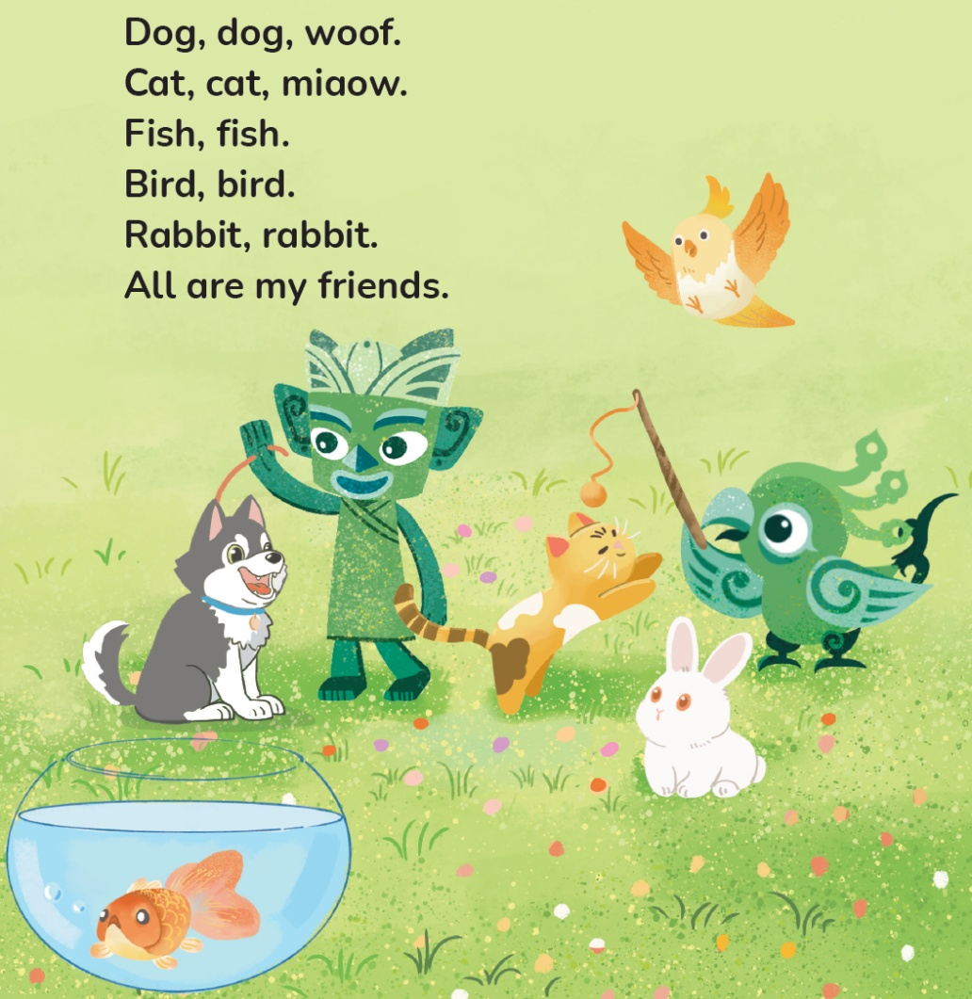
国家中小学课程资源
Let’s chant.
此处教师可插入教材第23页韵文的视频。

Slide 4

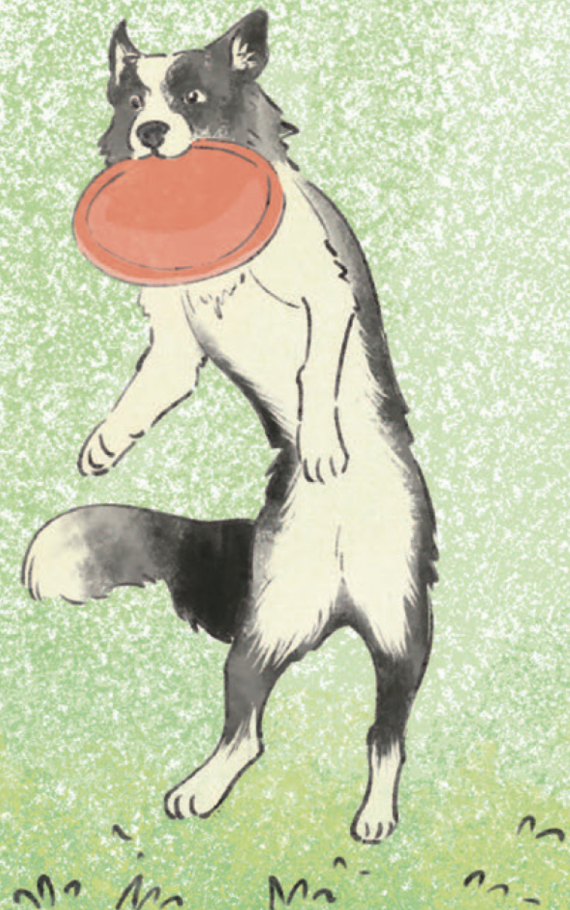
国家中小学课程资源
Guess and say.
dog
________

Slide 5
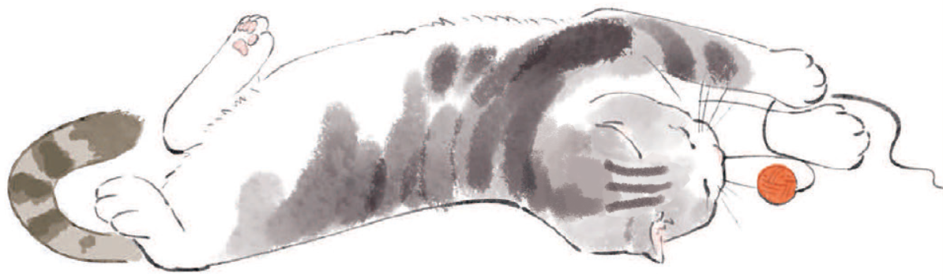
国家中小学课程资源
Guess and say.
cat
________

Slide 6
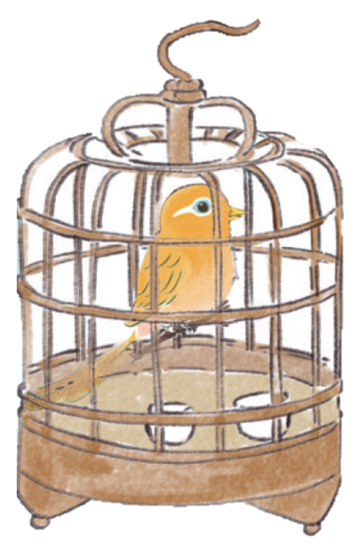
国家中小学课程资源
Guess and say.
bird
________

Slide 7
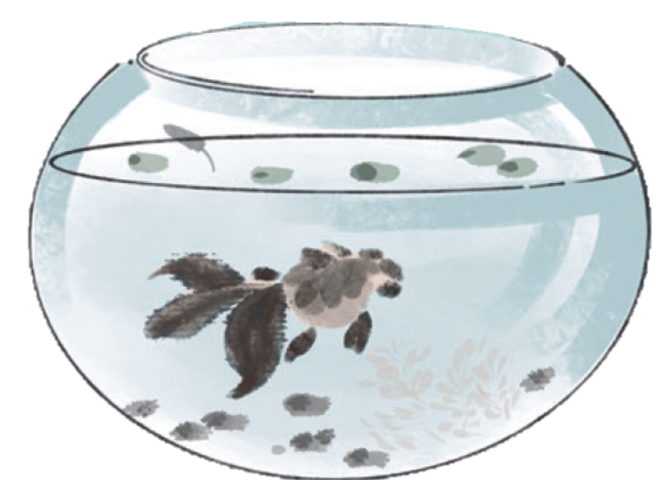

国家中小学课程资源
Guess and say.
fish
________

Slide 8
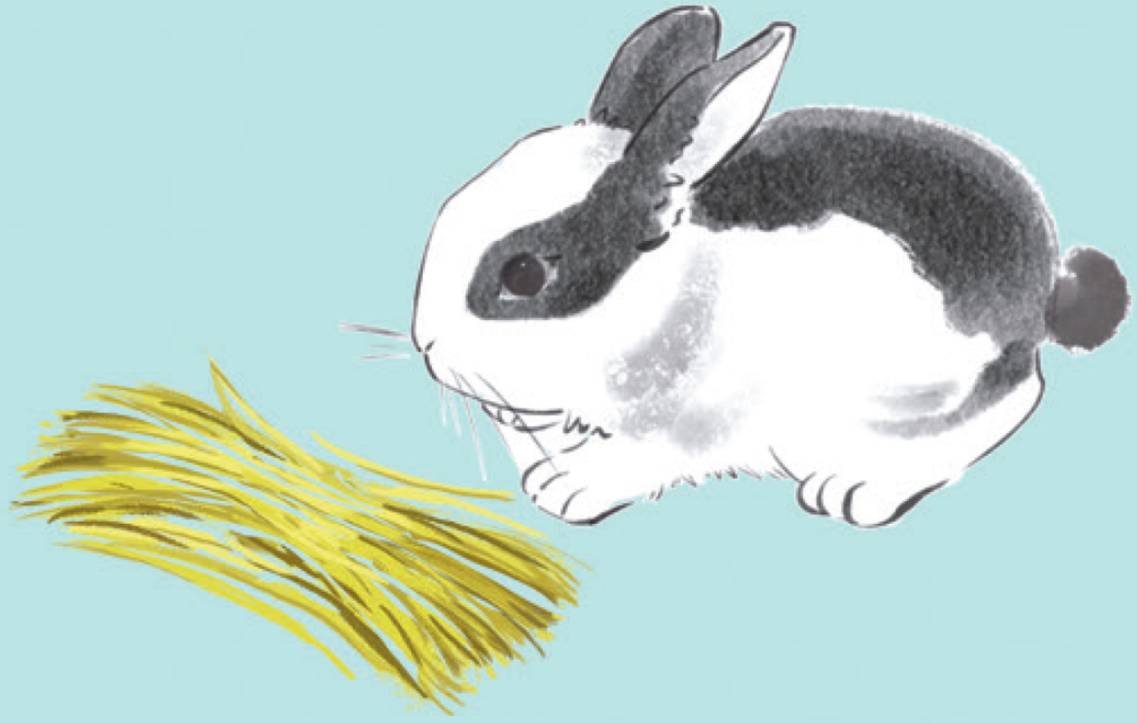
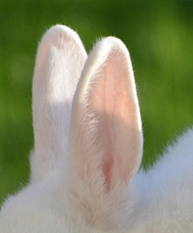
国家中小学课程资源
Guess and say.
rabbit
________

Slide 9
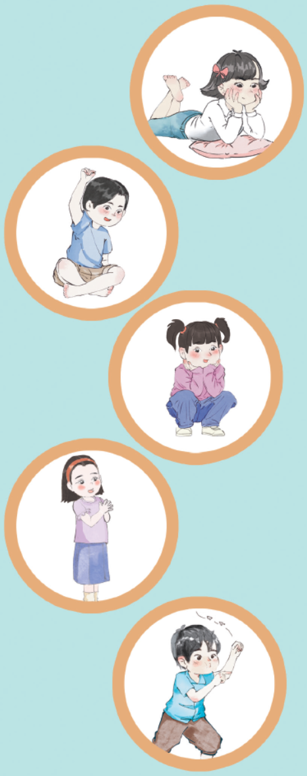
国家中小学课程资源
Look and say.
My pet
What pet does he / she have?

Slide 10

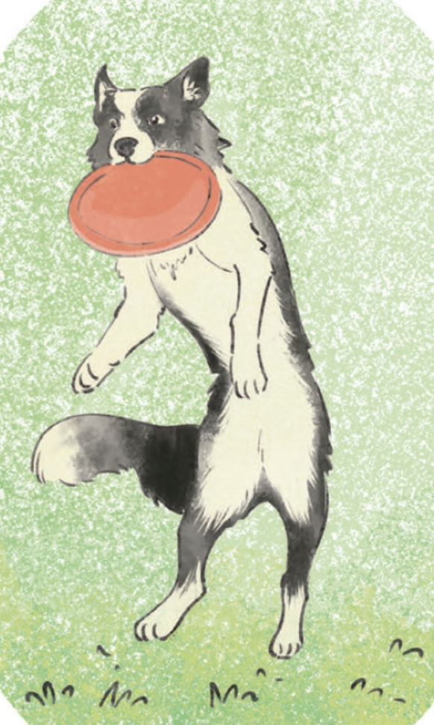
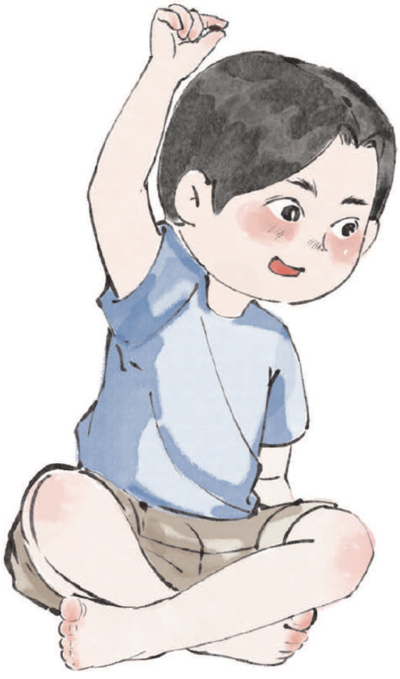
国家中小学课程资源
Look and say.
What can you see?
A boy.
What pet does the boy have?
A dog.
What will he say?

Slide 11
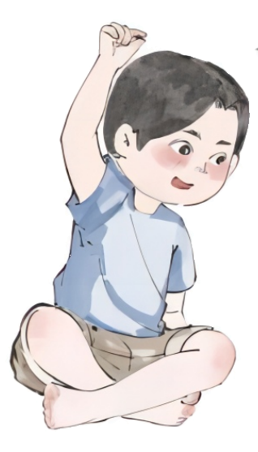
国家中小学课程资源
Listen, check and repeat.
I have a pet. It’s a dog.

Slide 12
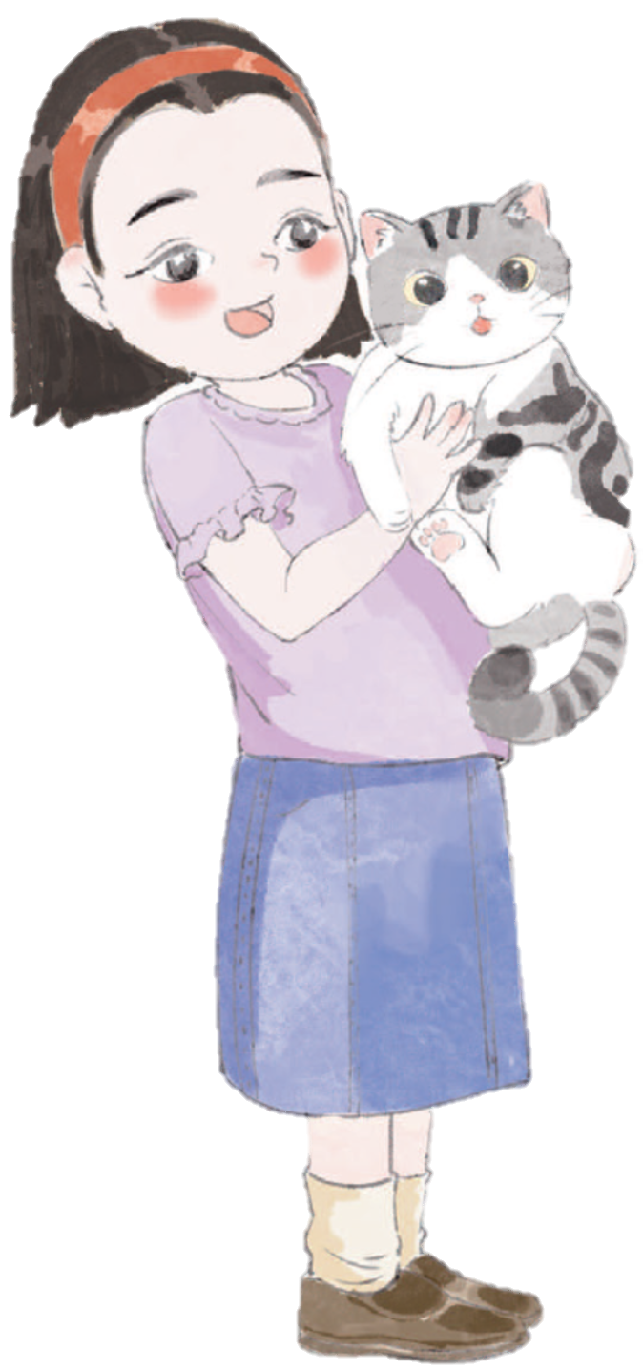
国家中小学课程资源
Look and say. Then listen, check and repeat.
I have a pet. It’s a cat.
What pet does the girl have?
A cat.
What will she say?

Slide 13
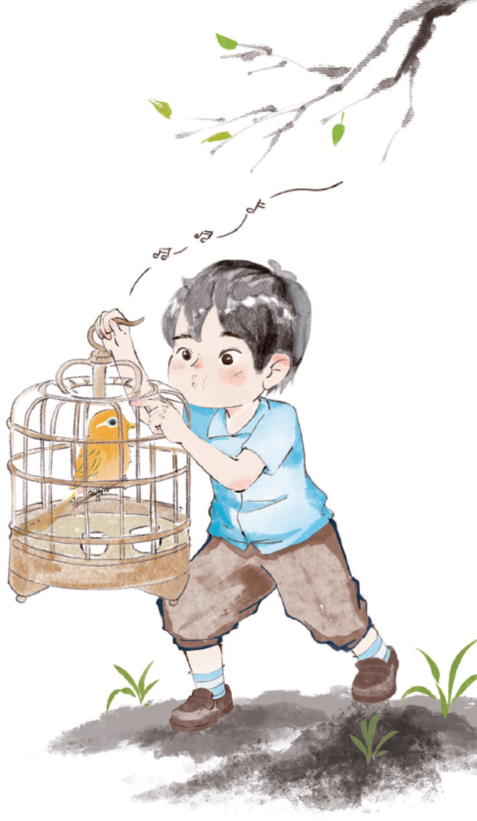

国家中小学课程资源
Look and say.
What is the boy doing?
What pet does he have? Why?
What will he say?

Slide 14
国家中小学课程资源
Listen, check and repeat.
I have a pet. It’s a bird.

Slide 15
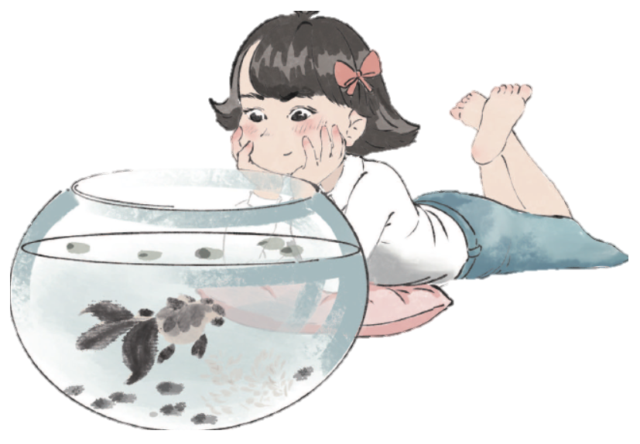
国家中小学课程资源
Look and say.
What pet does the girl have?
A fish.
What will she say?

Slide 16
国家中小学课程资源
Listen, check and repeat.
I have a pet. It’s a fish.

Slide 17
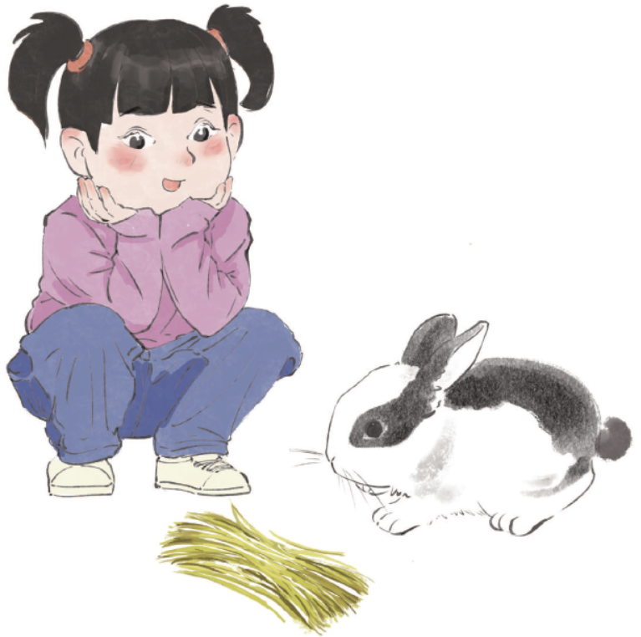

国家中小学课程资源
Look and say.
What pet does the girl have?
A rabbit.
What will she say?

Slide 18
国家中小学课程资源
Listen, check and repeat.
I have a pet. It’s a rabbit.

Slide 19
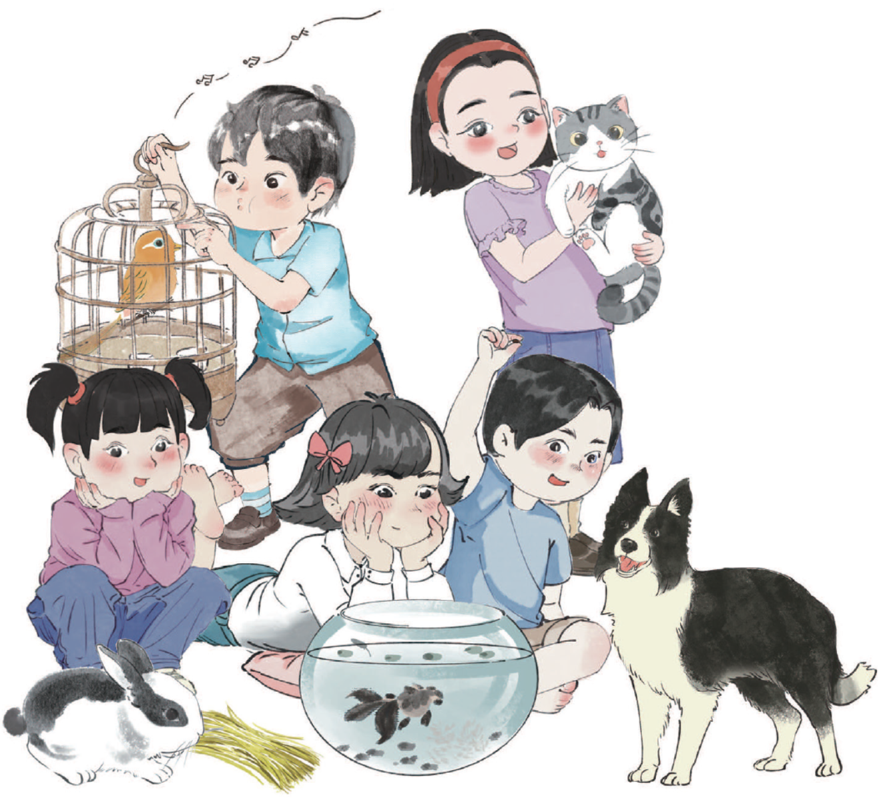
国家中小学课程资源
Look and say.
Are they happy?
Do they love their pets?
What will they say?

Slide 20
国家中小学课程资源
Listen, check and repeat.
We love our pets!

Slide 21
国家中小学课程资源
Watch the video and repeat.
此处教师可插入教材第24—29页故事的视频。

Slide 22
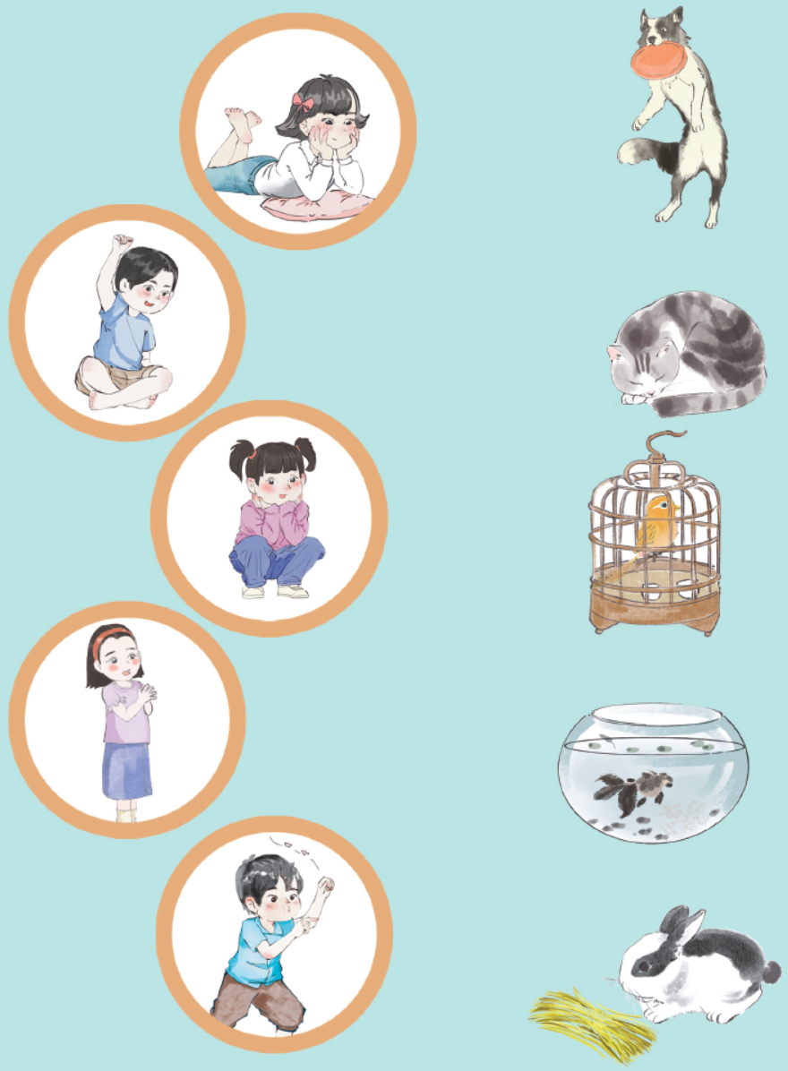
国家中小学课程资源
Look and match.

Slide 23
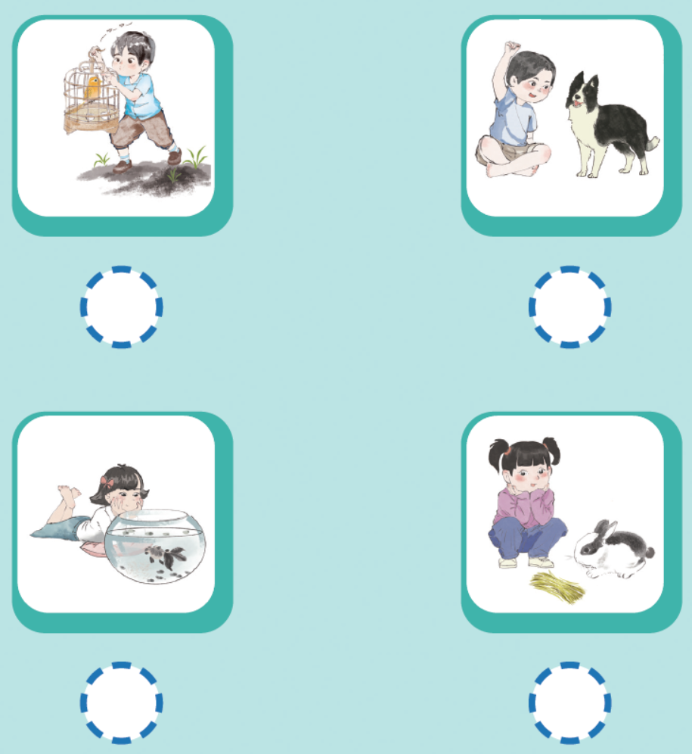
国家中小学课程资源
Listen and draw √ or ×.
√
√
×
√

Slide 24
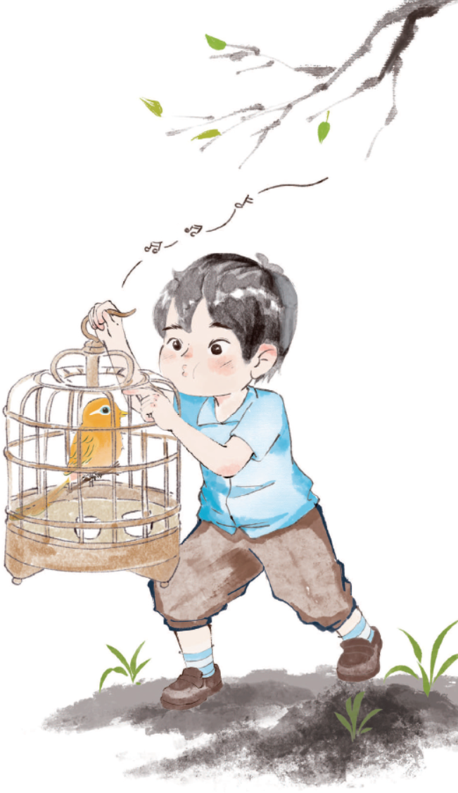
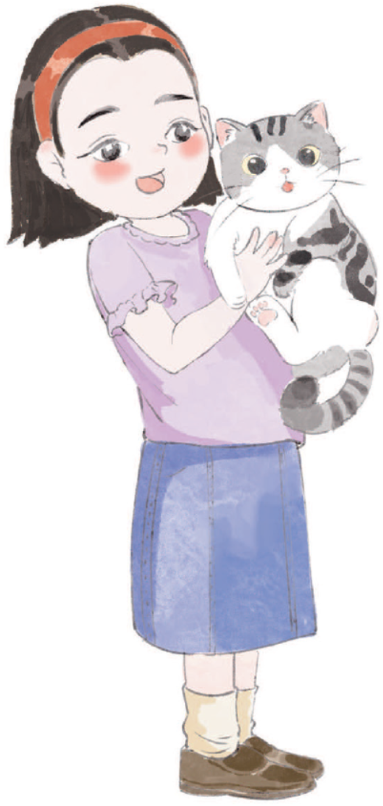
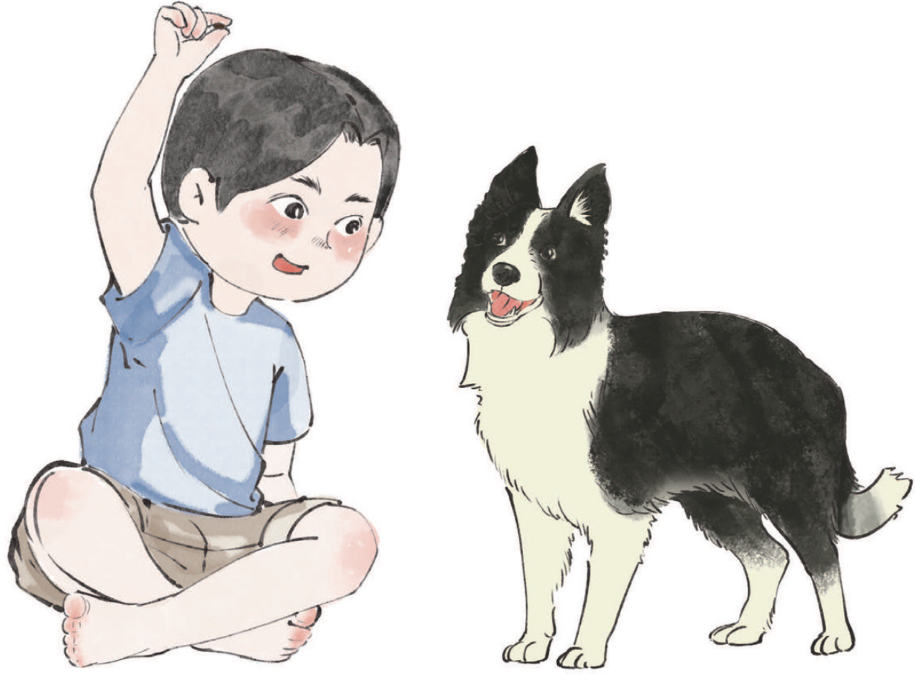
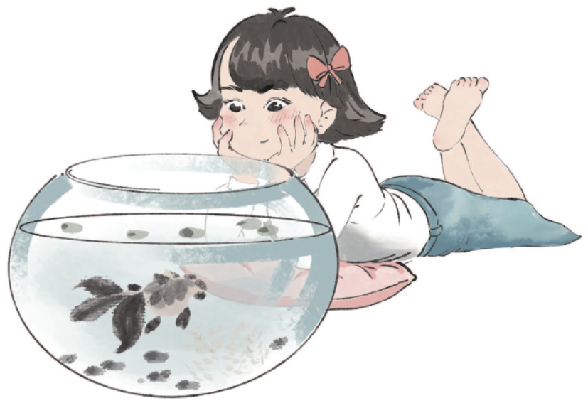
国家中小学课程资源
Look and say.
I have a pet. It’s...

Slide 25

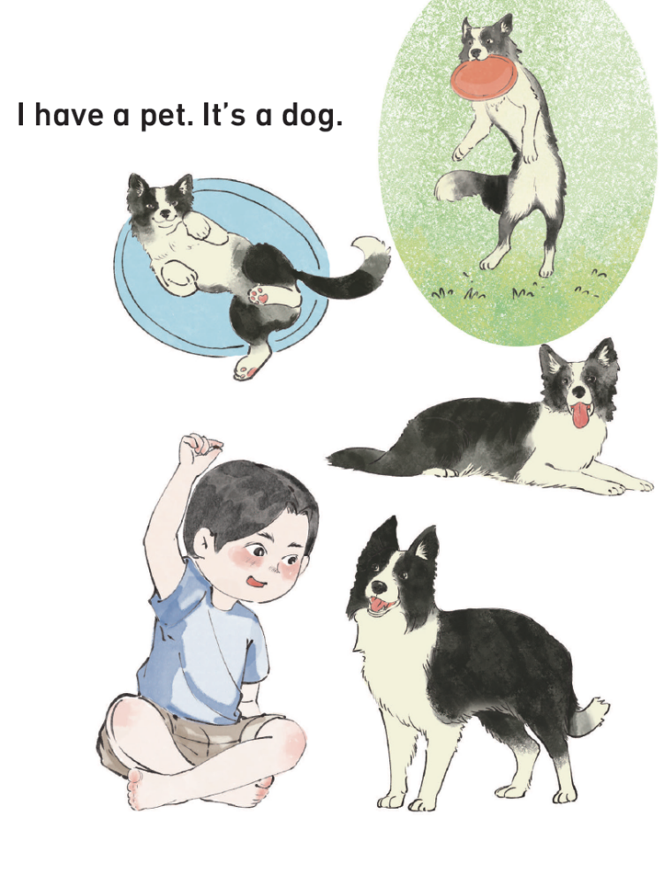
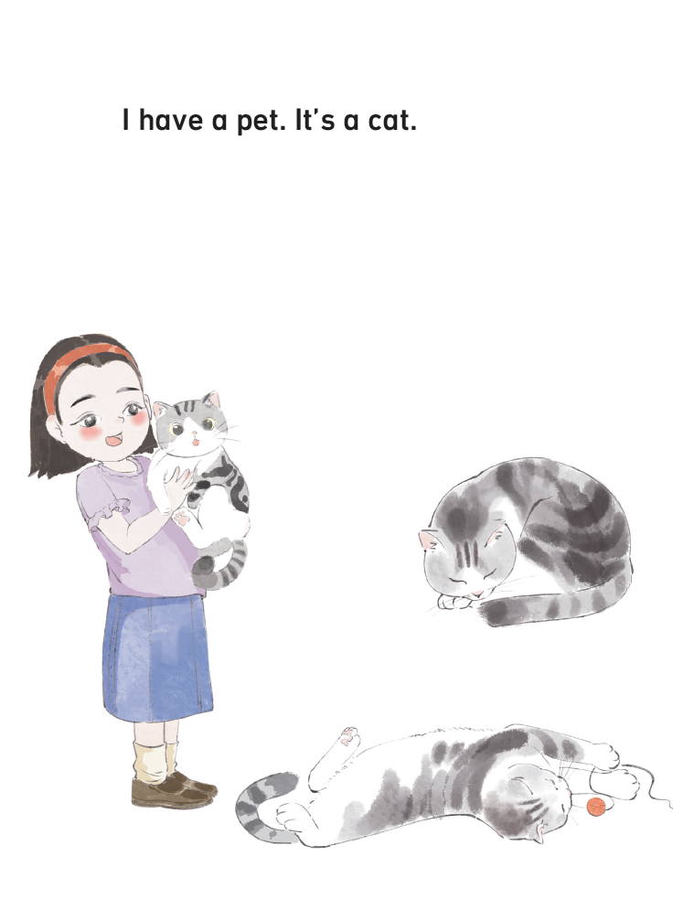
国家中小学课程资源
Read the story aloud.

Slide 26
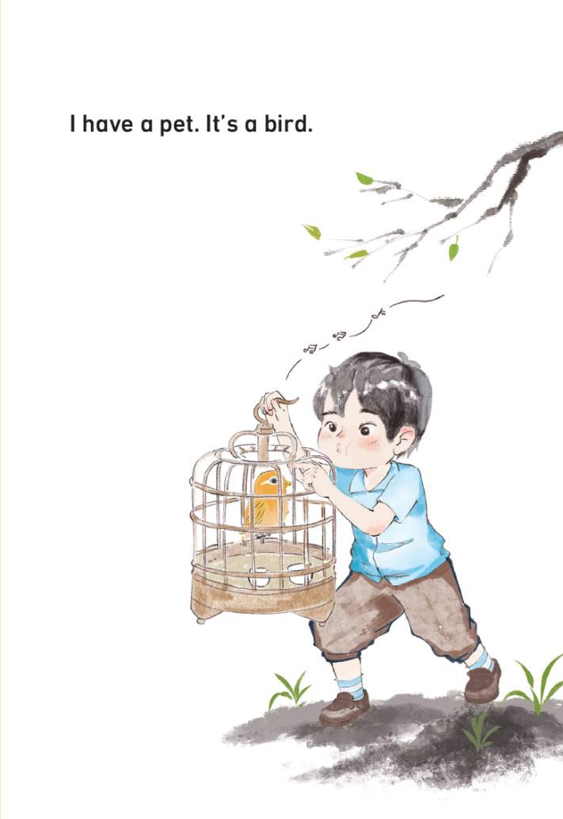
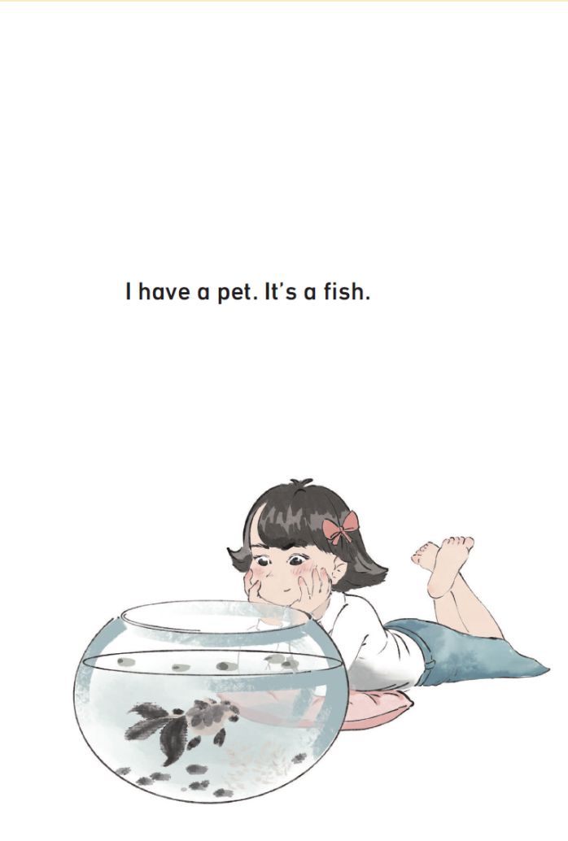
国家中小学课程资源
Read the story aloud.

Slide 27
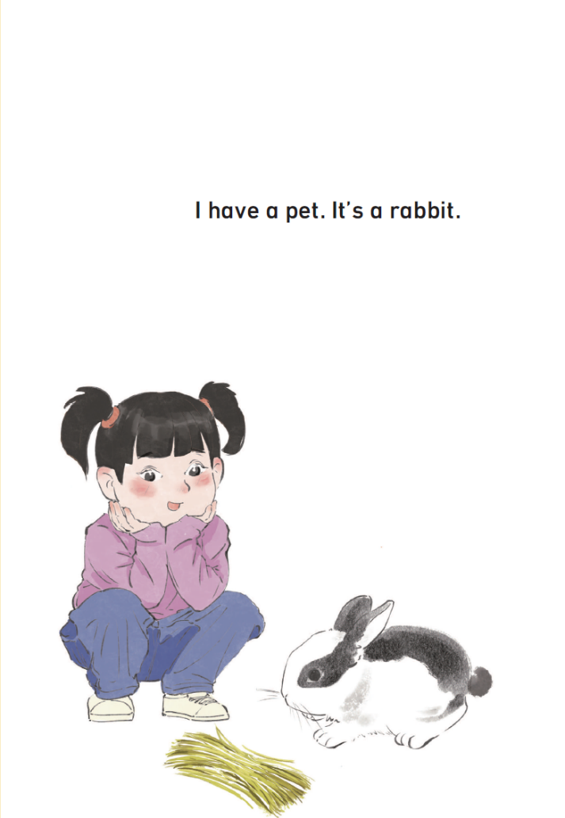
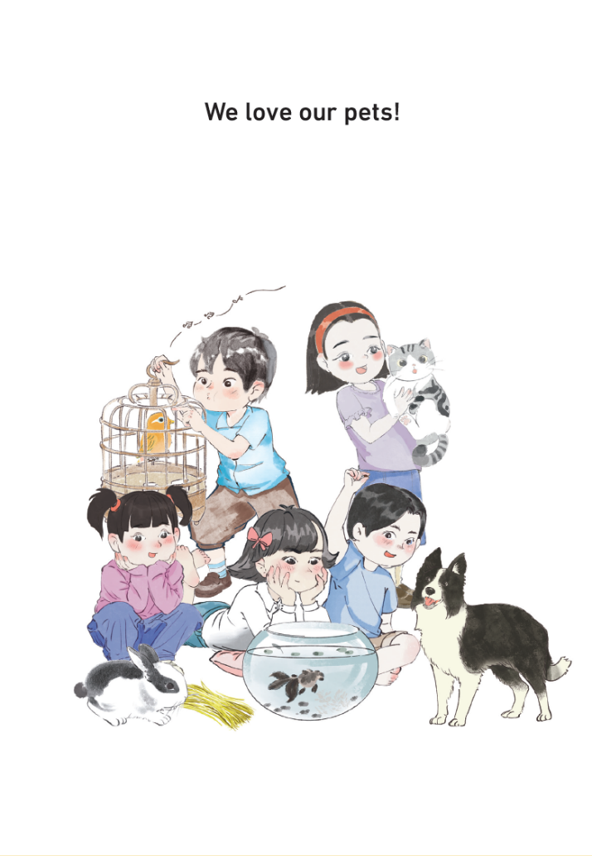
国家中小学课程资源
Read the story aloud.

Slide 28
国家中小学课程资源
Work in groups. Act out the story.
I have _______  star(s). | I can speak correctly. | 
 | I can act with emotions. | 
 | I can act creatively. | 
 | I can work with my friends. | 

Slide 29
Homework
带感情地朗读故事。
依据故事图片，运用核心句型介绍故事中的宠物。

Slide 30
《新启航英语》（预备级）
Unit 3 Pets
Period 2 Let’s read!
制作单位：外语教学与研究出版社

