Slide 1


《新启航英语》（预备级）
Unit 2 Family
Period 1 Let’s chant! & Let’s explore.
册 次：一年级下册 学 科：英语（外研社版）
主讲人：陈玉珍 学 校：成都市泡桐树小学
西区分校

Slide 2
通过本课时学习，学生能够：
理解韵文内容，掌握家庭成员的英文名称dad、mum、brother、sister、grandpa、grandma，以及表达对家人的爱的句型“We love...”。
熟练朗读韵文，并与同伴合作表演韵文。
通过构建家庭树，梳理家庭成员的关系，加深对核心词汇的理解与应用。

Slide 3
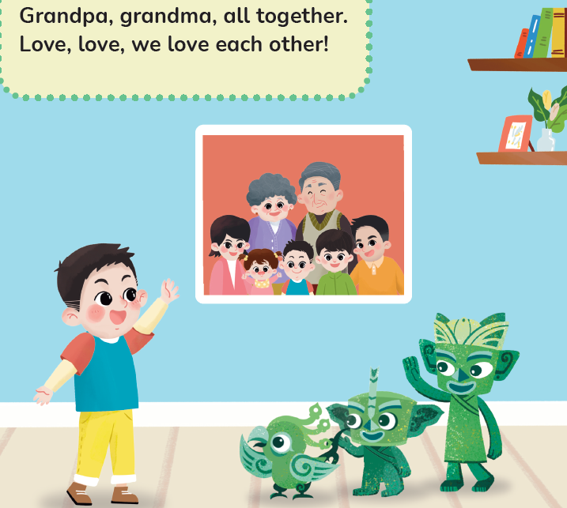
Look and say.
What will Taotao show to Qingqing, Tongtong and Feifei?
Taotao

Slide 4
Look and say.
How many people are there?
Who are they?

Slide 5

Listen, check and repeat.
How many people are there?
Seven.
Who are they?
They are Taotao, and Taotao’s dad, mum, brother, sister, grandpa and grandma.

Slide 6
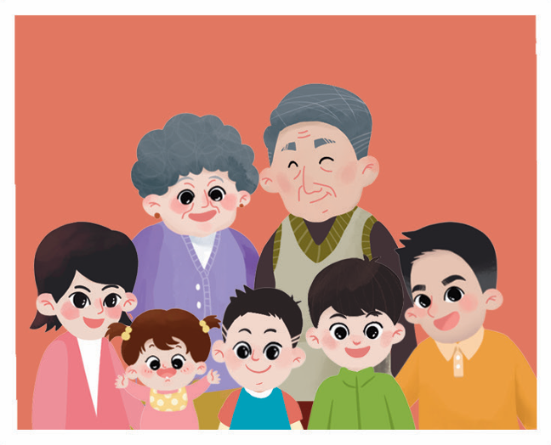
Listen, point and say.
grandma
grandpa
mum
dad
sister
brother

Slide 7
Look and say.
What will Taotao say?

Slide 8
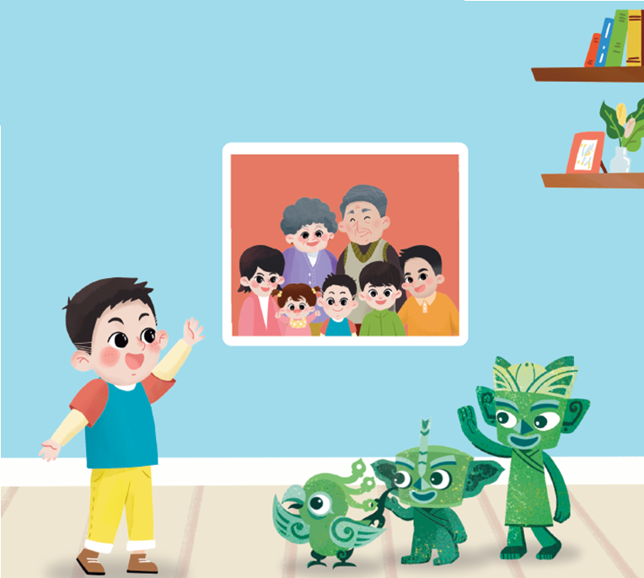
Listen, check and repeat.
What will Taotao say?
Love, love, we love each other!

Slide 9
Listen and repeat.
Love, love, we love each other!

Slide 10
Watch the video and chant.
此处教师可插入教材第12页韵文的视频。

Slide 11
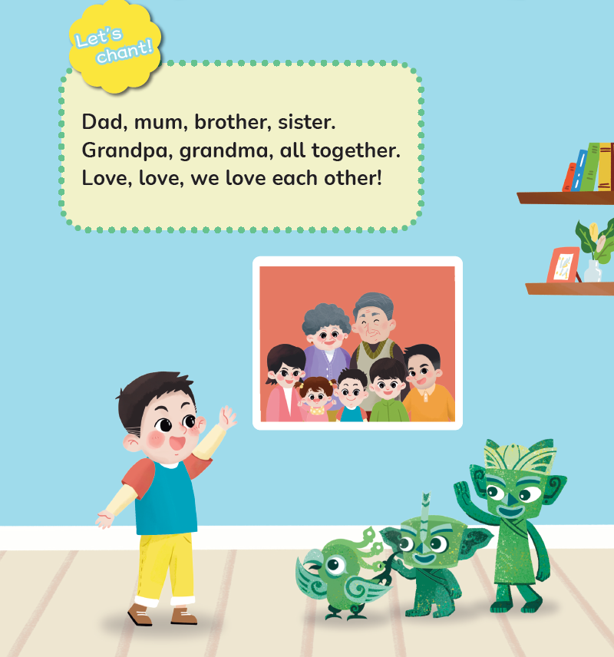
Listen and chant.

Slide 12
Chant together.

Slide 13
Work in groups. Chant and act out.

Slide 14

Look and say.
A family tree
1
2
3
4
5

Slide 15
Think and match.
A family tree
Where is Taotao?
Where is Taotao’s grandpa?
1
2
Why?
Where should Taotao’s grandma be?
3
4
How about the other family members?
5

Slide 16
Let’s check.
A family tree
5
3
2
1
4

Slide 17
Homework
带感情地表演韵文。
绘制自己的家庭树。

Slide 18
《新启航英语》（预备级）
Unit 2 Family
Period 1 Let’s chant! & Let’s explore.
制作单位：外语教学与研究出版社

