Slide 1


《新启航英语》（预备级）
Unit 2 Family
Period 2 Let’s read!
册 次：一年级下册 学 科：英语（外研社版）
主讲人：焦慕蓉 学 校：成都高新云芯学校

Slide 2
通过本课时学习，学生能够：
在看图片、听录音、朗读故事等活动中，梳理、理解故事内容。
掌握并灵活运用表示分享的表达“This is for...”, 以及表达对家人的爱的句型“I love my family.”，并在此过程中，理解家庭成员的长幼关系。
运用故事中的核心语言展示自己过生日分蛋糕的过程，模仿故事角色的语音、语调、表情、动作，感受温馨和谐的家庭氛围，培养尊敬长辈、爱护幼小的优秀品质。

Slide 3
Let’s chant.
此处教师可插入教材第12页韵文的视频。

Slide 4
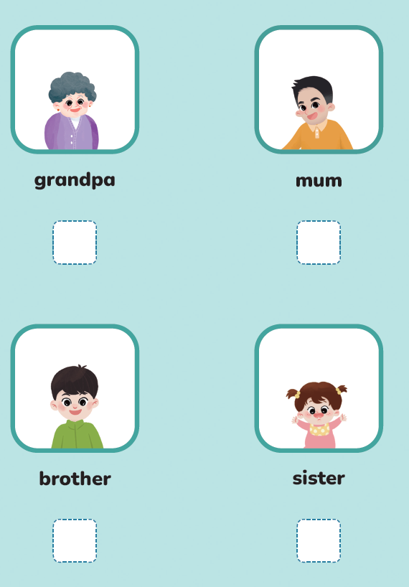

Listen, read and draw √ or ×.
×
×
√
√

Slide 5
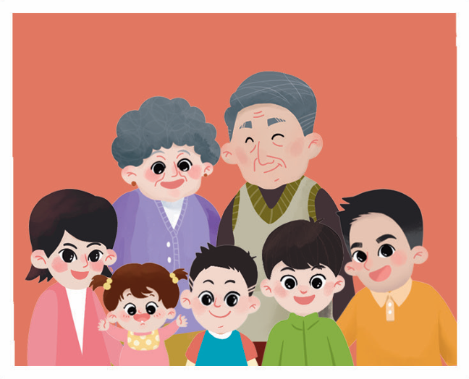
Look and say.
grandma
grandpa
Who are they?
mum
dad
sister
brother

Slide 6
Look and say.
Who are they?
What’s this?
Whose birthday is it?
How old is Taotao?

Slide 7

Listen, check and repeat.
Hello! I’m Taotao. I’m 7.

Slide 8

Look and say.
Hello! I’m Taotao. I’m 7.
What will Taotao’s mum say to him?
What will Taotao say?

Slide 9
Listen, check and repeat.
Hello! I’m Taotao. I’m 7.
This is for you, Taotao.
Thank you!

Slide 10
Look and say.
Who are they?
What will Taotao say to them?

Slide 11
Listen, check and repeat.
This is for Grandpa.
This is for Grandma.

Slide 12
Look and say.
Who are they?
What will Taotao say to them?

Slide 13
Listen, check and repeat.
This is for Mum.
This is for Dad.

Slide 14
Look and say.
Taotao shares the cake with his _______ and ________.
Taotao also shares the cake with his _______ and ______.
grandpa
grandma
mum
dad
Who will Taotao share the cake with next?

Slide 15
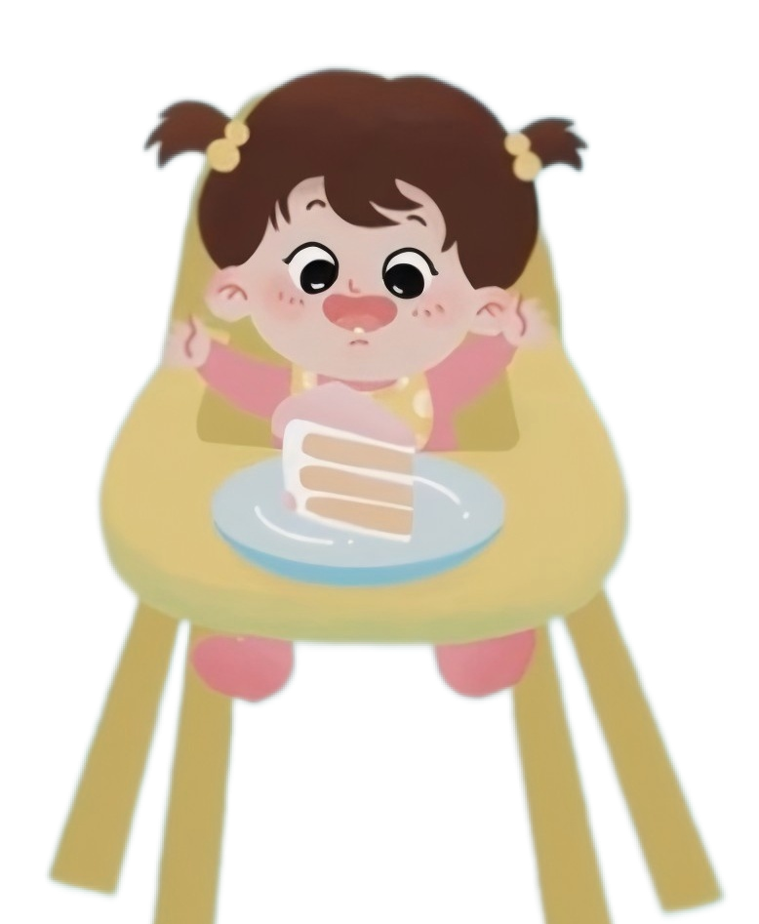
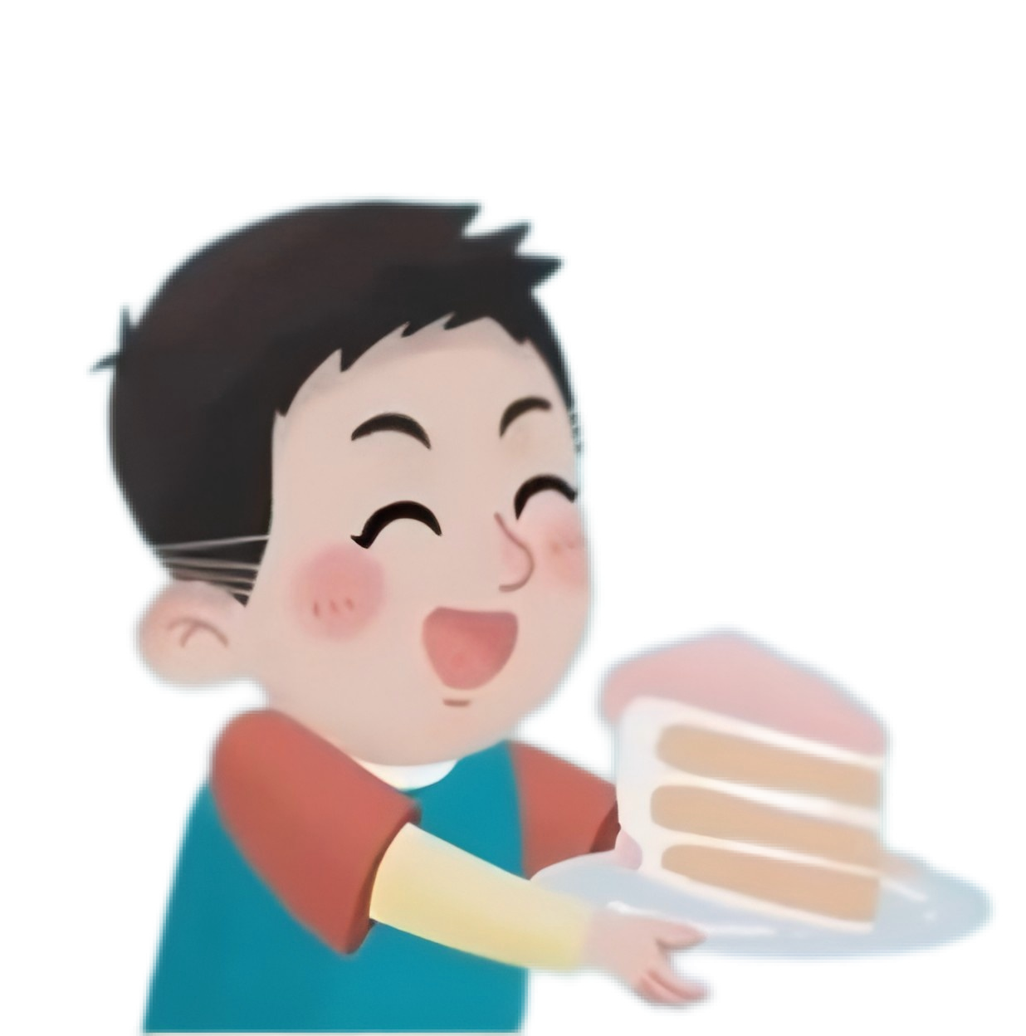
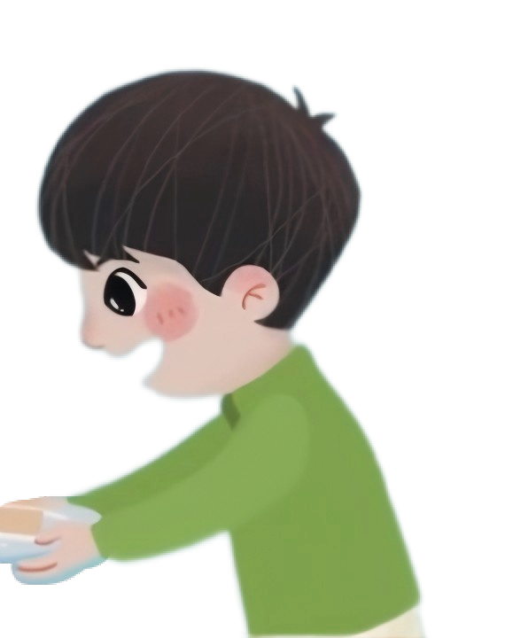



Listen, check and repeat.
baby sister
This is for my .
brother
This is for my .

Slide 16
Listen, check and repeat.
This is for me.

Slide 17
Look, think and say.
Taotao is the last one to take the cake.
Is he happy? Why?
What do you think of Taotao?

Slide 18
Look and say.
How do they feel?
What will Taotao say?

Slide 19
Listen, check and repeat.
I love my family.

Slide 20
Watch the video and repeat.
此处教师可插入教材第13—18页故事的视频。

Slide 21
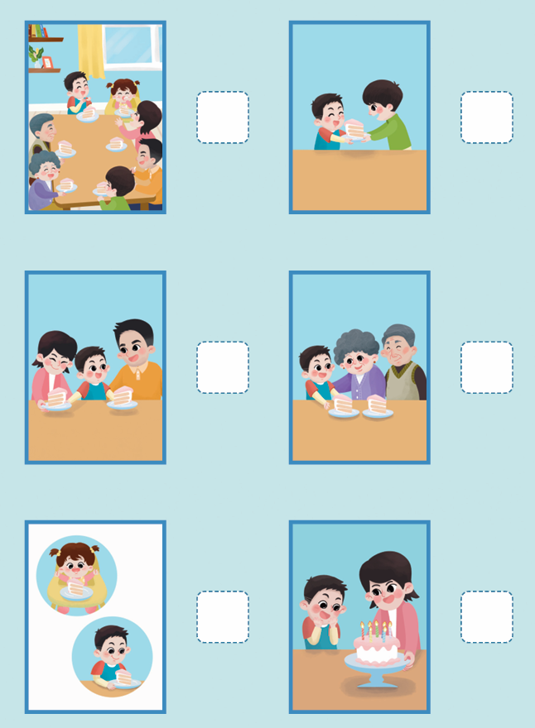
Read and number.
6
4
3
2
5
1

Slide 22
Read the story aloud.

Slide 23
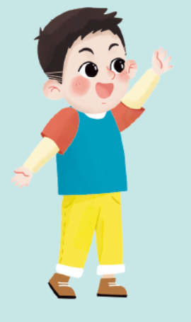
Retell the story.
This is for ______.
I love ______.

Slide 24

Think and say.
How many people are there in your family?
How will you share your birthday cake with your family?
What will you say to your family?

Slide 25
Act it out.
Check it.
I can use “This is for…” and “I love…”.
I can act with emotions.
I can share my birthday cake like Taotao.

Slide 26
Homework
带感情地朗读故事。
运用所学语言与同学合作表演Taotao分蛋糕的过程。

Slide 27
《新启航英语》（预备级）
Unit 2 Family
Period 2 Let’s read!
制作单位：外语教学与研究出版社

