Slide 1
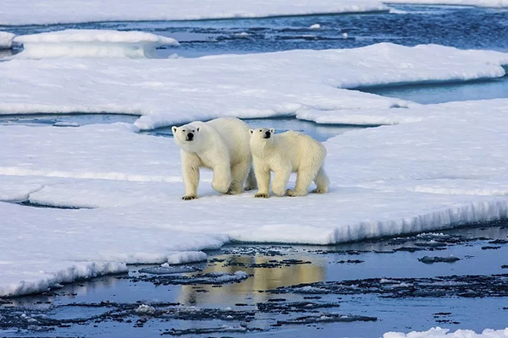
Knut
A Pet or Not?
北极熊克努特
选自《多维阅读第8级》

Slide 2
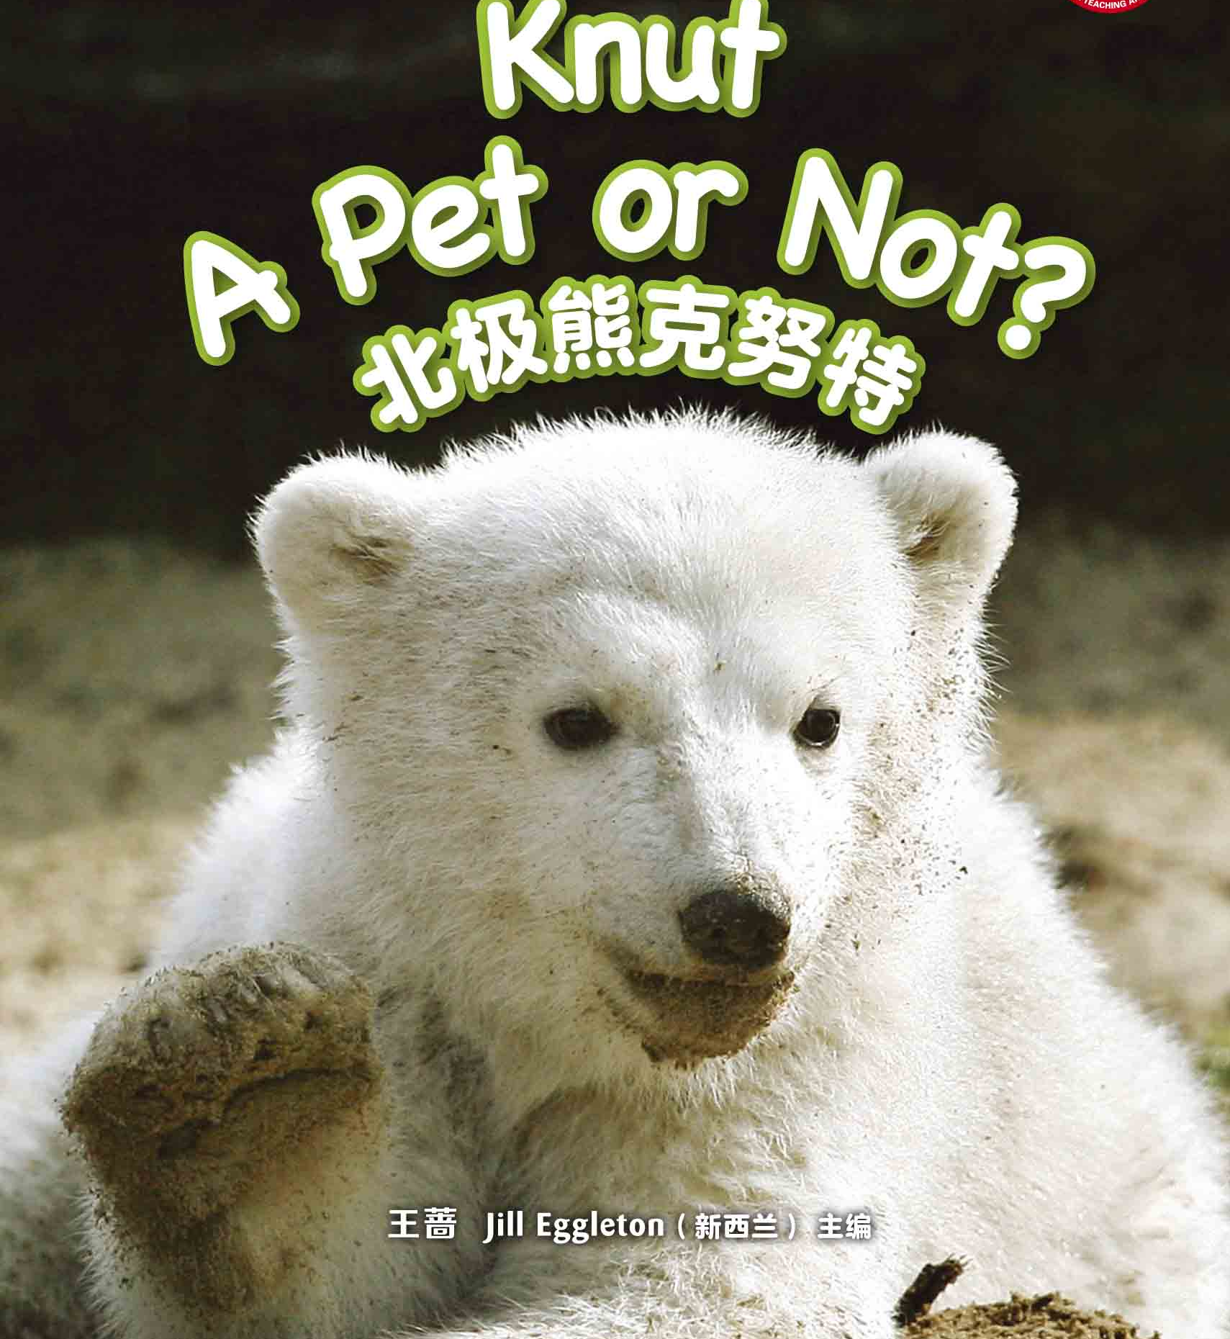
What can you see on the cover?
Title
Author
主编：王蔷 Jill Eggleton（新西兰）

Slide 3
1st reading: the whole story
Reading purpose:
Get to know the main idea of the story.

Slide 4
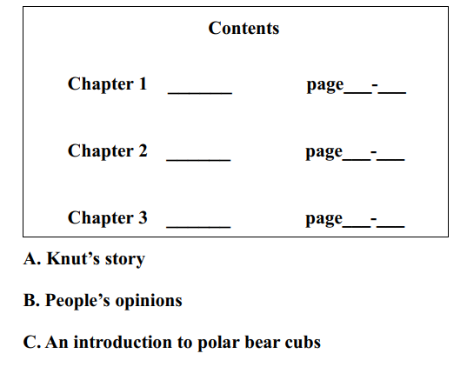

1st reading: the whole story

Slide 5
2nd reading: Chapter 1
Reading purpose:
Know about polar bear cubs.

Slide 6
2nd reading: Chapter 1
1. Where are most polar bear cubs born?
2. What do they eat?
3. Who protects them?

Slide 7
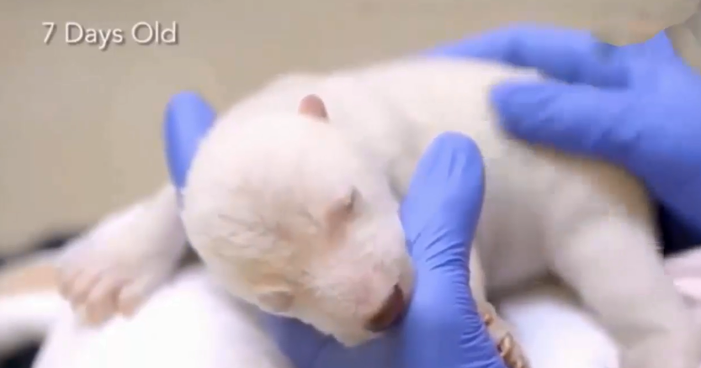
3rd reading: Chapter 2

Slide 8
3rd reading: Chapter 2
Reading purposes:
Know about Knut’s story.
Talk about the problems.
Find the solutions.

Slide 9
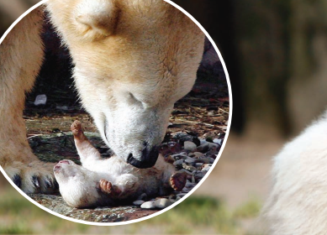
3rd reading: Chapter 2
What would you like to say?

Slide 10
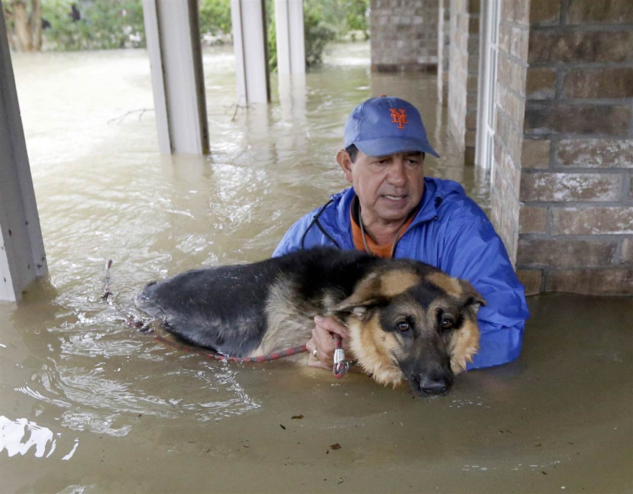
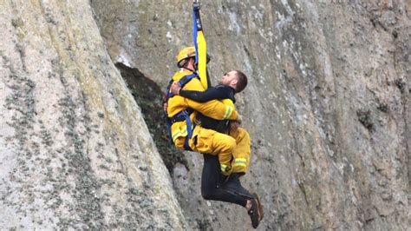
3rd reading: Chapter 2
Knut had to be rescued.
Who is rescued?
The dog is rescued.

Slide 11
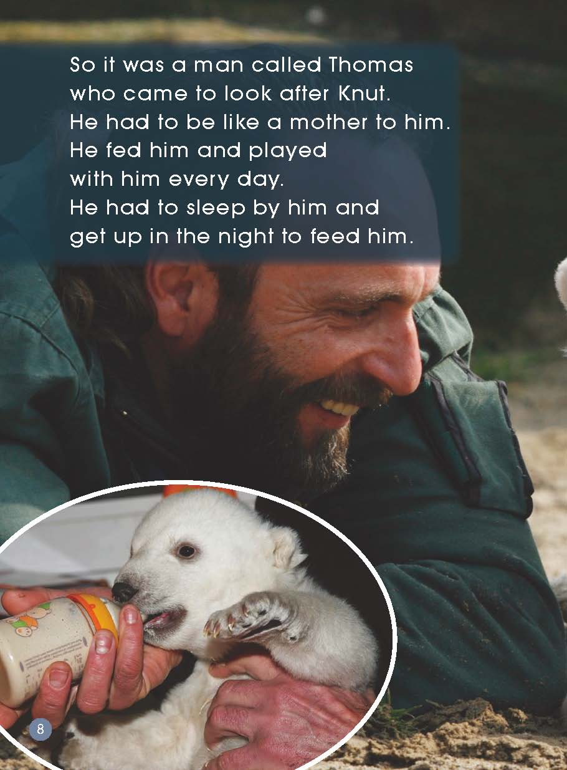
3rd reading: Chapter 2

Slide 12
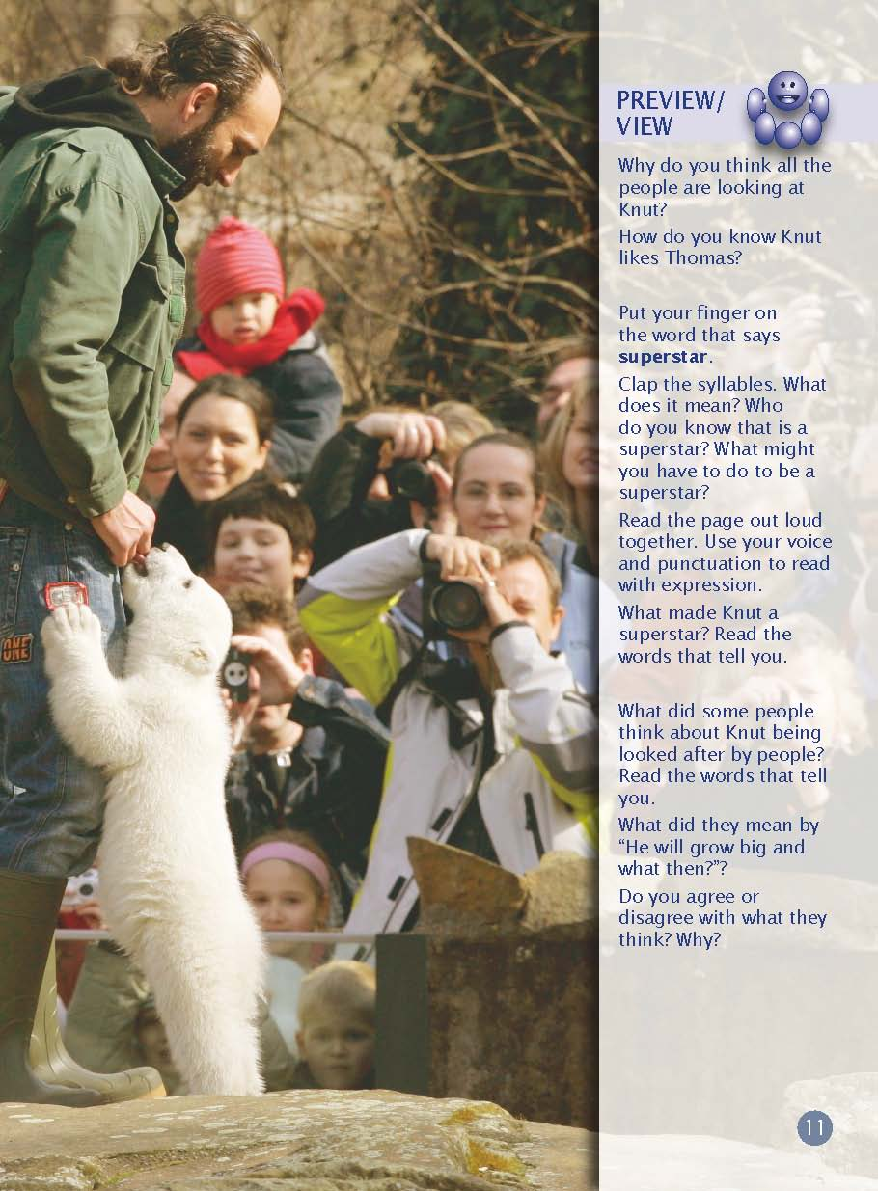
3rd reading: Chapter 2

Slide 13
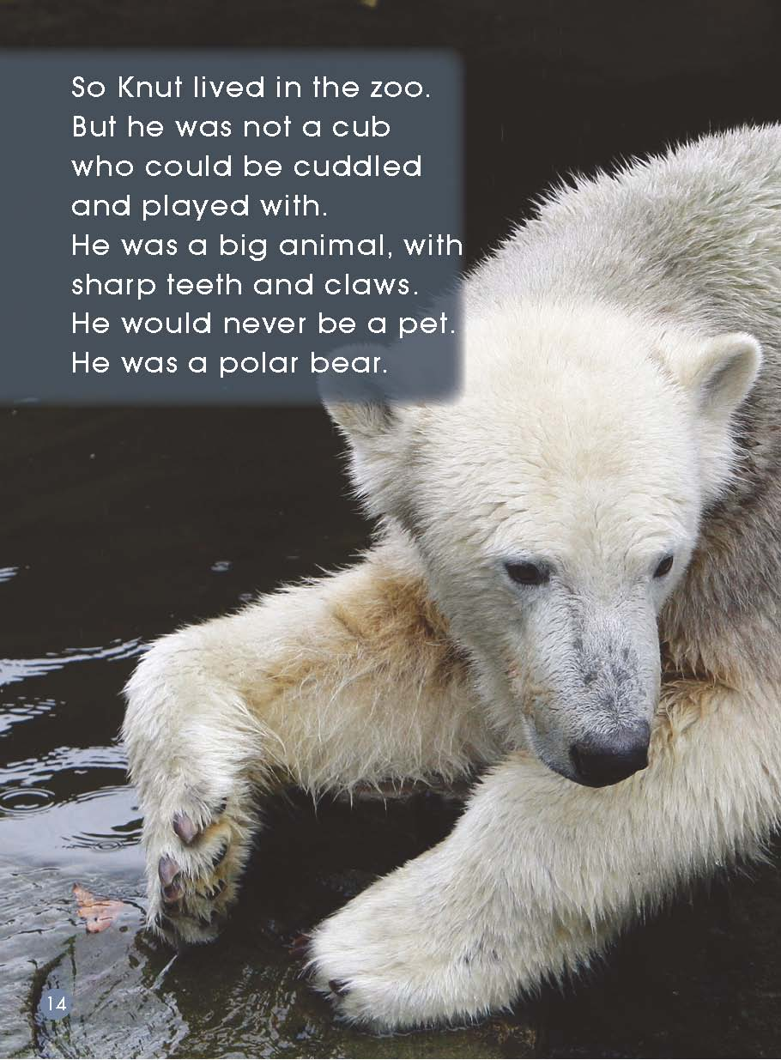
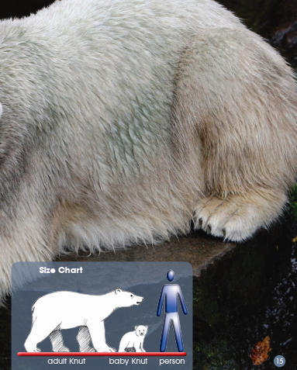
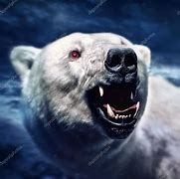
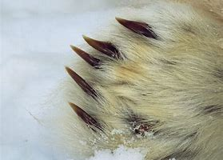
3rd reading: Chapter 2
sharp teeth
claws
Do you want to cuddle it?

Slide 14
3rd reading: Chapter 2

Slide 15

4th reading: Chapter 3
!!!
???

Slide 16
4th reading: Chapter 3
Reading purposes:
Find people’s opinions.
Show your opinion in role.

Slide 17
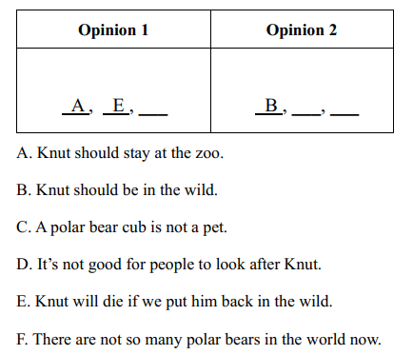
4th reading: Chapter 3
F
C
D

Slide 18


Your opinion on where Knut should be:
in the wild
at the zoo

Slide 19

A Meeting about Knut
in the wild or at the zoo

Slide 20
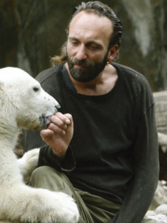
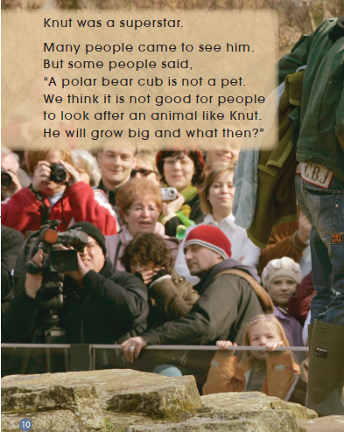
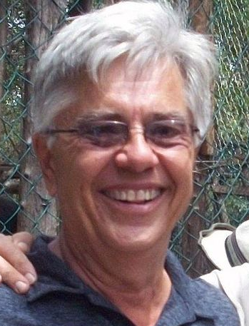
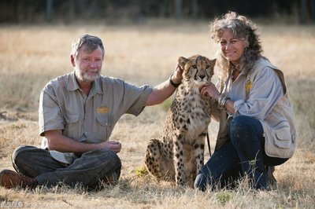

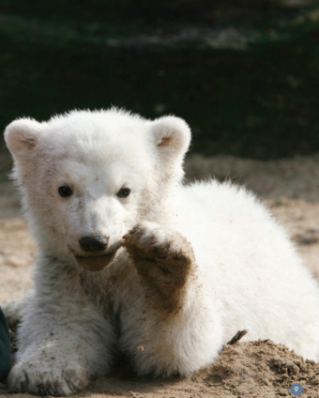
A Meeting about Knut
?
?
?
Thomas
Visitors
Zookeeper
?
?
?
Volunteers
Vet
Knut

Slide 21
A Meeting about Knut
Step 1: Choose a role.
Step 2: Think about your opinion.
Step 3: Talk about it in your group.
Hi, everyone. I’m…. I think…, because….

Slide 22
A Meeting about Knut
in the wild or at the zoo

Slide 23

Your opinion on where Knut should be:
in the wild
at the zoo

Slide 24
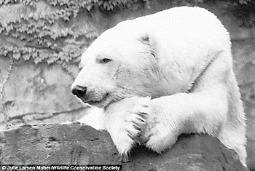
Knut died at the zoo in 2011, when he was only five years old. Most polar bears can live to 35 years.
People miss him so much.
Is there a better way?

Slide 25

Do you have questions?
Natural Selection

Slide 26
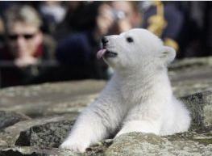
Homework
1. Read the story again.
2. If you want to know more about
Knut, check on the internet.
https://baike.baidu.com/item/%E5%85%8B%E5%8A%AA%E7%89%B9/6289?fr=aladdin

Slide 27
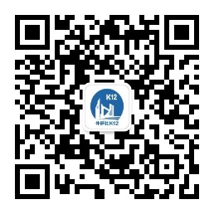
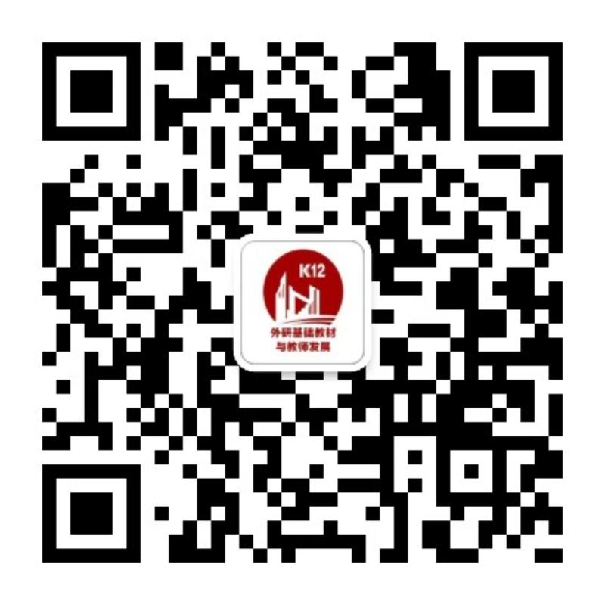
关注“外研社K12”公众号
关注“外研基础教材与教师发展”公众号

