Slide 1
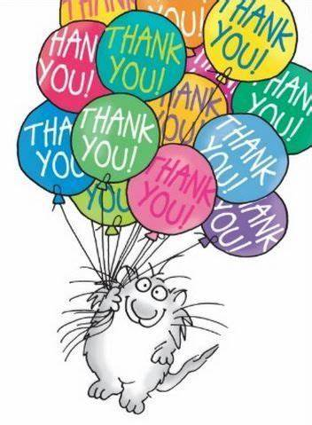
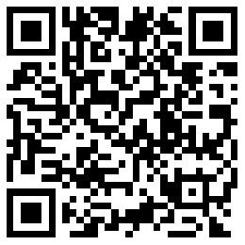

教学设计已修改
麻烦老师们扫码查看或下载新版教案
给大家添麻烦了 谢谢您的理解！

Slide 2

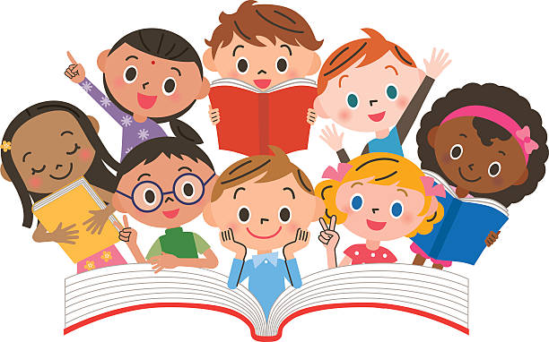
北京市朝阳区实验小学
徐响 六年级一班

Slide 3


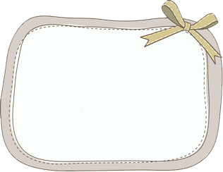
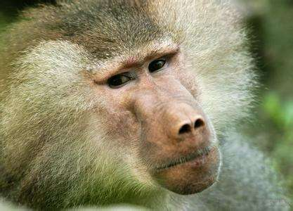
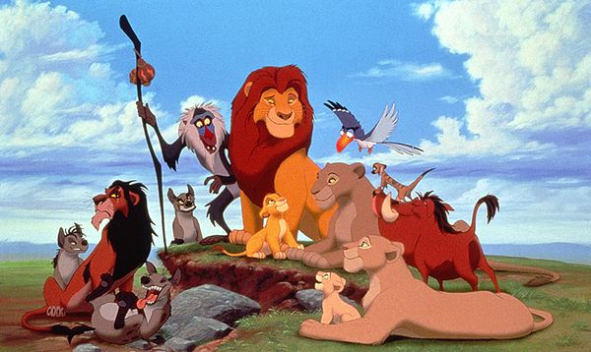
Let’s guess.
monkey
in the jungle
looks like
climb trees
lives
bigger than the monkey
can
is
Is it?
has
has
is
smaller than gorilla
a long face
…
baboon

Slide 4
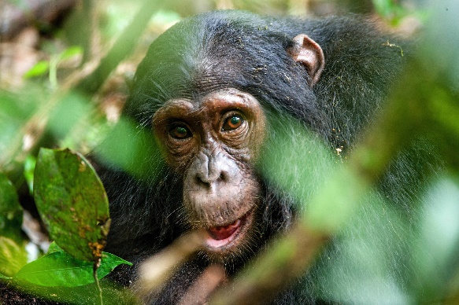
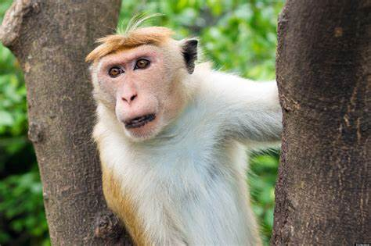
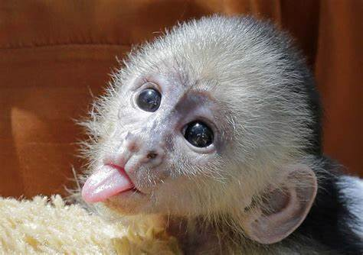
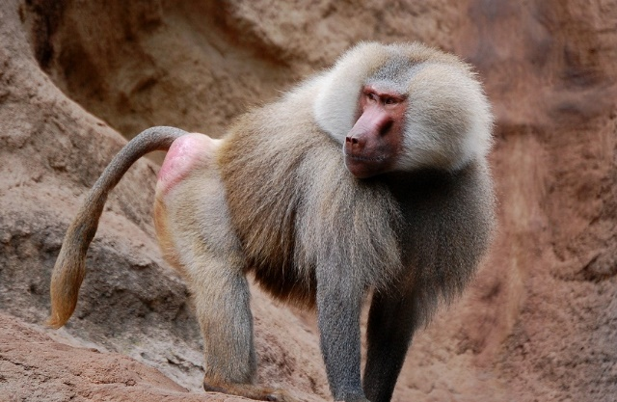
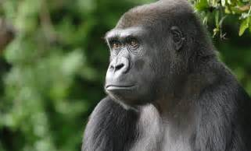
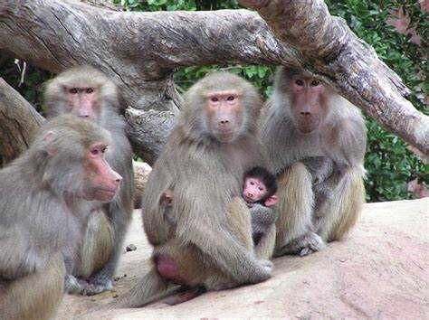
Can you find baboons?
1
2
3
4
5
6

Slide 5
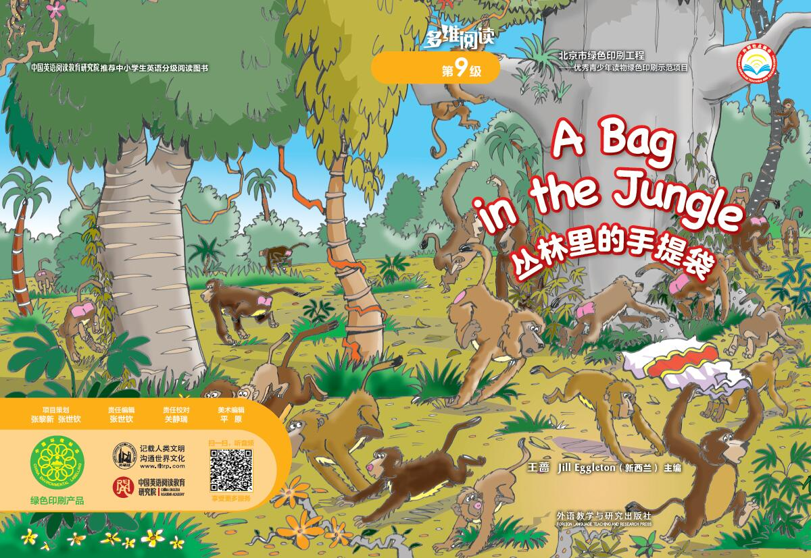
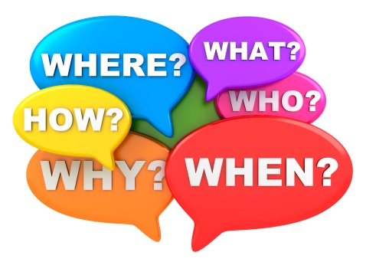
Let’s read the cover page.
What do you know?
What do you want to know?

Slide 6
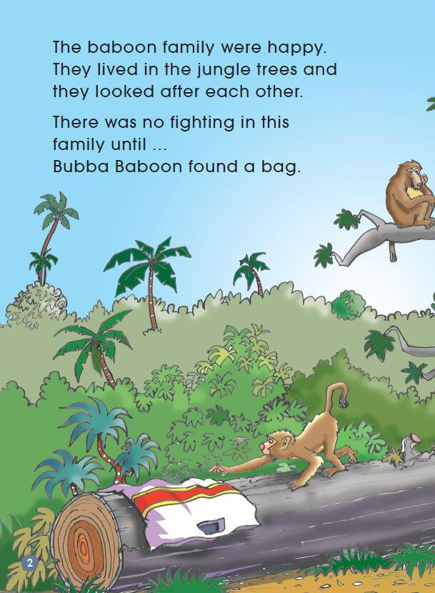
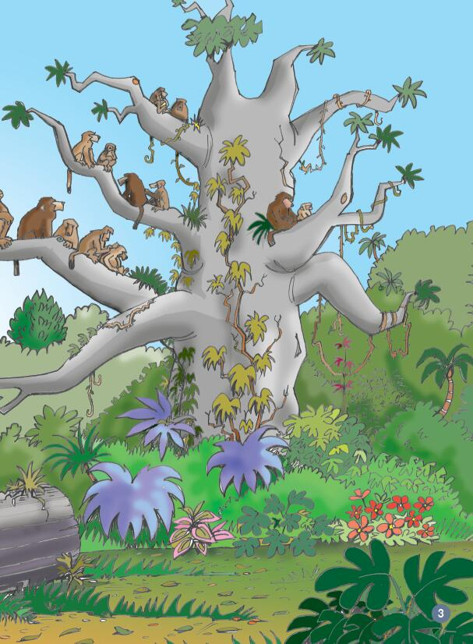

Let’s read.
What do you think of baboon family?

Slide 7
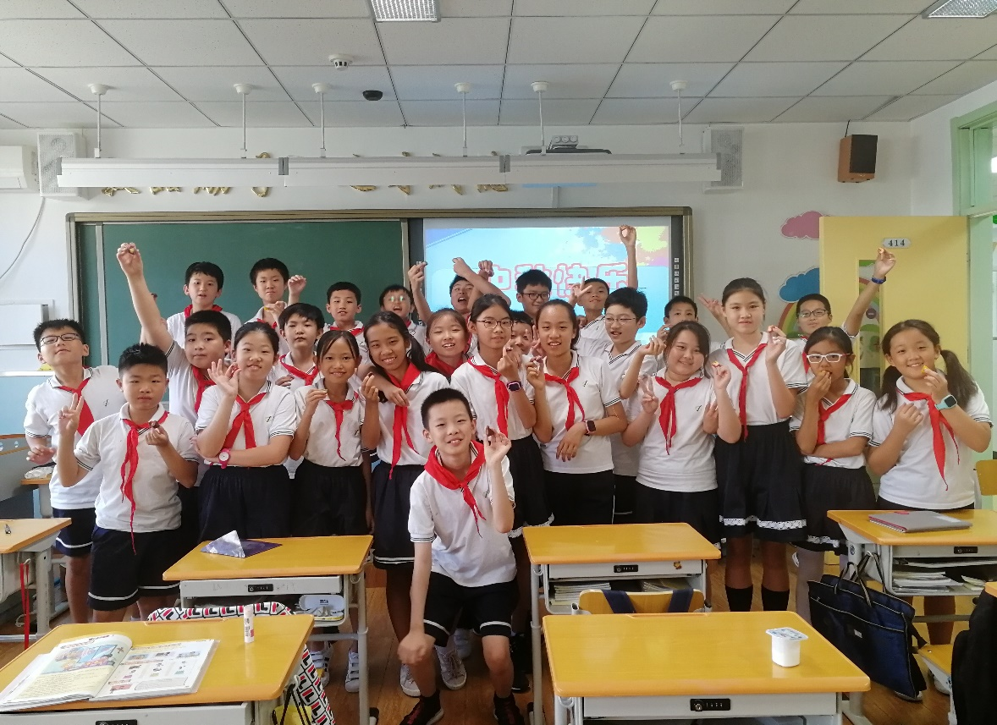
happy family
happy class?

Slide 8
Let’s read.
What happened next?
Bubba baboon

Slide 9

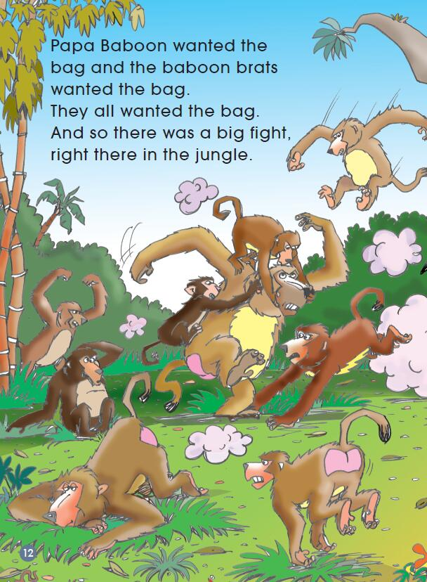
Think and predict
What might happen in the middle of the story?

Slide 10

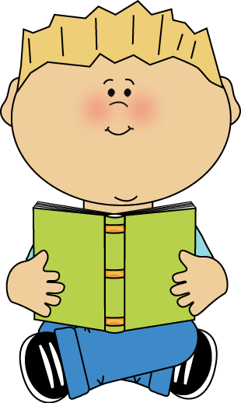
Read the story by yourself
What happened in the story?

Slide 11
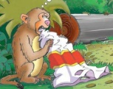
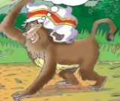
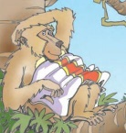
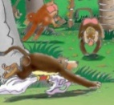

Think and tell
How do you feel now?
Are they a real（真正的） happy family?
Everyone wanted the bag.

Slide 12
Read again
How did they get the bag?
What did they do with the bag?
P2---P12

Slide 13
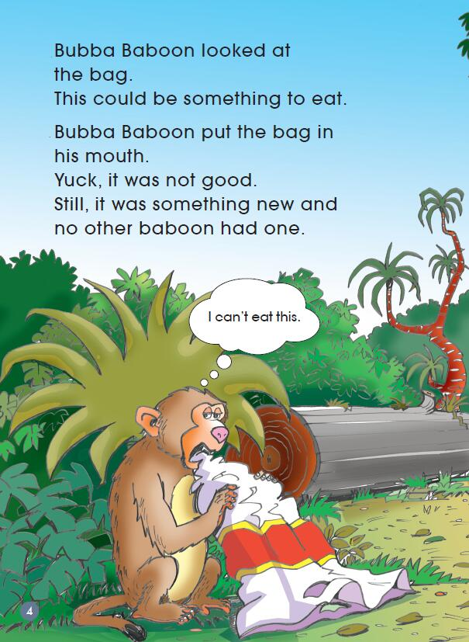
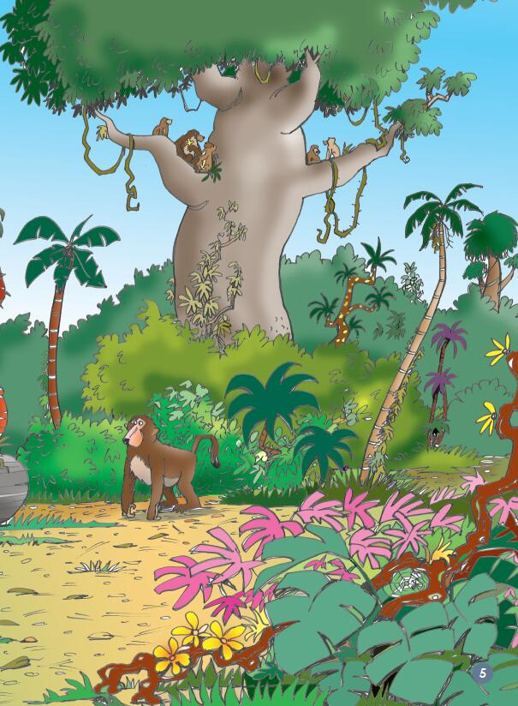
Let’s share together.
Why not throwing away?

Slide 14
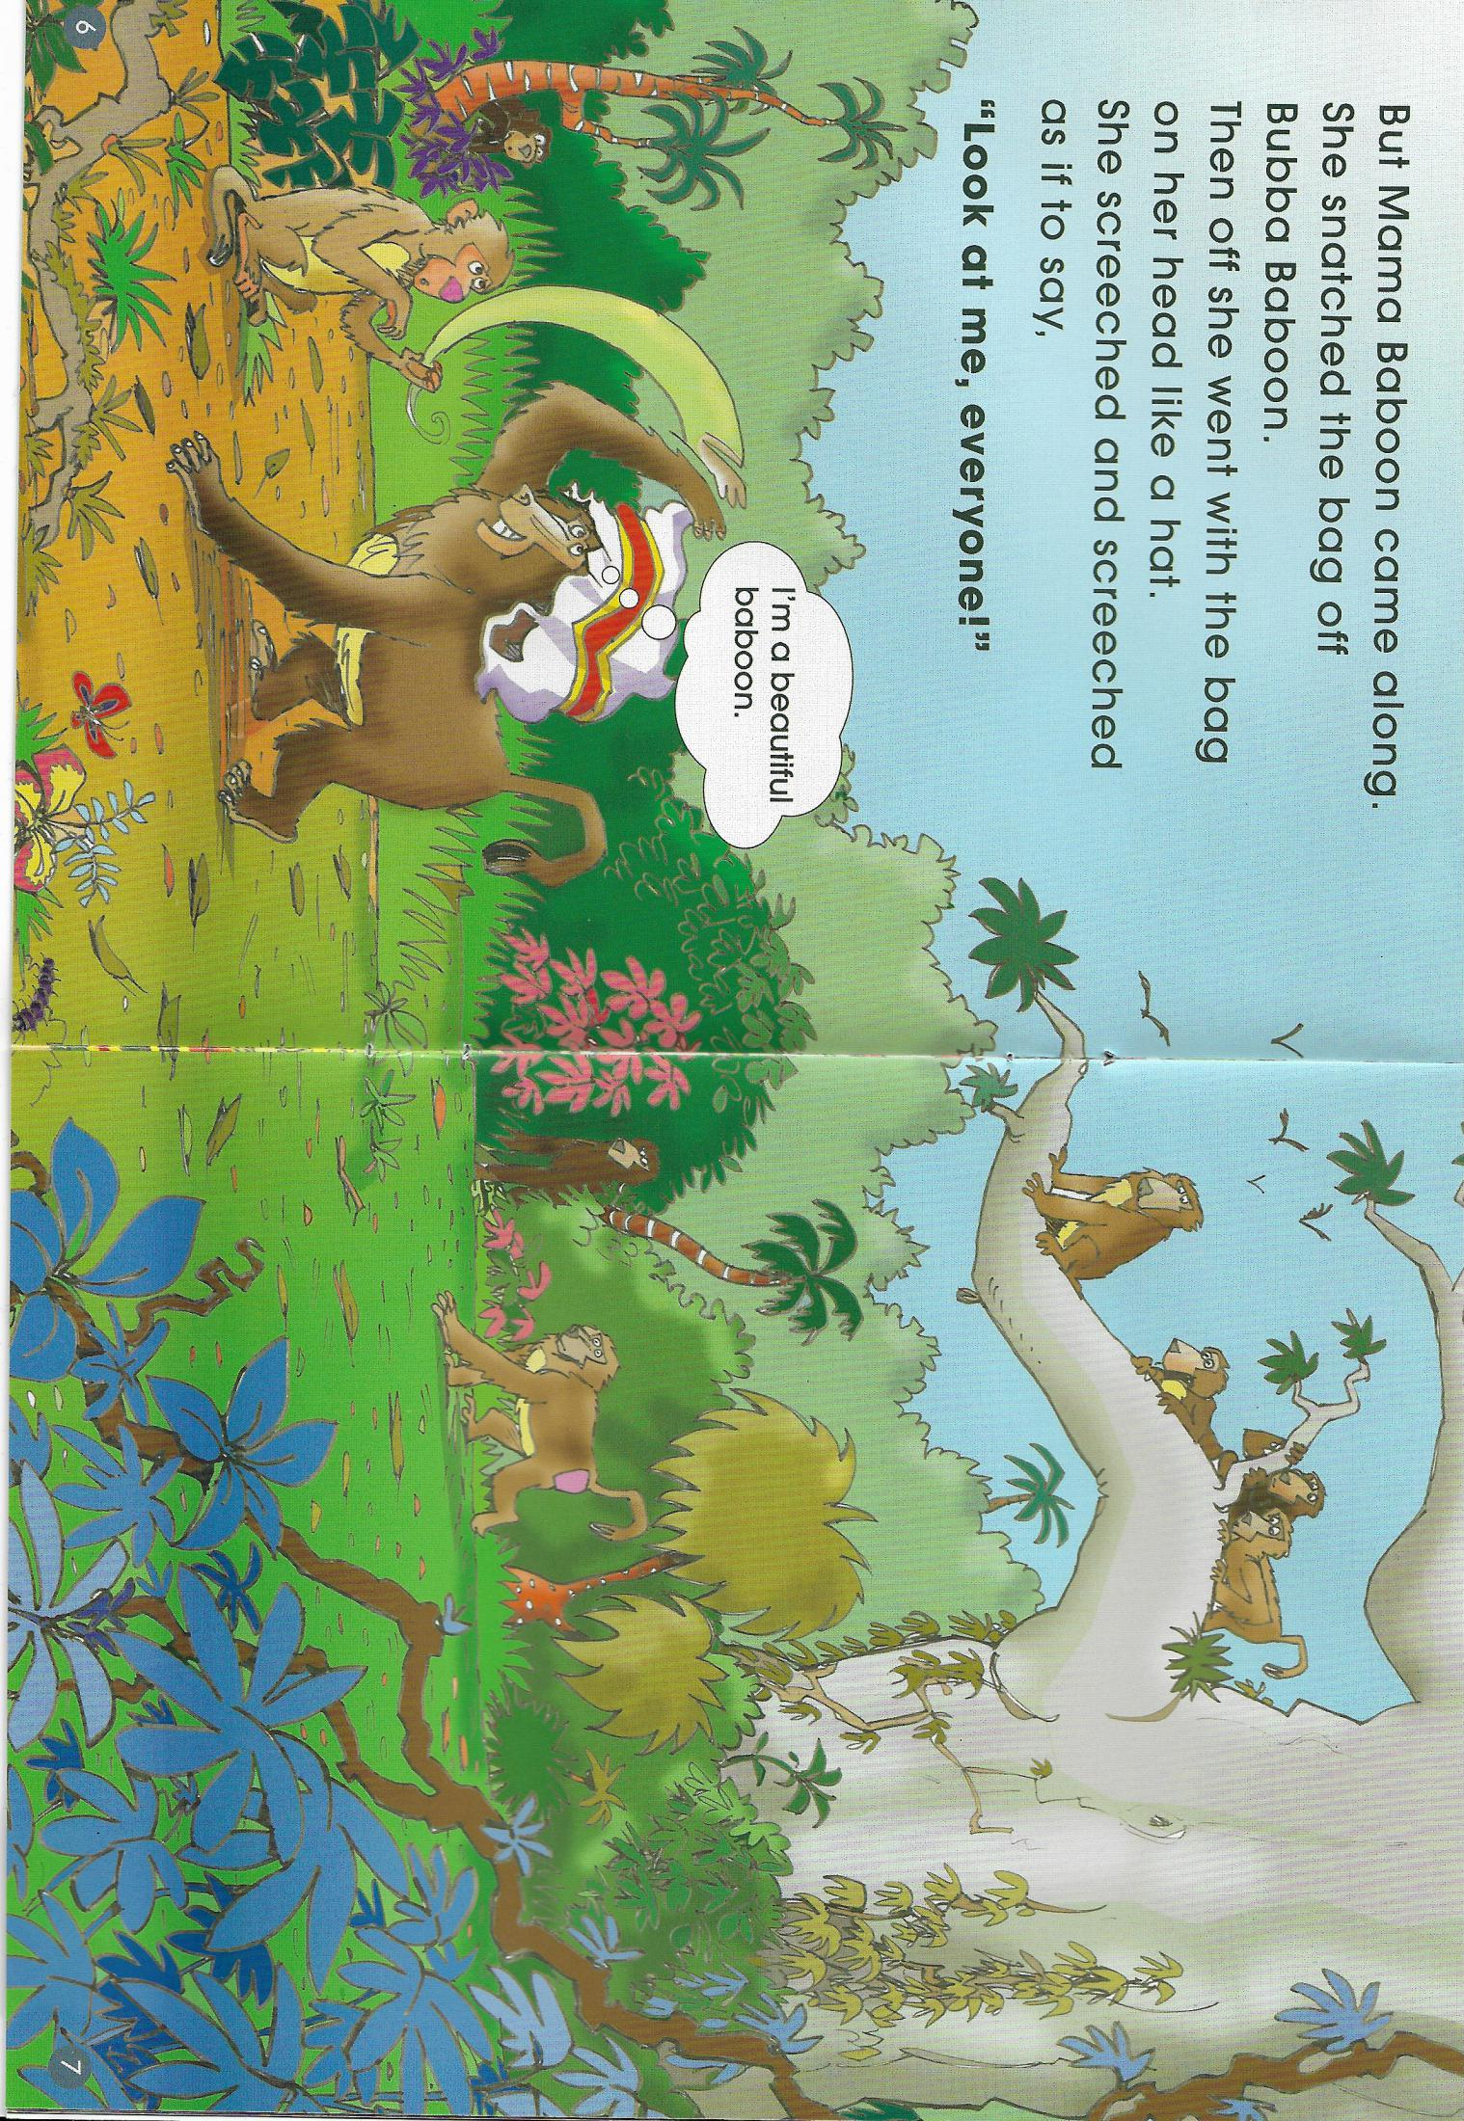
Let’s share together.
snatch
take sth quickly in the rude way
screech
make a loud high sound

Slide 15

Let’s act.
Mama baboon snatched the bag and put it on her head like a hat.
She screeched and screeched, as if to say:
Look at me, everyone.
I am a beautiful baboon!

Slide 17
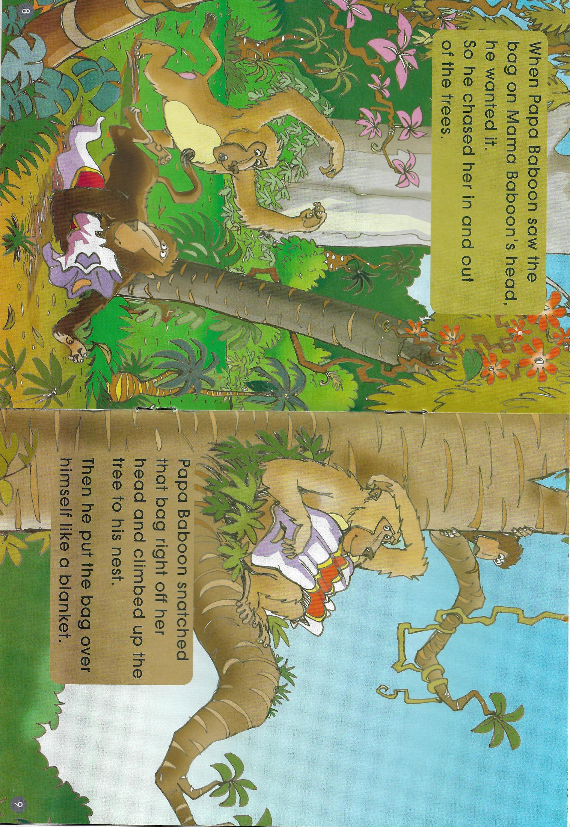
Let’s share together.
snatch
chase
climb up

Slide 18

Let’s say.
Papa baboon wanted the bag.
chased Mama baboon
snatched the bag
climbed up the tree
put it over himself
like a blanket
?

Slide 19
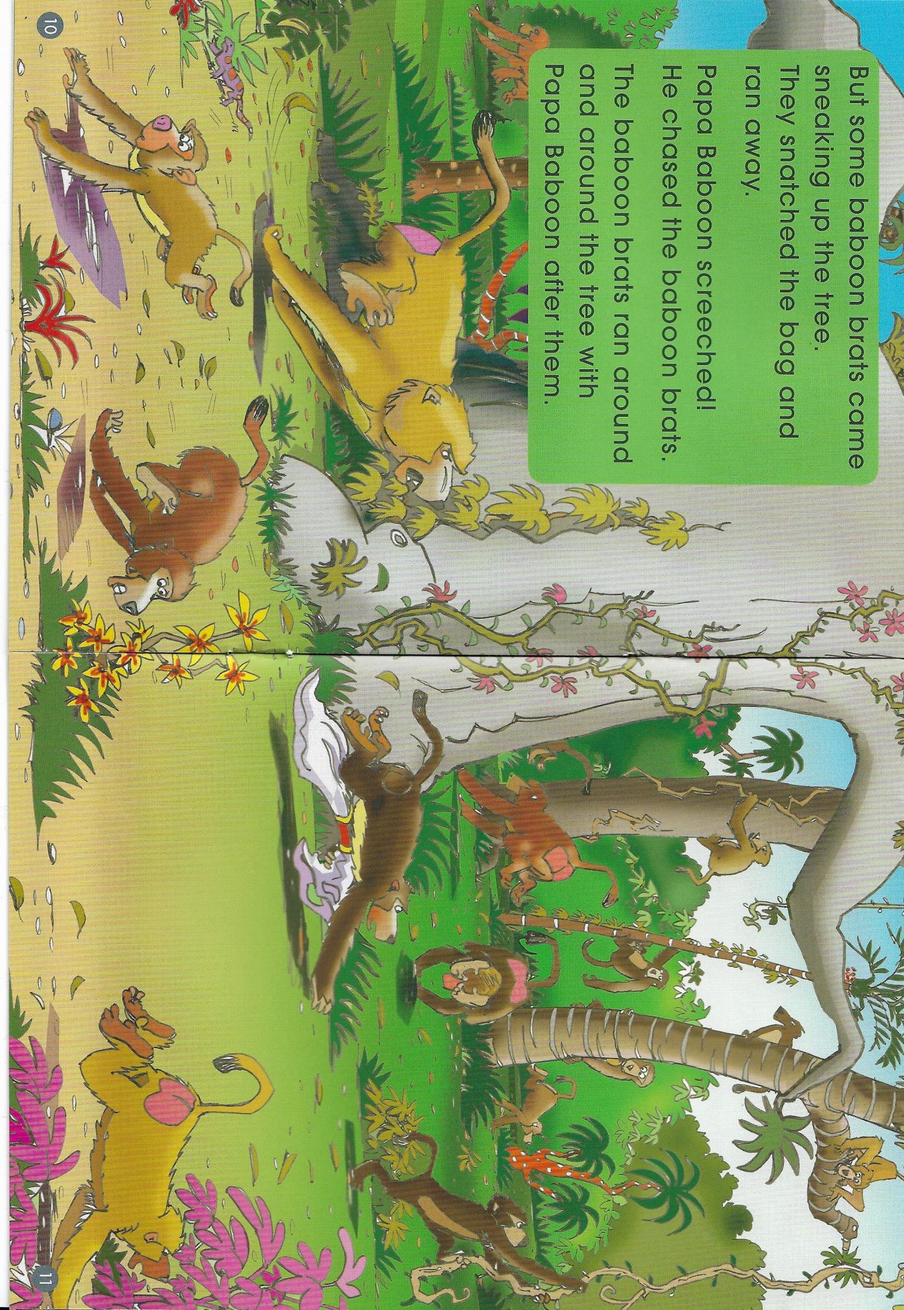
Let’s share together.
brats
Children who behaves badly
sneak
to go somewhere secretly

Slide 20
a big fight

Slide 21
Let’s think.
What’s the problem?

Slide 22
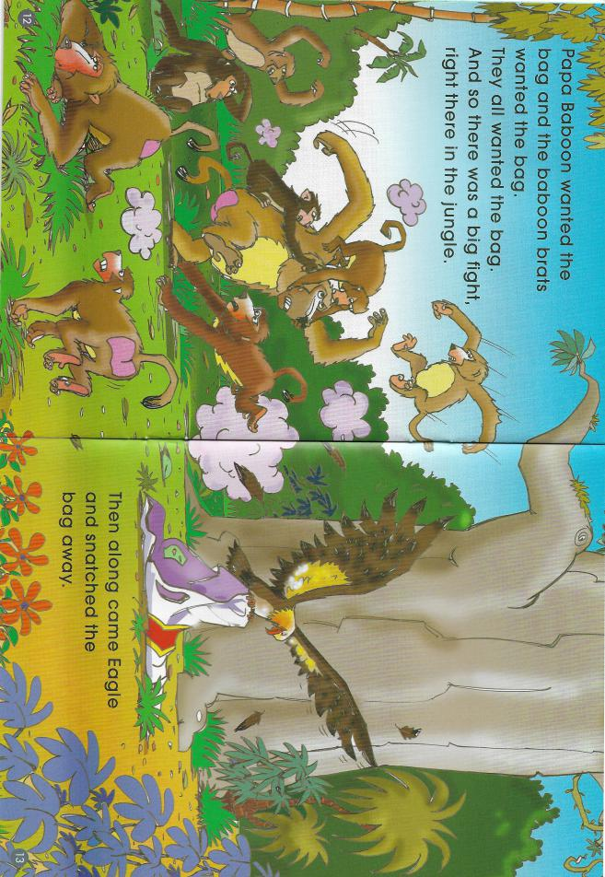
Let’s read.
What happened in the end?

Slide 23
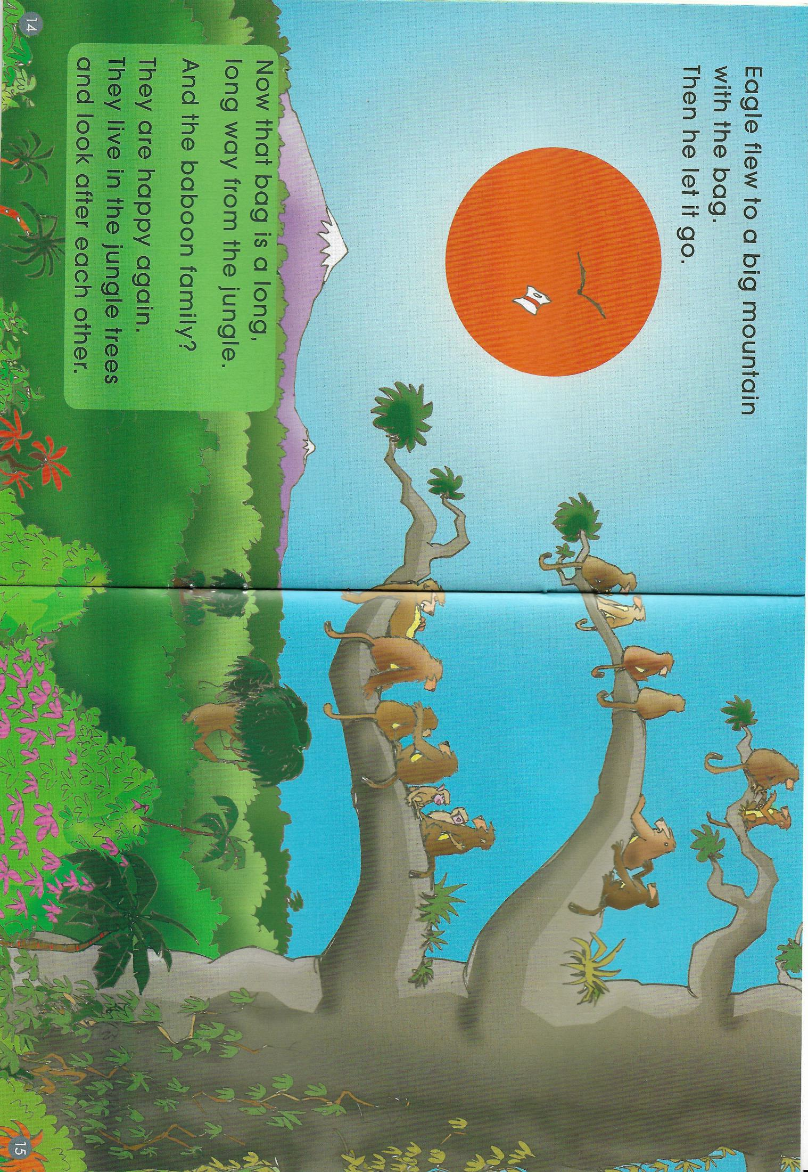

Slide 24


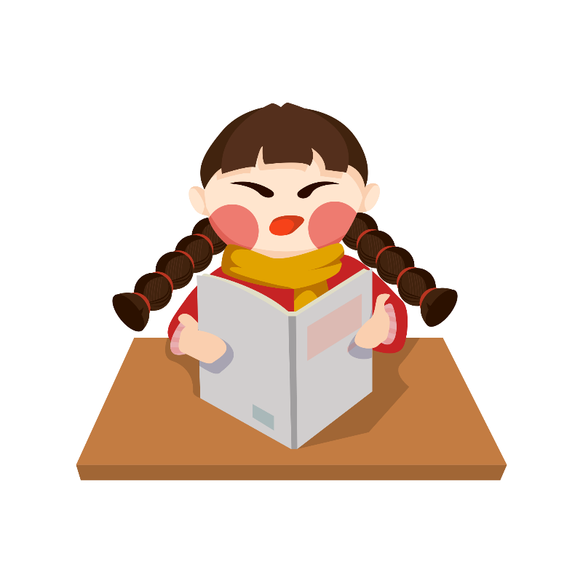
Read after the audio

Slide 25
Let’s do the role play.
Narrator （旁白）
Bubba baboon
Mama baboon
Papa baboon
5+6. Baboon brats
Please do not read the book, just say some important sentences or use your own languages.
Please do the actions!!!（动作语气）

Slide 26
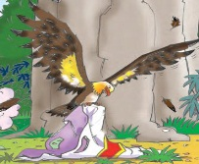
Let’s discuss.
solve the problem?
What would you do to
have a happy family
if you were the baboon?
If I were bubba baboon, I would...
If I were Mama baboon, I would...
If I were Papa baboon, I would...
If I were baboon brats, I would...
incident
（偶然，插曲）

Slide 27
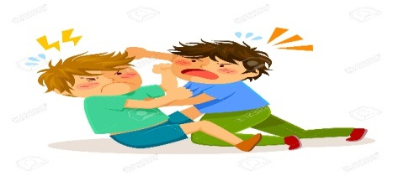
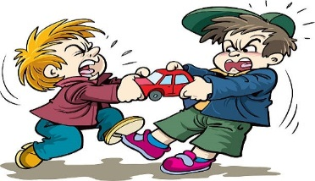
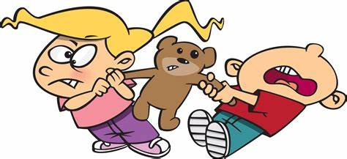
Let’s share your storys.
Do you have the same kinds of problem
in your class?
Did you fight with...?
Did you want something
that others also wanted?
Did you snatch something
without asking?
Did you...?

Slide 28
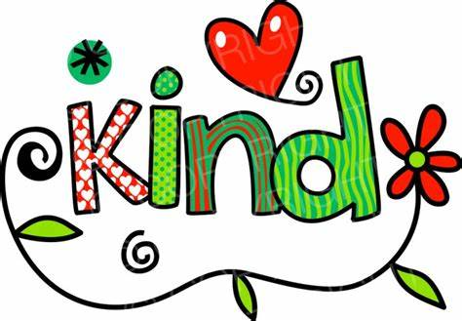

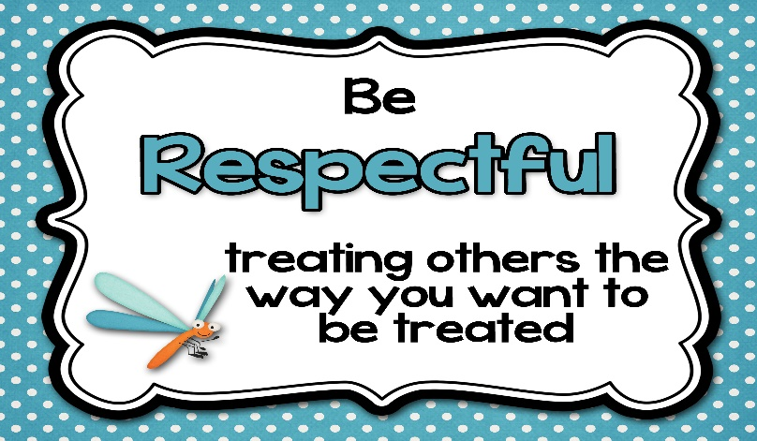
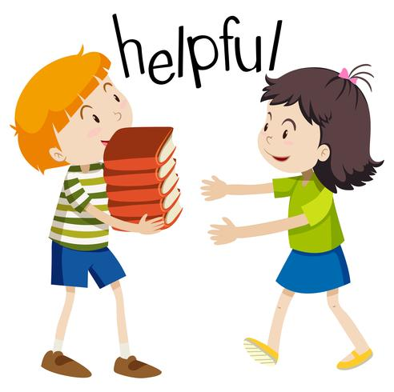
What is a real happy class?
A happy class should be______.
互相尊重

