Slide 1

教学设计

Slide 2
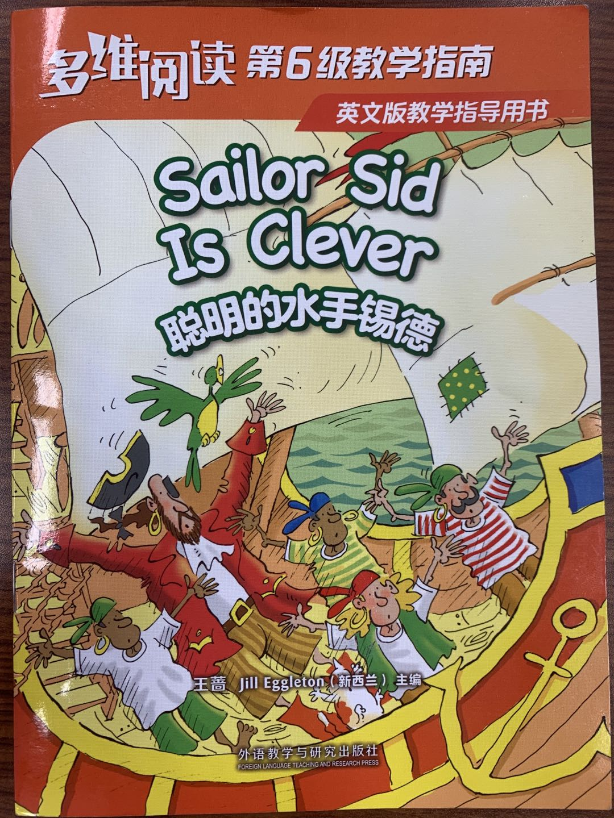

Slide 3
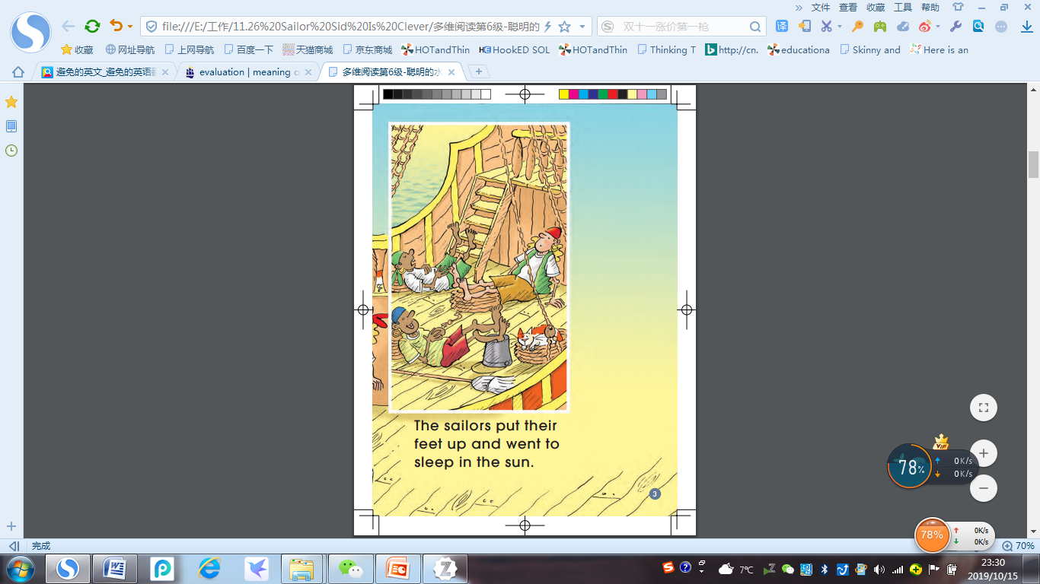
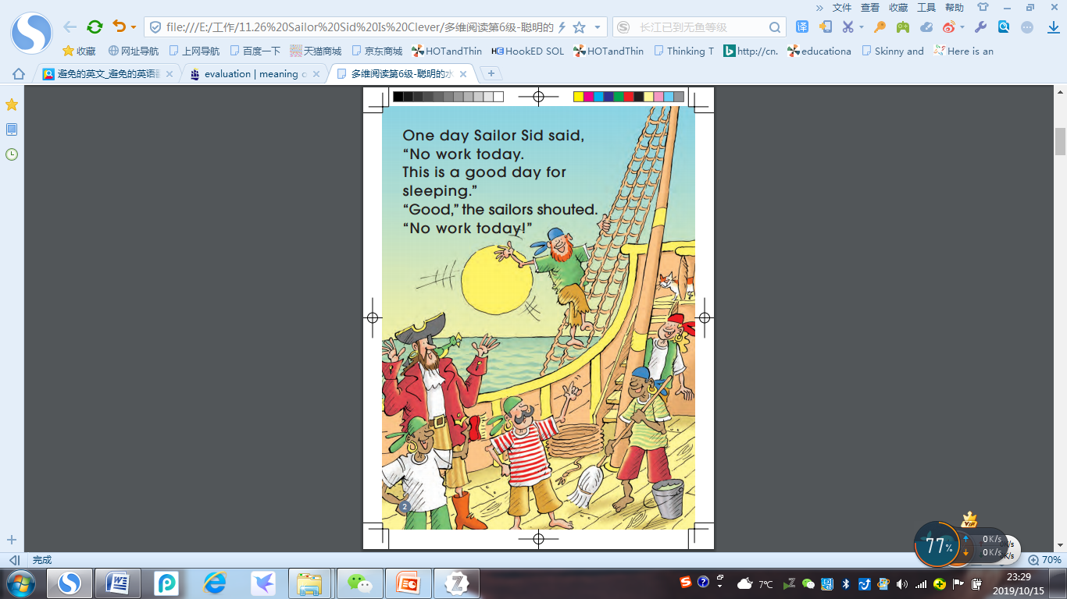
No work today. This is a good day for sleeping!
put their feet up

Slide 4
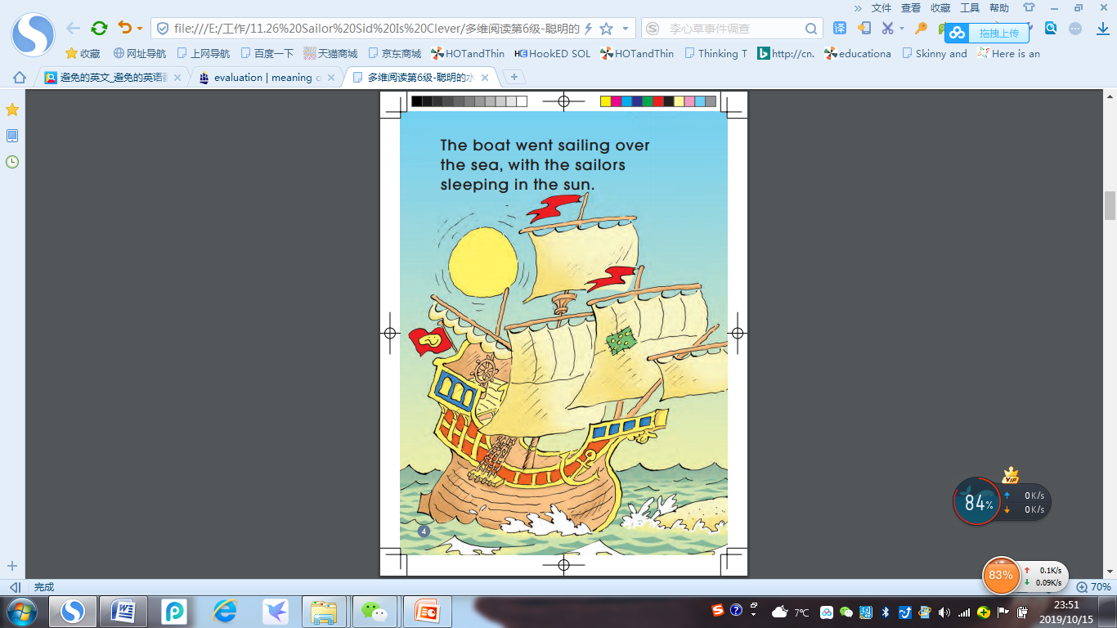
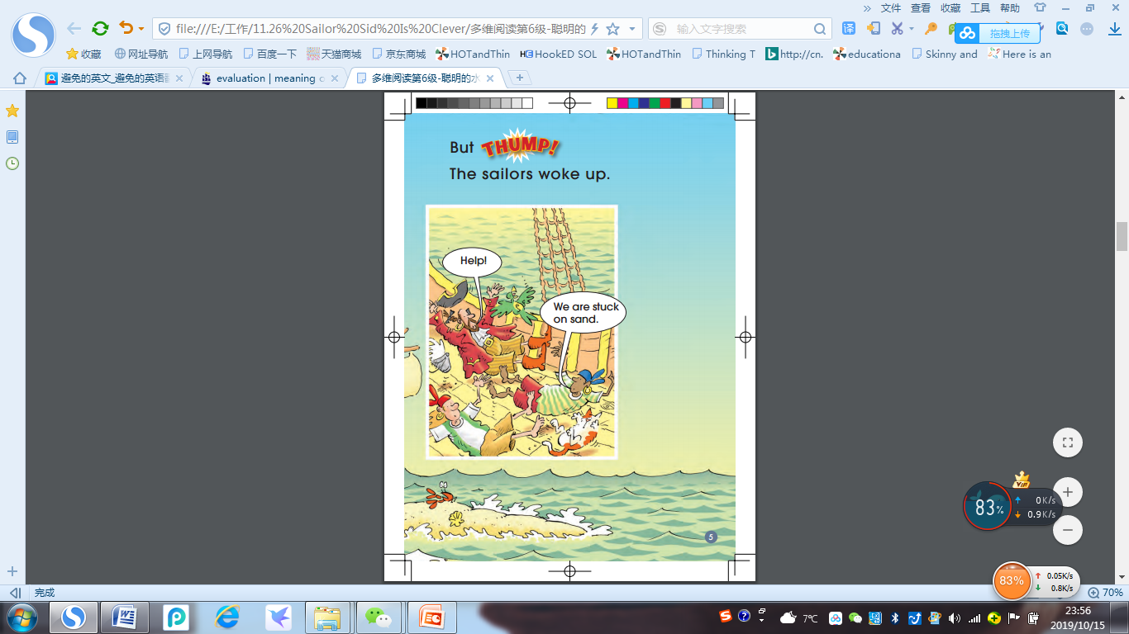

THUMP!
Help!
We are stuck on sand.

Slide 5
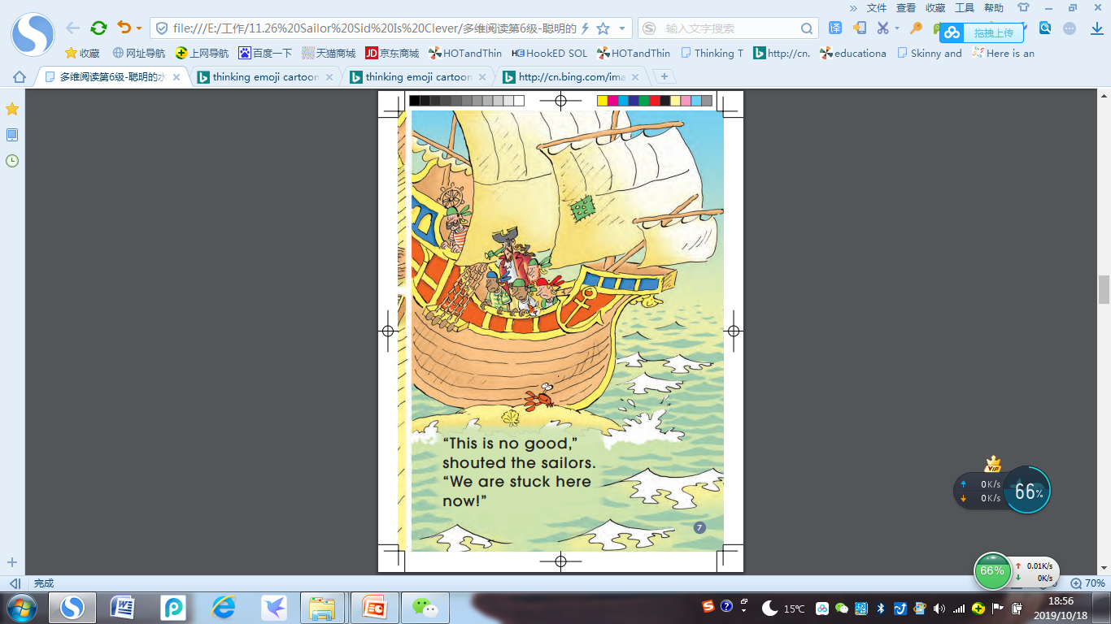
What would the sailors do next?

Slide 6
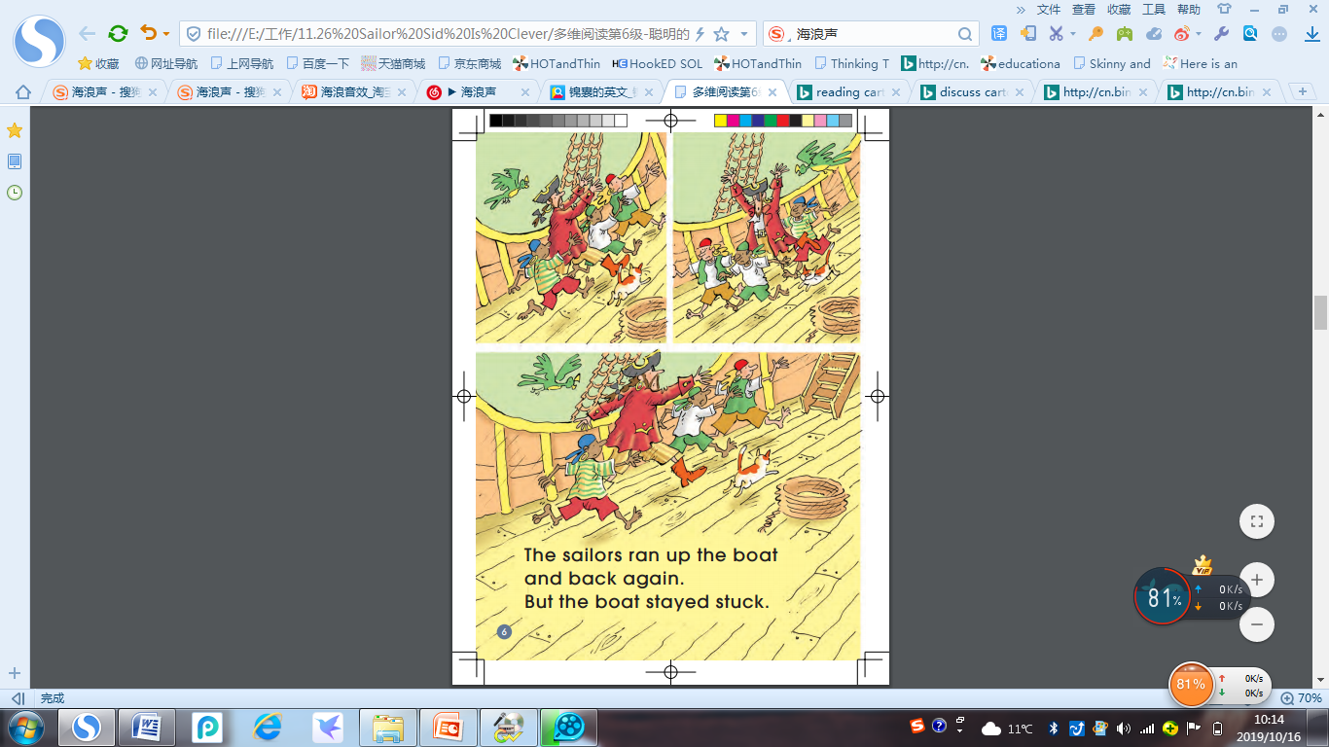
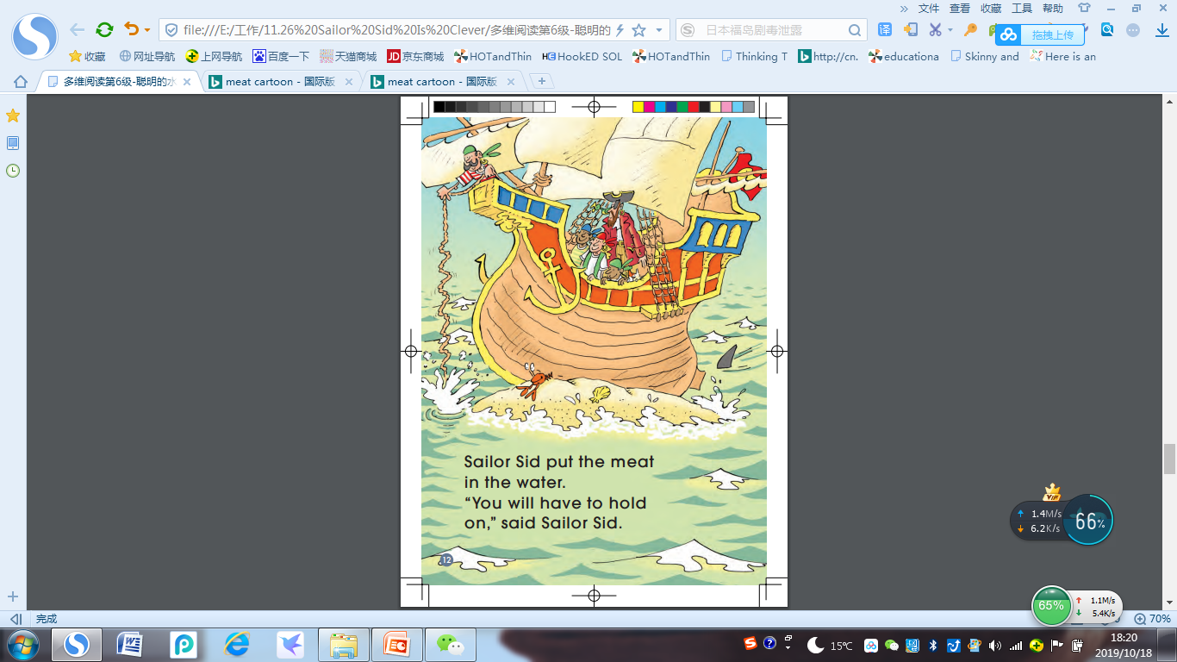
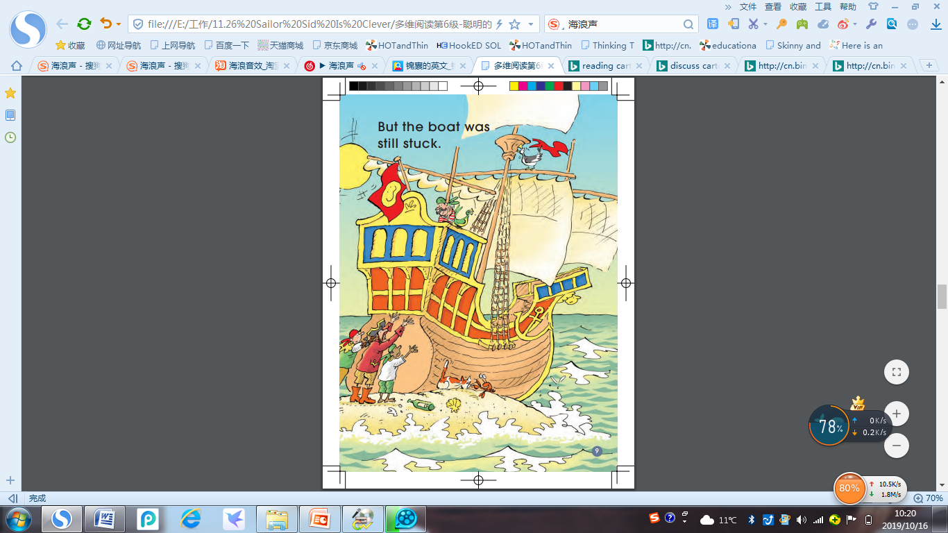
Notes:
请学生先关注图片 再看action

Slide 7
Read the 3 Actions
Notes:
Free talk about it.

Slide 9

Why do you think it could help them?
Notes:
Free talk about it.

Slide 11

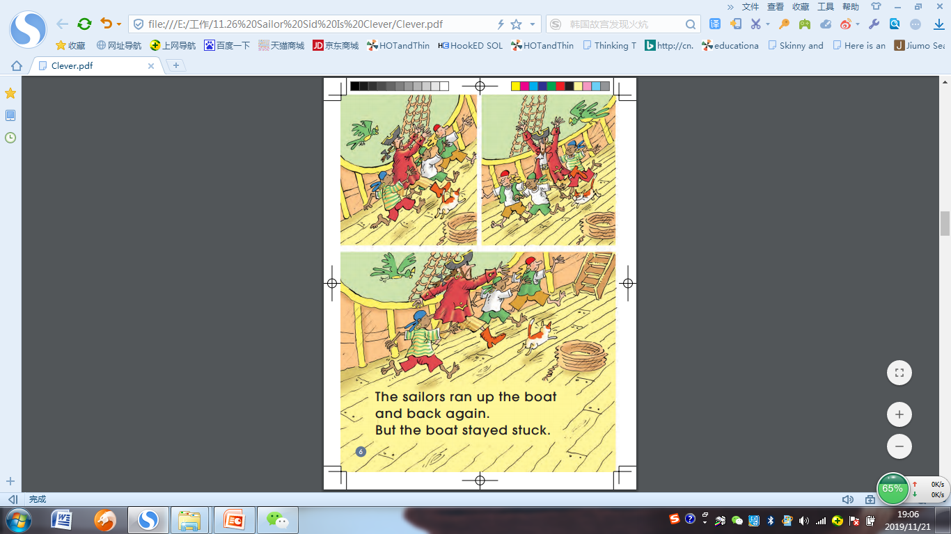
Look at page … , it says …
P6

Slide 12
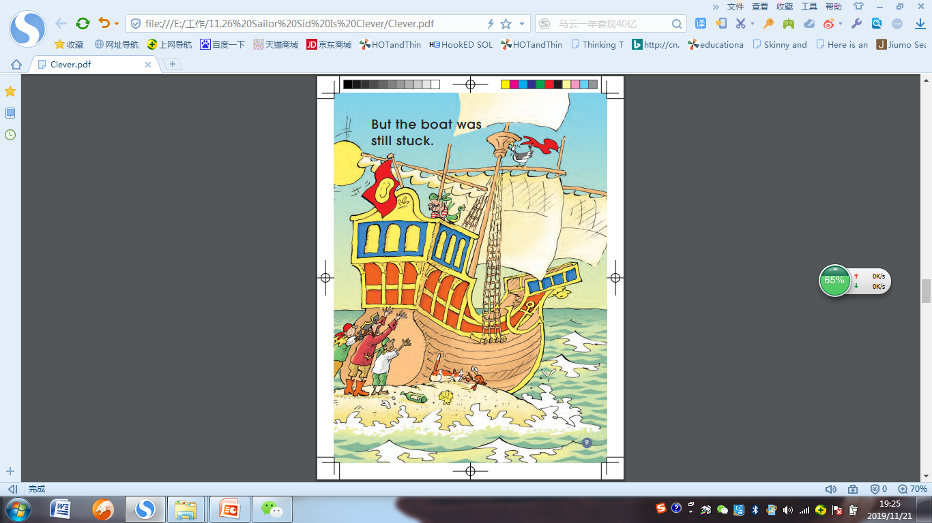
Look at page … , it says …
P9

Slide 13
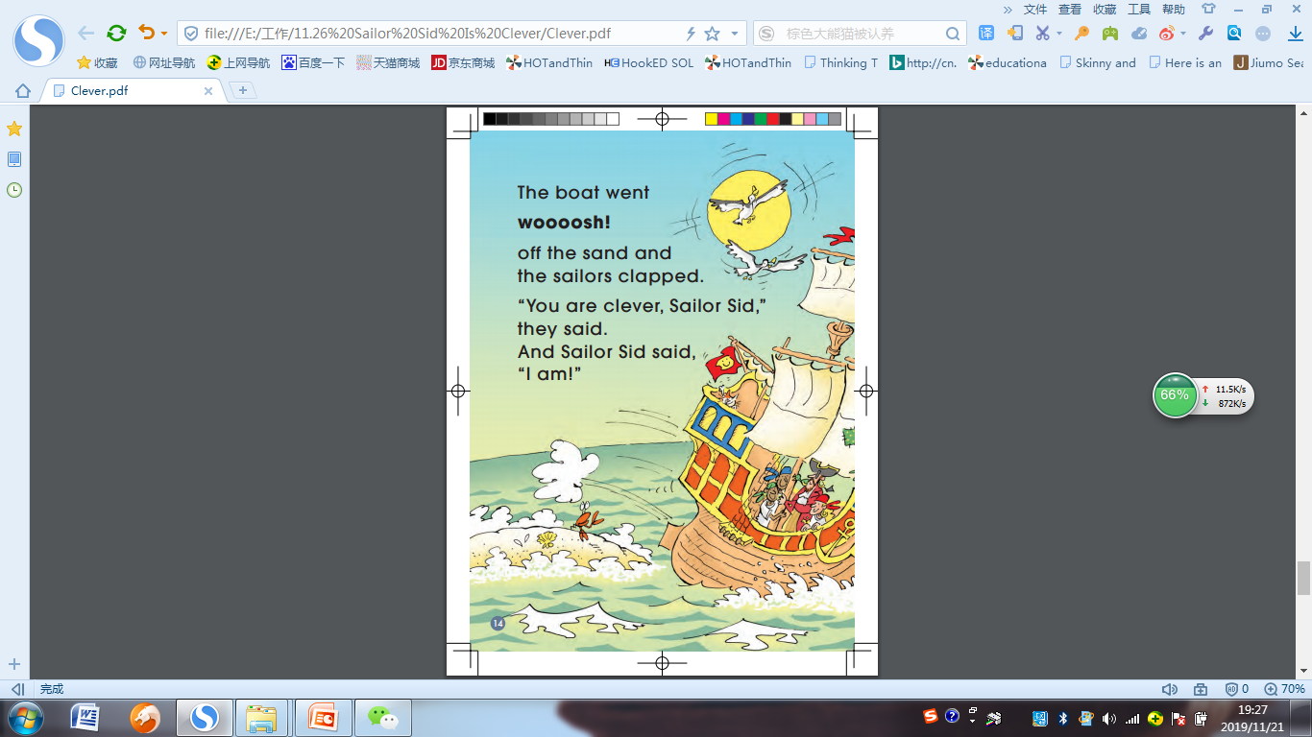
Look at page … , it says …
P14

Slide 14
From the book,
how do you know that Sid is clever?

Slide 16
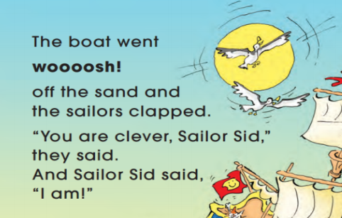
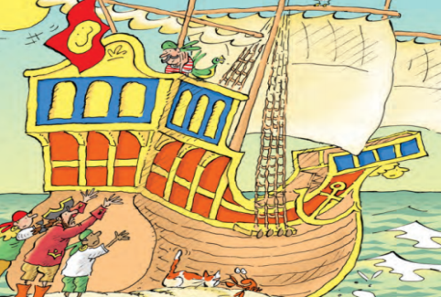
From the book,
how do you know that Sid is clever?
Look at page … , it says ...
Look at page … , the picture shows ...

Slide 17
What will you do if you are on the boat?

Slide 18
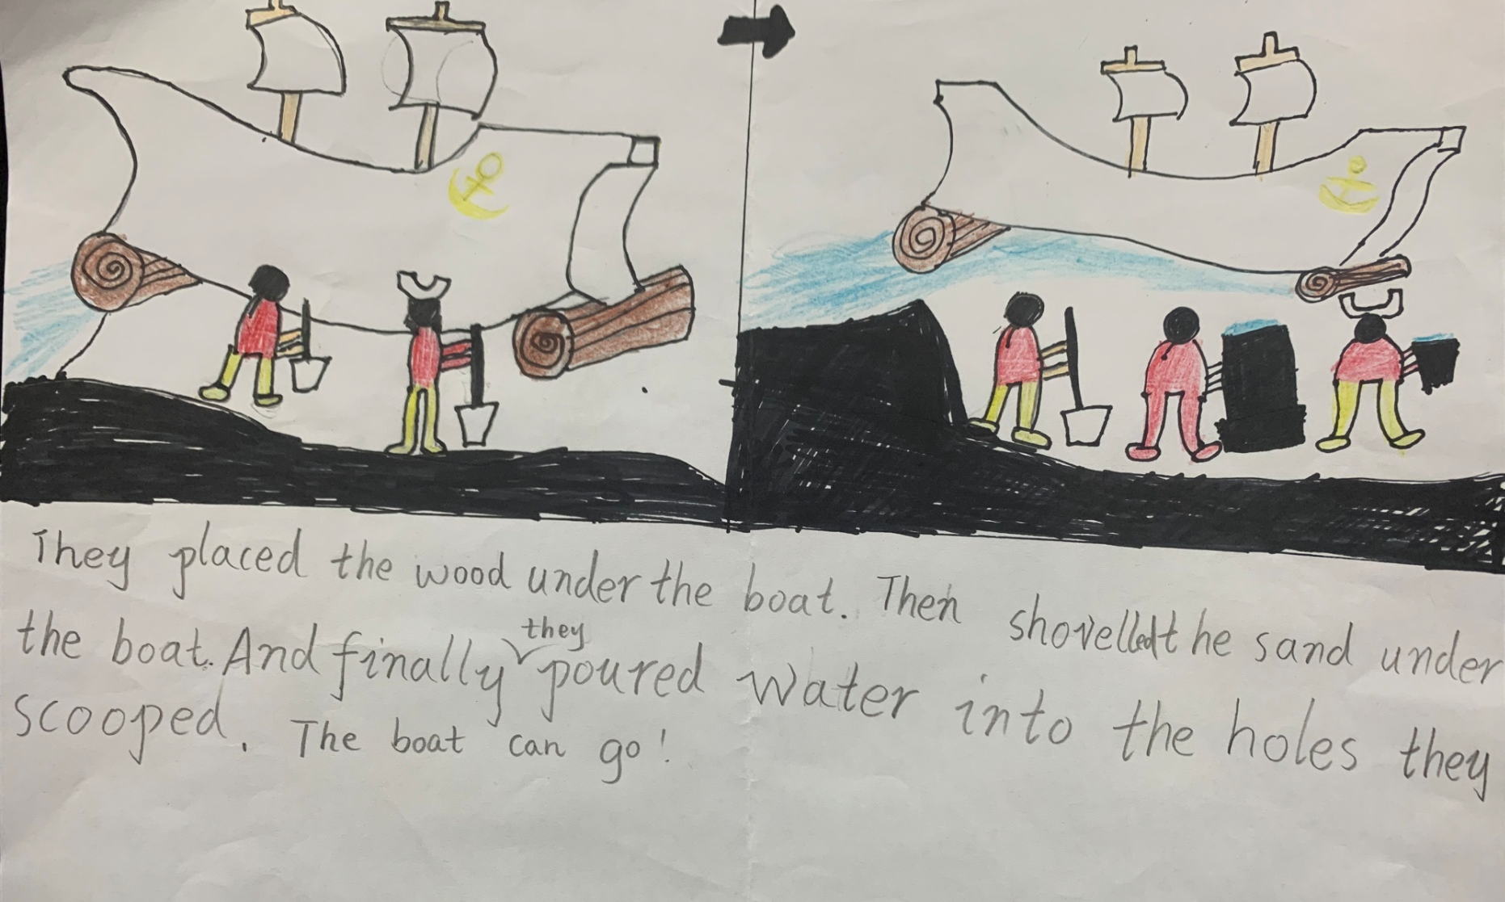

Slide 19
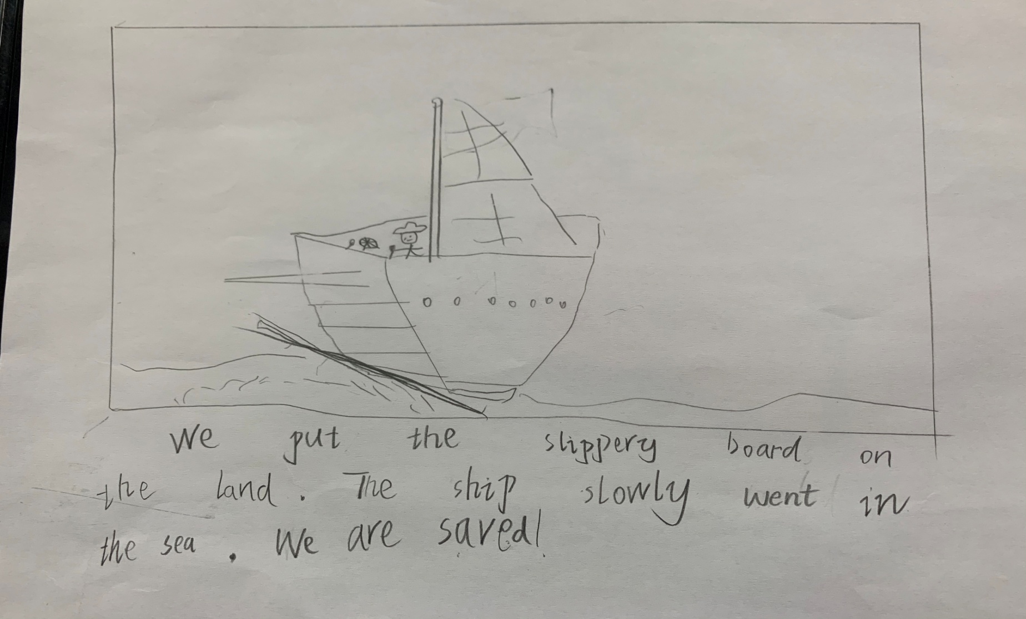

Slide 20
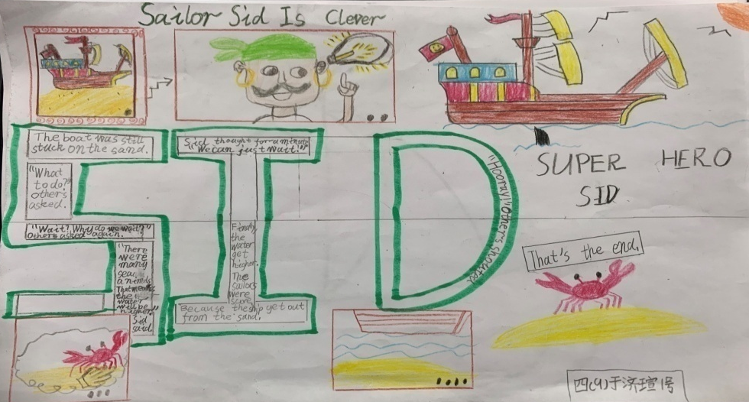
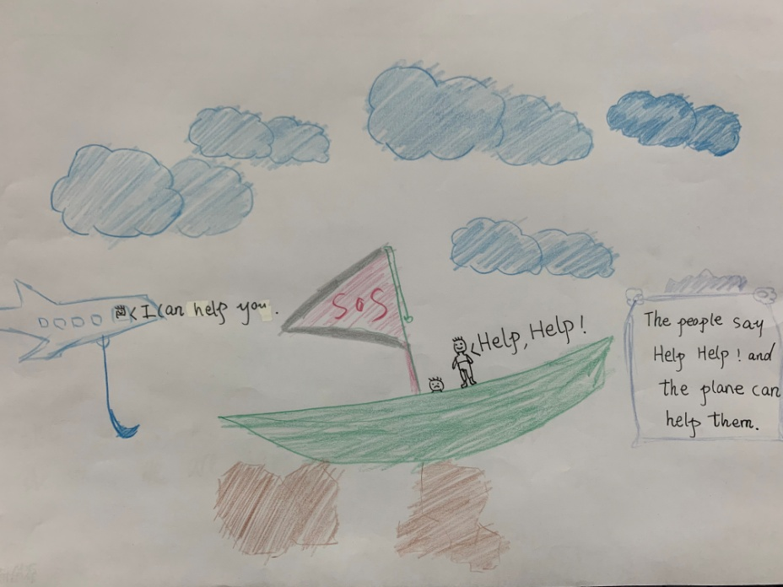
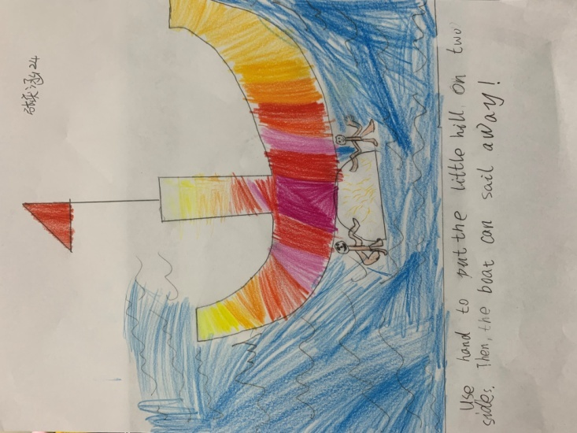
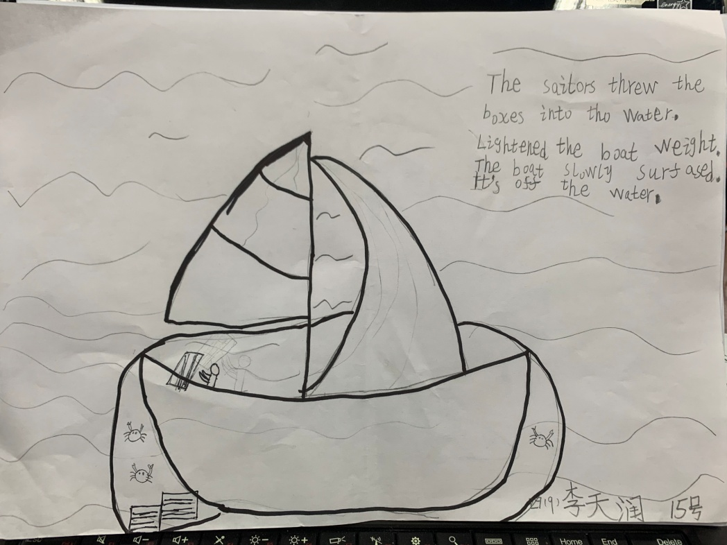

Slide 21

Homework
Read the story.
Write and draw a solution for the story.

Slide 22
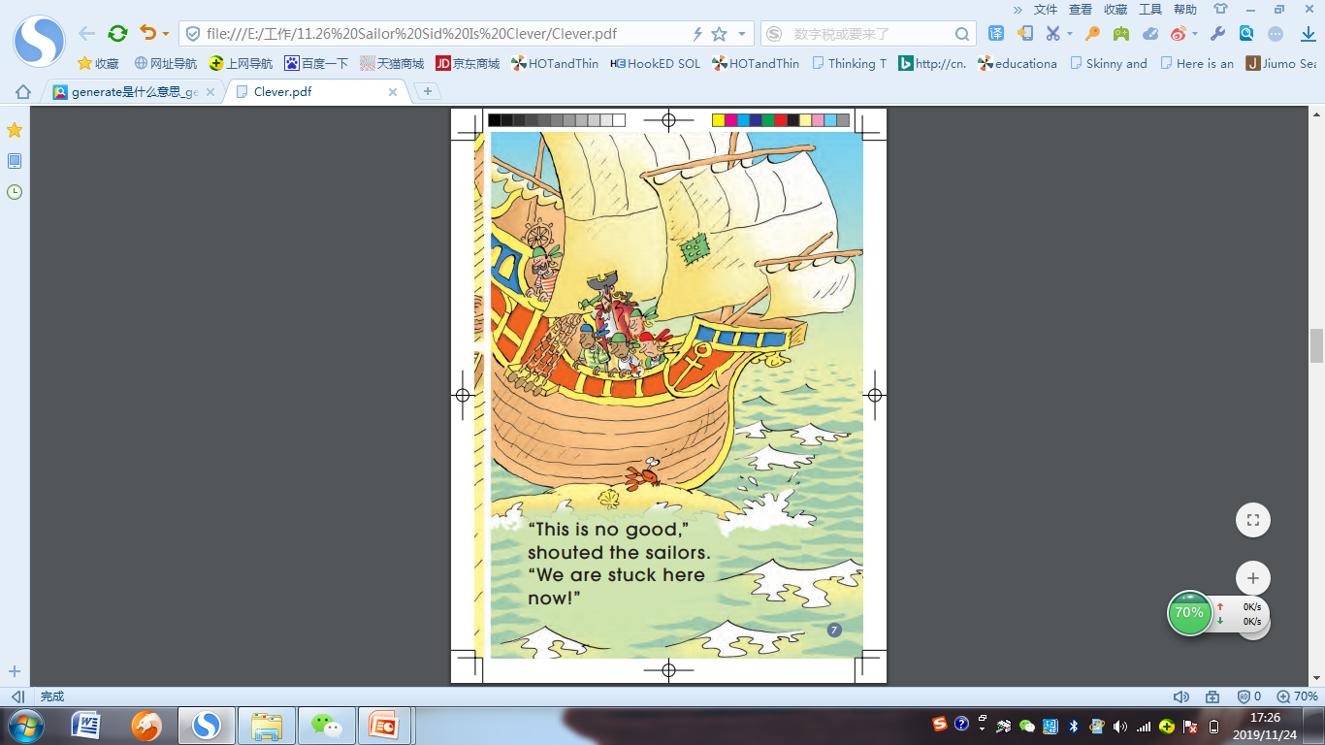
Look at page … , it says ...
P7

Slide 23
Fiction

Slide 24



Nonfictions

Slide 26
Idea 2
Idea 3
Idea 1

Slide 27


Slide 28
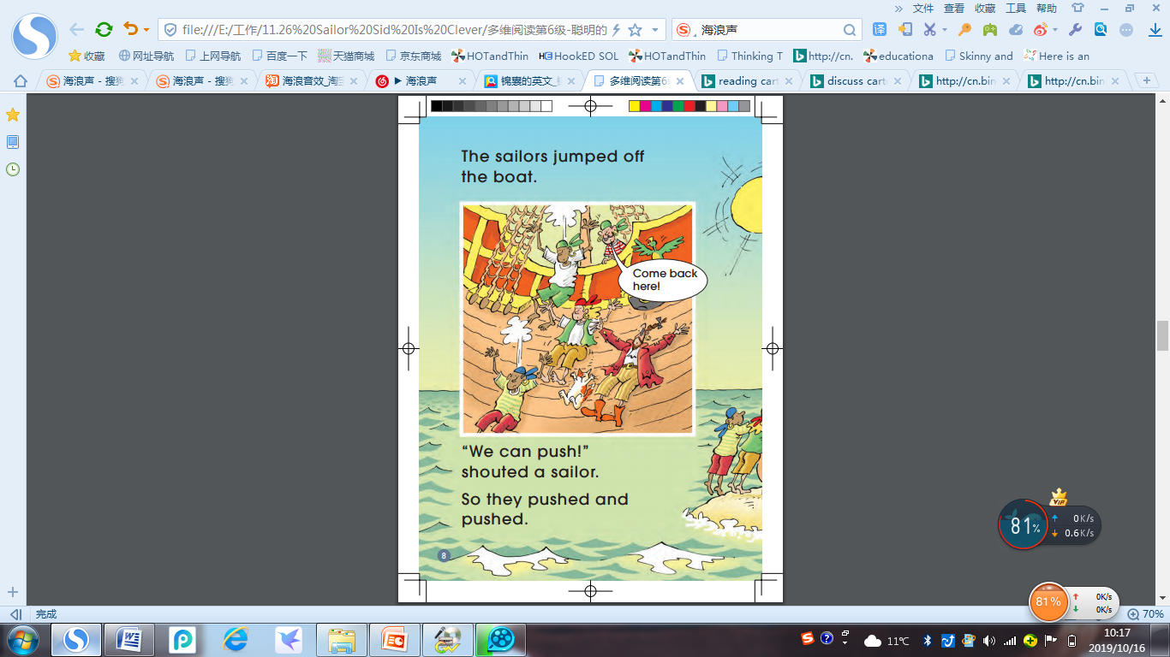

Slide 29
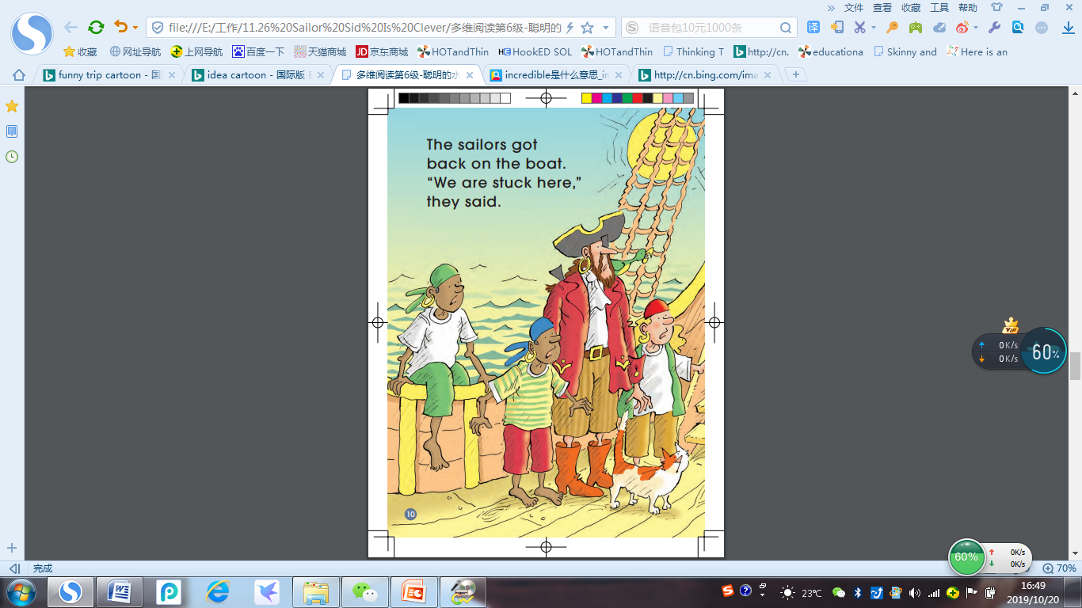
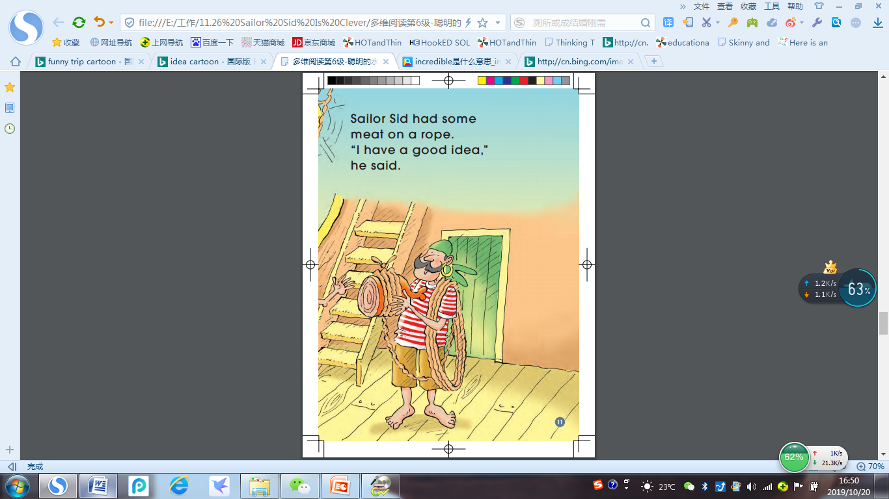

Slide 30
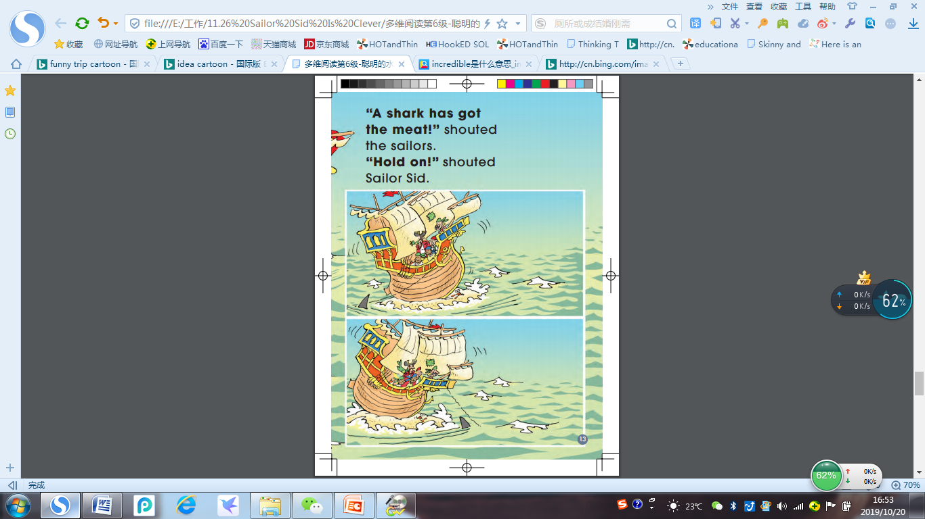

Slide 31
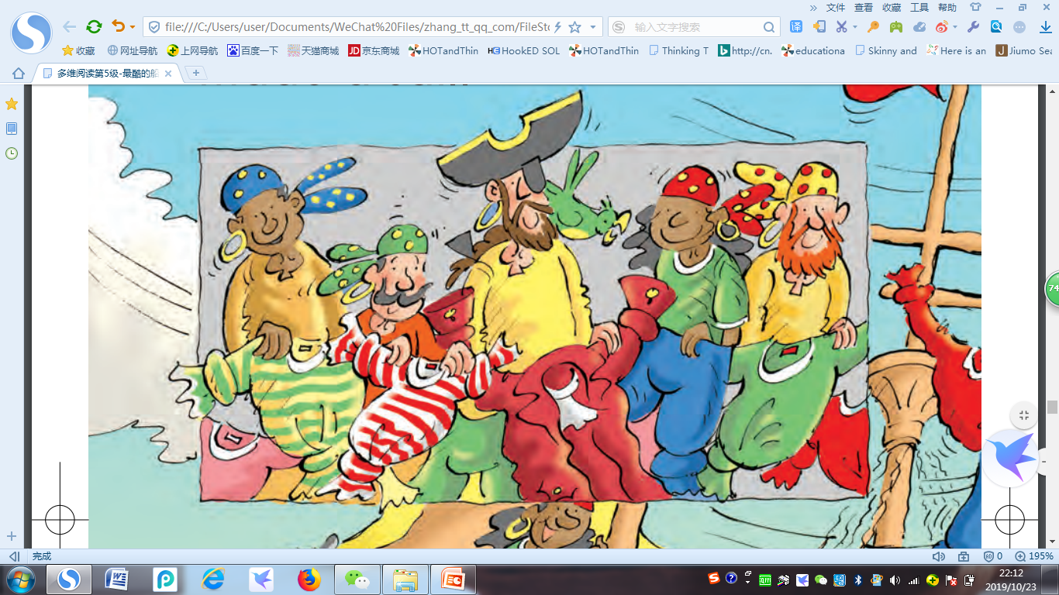

Slide 32

Sharing Tips
Read the idea and act it out.
Ask 1~2 questions.
Show your opinions.

Slide 33
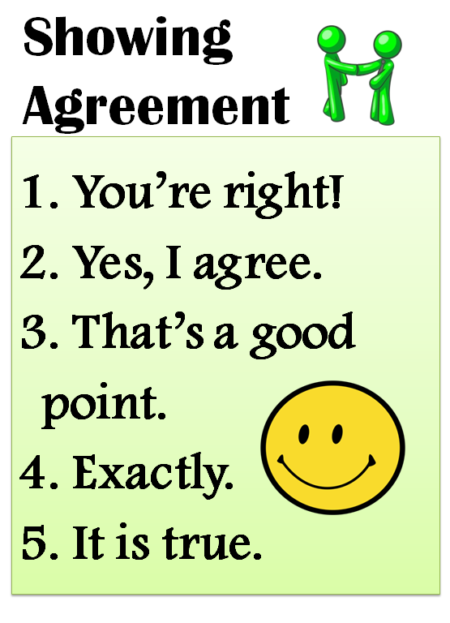
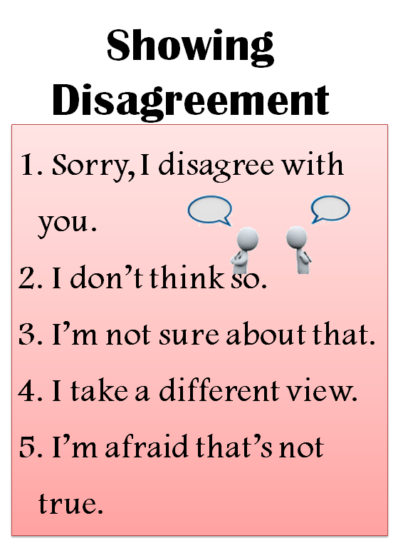

Slide 34
ran up the boat and back again

Slide 35
jumped off the boat
pushed and pushed

Slide 36
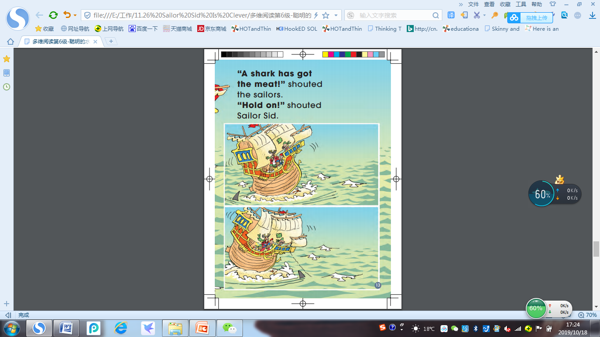
put the meat in the water
Hold on!

Slide 37
THUMP!
Woooosh!

