Slide 1
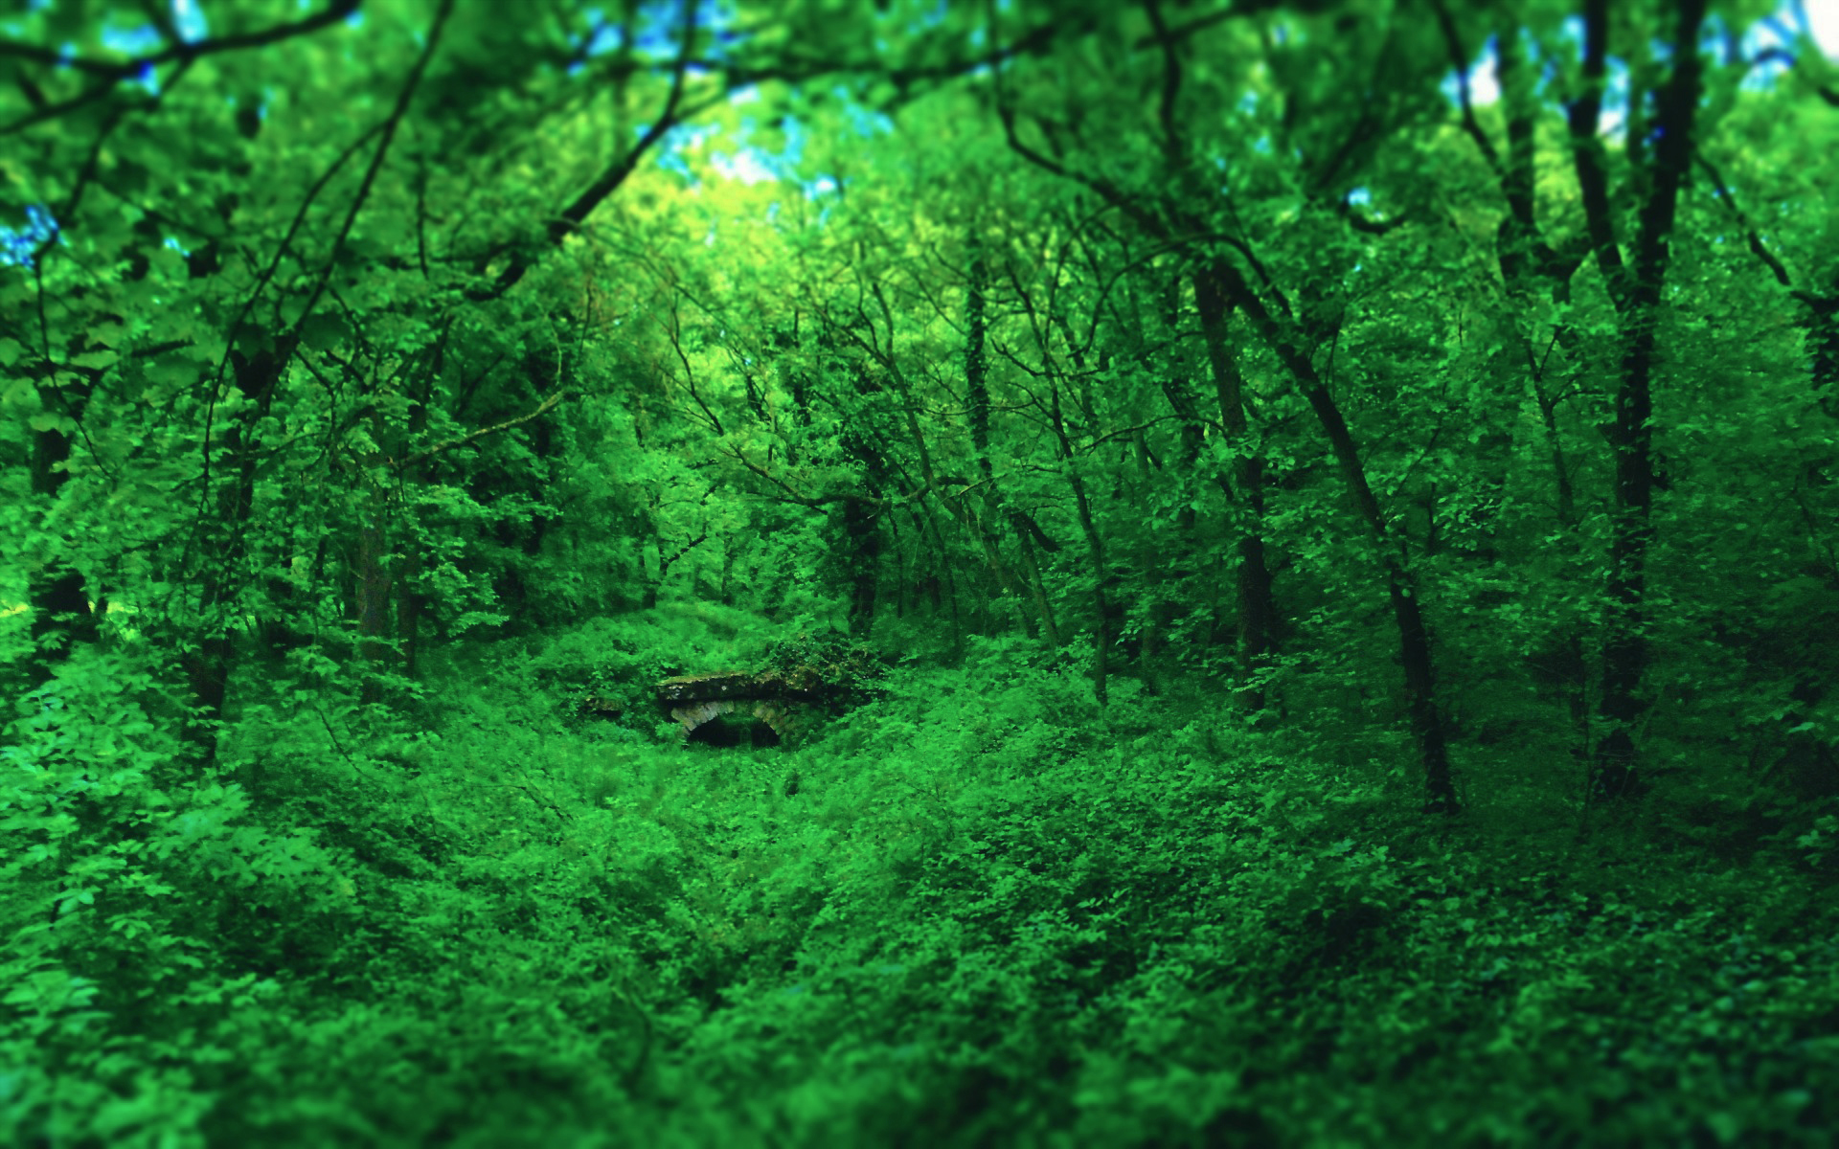
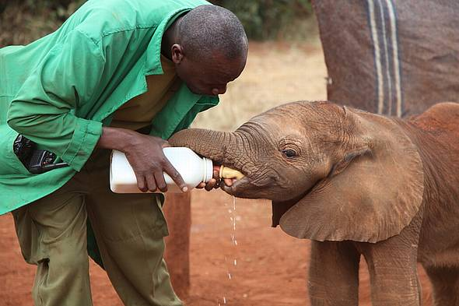
Orphan Elephants
第二课时
人大附中通州校区 乔璐洁 Jessica

Slide 2
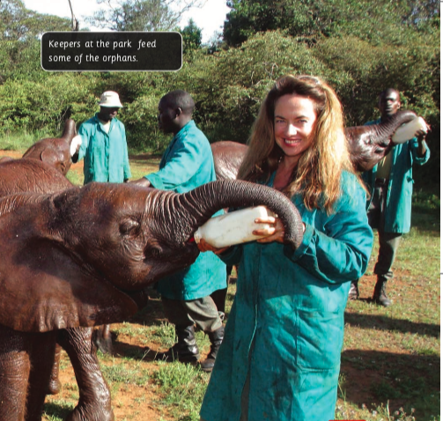
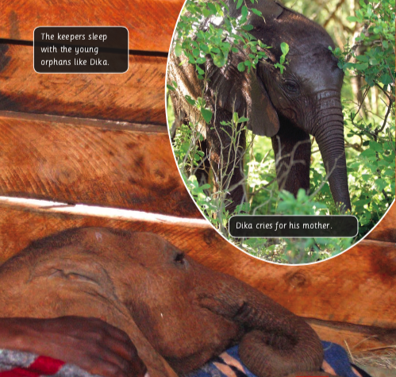
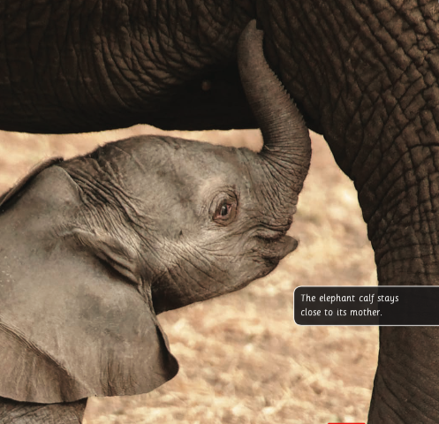
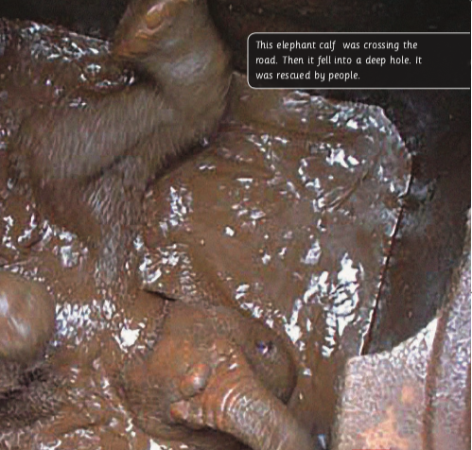
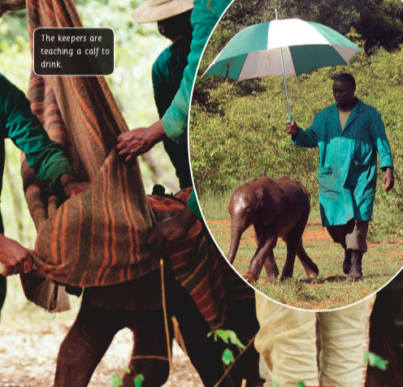
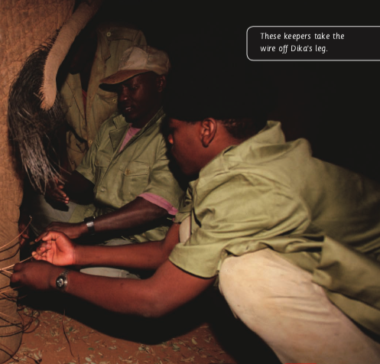
What have we learned？

Slide 3
Reading Circles
Group Discussion—Make your task better
Summarizer
Researcher
Connector
Questioner
Complete + Correct + Coherent
interesting/important facts; use your own words
add new feelings/comments…
imagination; critical; talk about the answers

Slide 4
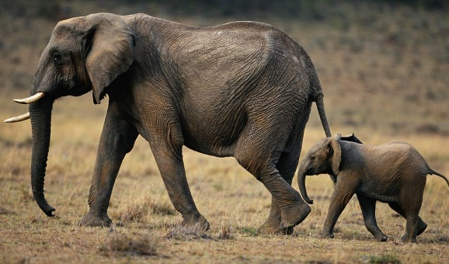
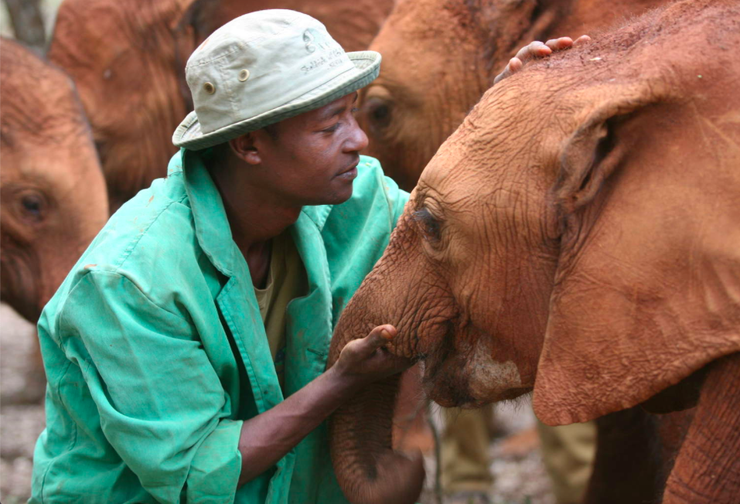
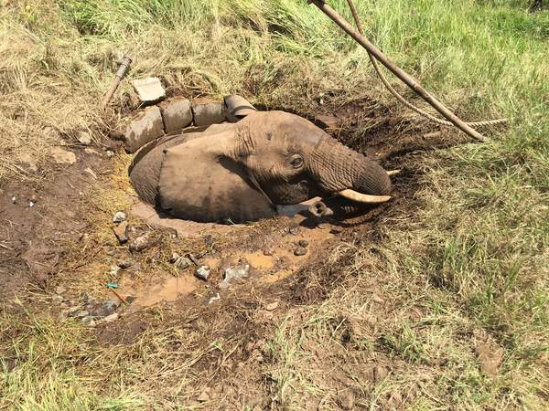
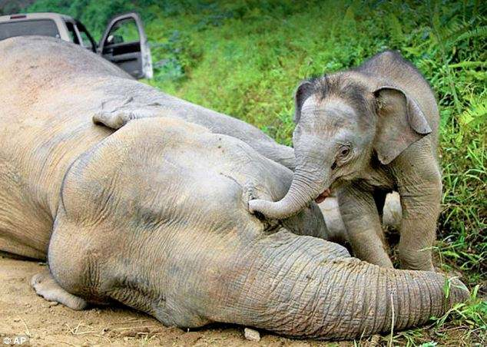
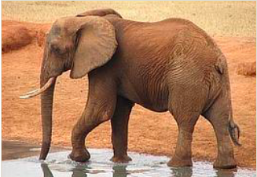
Check
Summarizer
Researcher
Connector
Questioner

Slide 5
Questions
Why do the keepers help the orphan elephants? Are they volunteers? Or organizations? (From Flower)
Do you think the elephants who live in the wild are happier than those who live in the park? Why? (From Sweely)
Were the orphan elephants scared of keepers at first? How did the keepers make them relaxed?（From Velika）

Slide 6

Questions
Why do keepers put a blanket on the orphan elephant’s trunk? (From Tony & 钱浩燃)
Why do you think elephants don’t forget where they were cared for? (Sweely)

Slide 7
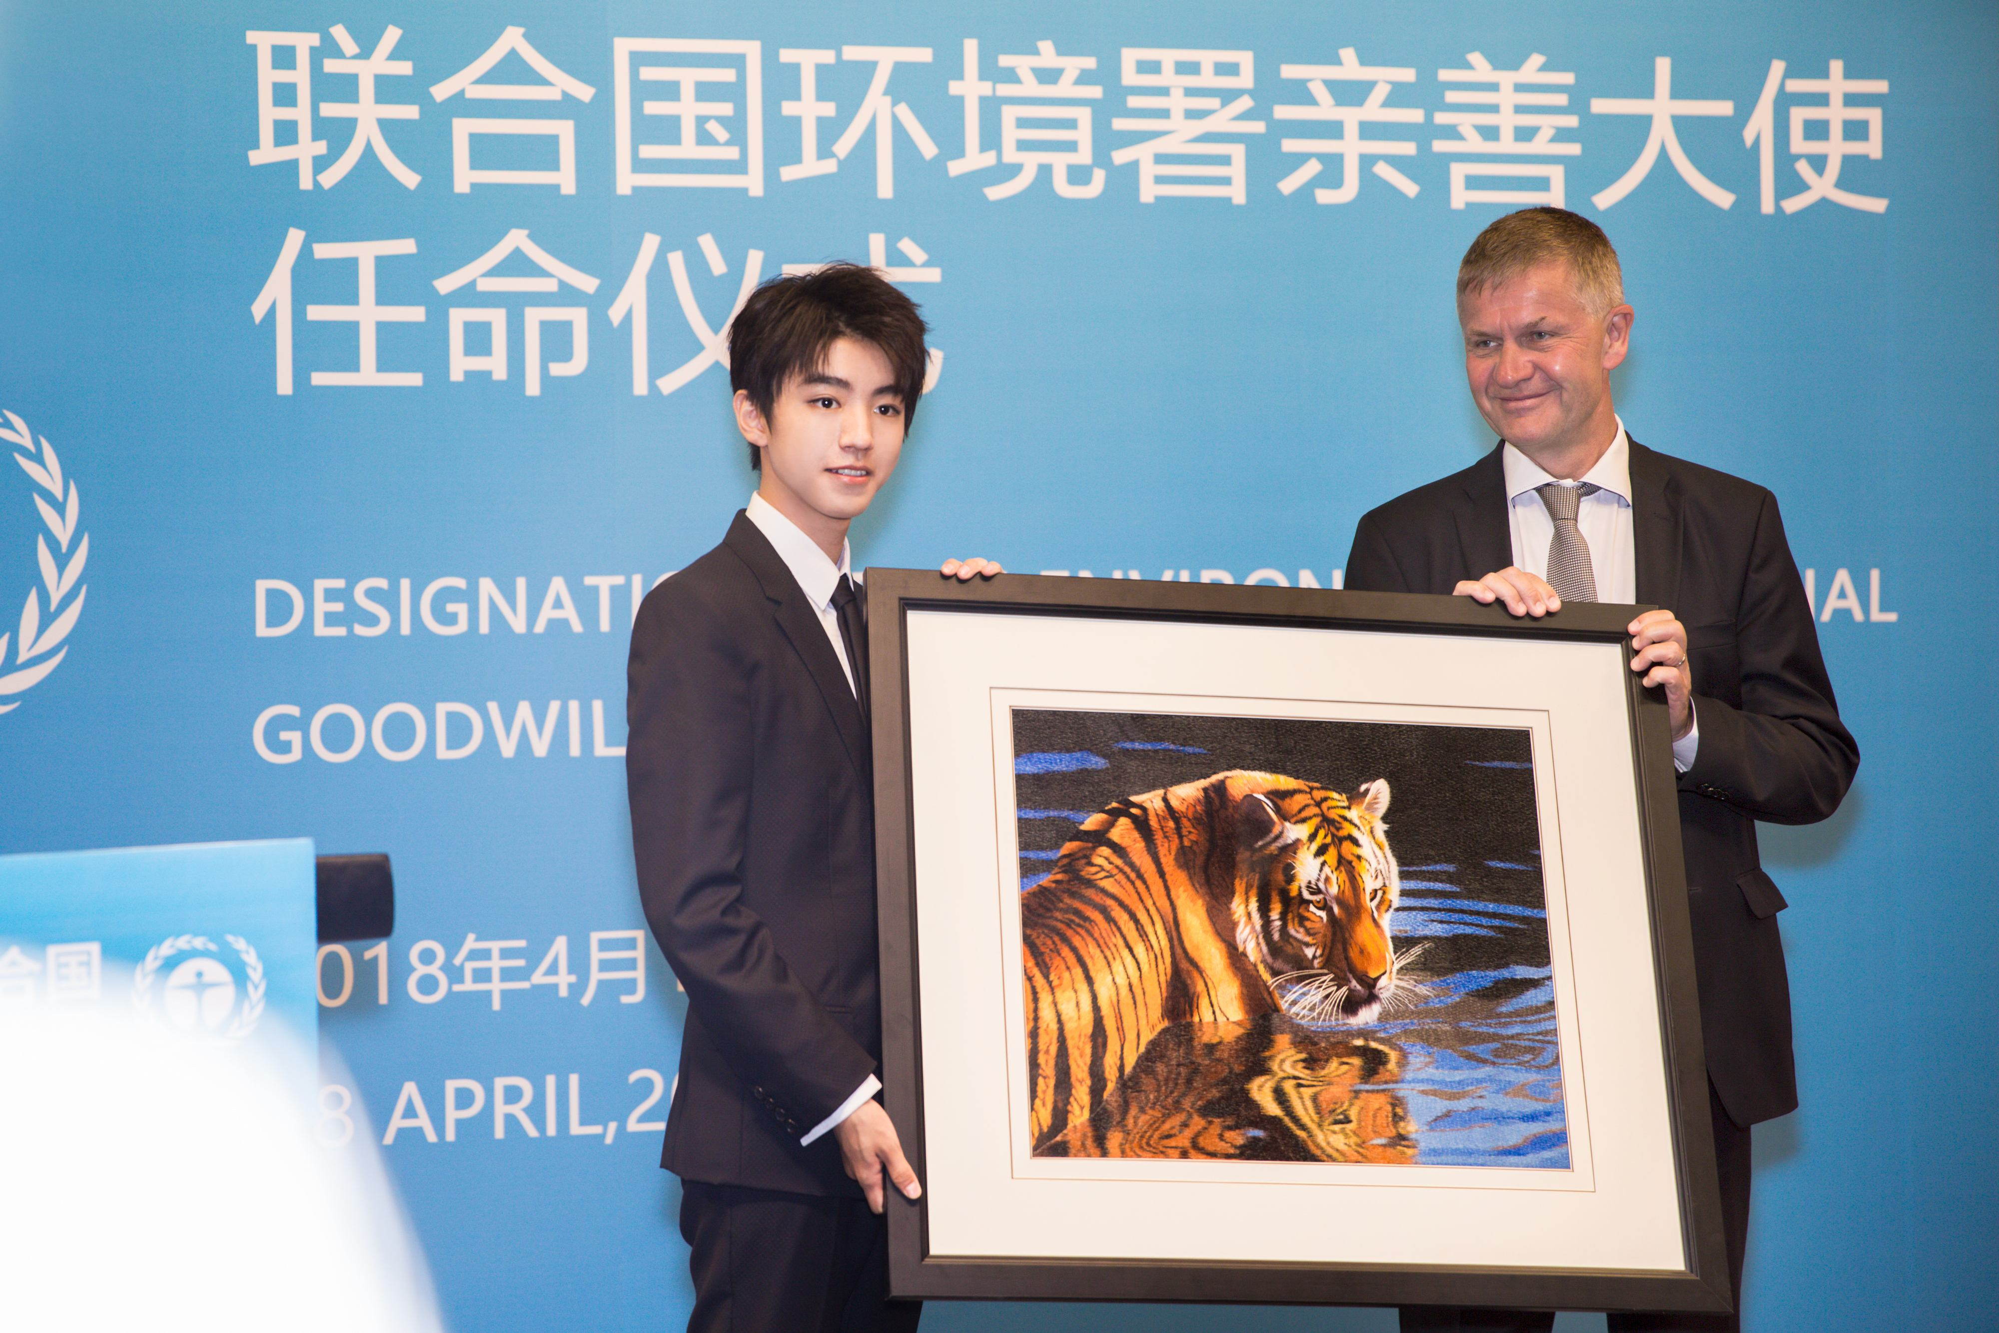

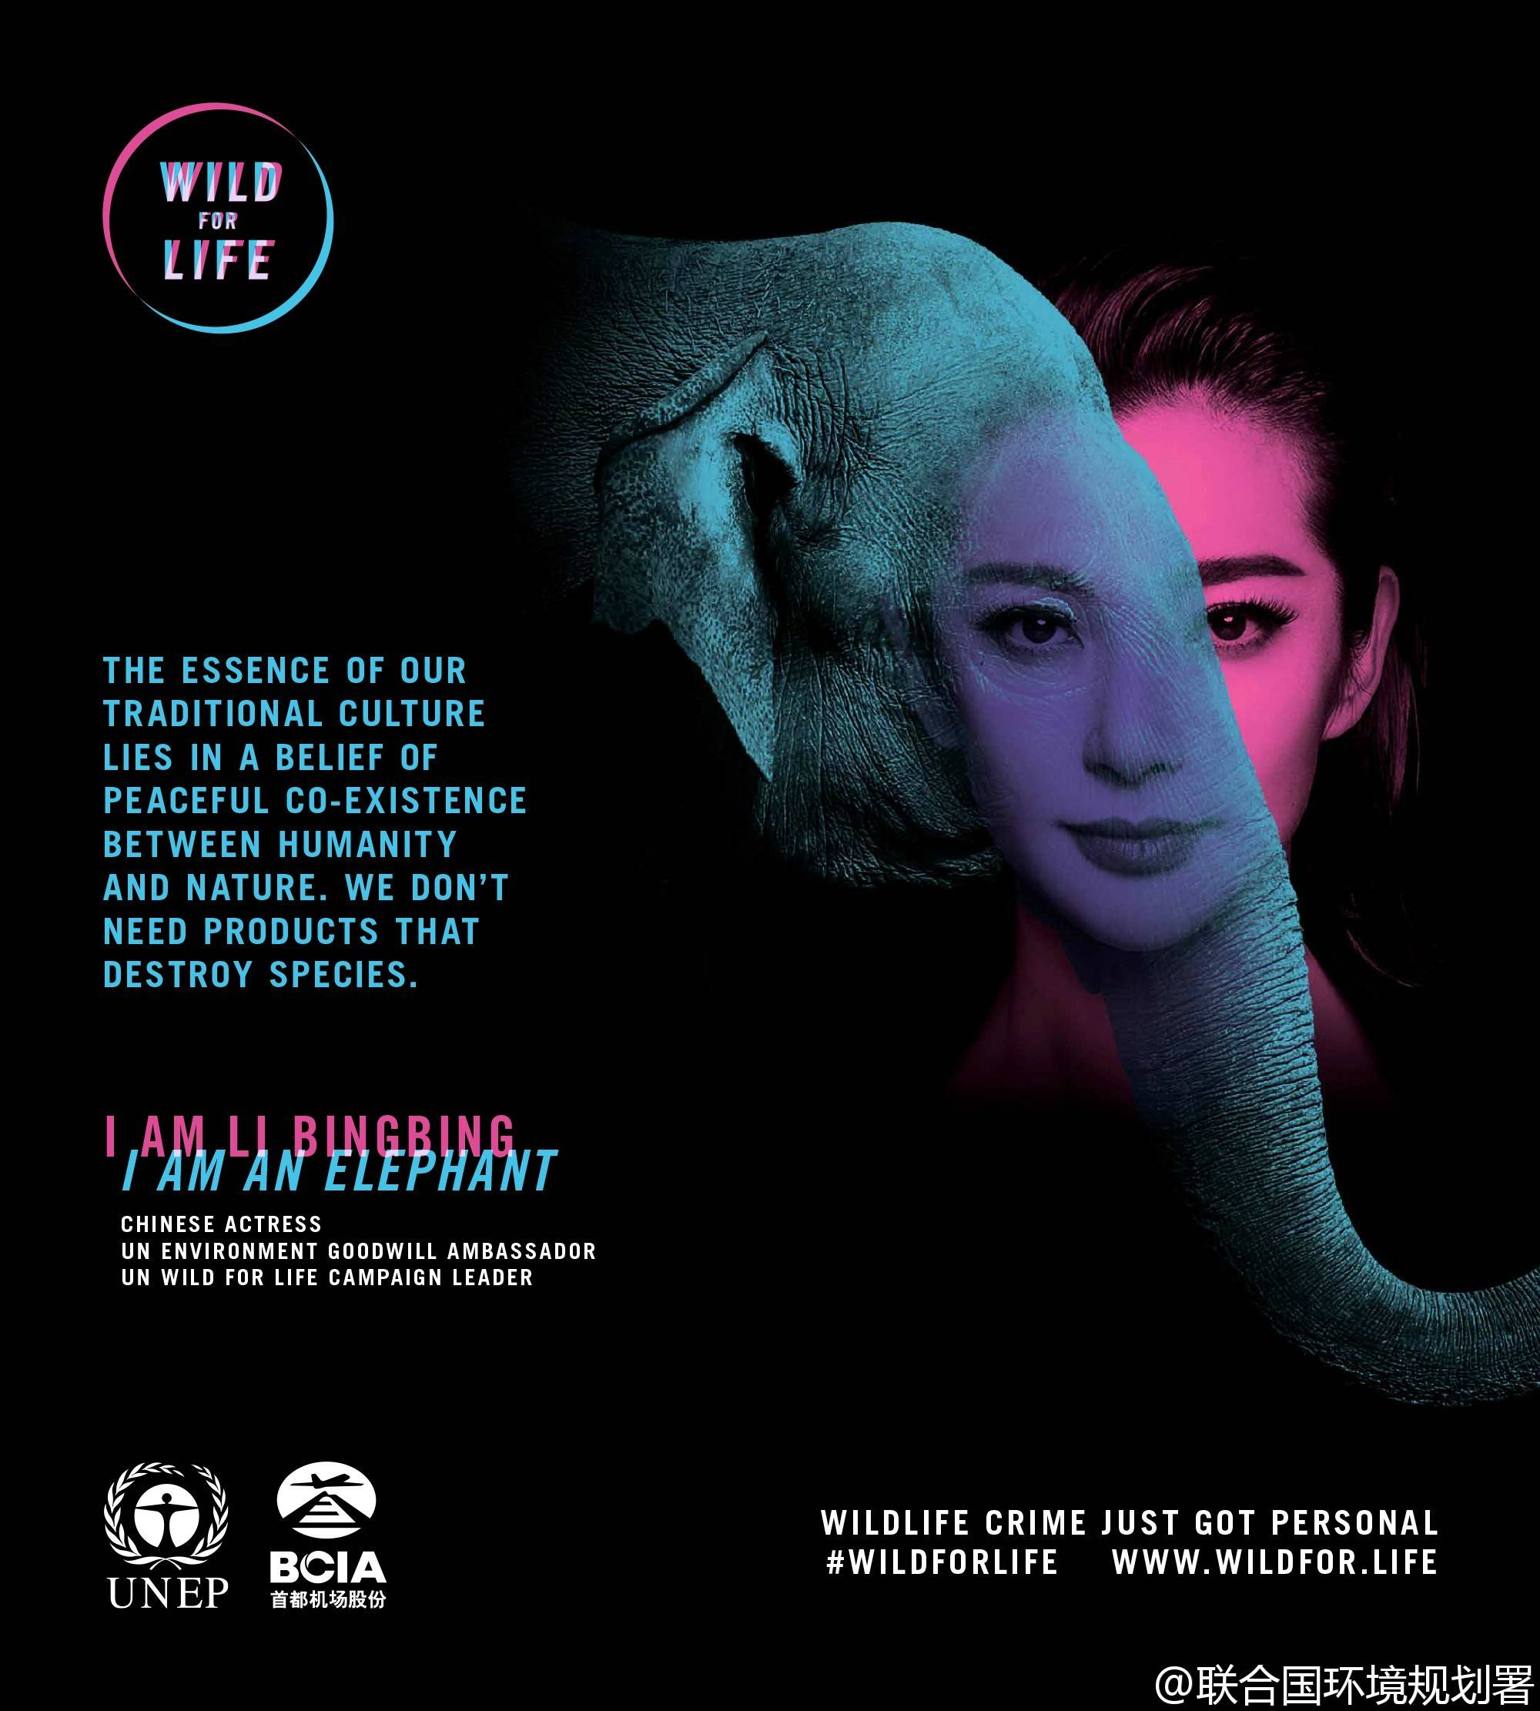

Slide 8
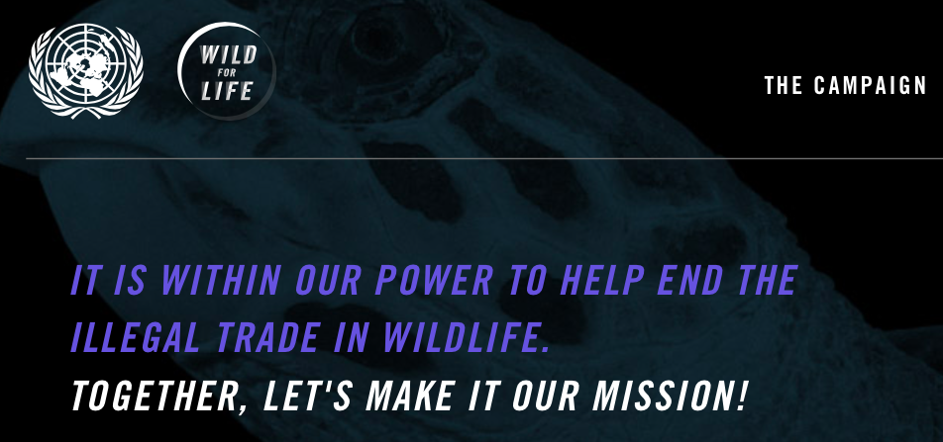
#Wild For Life# #为生命呐喊#

Slide 9





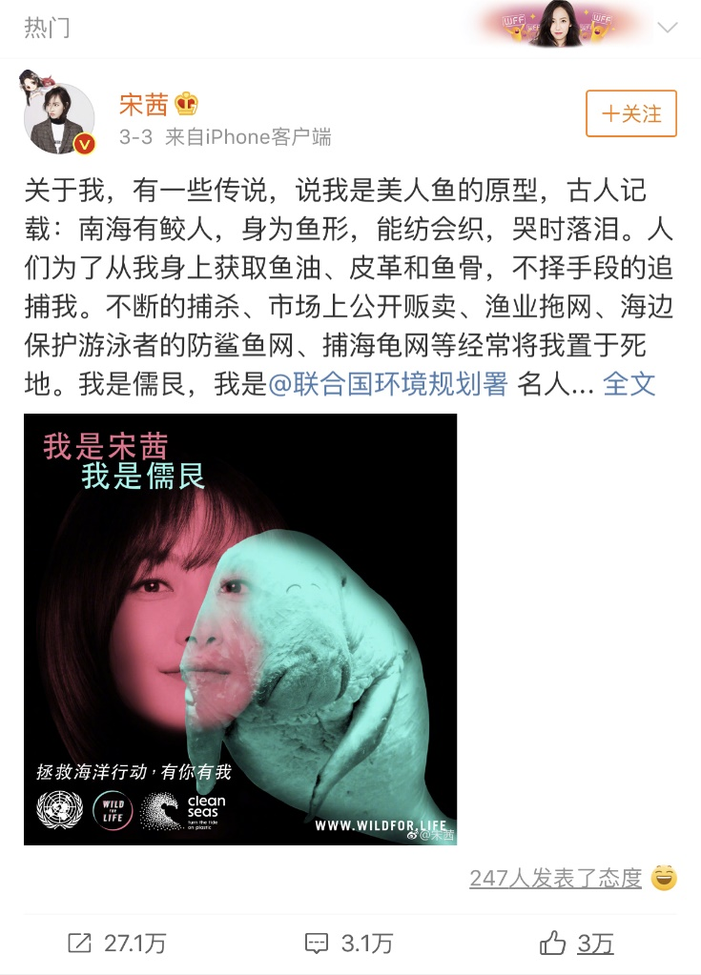

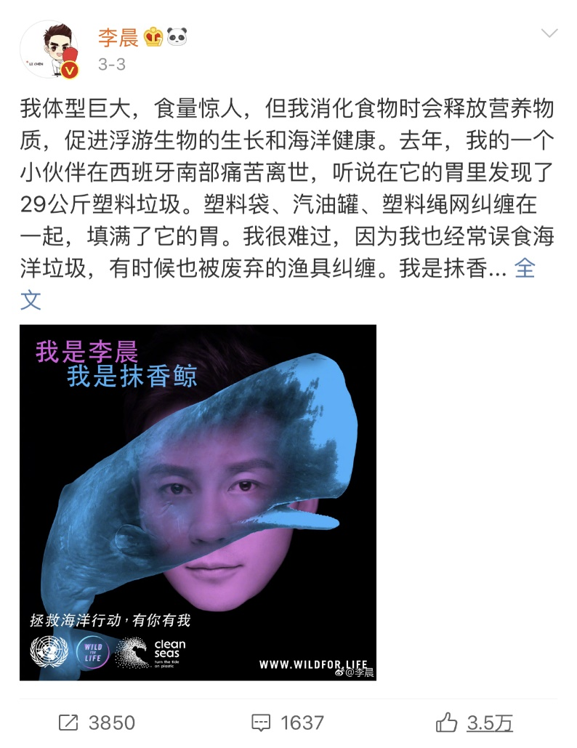
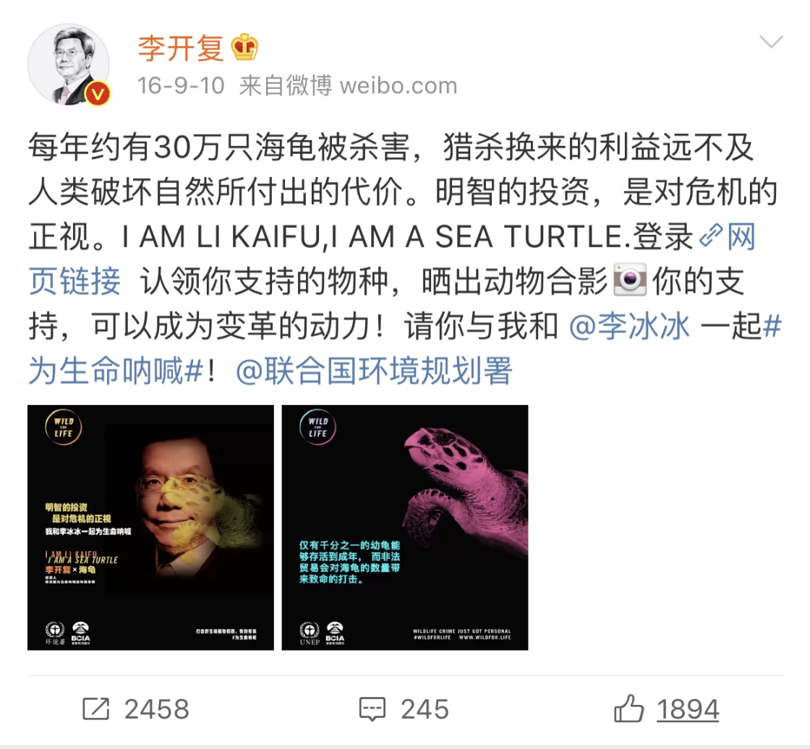

Slide 10

#Wild For Life#
#为生命呐喊#
Write a microblog for #Wild For Life# on Weibo.
  call people’s attention to orphan elephants/animal protection
  give at least 3 suggestions on animal/elephant protection

Slide 11






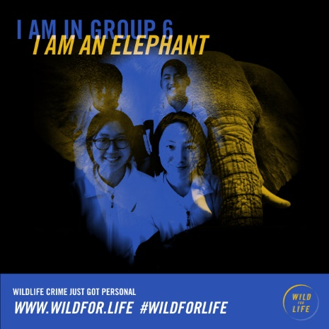


#Wild For Life#

Slide 12

It is NOW or NEVER.
We are in this together.

Slide 13
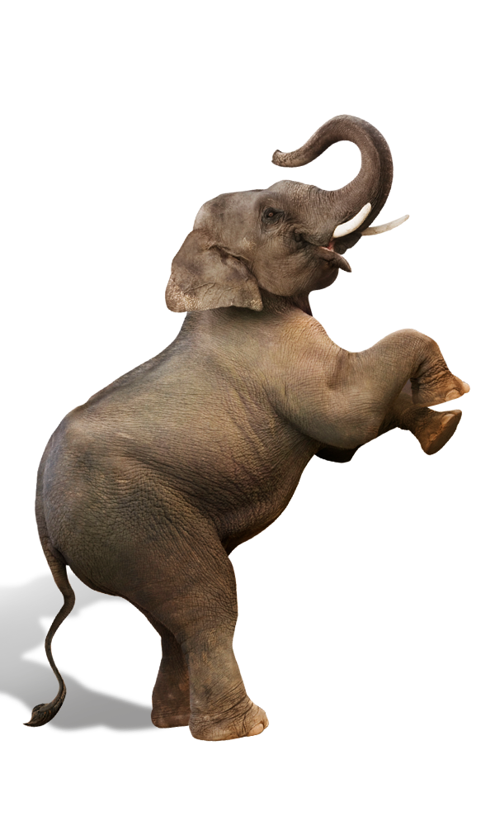
Homework
https://www.discoverwildlife.com
https://www.sheldrickwildlifetrust.org
北京市野生动物救护中心官网
Watch the documentary Born to be Wild, write a short passage or make a PPT or poster to introduce orphan elephants.
OR
Look in books or on the Internet to find out more about how we could help orphan animals. Make a poster to share for next class.

Slide 14
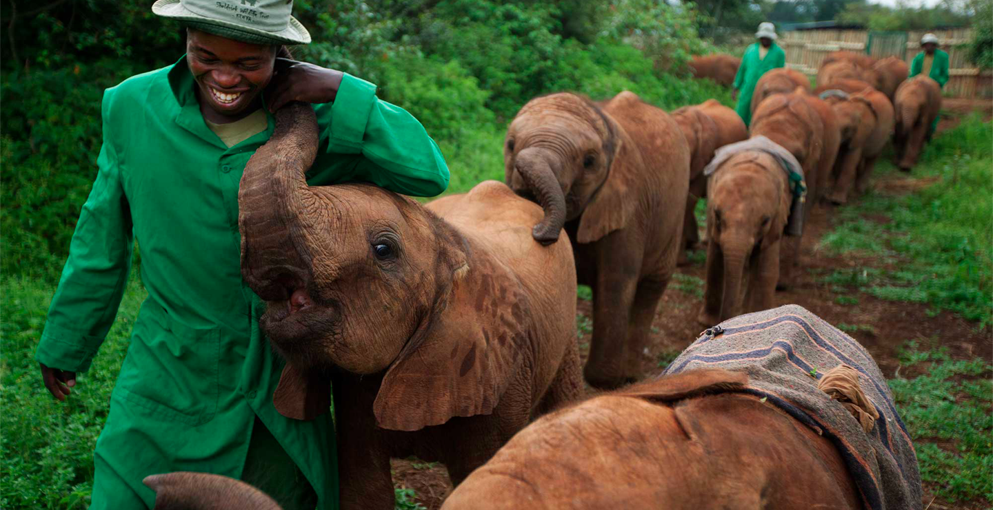
Thank you.

