Slide 1

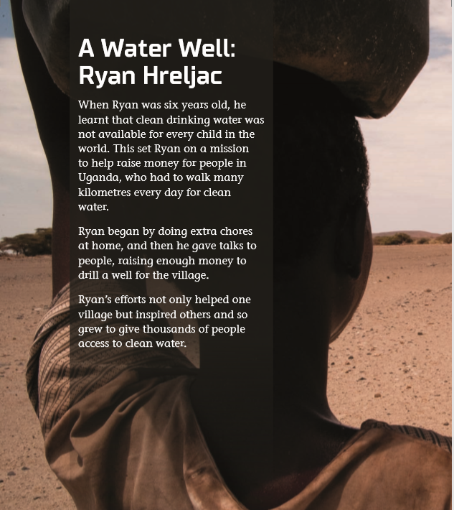
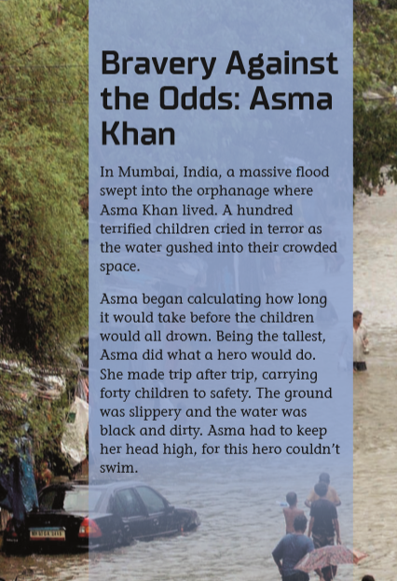
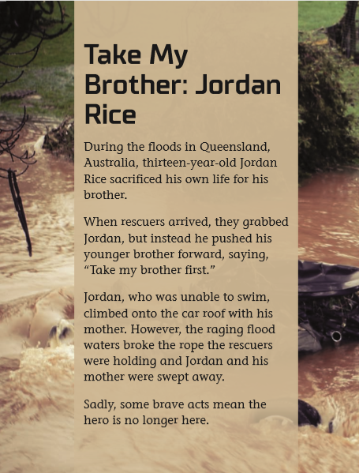
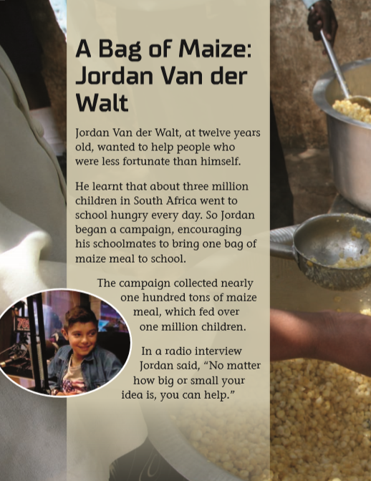

LISTENING
Page 6-7
Page 6-7
Page 6-7
Page 6-7

Slide 2

Discussion

Slide 3
Individual Reading

Slide 4

The hero I read about is …
When…
I believe she/he is a superkid hero because…

Slide 5

Reading

Slide 6

Vote for
“Superkid Hero of the Year”

Slide 7

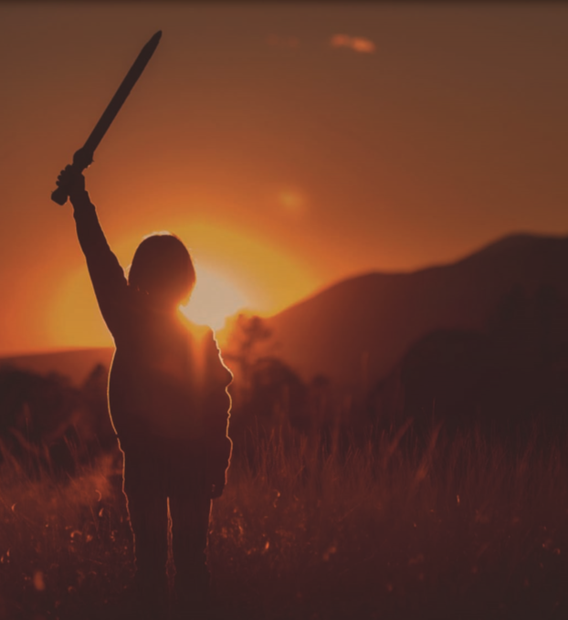

Slide 8
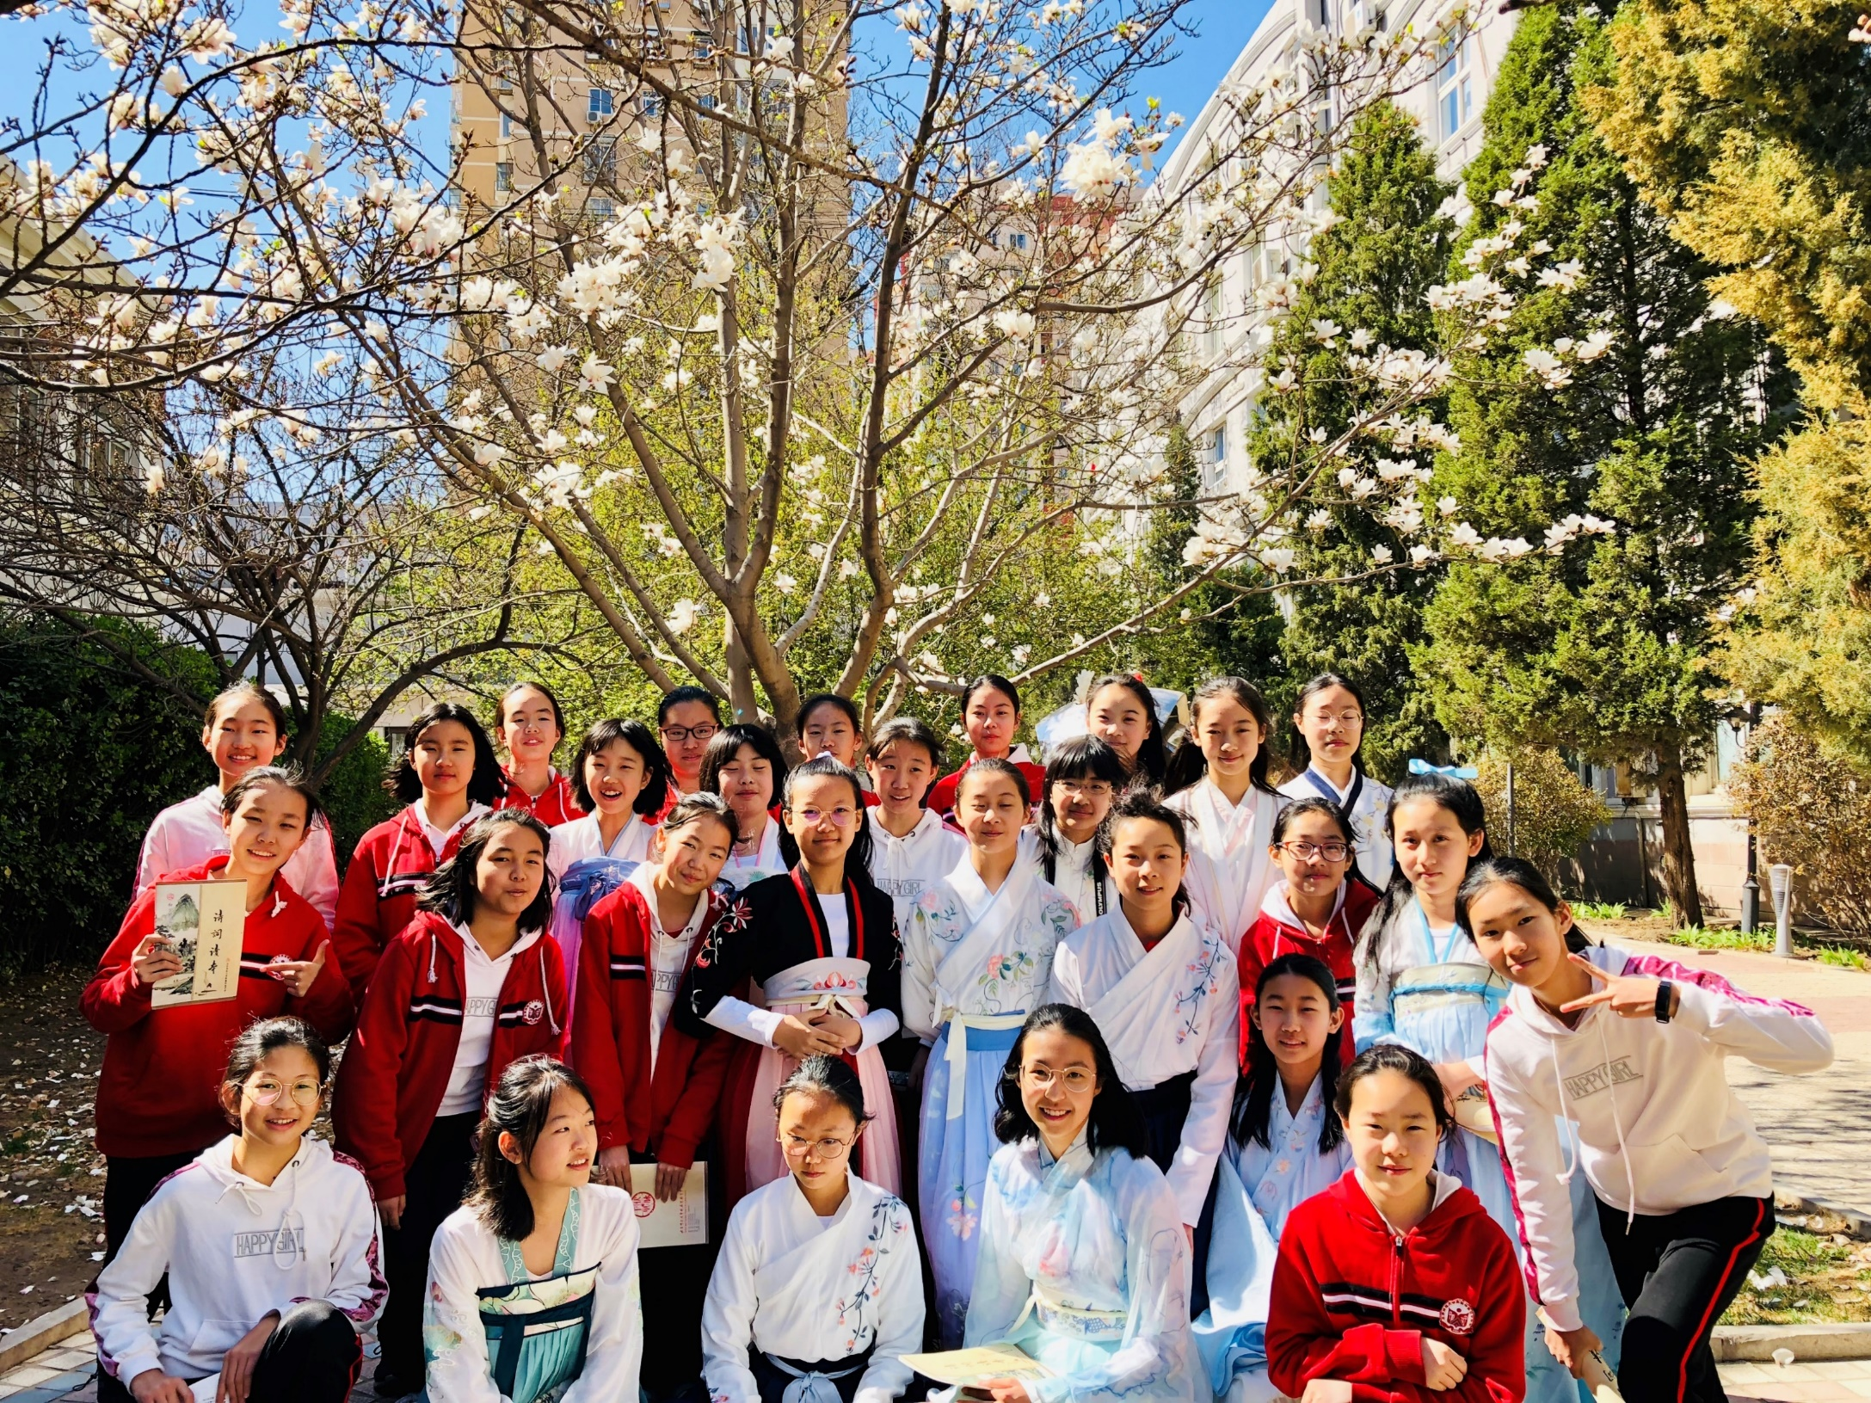
Thank You!

