Slide 2
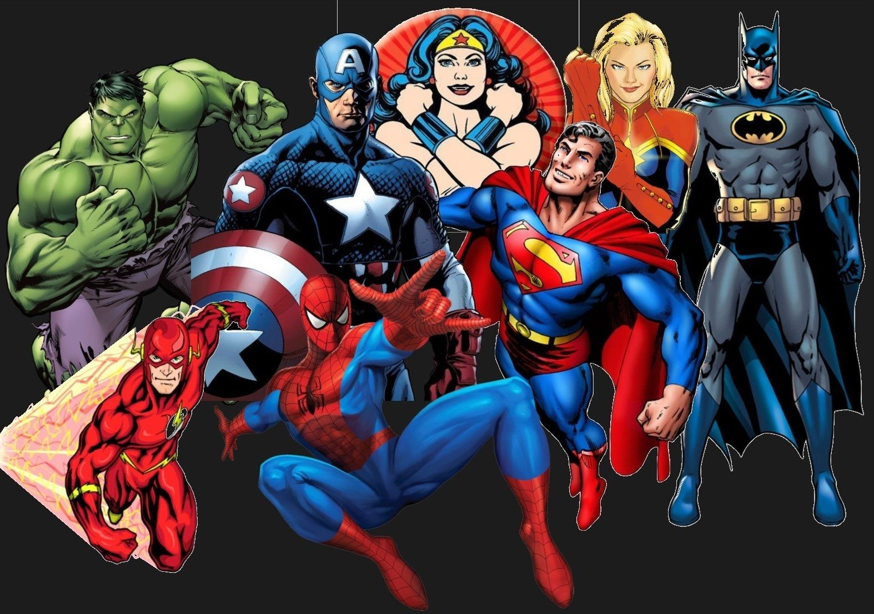

Slide 3
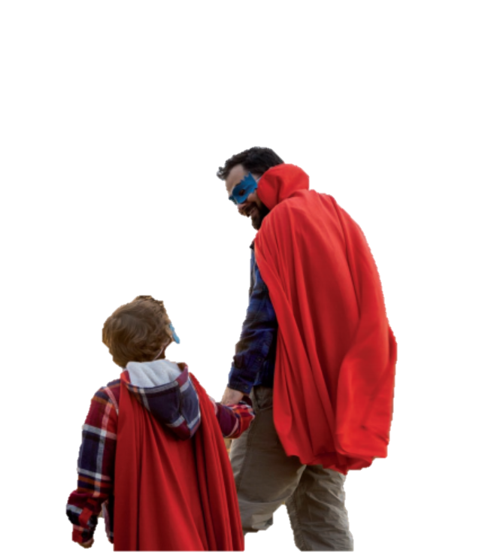
Super Heroes
Superheroes are characters in fiction stories who use superpowers to save and protect people.

Slide 4
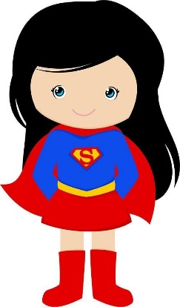
What are heroes like in the real world?

Slide 5
Heroes in the real world do not have superhuman powers, but they do have special gifts. Often they are people who can think quickly, show courage in a challenging situation or care for others. Probably every day someone becomes a hero, or someone will need one.
Heroes come from all cultures and races, and age is not a barrier to becoming a hero.
Some are children. They are superkid heroes.

Slide 6


Slide 7
Word Help!

Slide 8
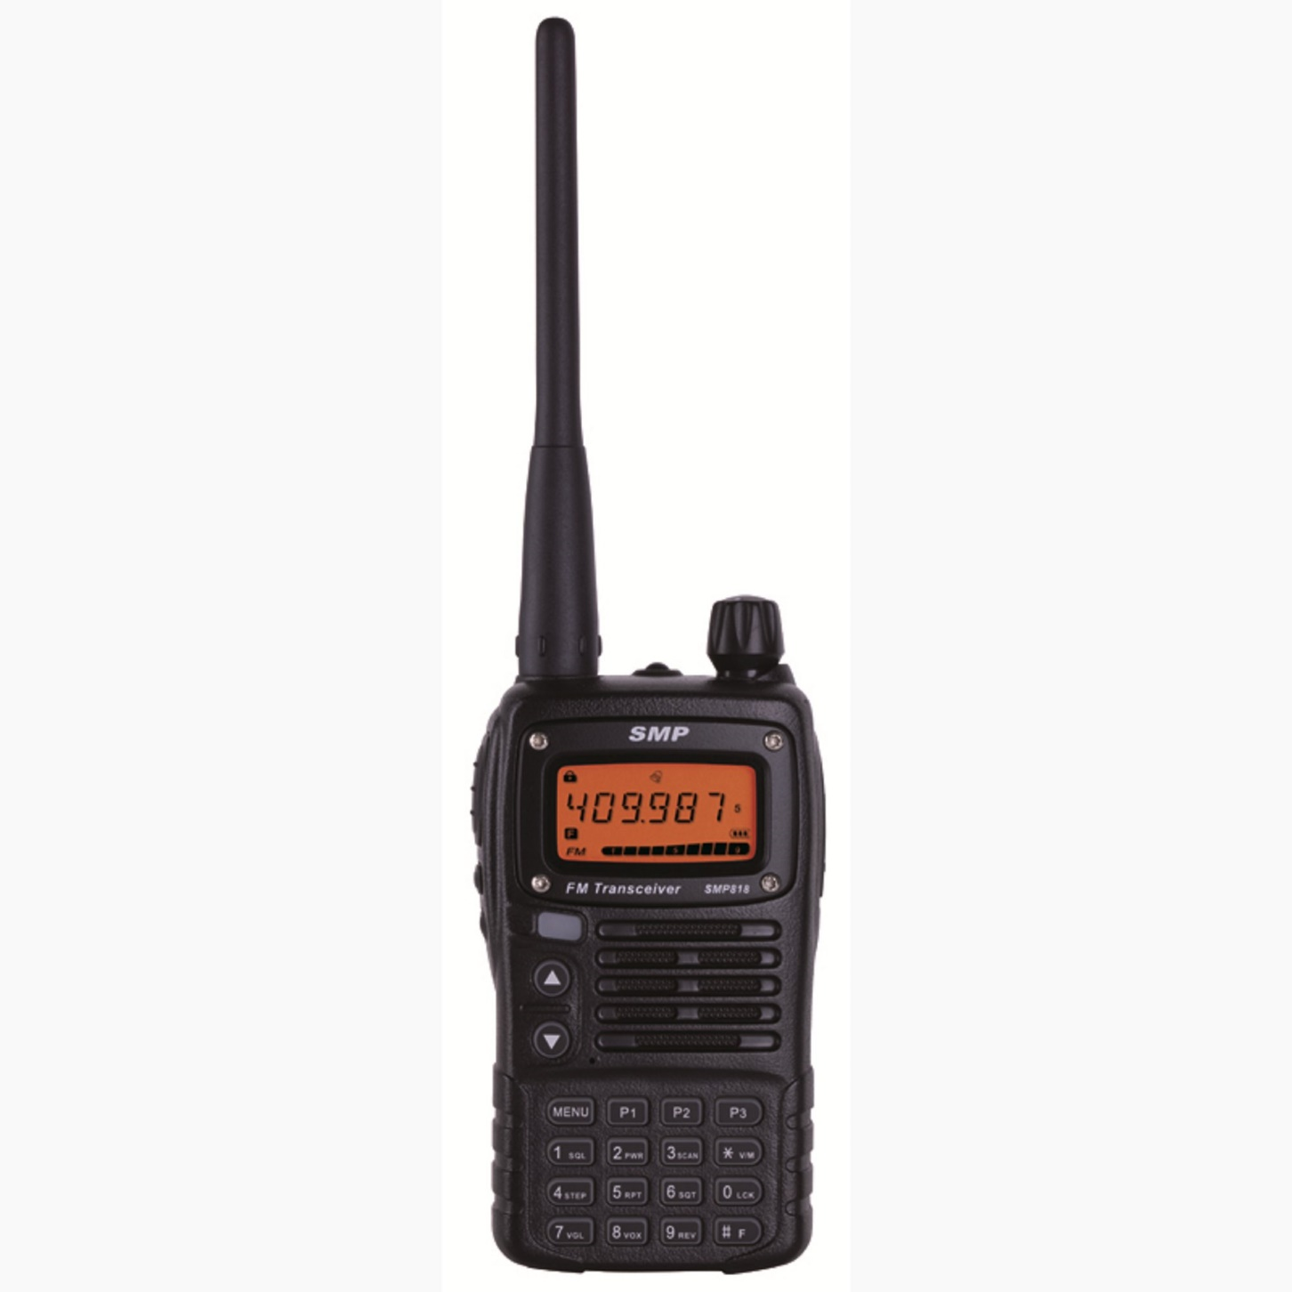
walkie-talkie

Slide 9
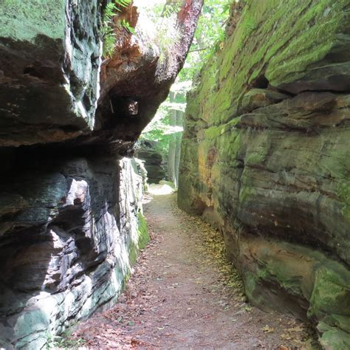
gorge

Slide 10

crevice

Slide 11
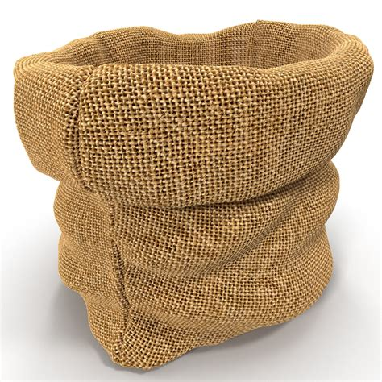
sack

Slide 12
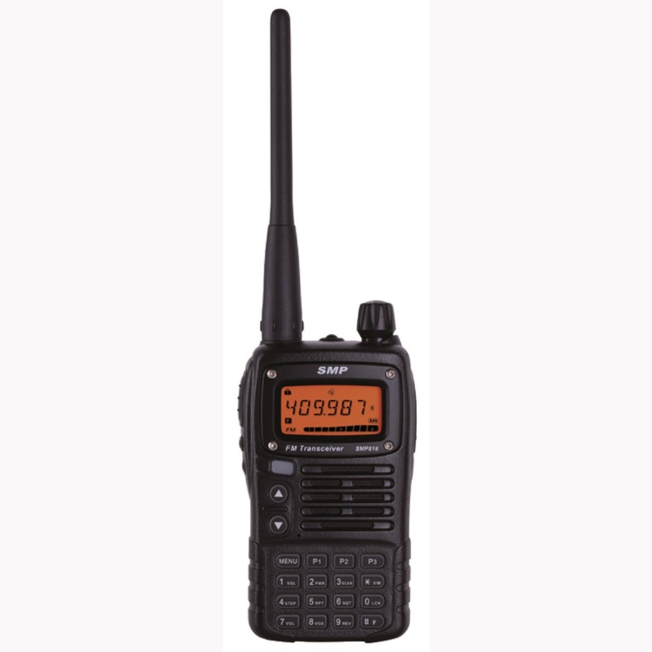
walkie-talkie
sack
gorge
crevice

Slide 13

LISTENING

Slide 14
READNING

Slide 15

Discussion Leader
Word Master
Passage Person
Summarizer

Slide 16
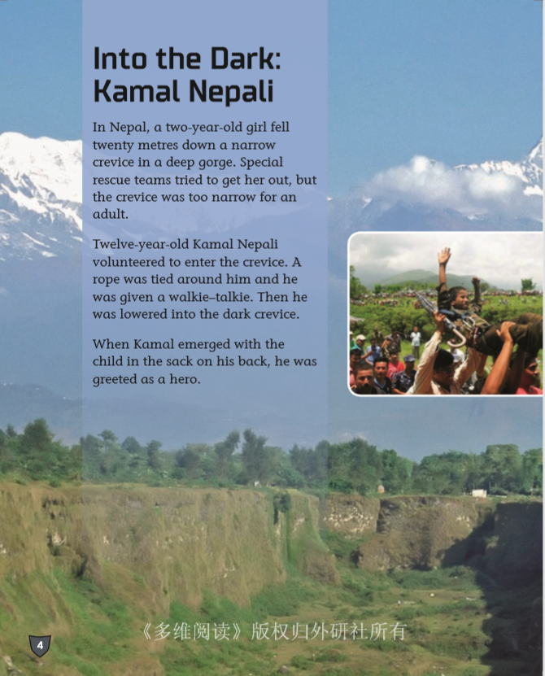
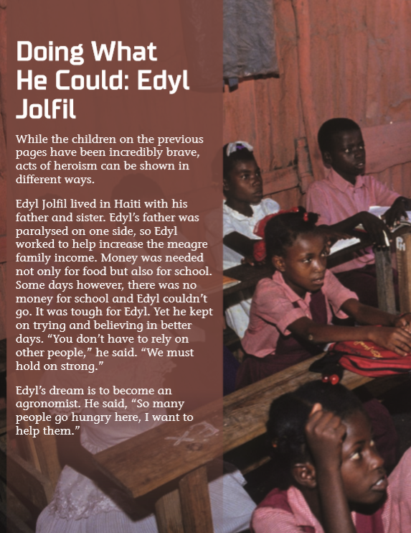
Page 6-7
Page 12-13

Slide 17
Challenging Situations
Behavior
Special
Gifts

Slide 18
What makes Kamal a hero?
What makes Edyl a hero?

Slide 19

Do we need super power to be a superkid hero?

Slide 20
Hero Challenge

Slide 21

I will be…/ I will…
If …, I will … . I will be ….
When…happens, I will…I will be…
If there is an accident, I will try my best to protect you. I will be a brave and strong woman for you.

