Slide 2



Slide 3
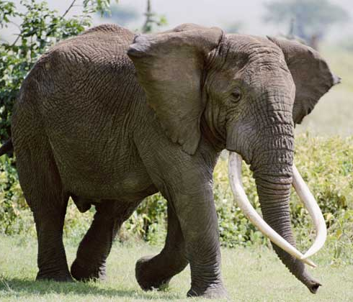
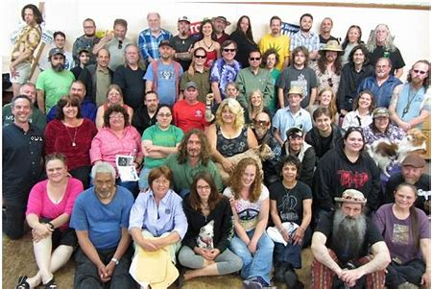
An adult elephant is about 4000-5000kg.
≈
60 people

Slide 4
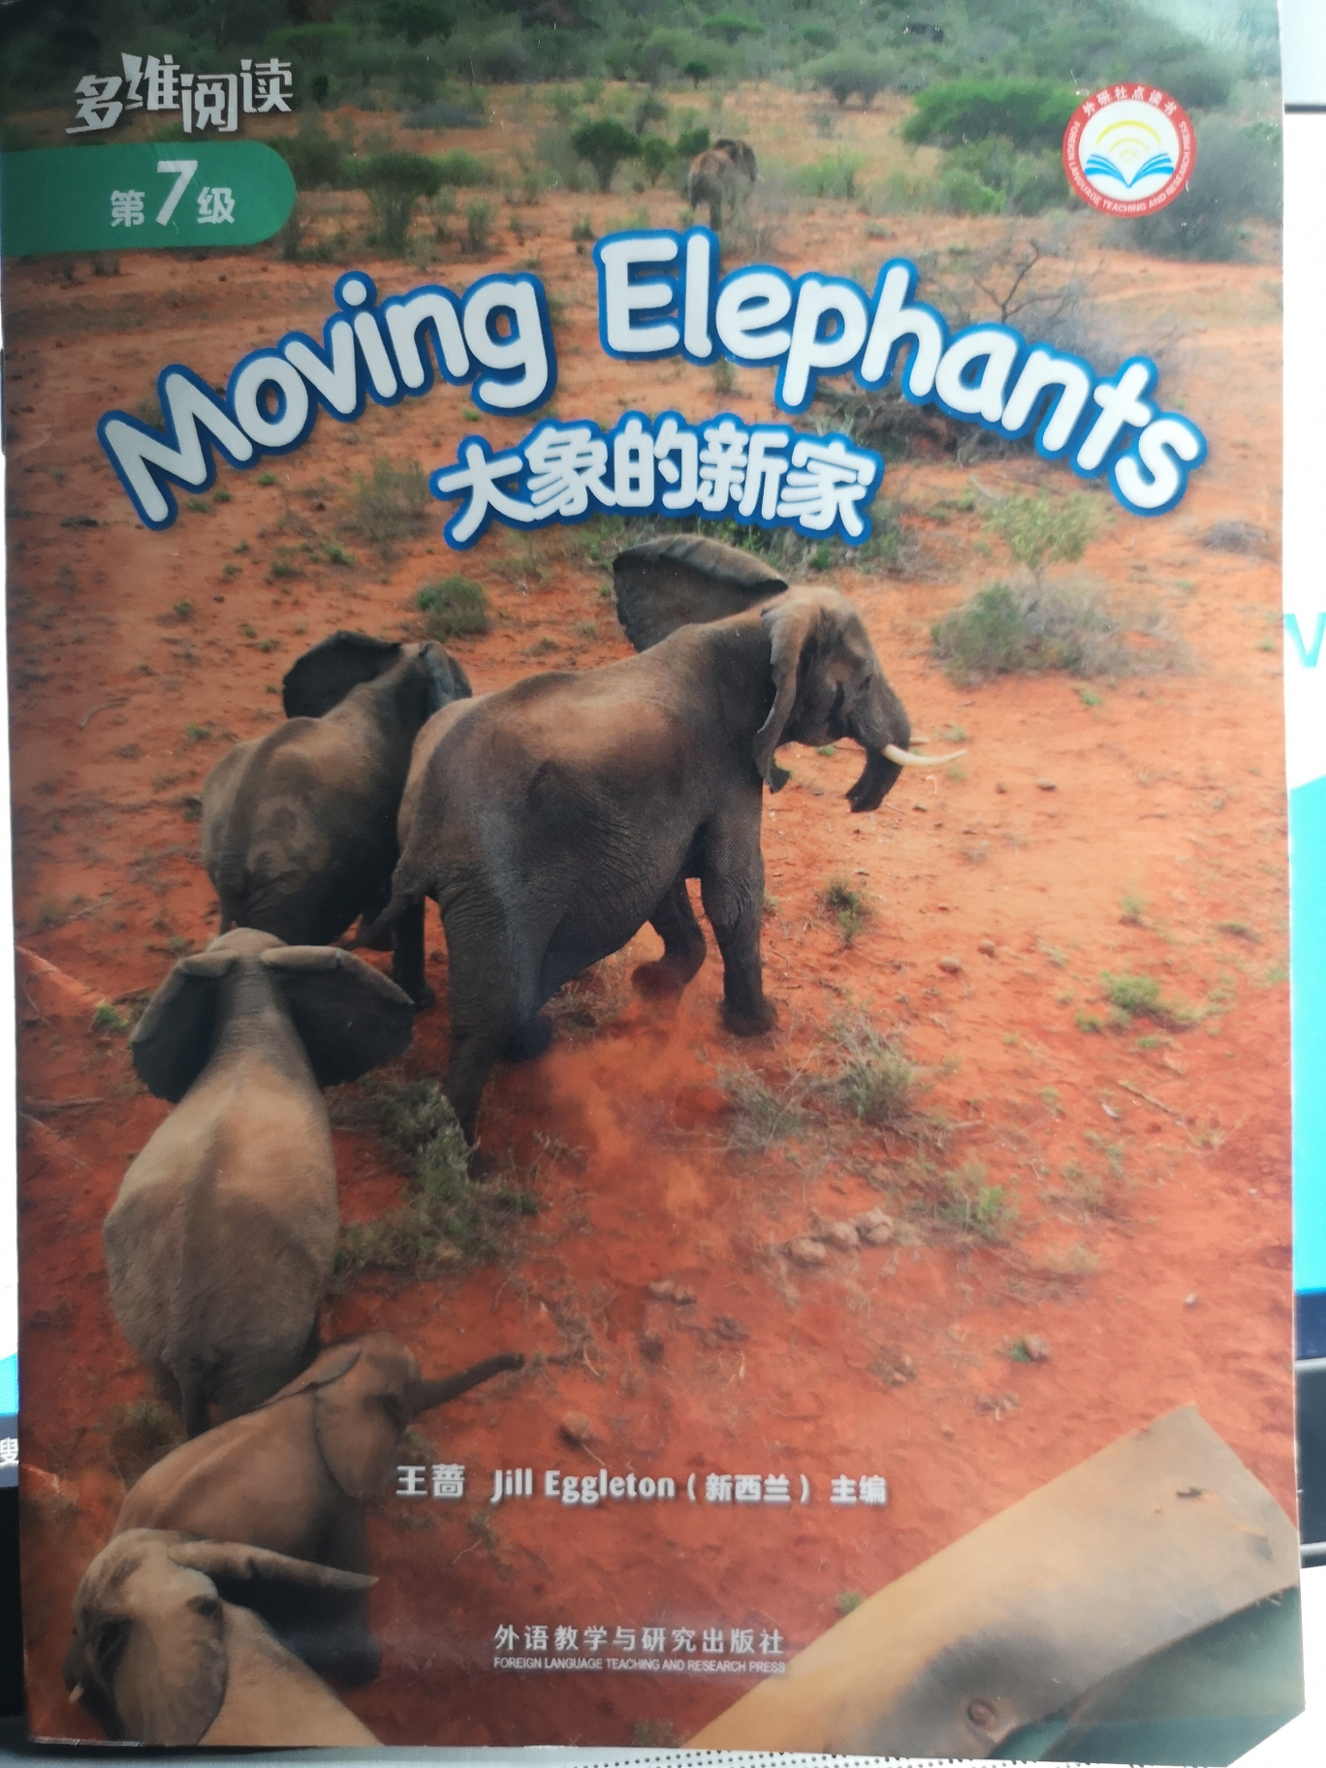
What do you know from the cover？
From the cover I know...
What's the title of this story？

Slide 6

What do you want to know about the story？

Slide 7
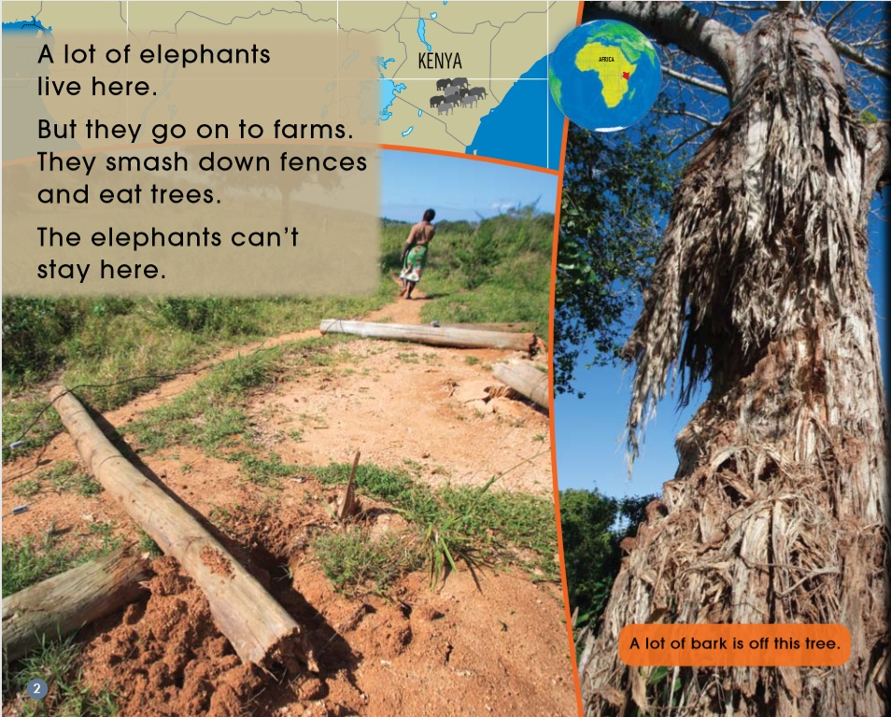
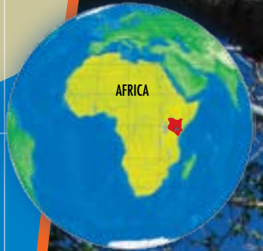
Why do elephants need to move？

Slide 8
Why do elephants need to move？
Elephants are big animals - a lot of them together in a small place can cause damage. They need a place where there is more room for them.
A lot of bark is off this tree.

Slide 9
How do they move to the new place?
P4-13

Slide 10
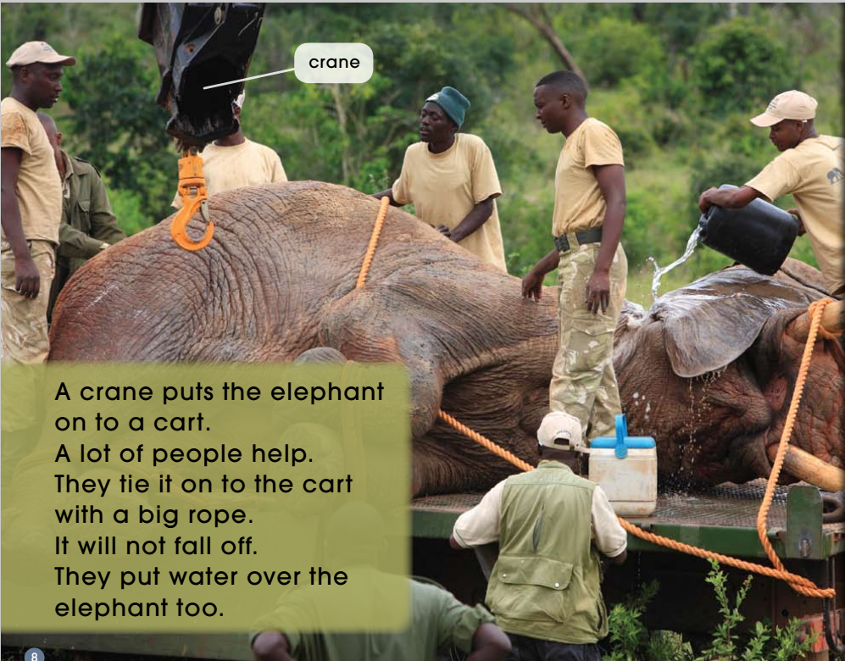
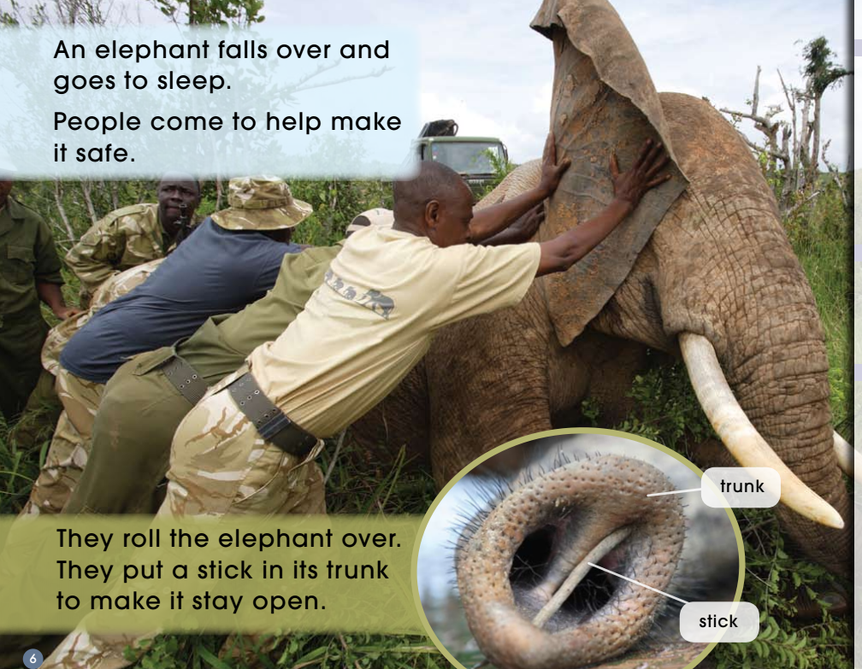
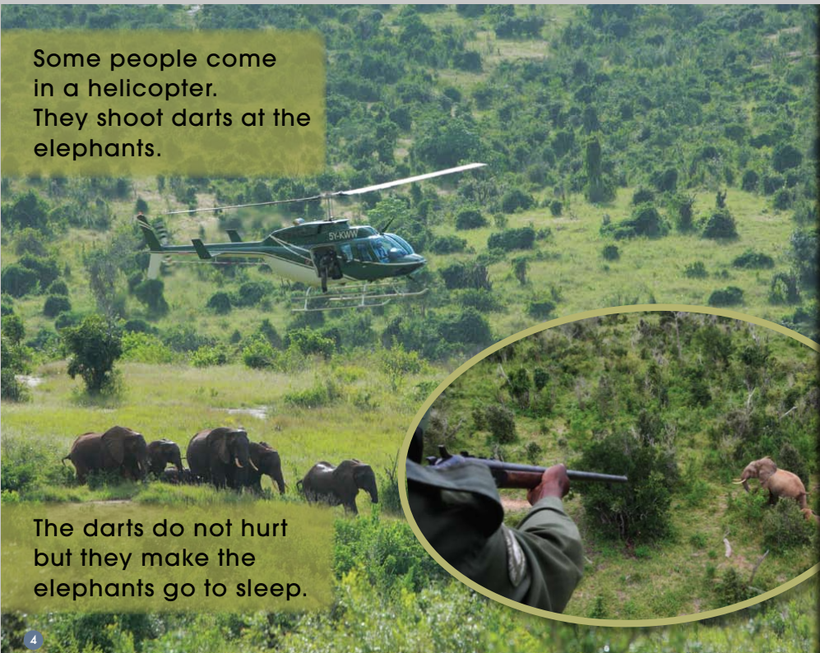
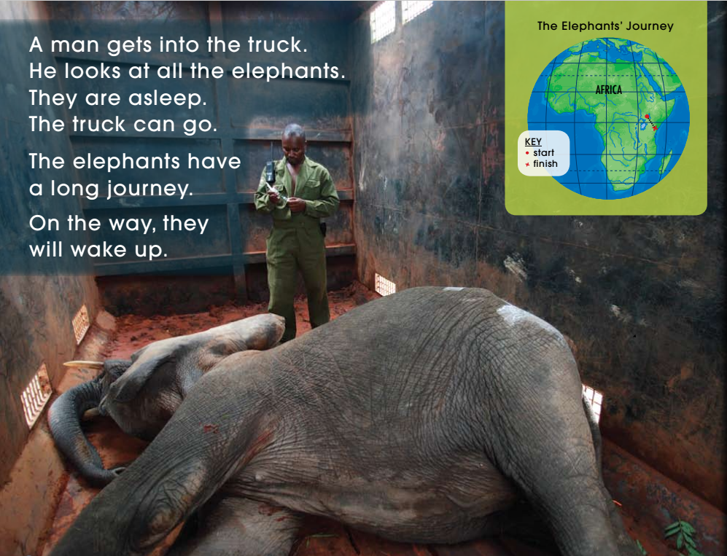
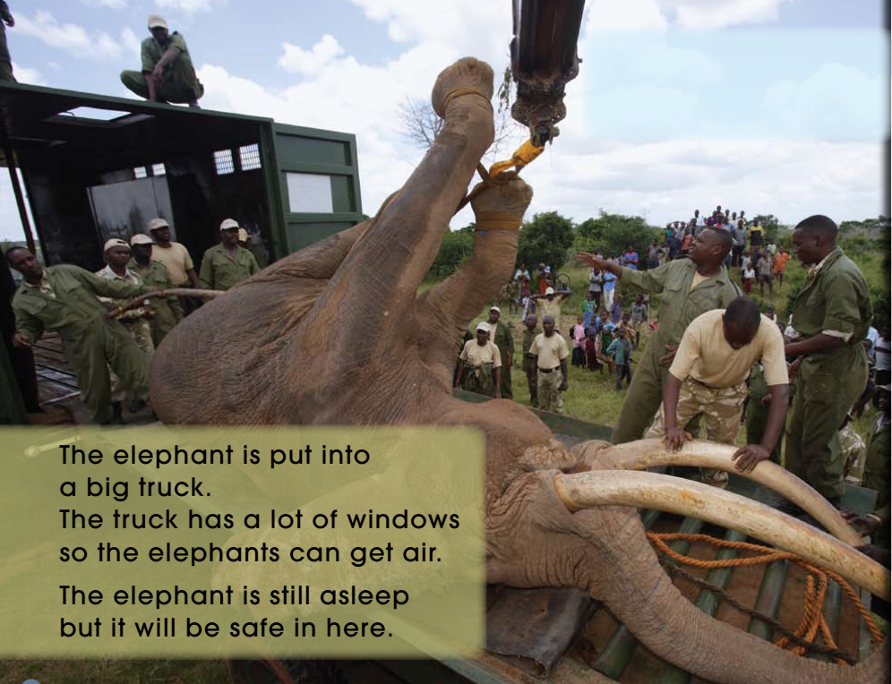
( )
1
( )
2
( )
3
( )
( )
5
4

Slide 11
P4-5
P6-7
P8-9
P12-13
P10-11

Slide 12
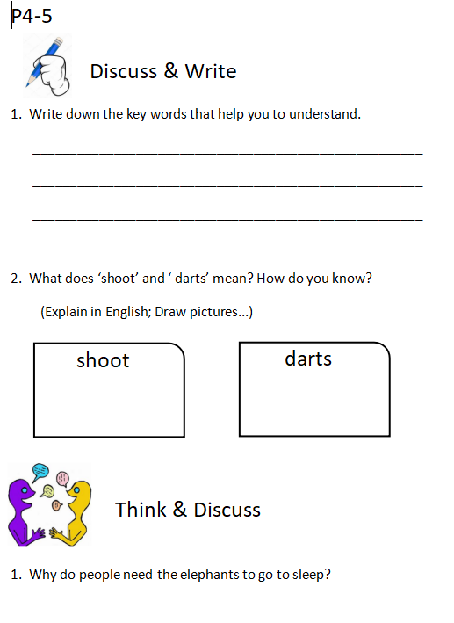
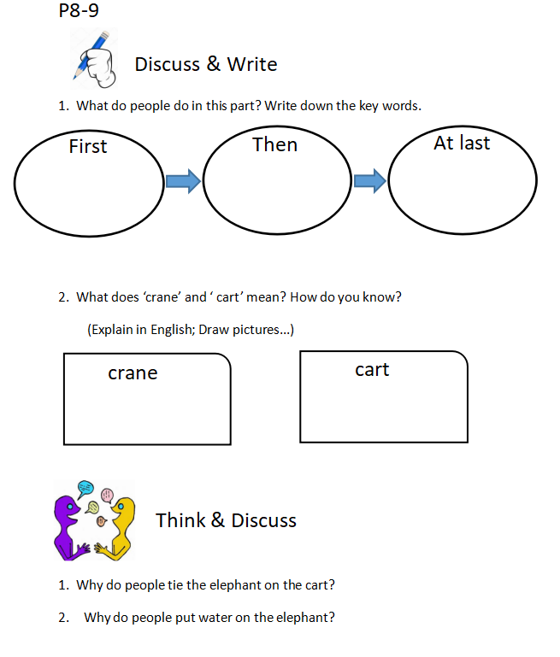

Slide 13
Group work
1. Listen and read your part by yourself.
2. Discuss in your group and finish the worksheet.
3. Talk about how to introduce your part to the class.

Slide 14
Introduce your part.
Use these words to help you:
A. In this part, people should ...
B. There are ... steps in this part. First... Then... At last...
C. From the picture, we know... / From the words, we know...
D. Do you have any ideas?

Slide 15

Why do people need the elephant to go to sleep?

Slide 16
Why do people put a stick in the elephant's trunk?
Do elephants need a stick when they sleep everyday?

Slide 18
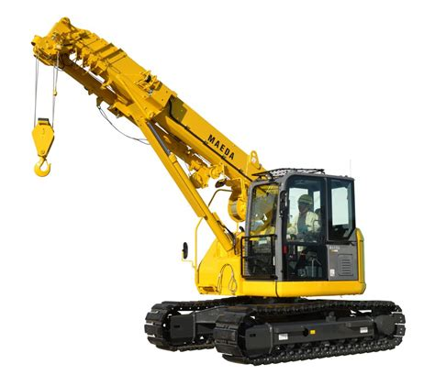
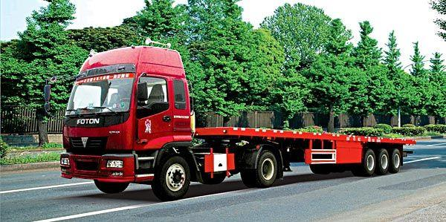
crane
cart

Slide 19
Why do people put water on the elephant?

Slide 20
Why there are many windows in the truck?

Slide 21
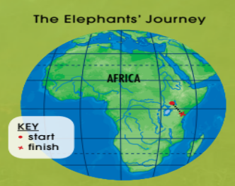
What would the man do if the elephant woke up?

Slide 22
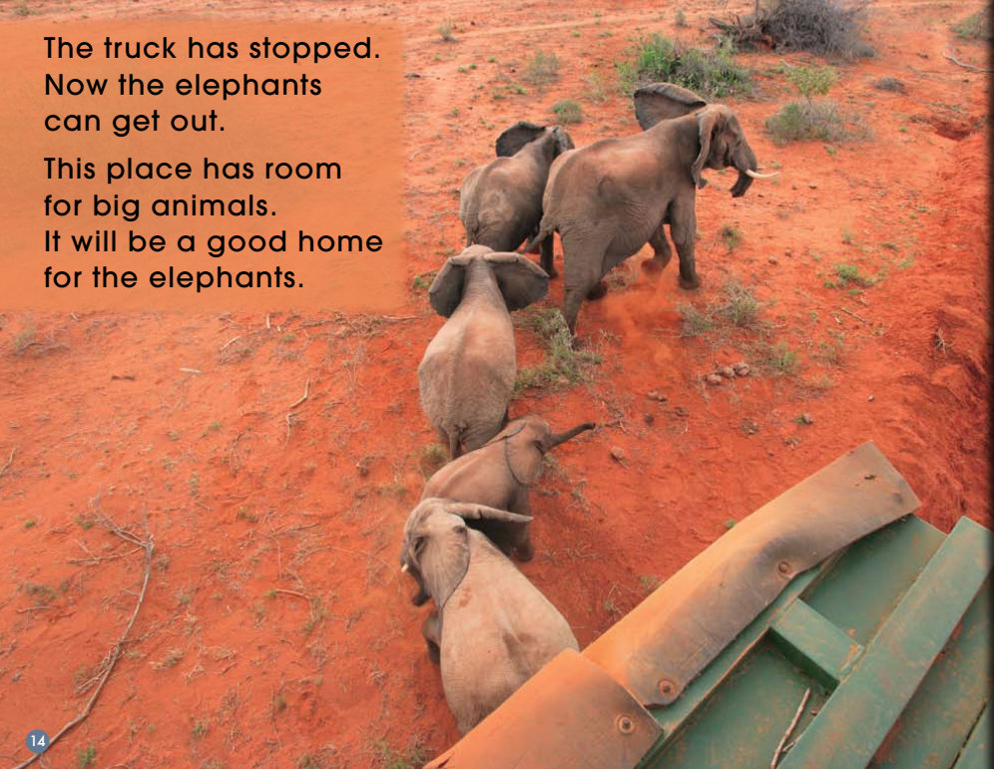

Slide 23
Listen and read.
Do you have any questions?
Any information you want to know more?

Slide 24

1. Check from books.
2. Surf the Internet: baidu google ...
3. Watch videos: Animals World

Slide 25
What's the story about?

Slide 26
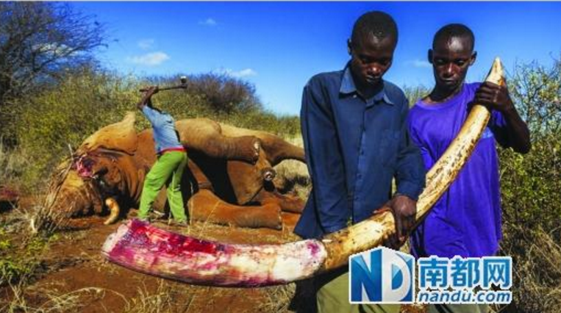
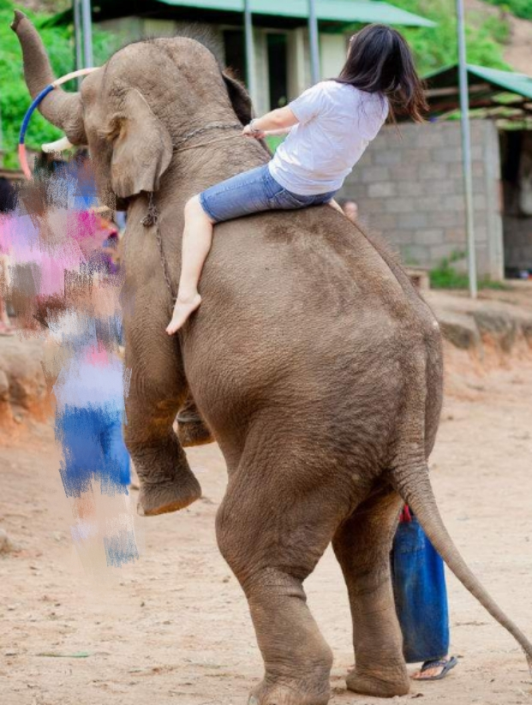
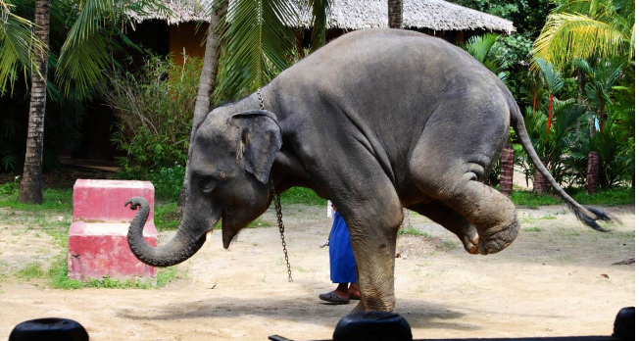

Slide 27



Slide 28
What would you do if you moved to a new place?
move to a new house
change a new school
go to a new country
...
1.Try to get more information about the
place you will go to.
2. Make some new friends.
3. Take part in some clubs.
4. Listen more, think more and
speak less.
...

Slide 29


