Slide 1
基于中高考改革的阅读教学思考
北京教育科学研究院基教研中心外语教研室 陈新忠
bjchenxinzhong@163.com
13601392046
Notes:
1

Slide 2
英语滚出高考界
社会化考试
英语教学的本真——工具性、交际性、应用性
增加听说考试
取消听力考试
高考分值的变化
……

Slide 3
学文化 启心智 爱生命
韩宝成

Slide 4
英语教学的人文（为人性）培养目标：
发展人、培养人

Slide 5
主要内容
宏观教学原则简介
阅读及阅读教学的思考
案例分析

Slide 6
主要内容
宏观教学原则简介
阅读及阅读教学的思考
案例分析

Slide 7
Reading is the process of constructing meaning through the dynamic interaction among the reader’s existing knowledge, the information suggested by the written language, and the context of the reading situation.
(Anthony, Pearson, & Raphael, 1993)

Slide 8
阅读是一种心理语言的猜测游戏。
这种游戏牵涉到思维和语言的互相作用。有效的阅读并不产生于对全部语言成份作精确的知觉和辨认，而是取决于阅读者的技巧，即选择最少的、最有生产力的和对产生第一次正确的猜测所必需的提示。阅读者能预测尚未读到的下文内容的能力。
（Kenneth S. Goodman）

Slide 9
阅读过程并不是简单的信息传递和读者被动接受信息的过程，而是读者不停地对视觉信息进行解码、加工和处理的过程，涉及读者的预测机制、认知能力和语篇分析能力。
(李炯英，秦智娟，2005)

Slide 10
阅读是一个构建意义的过程
阅读是一个猜测、推理的过程
作者与读者双方参与的言语交际、思想交流的过程
读者通过积极主动的思考和与文本的互动来获取信息
……

Slide 11
语言 vs.意义
表层理解 vs. 深层次理解
知识（事实）理解 vs. 生成性理解
课堂预设（教） vs. 课堂生成（学）
语言能力 vs. 认知水平
工具性 vs. 人文性

Slide 12
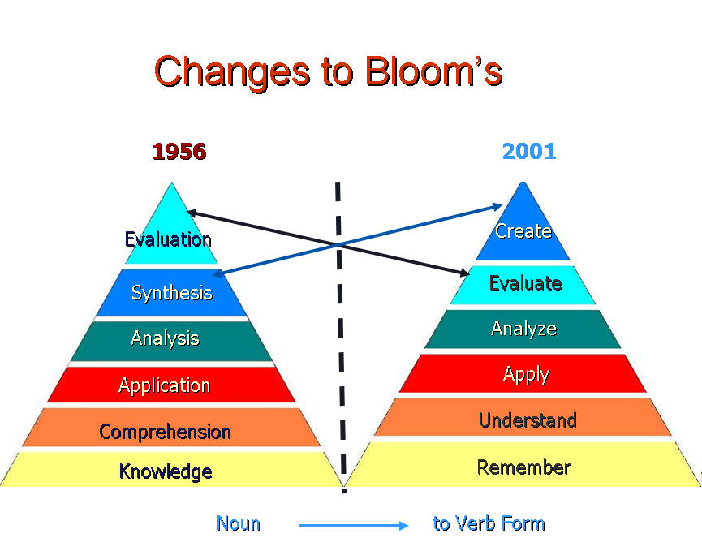

Slide 13
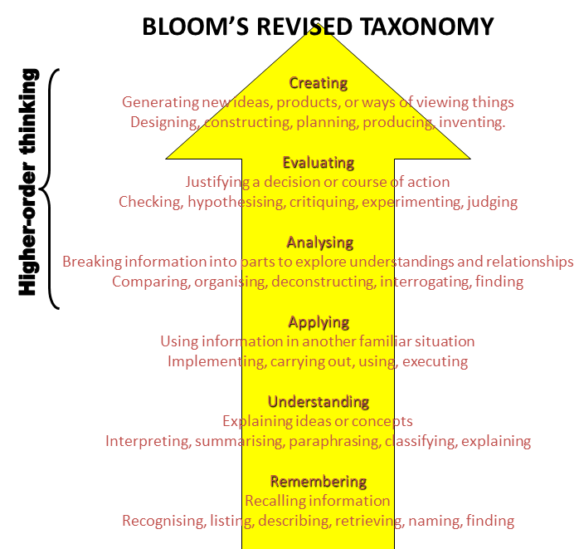

Slide 14
阅读素养
理解事实性信息(Retrieving information)
理解整体意义(Broad understanding)
发展诠释能力(Developing an interpretation)
反思与评价所读内容-理解深层含义 (Reflecting on content)
反思与评价文体与特征(Reflecting on form)

Slide 15
主要内容
宏观教学原则简介
阅读及阅读教学的思考
案例分析

Slide 16
案例1：阅读的过程

Slide 17
About twenty of us had been fortunate enough to receive invitations to a film-studio(影棚) to take part in a crowd-scene. Although our “act” would last only for a short time, we could see quite a number of interesting things.
What would they do/see in a film-studio?

Slide 18
We all stood at the far end of the studio as workmen prepared the scene, setting up trees at the edge of a winding path. Very soon, bright lights were turned on and the big movie-camera was wheeled into position. The director shouted something to the camera operator and then went to speak to the two famous actors nearby. Since it was hot in the studio, it came as a surprise to us to see one of the actors put on a heavy overcoat and start walking along the path. A big fan began blowing tiny white feathers down on him, and soon the trees were covered in “snow”. Two more fans were turned on, and a “strong wind” blew through the trees. The picture looked so real that it made us feel cold.
What/Who did they see in the film-studio?
How did they feel?
Do you think it is interesting?

Slide 19
The next scene was a complete contrast.
Imagine what would happen. In what way are they different?

Slide 20
The way it was filmed was quite unusual. Pictures in front taken on an island in the Pacific were shown on a glass screen. An actor and actress stood of the scene so that they looked trick like this, palm trees, sandy beaches, as if they were at the water's edge on an island. By a simple and blue, clear skies had been brought into the studio!
What was like in the second scene?
Do you think it was really a complete contrast?
Do you think it’s interesting?
What would happen next?

Slide 21
Since it was our turn next, we were left wondering what scene would be prepared for us. For a full three minutes in our lives we would be experiencing the excitement of being film “stars”!
What was like in the second scene?
Do you think it was really a complete contrast?
Do you think it’s interesting?

Slide 22
阅读不是仅仅停留在对文本表面文字的理解，而是强调读者为了不同的目的而阅读，强调他们对文字信息的理解、使用和反思，强调读者通过积极主动的思考和与文本的互动来获取信息。

Slide 23
案例2：文本的解读

Slide 24
“文学圈”阅读教学（Literature Circles）
SSR（Sustained Silent Reading）
输出假设（Output Hypothesis）
输出驱动假设（Output-driven Hypothesis）
翻转课堂（the Flipped Classroom）

Slide 25
把握改革关键的是教师，而不是别人。
（Stenhouse，1985）

Slide 26
Thank You !
bjchenxinzhong@163.com
13601392046

